Slide 1
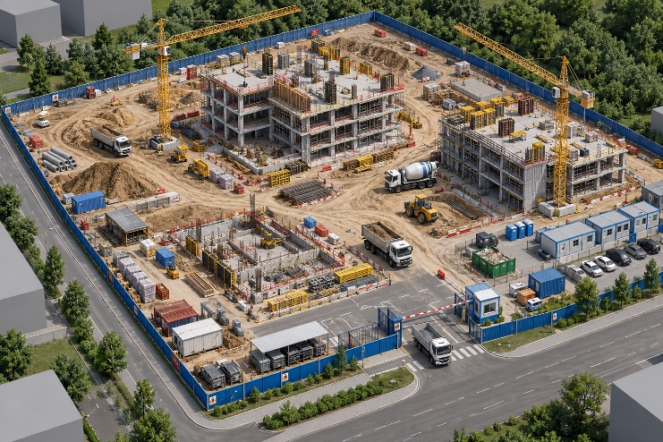
ACTi
Construction Site Surveillance Solutions

Slide 2

Commercial Building: Overview
ACTi's comprehensive construction site surveillance solutions are designed to enhance worker safety, prevent theft and vandalism, control unauthorized access, and improve overall site security and operational efficiency.
By integrating high-resolution IP cameras, intelligent video analytics, and advanced video management systems, ACTi enables continuous monitoring of construction activities, heavy machinery, valuable equipment, material storage areas, and site perimeters. With real-time video monitoring, automated event detection, and instant security alerts, site managers and security personnel can quickly identify potential threats, respond to incidents, and maintain better visibility across large and complex construction environments.
Flexible camera deployment options support both temporary and long-term installations, adapting to changing site layouts as construction progresses. ACTi's scalable surveillance solutions help construction companies minimize losses, strengthen safety compliance, streamline site management, and maintain a secure and productive working environment throughout every stage of the project.

Slide 3

Commercial Building: Map
Crane
Construction Area
Workers’ Camp
Material Storage
Control Room
Parking
Surrounding
Gate

Slide 4
Commercial Building: Applications vs Locations
 | Workers’ Camp | Gate | Control Room | Material Storage | Construction Area | Crane | Parking | Surrounding
Large Perimeter Surveillance |  |  |  |  |  |  |  | Y
Helmet Violation Detection |  |  |  |  | Y | Y
Vehicle Access Control |  | Y
Intercom Service |  | Y | Y
Fire Detection |  |  |  | Y | Y
Fall Detection |  |  |  | Y | Y | Y
On-the-Go Surveillance | Y | Y | Y | Y | Y | Y | Y | Y
Smoke Detection |  |  | Y | Y | Y
Site Safety Violation Detection |  |  |  | Y | Y | Y

Slide 5
Recommended Products vs Locations
 | Workers’ Camp | Gate | Control Room | Material Storage | Construction Area | Crane | Parking | Surrounding
Thermal Cameras |  |  |  | Y | Y
Intercom (Q950) | Y | Y | Y |  |  |  | Y
ALPR Bullet Camera (Gate control) |  | Y |  |  |  |  | Y
General Surveillance Bullets (3xx, 4xx series) | Y | Y | Y | Y | Y | Y | Y | Y
General Surveillance Domes (91x, 7xx, 8xx series) | Y | Y | Y | Y | Y | Y | Y | Y

Slide 6
Products vs Management Servers
 | Windows NVR (NVR 3) | Access Control Smart Server
Thermal Cameras | Y | Y
Intercom (Q950) | Y
ALPR Bullet Camera (Gate control) | Y | Y
General Surveillance Bullets (3xx, 4xx series) | Y | Y
General Surveillance Domes (91x, 7xx, 8xx series) | Y | Y

Slide 7

Windows NVR (NVR 3)
NVR 3 is one of the most famous ACTi products – it is a professional and elegant network video recorder platform with wide range of features and extremely reliable performance, available in two editions (read more).
Feature | NVR 3 Business | NVR 3 Corporate
Maximum Number of Channels | 100 | 200 (Standalone NVR 256)
Free ACTi Camera Channels Included | 32 | 1
Free 3rd Party Camera Channels Included | 1 | 1
CMS Support | No | Yes
POS, Access Control, Network IO Support | No | Yes
eMap | Yes | Yes
Google Map | No | Yes
Embedded Websites within Display | No | Yes
PTZ Control | Yes | Yes
Redundancy Support (N+1, N-to-N) | Yes | Yes
Workstation, Web Client, Mobile Client | Yes | Yes
Display Layouts (maximum grid size) | 225 | 225

Slide 8


Access Control Smart Server
Access Control Smart Server (ACSS) is an easy-to-use access control software for managing employees and visitors access through the doors and gates as well as managing employee attendance. (read more)
Core Function
Access Control Management Doors, gates, locks, identification of face*, card, ALPR*, tailgating* detection
Attendance Management Work shifts, clock-in, clock-out, late, absent
Visitor management Visitor enrollment for temporary access
Construction site management Temporary sites management
Food ordering management Conveniently manage the employee services
Conference room management Book the available meeting rooms in your company
Customer arrival management Track when the customers arrive to the appointments

Slide 9


ALPR Camera (A426)
The AI camera can recognize multiple license plates across multiple lanes at the same time.
WATCH THE VIDEO
https://www.acti.com/video/v2902
ALPR Camera + NVR 3
ACTi NVR 3 supports the deep learning AI events and metadata. When the blacklisted vehicle is detected, the NVR will display instant alert.
WATCH THE VIDEO
https://www.acti.com/video/v2904

Slide 10






ACTi AI Solution Architecture
MOBILE CLIENT
E-mail
alerts
alerts
video
video
Realtime
analytics data
Realtime
analytics data, alerts
AI CAMERA
NVR SERVER
(ACTi NVR 3 Corporate)
NVR CLIENT

Slide 11
ACTi Advantages compared to Server-Based AI Providers
Hundreds of channels with deep learning analytics can be managed by a single VMS server, using just a common server hardware configuration. The Server-based AI solutions have limited number of channels and require very expensive hardware.
VMS video recording functionality is much better secured when the VMS does not have the burden of running the analytics that may consume the server resource to its limits.
Faster response to the events – AI cameras can control the other nearby PTZ cameras for instant response, to get better video coverage of the scene. The analyses that are processed on the VMS side will be too slow for proper response.
Since the AI features are inside the camera, there are no Analytics related licenses required on the server side. Therefore, the cost of VMS in some cases is up to 10 times lower than the server-side AI solutions.

Slide 12
NVR and CMS Features
ACTi NVR 3 Corporate (and CMS 2) manages the analytics events from the cameras as follows:
Set up the analytic rules and thresholds – for example, how big is the crowd, how long time is considered loitering.
Receive real-time analytic events from all the cameras and respond by the pre-defined actions, such as send e-mail, instant pop-up of the video channel on the VMS screen and more.
Automatically push video to the mobile app of the patrolling security guards.
Search by the specific filter rules, bookmarks, thumbnails.

Slide 13

Where to Buy
Via Authorized Resellers
https://www.acti.com/Corporate/WhereToBuy
From ACTi Corporation Directly
E-Mail: sales@acti.com
Tel (US): +1-866-410-2284 (Toll Free)
Tel (Non-US): +886-2-2656-2588

Slide 14
Support & Services
Technical Support
- Online Customer Helpdesk - https://www.acti.com/chd
- Phone support
US: +1-866-410-2284 (Toll Free)
Other Regions: +886-2-2656-5200
RMA Services
- Warranty
- Repair services
Training
- Self-learning

