Slide 1
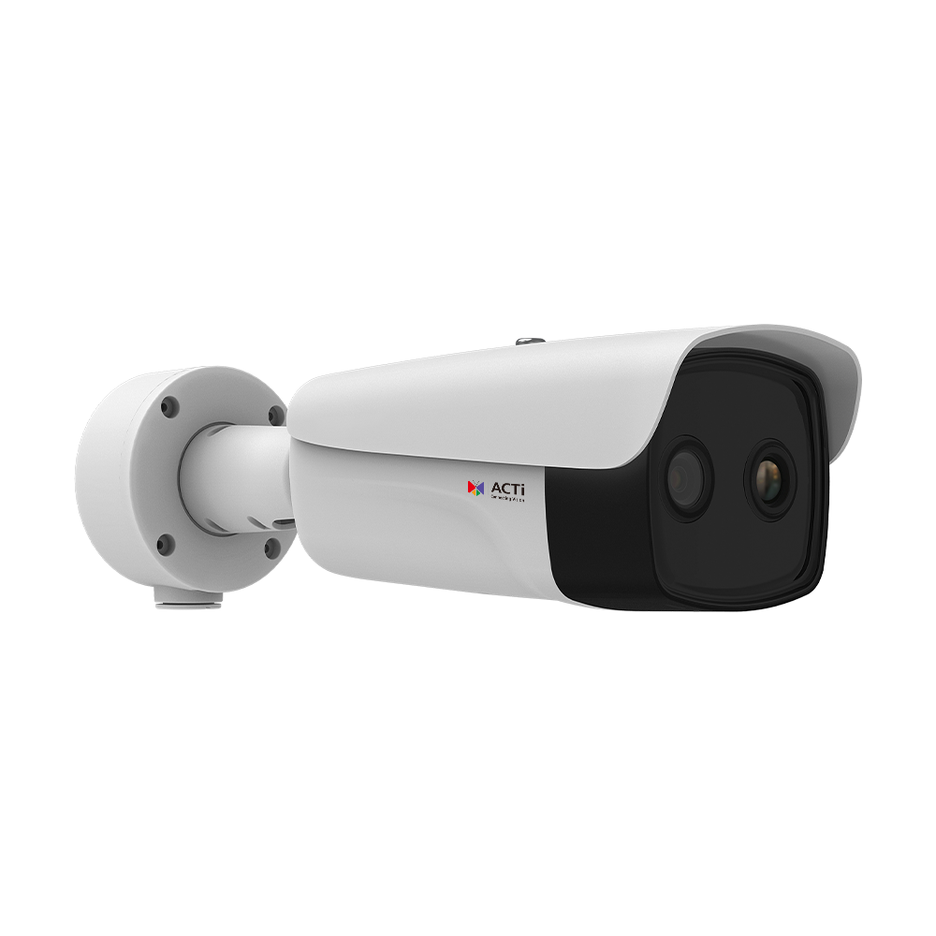
A384, A384-P1
New Product Introduction
5 Megapixel Bi-Spectrum Thermal Bullet with Smart Dual Light

Slide 2
ACTi is introducing the newest product:
A384
5MP Deep Learning AI f3.6mm Thermal Bullet with IR LED 30m, White LED 30m, Smart Dual Light, WDR 120dB
A384-P1
5MP Deep Learning AI f6.9mm Thermal Bullet with IR LED 30m, White LED 30m, Smart Dual Light, WDR 120dB

Slide 3
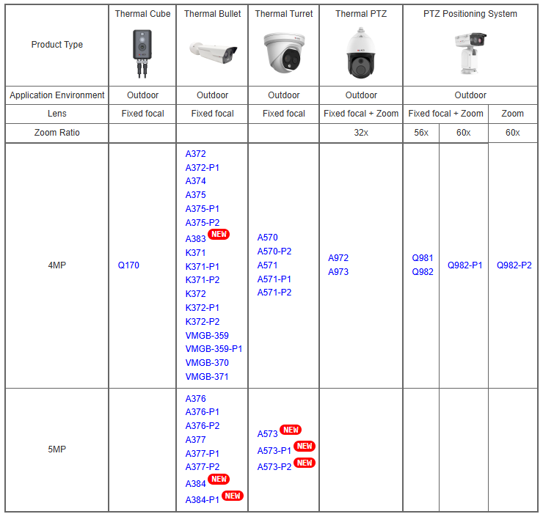
Product Matrix:

Slide 4
Product Comparison (in the order of focal length):
4MP Fixed Thermal Bullets | Specifications
 | Focal length (thermal) | Thermal DORI (det/obsr/recg/ident)
A372 | 1.35mm | 56/28/14/7m
A372-P1 | 2.6mm | 108/54/27/14m
VMGB-359-P1/370/371 | 3.1mm | 91/46/23/11m
A374 | 3.6mm | 150/75/38/19m
A384 | 3.6mm | 150/75/38/19m
VMGB-359 | 6.2mm | 182/91/46/23m
A375 | 6.5mm | 191/96/48/24m
A384-P1 | 6.9mm | 287/144/72/36m
A375-P1 | 9.7mm | 294/147/74/37
K371/K372 | 10mm | 370/264/100/60m
A375-P2 | 15mm | 441/221/110/55m
K371-P1/K372-P1 | 25mm | 950/659/240/160m
K371-P2/K372-P2 | 35mm | 1250/922/340/230m
A383 | 35mm | 1458/729/365/182m

Slide 5
 | A384 | A384-P1
Type | Bi-Spectrum Fixed Bullet | Bi-Spectrum Fixed Bullet
Thermal Sensitivity | NETD <25mK | NETD <25mK
Spatial Resolution | 3.33 mrad | 3.33 mrad
Max Visual Sensor Resolution | 5MP | 5MP
Max Thermal Effective Pixels | 256 x 192 | 256 x 192
Lenses | 3.6mm (thermal) 4.3mm (visual) | 6.9mm (thermal) 8.0mm (visual)
Smart Dual Light | IR 30m, White LED 30m | IR 60m, White LED 60m
WDR | 120dB | 120dB
NDAA | No | No
PoE | Class 4 (IEEE802.3at) | Class 4 (IEEE802.3at)
Certification | IP68, IK10 | IP68, IK10

Slide 6
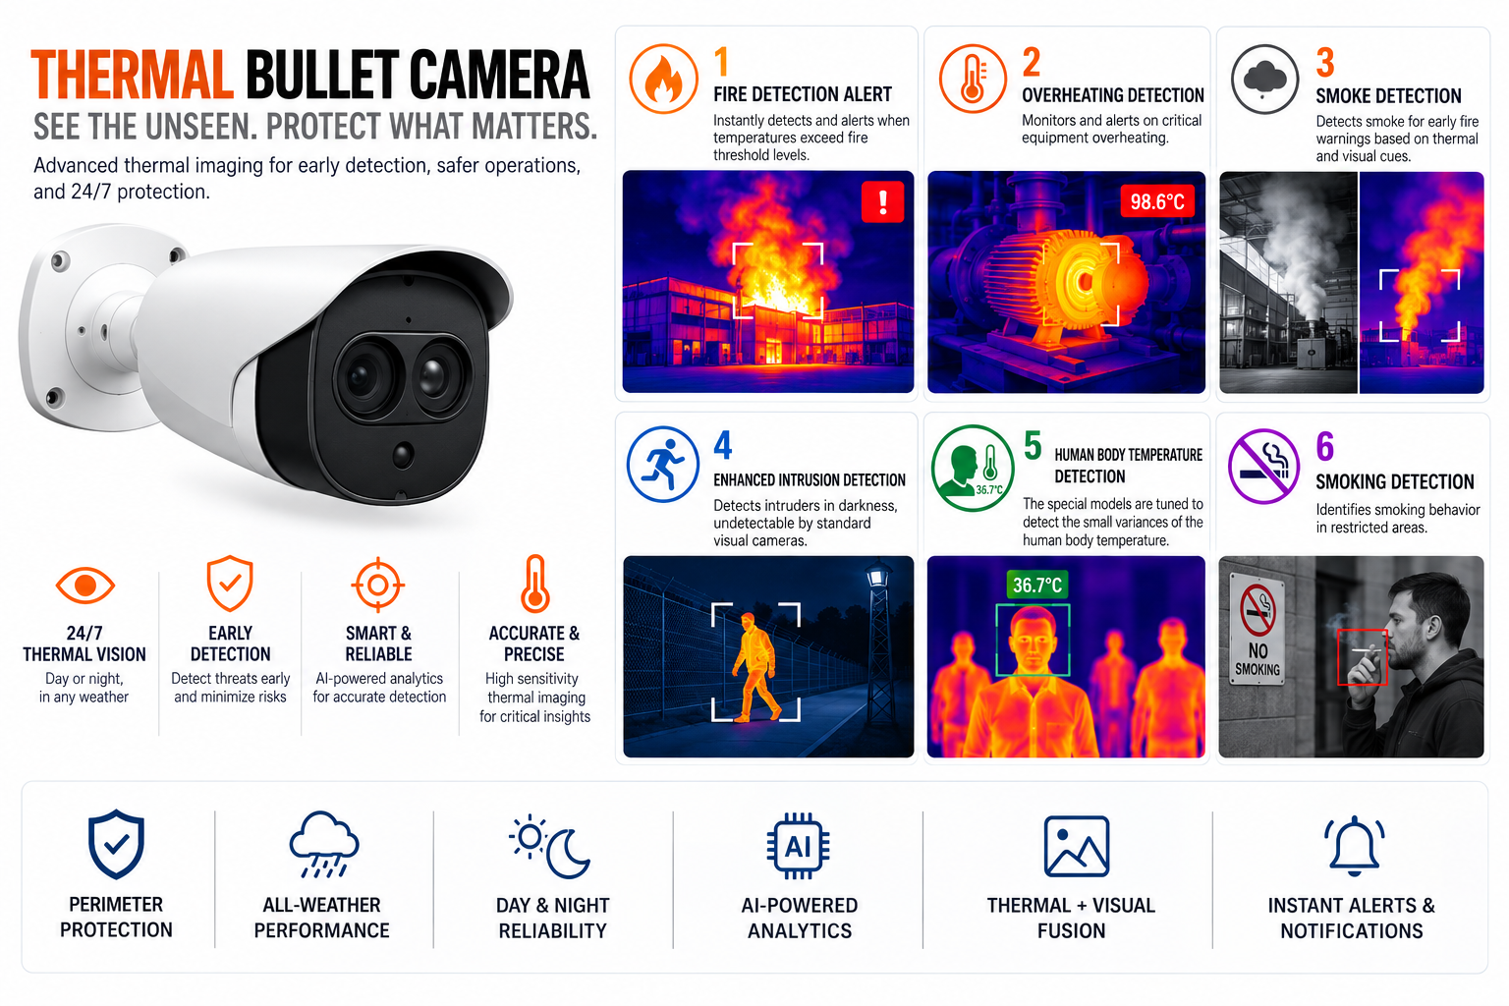

Slide 7
Supported VMS and Solutions
 | Standard Features | AI Events/Meta | Solutions
NVR 3 Corporate | Yes | Yes | S110, S111, S112
NVR 3 Business | Yes | Yes | S110, S111, S112
CMS 2 | Yes | Yes | S120, S121, S122
ZNR-Series NVR | Yes | Yes | S60
ENR-Series NVR | Yes |  | S72

