Slide 1
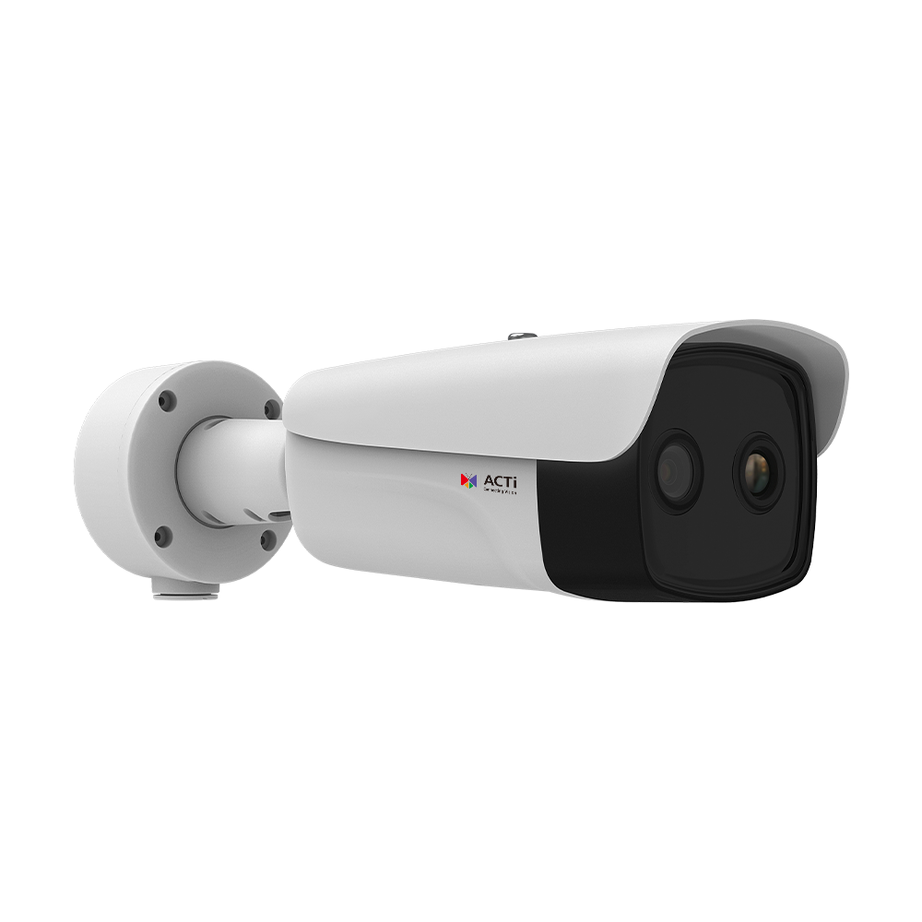
A383
New Product Introduction
4 Megapixel Bi-Spectrum Thermal Bullet with Telephoto Fixed Lens (f35mm)

Slide 2
ACTi is introducing the newest product:
A383
4MP Deep Learning AI f35mm Bi-Spectrum Thermal Bullet with IR LED 100m, WDR 120dB, NETD <20mK

Slide 3
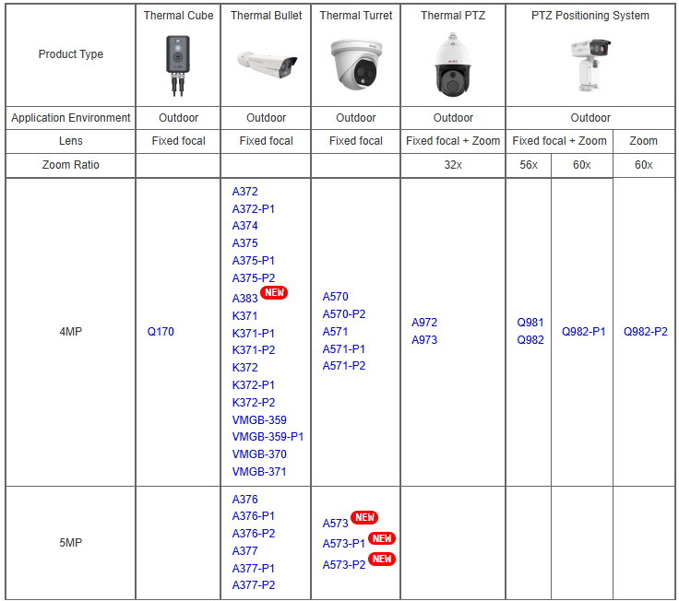
Product Matrix:

Slide 4
Product Comparison (in the order of focal length):
4MP Fixed Thermal Bullets | Specifications
 | Focal length (thermal) | Thermal DORI (det/obsr/recg/ident)
A372 | 1.35mm | 56/28/14/7m
A372-P1 | 2.6mm | 108/54/27/14m
VMGB-359-P1/370/371 | 3.1mm | 91/46/23/11m
A374 | 3.6mm | 150/75/38/19m
VMGB-359 | 6.2mm | 182/91/46/23m
A375 | 6.5mm | 191/96/48/24m
A375-P1 | 9.7mm | 294/147/74/37m
K371/K372 | 10mm | 370/264/100/60m
A375-P2 | 15mm | 441/221/110/55m
K371-P1/K372-P1 | 25mm | 950/659/240/160m
K371-P2/K372-P2 | 35mm | 1250/922/340/230m
A383 | 35mm | 1458/729/365/182m
A383 can detect people using the thermal sensor from the 1.4km distance!

Slide 5
 | A383 | K371-P2 | K372-P2
Type | Bi-Spectrum Fixed Bullet | Bi-Spectrum Fixed Bullet | Bi-Spectrum Fixed Bullet
Thermal Sensitivity | NETD <20mK | NETD <30mK | NETD <30mK
Spatial Resolution | 0.34 mrad | 0.34 mrad | 0.34 mrad
Max Visual Sensor Resolution | 4MP | 4MP | 4MP
Max Thermal Effective Pixels | 640 x 512 | 400 x 300 | 640 x 512
Lenses | 35mm (thermal) 12.4mm (visual) | 35mm (thermal) 12.0mm (visual) | 35mm (thermal) 12.0mm (visual)
WDR | 120dB | 120dB | 120dB
NDAA | No | Yes | Yes
PoE | IEEE802.3af | IEEE802.3at | IEEE802.3at
Certification | IP68, IK10, NEMA 4X | IP68, IK10, UL | IP68, IK10, UL

Slide 6
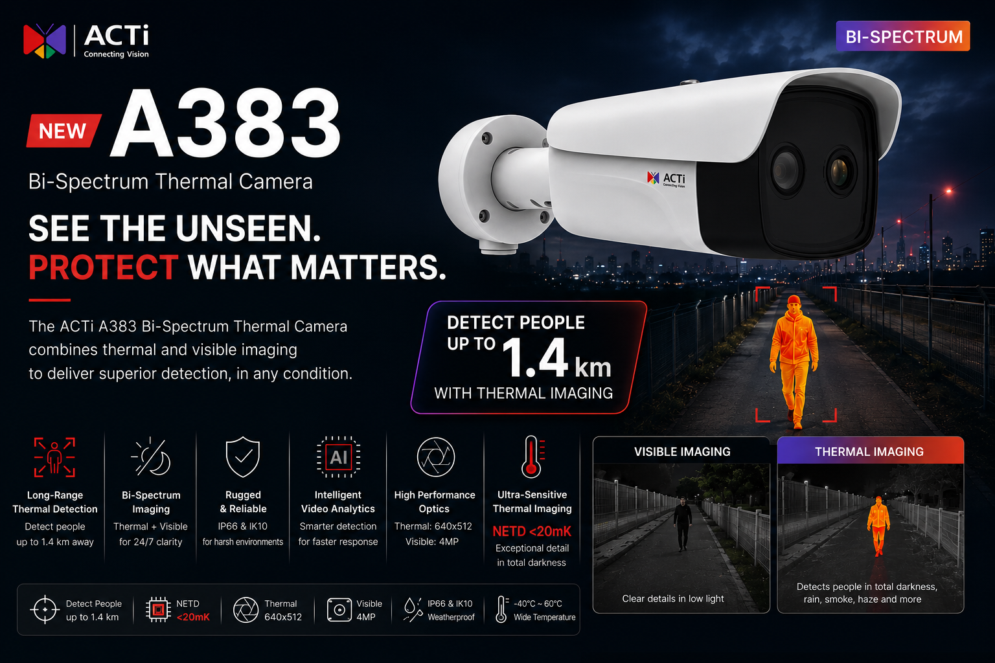

Slide 7
Supported VMS and Solutions
 | Standard Features | AI Events/Meta | Solutions
NVR 3 Corporate | Yes | Yes | S110, S111, S112
NVR 3 Business | Yes | Yes | S110, S111, S112
CMS 2 | Yes | Yes | S120, S121, S122
ZNR-Series NVR | Yes | Yes | S60
ENR-Series NVR | Yes |  | S72

