Slide 1



PCAM-0101, PCAM-1600, PCAM-1601, PCAM-1601-P1, PCAM-1602, PCAM-1603
New Product Introduction
Body Worn Cameras for the Security Teams

Slide 2
Overview
ACTi's surveillance system based on the body worn cameras and the Windows-based NVR is a ready-to-deploy solution. ACTi has a wide range of PCAM-series body-worn cameras to be chosen. Each camera is able to stream live RTSP stream to the NVR. The NVR would then record it and also show it on the client applications, such as workstations, web clients or mobile clients.
This solution is perfect for the security teams of schools, banks, high value retail stores and more. The patrol team would have the body-worn cameras attached to their chests. They would also carry the mobile devices with the ACTi Mobile Client app installed. This way, every security officer would also have access to the live video streams of each other's body-worn cameras. That would give an instant awareness of the potentially escalating situations.

Slide 3
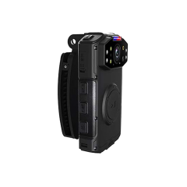
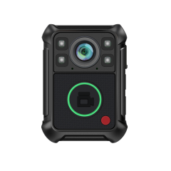
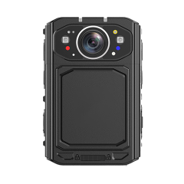
ACTi is introducing the newest products:
PCAM-0101
2MP Body Worn with IR LED, Basic WDR, IP67, LCD display, Wi-Fi, Mic
PCAM-1600
4MP Body Worn with IR LED, Basic WDR, IP68, LCD display, Wi-Fi, 5G, GPS, Image Stabilizer, Mic
PCAM-1601
8MP Body Worn with IR LED, Basic WDR, IP68, Touch Screen, Wi-Fi, GPS, Bluetooth, Image Stabilizer, Mic, Audio out, Face Recognition

Slide 4
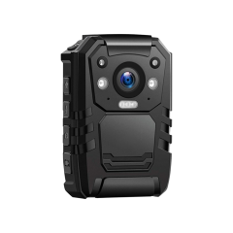
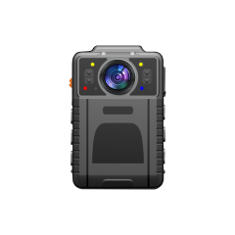
ACTi is introducing the newest products:
PCAM-1601-P1
8MP Body Worn with IR LED, Basic WDR, IP68, Touch Screen, Wi-Fi, 5G, GPS, Bluetooth, Image Stabilizer, Mic, Audio out, Face Recognition
PCAM-1602
3MP Body Worn with IR LED, Basic WDR, IP67, TFT Screen, Wi-Fi, GPS, Mic
PCAM-1603
4MP Body Worn with IR LED, Basic WDR, IP68, TFT Screen, Wi-Fi, GPS, Bluetooth, Image Stabilizer

Slide 5
Spec Comparison:
Model | PCAM-0101 | PCAM-1600 | PCAM-1601 / PCAM-1601-P1 | PCAM-1602 | PCAM-1603
Photo
Product Type | Body worn | Body worn | Body worn | Body worn | Body worn
Max Resolution | 2MP | 4MP | 8MP | 3MP | 4MP
IR LED | Yes | Yes | Yes | Yes | Yes
fps | 30 fps | 30 fps | 30 fps | 30 fps | 60 fps
Max Snapshot | - | 40MP | 80MP | 32MP | 40MP
Casing | IP67 | IP68 | IP68 | IP67 | IP68
Screen | Yes | Yes | Yes | Yes | Yes
Audio | Mic | Mic | Mic + Speaker | Mic | Mic
Wireless | WiFi, 4G | WiFi | WiFi, 5G | WiFi | WiFi
Battery | 3000 mAh | 3900 mAh | 3000/4000 mAh | 3500 mAh | 3000 mAh
Recording hours | 10h | 15h | 12h / 16h | 12h | 10h
NDAA | No | No | No | No | No
Warranty | 1 year | 1 year | 1 year | 1 year | 1 year

Slide 6
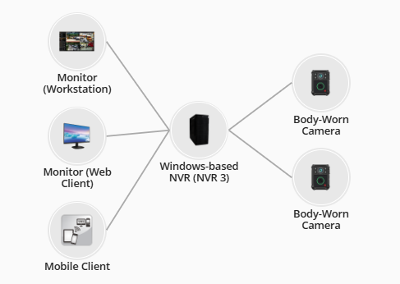
Solution
Each camera is able to stream live RTSP stream to the NVR. The NVR would then record it and also show it on the client applications, such as workstations, web clients or mobile clients.
https://www.acti.com/solutions/special-camera-and-NVR-solution?sid=S30

