Slide 1
A957, A959, A981
New Product Introduction
New Generation AI PTZ with TPM 2.0 Security

Slide 2
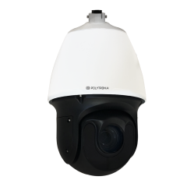
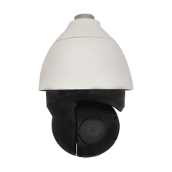
ACTi is introducing the newest products:
A957
5MP Deep Learning AI 40x Outdoor PTZ with IR LED 250m, WDR 150dB, TPM 2.0
A959
8MP Deep Learning AI 22x Outdoor PTZ with IR LED 250m, WDR 150dB, TPM 2.0
A981
8MP Deep Learning AI 30x Outdoor PTZ with IR LED 250m, WDR 150dB, TPM 2.0

Slide 3
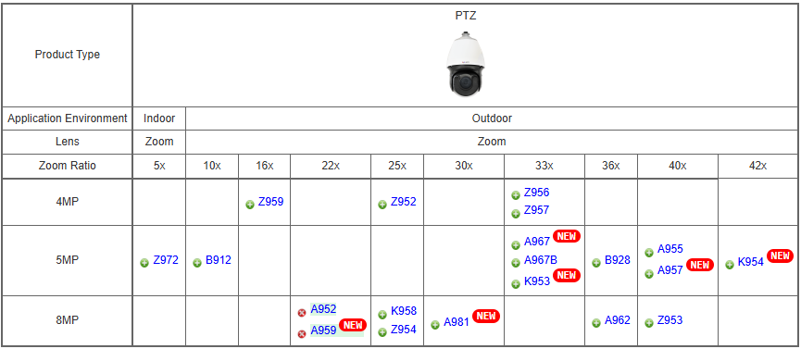
Product Matrix:

Slide 4


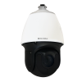
Spec Comparison:
Model | A955 | A957 (new) | A952 | A959 (new) | A981 (new)
Photo
Product type | PTZ | PTZ | PTZ | PTZ | PTZ
Resolution | 5MP | 5MP | 8MP | 8MP | 8MP
Zoom | 40x | 40x | 22x | 22x | 30x
Maximum Frame Rate | 30@5MP, 60@2MP | 30@5MP, 60@2MP | 30@8MP, 30@all | 30@8MP, 30@all | 30@8MP, 30@all
IR LED | Yes (250m) | Yes (250m) | Yes (250m) | Yes (250m) | Yes (250m)
WDR | 150dB | 150dB | 150dB | 150dB | 150dB
Low Light | Extreme | Extreme | Extreme | Extreme | Extreme
Analytics | Deep Learning AI | Deep Learning AI | Deep Learning AI | Deep Learning AI | Deep Learning AI
TPM 2.0 | - | Yes | - | Yes | Yes
NDAA | Yes | Yes | Yes | Yes | Yes
Approvals | CE, FCC, IP66, IK10, CNS-16120 | CE, FCC, IP66, IK10 | CE, FCC, IP66, IK10 | CE, FCC, IP66, IK10 | CE, FCC, IP66, IK10

Slide 5
AI Features:
Model | A955 | A957 (new) | A952 | A959 (new) | A981 (new)
Smart Motion Detection | Y | Y | Y | Y | Y
Smart Intrusion protection | Y | Y | Y | Y | Y
ALPR | Y | Y | Y | Y | Y
License Plate Detection | Y | Y | Y | Y | Y
Face Recognition | Y | Y | Y | Y | Y
Face Detection | Y | Y | Y | Y | Y
Other analytics: Tampering Detection, Missing Object Detection, Unattended Object Detection, Crowd Detection, People Loitering Detection, People Flow Counting, People Density Counting, Vehicle Flow Counting, Vehicle Density Counting, Face Detection, Face Capture, Face Matching, Object Metadata (, Age Detection, Gender Detection, Face Mask Detection, Vehicle Type Detection, Direction Detection), Stopped vehicle detection, Incorrect Direction Detection | Y | Y | Y | Y | Y

Slide 6
Supported VMS and Solutions
 | Standard Features | AI Events/Meta | Solutions
NVR 3 Corporate | Yes | Yes | S110, S111, S112
NVR 3 Business | Yes | Yes | S110, S111, S112
CMS 2 | Yes | Yes | S120, S121, S122
ZNR-Series NVR | Yes | Yes | S60
ENR-Series NVR | Yes |  | S72

Slide 7

TPM 2.0
What is TPM 2.0?
TPM 2.0 is an international standard developed by the Trusted Computing Group (TCG) that defines a dedicated security chip (or firmware-based module) integrated into computing devices.
Core Functions
Secure cryptographic key generation
Hardware-based encryption
Platform integrity measurement
Device identity protection
Read more: https://www.acti.com/technologies/tpm-2.0

