Slide 1
A412, A828
New Product Introduction
Zoom Bullet and Dome with TPM 2.0 Security

Slide 2
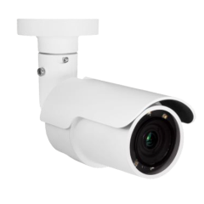
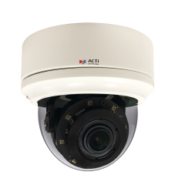
ACTi is introducing the newest products:
A412
5MP Deep Learning AI 4.4x Zoom Bullet with IR LED 85m, WDR 135dB
A828
5MP Deep Learning AI 4.4x Outdoor Zoom Dome with IR LED 85m, WDR 135dB

Slide 3
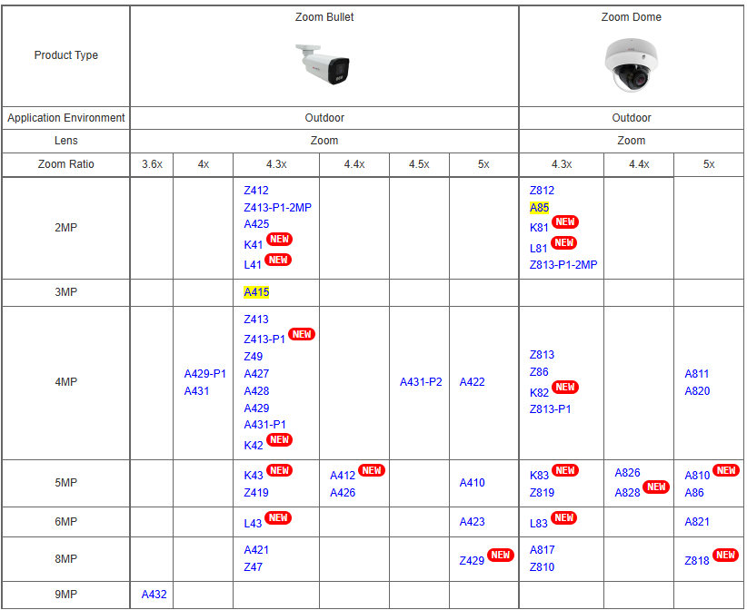
Product Matrix

Slide 4

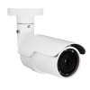

Spec Comparison:
Model | A426 | A412 | A826 | A828
Photo
Product type | Zoom Bullet | Zoom Bullet | Zoom Dome | Zoom Dome
Resolution | 5MP | 5MP | 5MP | 5MP
Lens | Zoom, 4.4x | Zoom, 4.4x | Zoom, 4.4x | Zoom, 4.4x
HOR | 97.5° - 32.8° | 97.5° - 32.8° | 102.1° - 31.5° | 102.1° - 31.5°
LED | IR LED, 85m | IR LED, 85m | IR LED, 85m | IR LED, 85m
WDR | 135dB | 135dB | 135dB | 135dB
Audio | Line-in/line-out | Line-in/line-out | Line-in/line-out | Line-in/line-out
Environment | IP66, IK10 | IP66, IK10 | IP66, IK10 | IP66, IK10
Analytics | Yes | Yes | Yes | Yes
NDAA | Yes | Yes | Yes | Yes
TPM 2.0 | - | Yes | - | Yes

Slide 5
AI Features:
Model | A426 | A412 | A826 | A828
Smart Motion Detection | Y | Y | Y | Y
Smart Intrusion protection | Y | Y | Y | Y
ALPR | Y | Y | Y | Y
License Plate Detection | Y | Y | Y | Y
Face Recognition | Y | Y | Y | Y
Face Detection | Y | Y | Y | Y
Other analytics: Tampering Detection, Missing Object Detection, Unattended Object Detection, Crowd Detection, People Loitering Detection, People Flow Counting, People Density Counting, Vehicle Flow Counting, Vehicle Density Counting, Face Detection, Face Capture, Face Matching, Object Metadata (, Age Detection, Gender Detection, Face Mask Detection, Vehicle Type Detection, Direction Detection), Stopped vehicle detection, Incorrect Direction Detection | Y | Y | Y | Y

Slide 6
Supported VMS and Solutions
 | Standard Features | AI Events/Meta | Solutions
NVR 3 Corporate | Yes | Yes | S110, S111, S112
NVR 3 Business | Yes | Yes | S110, S111, S112
CMS 2 | Yes | Yes | S120, S121, S122
ZNR-Series NVR | Yes | Yes | S60
ENR-Series NVR | Yes |  | S72

Slide 7
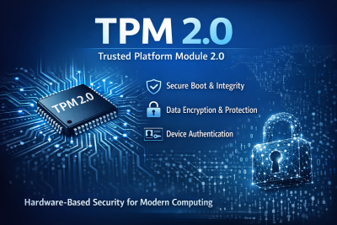
TPM 2.0
What is TPM 2.0?
TPM 2.0 is an international standard developed by the Trusted Computing Group (TCG) that defines a dedicated security chip (or firmware-based module) integrated into computing devices.
Core Functions
Secure cryptographic key generation
Hardware-based encryption
Platform integrity measurement
Device identity protection
Read more: https://www.acti.com/technologies/tpm-2.0

