Slide 1
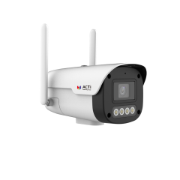
Z337
New Product Introduction
4 Megapixel Wireless 4G Bullet

Slide 2
ACTi is introducing the newest product:
Z337
4MP Wireless 4G Deep Learning AI ColorGuard f4.0mm Fixed Bullet with IR LED 50m, White LED 30m, Smart Dual Light, WDR 120dB

Slide 3
Product Matrix
 | Fixed Bullet
 | Wireless 4G + DC power | PoE
2MP |  | Z316, Z316-P1, Z330, Z330-P1, K31, K31-P1, L31, L31-P1
4MP | Z337 | Z317, Z317-P1, Z322, Z331, Z331-P1, A313, K32, K32-P1, Z324
5MP |  | Z315, K33, Z319, Z332
6MP |  | A314, L33, L33-P1
8MP |  | Z325, Z318

Slide 4
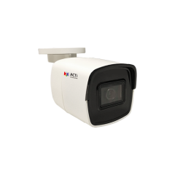
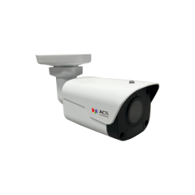
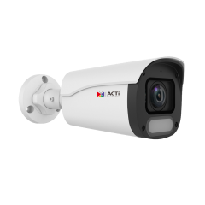
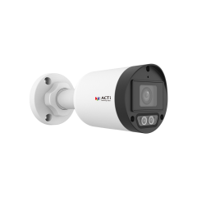
Spec Comparison:
Model | A313 | K32 / K32-P1 | Z324 | Z331 / Z331-P1 | Z337 (new)
Photo
Product type | Fixed Bullet | Fixed Bullet | Fixed Bullet | Fixed Bullet | Fixed Bullet
Wireless 4G |  |  |  |  | Yes
Resolution | 4MP | 4MP | 4MP | 4MP | 4MP
Lens | 2.8mm | 2.8mm/4.0mm | 2.8mm | 2.8mm/4.0mm | 4.0mm
LED | IR LED | IR LED | IR & White LED | IR & White LED | IR & White LED
Frame Rates | 30fps @ 4MP 30fps @ 3MP | 25fps @ 4MP 30fps @ 3MP | 25fps @ 4MP 30fps @ 3MP | 25fps @ 4MP 30fps @ 3MP | 30fps @ 4MP 30fps @ 3MP
Low Light | Extreme | Extreme | Extreme | Extreme | Superior
ColorGuard | - | - | Yes | Yes | Yes
Audio | - | Mic | Mic | Mic | Mic, Line-in/out, speaker
Analytics | Yes | Yes | Yes | Yes | Yes
NDAA | Yes | Yes | Yes | Yes | Yes
Casing | IP68, IK10 | IP68, IK10 | IP68, IK10 | IP68, IK10 | IP68

Slide 5
Built-in AI:
AI Feature | A313 | K32 / K32-P1 | Z324 | Z331 / Z331-P1 | Z337 (new)
Face Detection | Y | - | - | - | -
Smart Motion Detection | - | Y | Y | Y | Y
Smart Intrusion Protection | - | - | Y | - | Y
People Detection | Y | Y | Y | - | Y
Vehicle Detection | Y | Y | Y | - | Y
People Line Crossing | Y | Y | Y | - | Y
Vehicle Line Crossing | Y | - | Y | - | Y
Object Line Crossing | Y | - | - | - | -
People Counting | - | - | - | - | -

Slide 6
Supported VMS and Solutions
 | Standard Features | AI Events/Meta | Solutions
NVR 3 Corporate | Yes | Yes | S110, S111, S112
NVR 3 Business | Yes | Yes | S110, S111, S112
CMS 2 | Yes | Yes | S120, S121, S122
ZNR-Series NVR | Yes | Yes | S60
ENR-Series NVR | Yes |  | S72

Slide 7
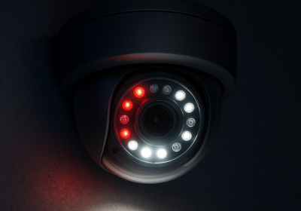
Technology: Smart Dual Light
What is Dual Light?
When the cameras contain both IR LED and White LED as built-in illuminators then these are called dual light cameras. IR LED illuminates the light in the wavelength that is invisible for a human eye but the camera can see it and produce a monochrome image, usually in the grayscale.
The White LED inside the camera illuminates the light in the wavelength of the visible spectrum. It allows the camera to capture and produce the full color image even in the total darkness.
What is Smart Dual Light?
The Smart Dual Light is the intelligent feature of the camera that controls both IR and White LED automatically depending on the actual scene. The built-in AI analyzes the objects and decides when the object is significant so that it is necessary to capture it in full colors as an evidence. In such case the camera will switch from the IR LED mode to the White LED mode during the presence of that object and it swiches back to the IR LED mode once the object is gone. Those significant objects may be people or vehicles, for example.
https://www.acti.com/technologies/smart-dual-light

