Slide 1
K-Series Cameras
New Products Introduction

Slide 2
What is K-Series?
Various form factors – bullet, dome, PTZ, multi-imager PTZ
2-32 Megapixel
Excellent video quality
Built-in deep learning AI
All products IP68 rated
BSMI, UL, NDAA, TAA
TLS 1.2 or 1.3 Security
Price level about 10% higher than Z-series

Slide 3
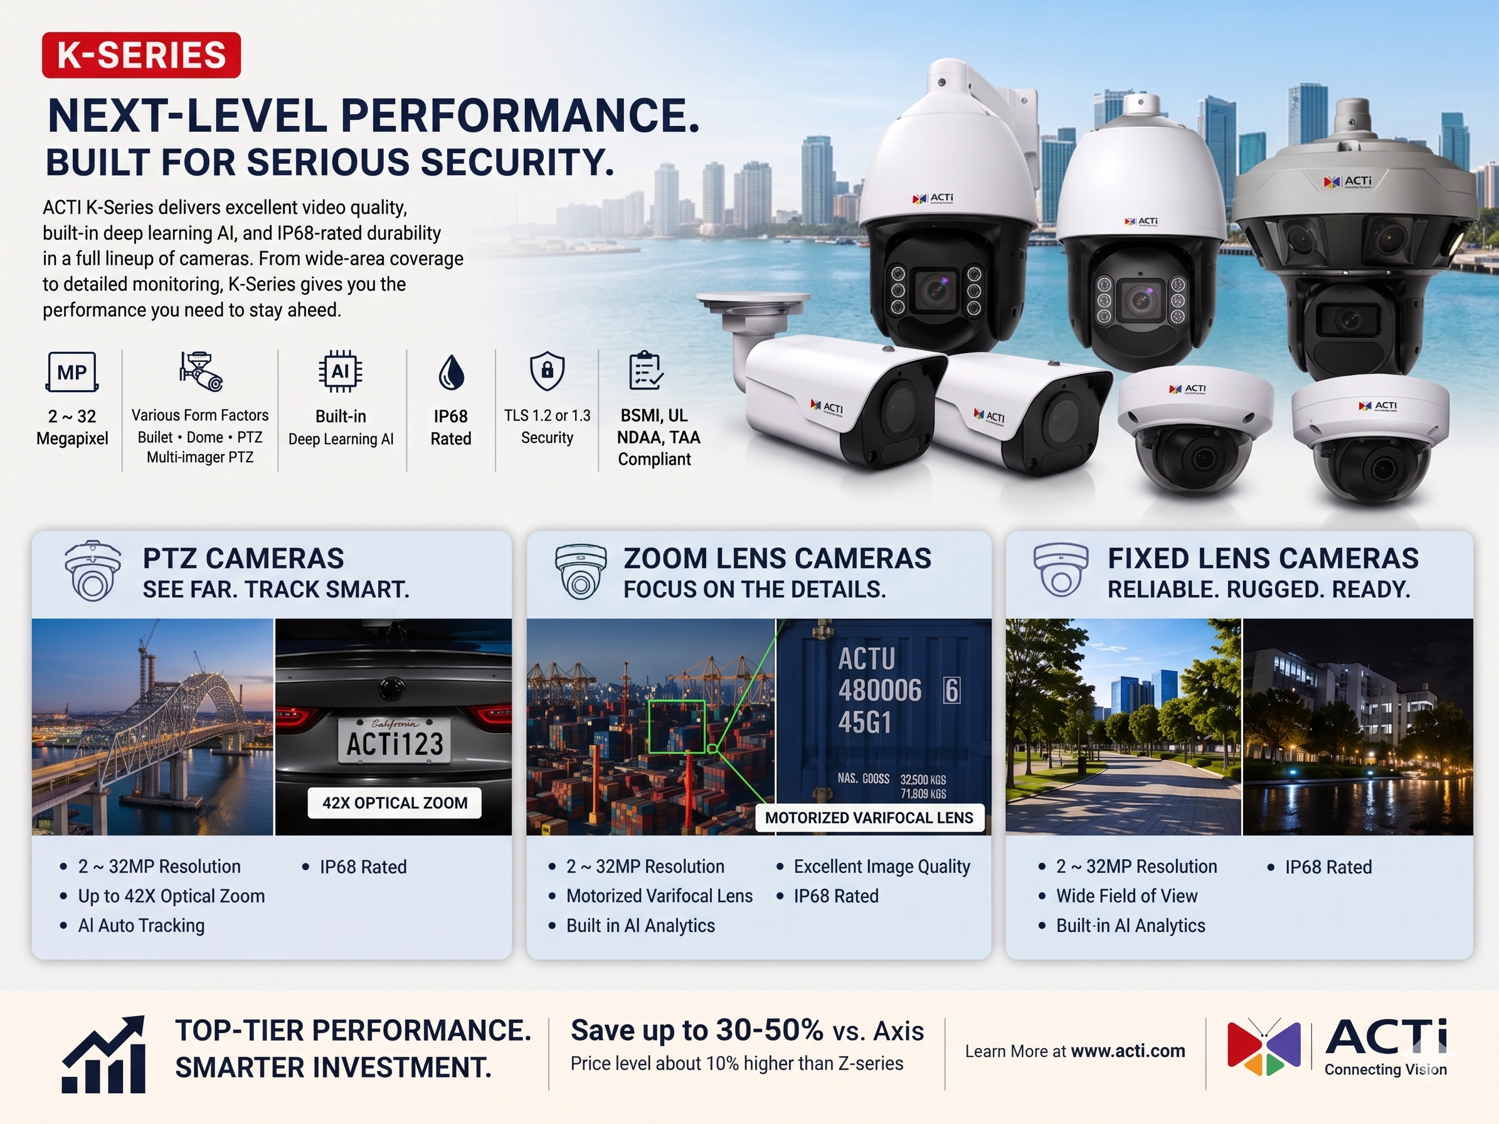

Slide 4






K-Series Product Matrix
 | Fixed Bullet | Zoom Bullet | Fixed Dome | Zoom Dome | PTZ |  |  | Multi-Imager PTZ
 | Fixed focal | Zoom | Fixed focal | Zoom | Zoom |  |  | Fixed focal + Zoom
 | - | 4.3x | - | 4.3x | 25x | 33x | 42x | 42x
2MP | K31 K31-P1 | K41 | K71 K71-P1 | K81 |  | K953-2MP
4MP | K32 K32-P1 | K42 | K72 K72-P1 | K82
5MP | K33 | K43 | K73 | K83 |  | K953 | K954
8MP |  |  |  |  | K958
32MP |  |  |  |  |  |  |  | K9001

Slide 5
PTZ Cameras

Slide 6
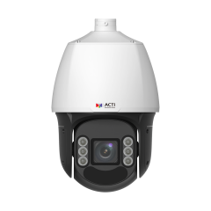
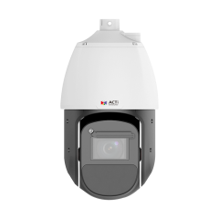
ACTi is introducing the newest products:
K953
5MP Deep Learning AI ColorGuard LightGuard 33x Outdoor PTZ with IR LED 250m, ColorVizion, WDR 145dB
K954
5MP Deep Learning AI 42x Outdoor PTZ with IR LED 500m, ColorVizion, WDR 150dB
K958
8MP Deep Learning AI 25x Outdoor PTZ with IR LED 200m, ColorVizion, WDR 145dB

Slide 7
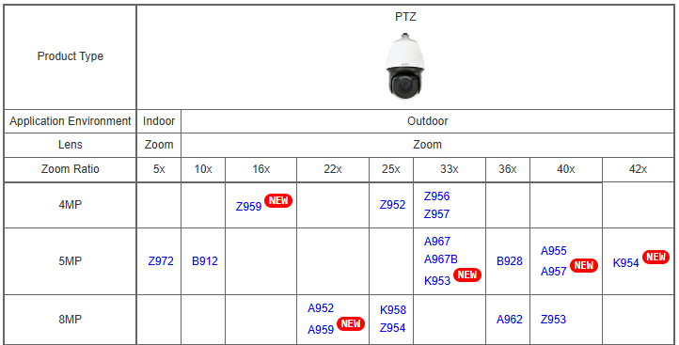
Product Matrix:

Slide 8
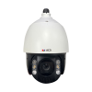
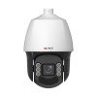
Spec Comparison:
Model | A967 | A967B | K953 (new)
Photo
Product type | PTZ | PTZ | PTZ
Resolution | 5MP | 5MP | 5MP
Zoom | 33x | 33x | 33x
Maximum Frame Rate | 30@5MP, 60@2MP | 30@5MP, 60@2MP | 60@5MP, 60@all
IR LED | Yes (250m) | Yes (250m) | Yes (250m)
WDR | 150dB | 150dB | 145dB
Low Light | Extreme | Extreme | Extreme
Analytics | Deep Learning AI | Deep Learning AI | Deep Learning AI
PoE Power | IEEE802.3bt, 42W | IEEE802.3bt, 42W | IEEE802.3at, 25W
TLS Security | TLS v1.2 | TLS v1.2 | TLS v1.2, TLS v1.3
NDAA | Yes | Yes | Yes
Approvals | CE, FCC, IP66, IK10, BSMI, CNS-16120 | CE, FCC, IP66, IK10, BSMI | CE, FCC, IP68, IK10, BSMI, UL

Slide 9
Built-in Analytics
 | A967 | A967B | K953
Face Recognition | - | - | Y
Face Detection | - | - | Y
Automatic License Plate Recognition (ALPR) | - | - | -
License Plate Detection | - | - | -
Vehicle Detection | - | - | Y
Smart Motion Detection | - | - | Y
Smart Intrusion Protection | Y | Y | Y
People (Flow/Density) Counting | - | - | Y
People Detection | - | - | Y
People Enter Area Detection | Y | Y | Y
Vehicle Enter Area Detection | Y | Y | Y
Other analytics (object detection, etc.) | Y | Y | Y

Slide 10

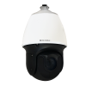
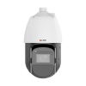
Spec Comparison:
Model | A955 | A957 | K954 (new)
Photo
Product type | PTZ | PTZ | PTZ
Resolution | 5MP | 5MP | 5MP
Zoom | 40x | 40x | 42x
Maximum Frame Rate | 30@5MP, 60@2MP | 30@5MP, 60@2MP | 60@5MP, 60@all
IR LED | Yes (250m) | Yes (250m) | Yes (500m)
WDR | 150dB | 150dB | 150dB
Low Light | Extreme | Extreme | Extreme
Analytics | Deep Learning AI | Deep Learning AI | Deep Learning AI
PoE Power | IEEE802.3bt, 51W | IEEE802.3bt, 51W | IEEE802.3bt, 67W
TLS Security | TLS v1.2 | TLS v1.2 | TLS v1.2, TLS v1.3
NDAA | Yes | Yes | Yes
Approvals | CE, FCC, IP66, IK10, CNS-16120 | CE, FCC, IP66, IK10 | CE, FCC, IP68, IK10, BSMI, UL

Slide 11
Built-in Analytics
 | A955 | A957 | K954
Face Recognition | Y | Y | Y
Face Detection | Y | Y | Y
Automatic License Plate Recognition (ALPR) | - | - | -
License Plate Detection | - | - | -
Vehicle Detection | Y | Y | Y
Smart Motion Detection | - | - | Y
Smart Intrusion Protection | - | - | Y
People (Flow/Density) Counting | - | - | Y
People Detection | Y | Y | Y
People Enter Area Detection | - | - | Y
Vehicle Enter Area Detection | - | - | Y
Other analytics (object detection, etc.) | Y | Y | Y

Slide 12
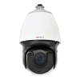
Spec Comparison:
Model | A952 | Z954 | K958 (new)
Photo
Product type | PTZ | PTZ | PTZ
Resolution | 8MP | 8MP | 8MP
Zoom | 22x | 25x | 25x
Maximum Frame Rate | 30@8MP, 30@other | 30@8MP, 30@other | 30@8MP, 60@4MP
IR LED | Yes (250m) | Yes (200m) | Yes (200m)
WDR | 150dB | 145dB | 145dB
Low Light | Extreme | Extreme | Extreme
Analytics | Deep Learning AI | Deep Learning AI | Deep Learning AI
PoE Power | IEEE802.3bt, 51W | IEEE802.3bt, 58W | IEEE802.3at, 23.9W
TLS Security |  |  | TLS v1.2, TLS v1.3
NDAA | Yes | Yes | Yes
Approvals | CE, FCC, IP66, IK10 | CE, FCC, IP66, IK10, UL | CE, FCC, IP68, IK10, BSMI, UL

Slide 13
Built-in Analytics
 | A952 | Z954 | K958
Face Recognition | Y | - | Y
Face Detection | Y | Y | Y
Automatic License Plate Recognition (ALPR) | Y | - | -
License Plate Detection | Y | - | -
Vehicle Detection | Y | - | Y
Smart Motion Detection | - | - | Y
Smart Intrusion Protection | - | - | Y
People (Flow/Density) Counting | Y | Y | Y
People Detection | Y | - | Y
People Enter Area Detection | Y | Y | Y
Vehicle Enter Area Detection | Y | - | Y
Other analytics (object detection, etc.) | Y | Y | Y

Slide 14
Zoom Lens Cameras

Slide 15
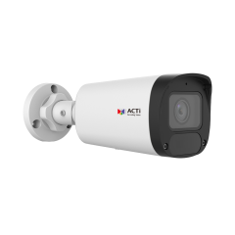
ACTi is introducing the newest products:
K41
2MP Deep Learning AI 4.3x Zoom Bullet with IR LED 60m, WDR 130dB
K42
4MP Deep Learning AI 4.3x Zoom Bullet with IR LED 60m, WDR 130dB
K43
5MP Deep Learning AI 4.3x Zoom Bullet with IR LED 60m, WDR 130dB

Slide 16
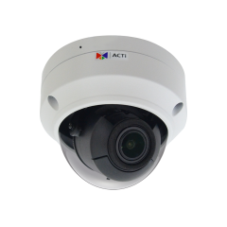
ACTi is introducing the newest products:
K81
2MP Deep Learning AI 4.3x Zoom Dome with IR LED 60m, WDR 130dB
K82
4MP Deep Learning AI 4.3x Zoom Dome with IR LED 60m, WDR 130dB
K83
5MP Deep Learning AI 4.3x Zoom Dome with IR LED 60m, WDR 130dB

Slide 17
Product Matrix:
Product Type | Zoom Bullet | Zoom Dome
Application Environment | Outdoor | Outdoor
Lens | Zoom | Zoom
Zoom Ratio | 4.3x | 4.3x
2MP | K41 | K81
4MP | K42 | K82
5MP | K43 | K83

Slide 18
Spec Comparison:
Model | K41 | K42 | K43
Photo
Product type | Zoom Bullet | Zoom Bullet | Zoom Bullet
Resolution | 2MP | 4MP | 5MP
Lens | Zoom, 4.3x | Zoom, 4.3x | Zoom, 4.3x
HOR | 111° - 36.6° | 95.6° - 30.9° | 96.4° - 32.7°
LED | IR LED, 60m | IR LED, 60m | IR LED, 60m
Audio | Built-in Mic | Built-in Mic | Built-in Mic
Op Temperature | -40°C ~ 60°C | -40°C ~ 60°C | -40°C ~ 60°C
Environment | IP68, IK10 | IP68, IK10 | IP68, IK10
Analytics | Yes | Yes | Yes
NDAA | Yes | Yes | Yes
UL Listed | Yes | Yes | Yes
BSMI | Yes | Yes | Yes

Slide 19
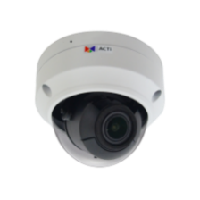
Spec Comparison:
Model | K81 | K82 | K83
Photo
Product type | Zoom Dome | Zoom Dome | Zoom Dome
Resolution | 2MP | 4MP | 5MP
Lens | Zoom, 4.3x | Zoom, 4.3x | Zoom, 4.3x
HOR | 111° - 36.6° | 95.6° - 30.9° | 96.4° - 32.7°
LED | IR LED, 60m | IR LED, 60m | IR LED, 60m
Audio | Built-in Mic | Built-in Mic | Built-in Mic
Op Temperature | -40°C ~ 60°C | -40°C ~ 60°C | -40°C ~ 60°C
Environment | IP68, IK10 | IP68, IK10 | IP68, IK10
Analytics | Yes | Yes | Yes
NDAA | Yes | Yes | Yes
UL Listed | Yes | Yes | Yes
BSMI | Yes | Yes | Yes

Slide 20
Analytics Comparison:
Analytics | K41, K42, K43 | K81, K82, K83
Smart Motion Detection | Y | Y
People Detection | Y | Y
Vehicle Detection | Y | Y
Tampering Detection | Y | Y
People Line Crossing Detection | Y | Y
People Intrusion Detection | Y | Y

Slide 21
Fixed Lens Cameras

Slide 22
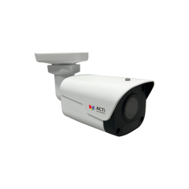
ACTi is introducing the newest products:
K31
2MP Deep Learning AI f2.8mm Fixed Bullet with IR LED 50m, WDR 130dB
K31-P1
2MP Deep Learning AI f4mm Fixed Bullet with IR LED 50m, WDR 130dB

Slide 23
ACTi is introducing the newest products:
K32
4MP Deep Learning AI f2.8mm Fixed Bullet with IR LED 50m, WDR 130dB
K32-P1
4MP Deep Learning AI f4mm Fixed Bullet with IR LED 50m, WDR 130dB

Slide 24
ACTi is introducing the newest products:
K33
5MP Deep Learning AI f2.8mm Fixed Bullet with IR LED 50m, WDR 130dB

Slide 25
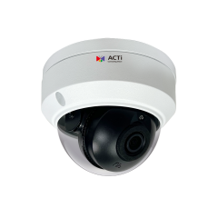
ACTi is introducing the newest products:
K71
2MP Deep Learning AI f2.8mm Fixed Dome with IR LED 50m, WDR 130dB
K71-P1
2MP Deep Learning AI f4mm Fixed Dome with IR LED 50m, WDR 130dB

Slide 26
ACTi is introducing the newest products:
K72
4MP Deep Learning AI f2.8mm Fixed Dome with IR LED 50m, WDR 130dB
K72-P1
4MP Deep Learning AI f4mm Fixed Dome with IR LED 50m, WDR 130dB

Slide 27
ACTi is introducing the newest products:
K73
5MP Deep Learning AI f2.8mm Fixed Dome with IR LED 50m, WDR 130dB

Slide 28
Spec Comparison:
Model | K31 / K31-P1 | K32 / K32-P1 | K33
Photo
Product type | Fixed Bullet | Fixed Bullet | Fixed Bullet
Resolution | 2MP | 4MP | 5MP
Lens | f2.8mm/f4mm | f2.8mm/f4mm | f2.8mm
HOR | 112.9°/91.2° | 101.5°/84.1° | 101.5°
LED | IR LED, 50m | IR LED, 50m | IR LED, 50m
Audio | Built-in Mic | Built-in Mic | Built-in Mic
Oper. Temperature | -40°C ~ 60°C | -40°C ~ 60°C | -40°C ~ 60°C
Environment | IP68, IK10 | IP68, IK10 | IP68, IK10
Analytics | Yes | Yes | Yes
NDAA | Yes | Yes | Yes
UL Listed | Yes | Yes | Yes
BSMI | Yes | Yes | Yes

Slide 29
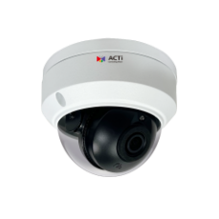
Spec Comparison:
Model | K71 / K71-P1 | K72 / K72-P1 | K73
Photo
Product type | Fixed Dome | Fixed Dome | Fixed Dome
Resolution | 2MP | 4MP | 5MP
Lens | f2.8mm/f4mm | f2.8mm/f4mm | f2.8mm
HOR | 112.9°/91.2° | 101.5°/84.1° | 101.5°
LED | IR LED, 50m | IR LED, 50m | IR LED, 50m
Audio | Built-in Mic | Built-in Mic | Built-in Mic
Oper. Temperature | -40°C ~ 60°C | -40°C ~ 60°C | -40°C ~ 60°C
Environment | IP68, IK10 | IP68, IK10 | IP68, IK10
Analytics | Yes | Yes | Yes
NDAA | Yes | Yes | Yes
UL Listed | Yes | Yes | Yes
BSMI | Yes | Yes | Yes

Slide 30
Analytics Comparison:
Analytics | K31, K31-P1, K32, K32-P1 K33 | K71, K71-P1, K72, K72-P1, K73
Smart Motion Detection | Y | Y
People Detection | Y | Y
Vehicle Detection | Y | Y
Tampering Detection | Y | Y
People Line Crossing Detection | Y | Y
People Intrusion Detection | Y | Y

Slide 31
Solutions

Slide 32
Supported VMS and Solutions
 | Standard Features | AI Events/Meta | Solutions
NVR 3 Corporate | Yes | Yes | S110, S111, S112
NVR 3 Business | Yes | Yes | S110, S111, S112
CMS 2 | Yes | Yes | S120, S121, S122
ZNR-Series NVR | Yes | Yes | S60
ENR-Series NVR | Yes |  | S72

