Slide 1
KNR-Series NVR
Product Introduction

Slide 2
What is KNR-Series?
Mini and Rackmount type NVR servers
Linux-based (ARM-based embedded SoC)
Hardware RAID for 2, 4 and 8 bay models!
Wide range of RAID configurations (0, 1, 5, 6, 10)
Built using the newest generation components (long life support)

Slide 3
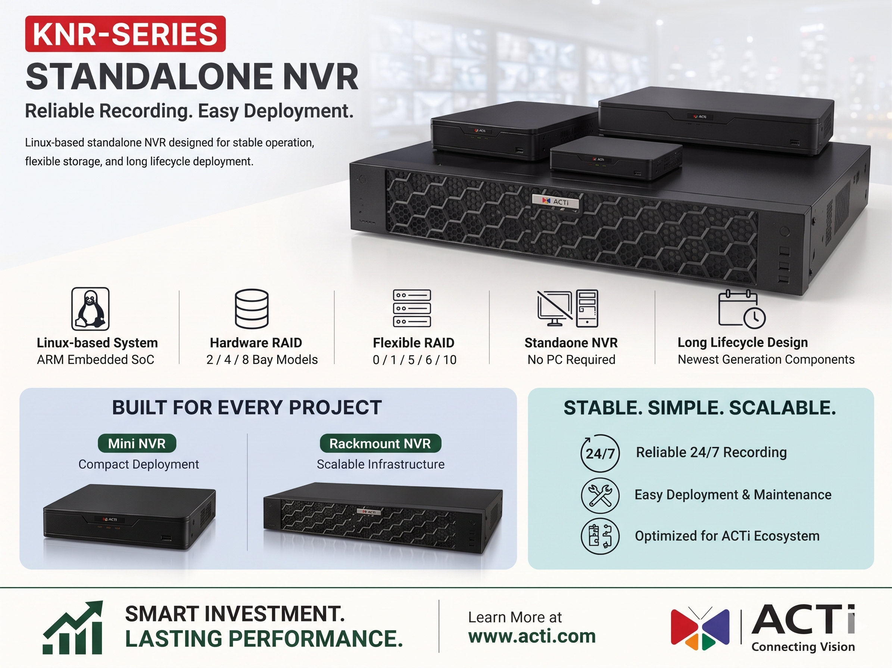

Slide 4
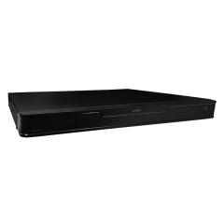
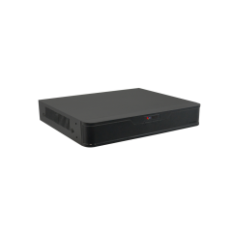


Product Matrix
Maximum Recording Channels | Bundled Licenses | Built-in PoE Connectors | Mini Standalone NVR | Rackmount Standalone NVR
 |  |  | 1 Bay | 2 Bays (RAID) | 4 Bays (RAID) | 8 Bays (RAID)
8 | 8 | 0 | KNR-120
16 | 16 | 0 | KNR-121
 |  | 16 |  | KNR-220P
32 | 32 | 0 |  |  | KNR-420
64 | 64 | 0 |  |  |  | KNR-421

Slide 5
Product Overview
KNR-120
8-Channel 1-Bay Mini Standalone NVR
KNR-121
16-Channel 1-Bay Mini Standalone NVR

Slide 6
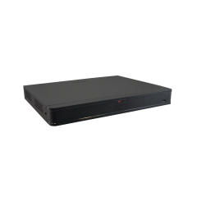
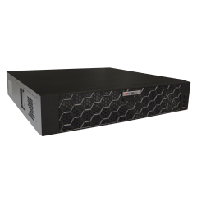
Product Overview
KNR-220P
Deep Learning AI 16-Channel 2-Bay RAID 1U Rackmount Standalone NVR with 16-port PoE Connectors
KNR-420
32-Channel 4-Bay RAID 1U Rackmount Standalone NVR
KNR-421
64-Channel 8-Bay RAID 2U Rackmount Standalone NVR

Slide 7
Specifications Comparison
Model | KNR-120 | KNR-121 | KNR-222P | KNR-420 | KNR-421
Photo
Max Channels | 8 | 16 | 16 | 32 | 64
PoE Ports | - | - | 16 | - | -
Storage Bays | 1 | 1 | 2 | 4 | 8
RAID | - | - | 0, 1 | 0, 1, 5, 6, 10 | 0, 1, 5, 6, 10
Op. System | Linux | Linux | Linux | Linux | Linux
Recording Throughput | 64 Mbps | 80 Mbps | 160 Mbps | 160 Mbps | 320 Mbps
Outgoing Throughput | 48 Mbps | 80 Mbps | 128 Mbps | 128 Mbps | 160 Mbps
NDAA, BSMI, UL | Yes | Yes | Yes | Yes | Yes

