Slide 1
K953, K954, K958
New Product Introduction
5-8MP PTZ with 60fps, TLS Security, BSMI

Slide 2
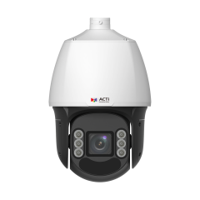
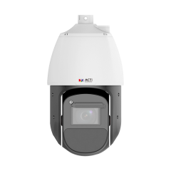
ACTi is introducing the newest products:
K953
5MP Deep Learning AI ColorGuard LightGuard 33x Outdoor PTZ with IR LED 250m, ColorVizion, WDR 145dB
K954
5MP Deep Learning AI 42x Outdoor PTZ with IR LED 500m, ColorVizion, WDR 150dB
K958
8MP Deep Learning AI 25x Outdoor PTZ with IR LED 200m, ColorVizion, WDR 145dB

Slide 3
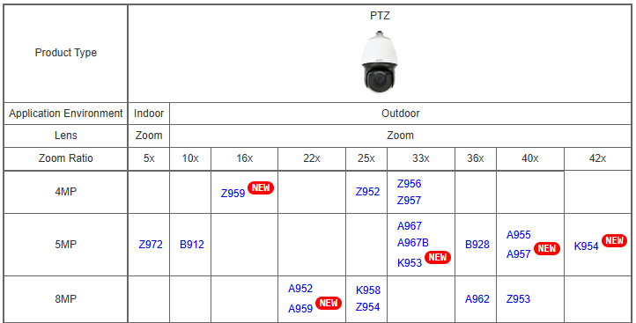
Product Matrix:

Slide 4
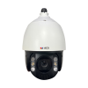
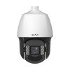
Spec Comparison:
Model | A967 | A967B | K953 (new)
Photo
Product type | PTZ | PTZ | PTZ
Resolution | 5MP | 5MP | 5MP
Zoom | 33x | 33x | 33x
Maximum Frame Rate | 30@5MP, 60@2MP | 30@5MP, 60@2MP | 60@5MP, 60@all
IR LED | Yes (250m) | Yes (250m) | Yes (250m)
WDR | 150dB | 150dB | 145dB
Low Light | Extreme | Extreme | Extreme
Analytics | Deep Learning AI | Deep Learning AI | Deep Learning AI
PoE Power | IEEE802.3bt, 42W | IEEE802.3bt, 42W | IEEE802.3at, 25W
TLS Security | TLS v1.2 | TLS v1.2 | TLS v1.2, TLS v1.3
NDAA | Yes | Yes | Yes
Approvals | CE, FCC, IP66, IK10, BSMI, CNS-16120 | CE, FCC, IP66, IK10, BSMI | CE, FCC, IP68, IK10, BSMI, UL

Slide 5
Built-in Analytics
 | A967 | A967B | K953
Face Recognition | - | - | Y
Face Detection | - | - | Y
Automatic License Plate Recognition (ALPR) | - | - | -
License Plate Detection | - | - | -
Vehicle Detection | - | - | Y
Smart Motion Detection | - | - | Y
Smart Intrusion Protection | Y | Y | Y
People (Flow/Density) Counting | - | - | Y
People Detection | - | - | Y
People Enter Area Detection | Y | Y | Y
Vehicle Enter Area Detection | Y | Y | Y
Other analytics (object detection, etc.) | Y | Y | Y

Slide 6

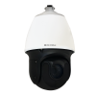
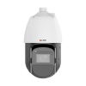
Spec Comparison:
Model | A955 | A957 | K954 (new)
Photo
Product type | PTZ | PTZ | PTZ
Resolution | 5MP | 5MP | 5MP
Zoom | 40x | 40x | 42x
Maximum Frame Rate | 30@5MP, 60@2MP | 30@5MP, 60@2MP | 60@5MP, 60@all
IR LED | Yes (250m) | Yes (250m) | Yes (500m)
WDR | 150dB | 150dB | 150dB
Low Light | Extreme | Extreme | Extreme
Analytics | Deep Learning AI | Deep Learning AI | Deep Learning AI
PoE Power | IEEE802.3bt, 51W | IEEE802.3bt, 51W | IEEE802.3bt, 67W
TLS Security | TLS v1.2 | TLS v1.2 | TLS v1.2, TLS v1.3
NDAA | Yes | Yes | Yes
Approvals | CE, FCC, IP66, IK10, CNS-16120 | CE, FCC, IP66, IK10 | CE, FCC, IP68, IK10, BSMI, UL

Slide 7
Built-in Analytics
 | A955 | A957 | K954
Face Recognition | Y | Y | Y
Face Detection | Y | Y | Y
Automatic License Plate Recognition (ALPR) | - | - | -
License Plate Detection | - | - | -
Vehicle Detection | Y | Y | Y
Smart Motion Detection | - | - | Y
Smart Intrusion Protection | - | - | Y
People (Flow/Density) Counting | - | - | Y
People Detection | Y | Y | Y
People Enter Area Detection | - | - | Y
Vehicle Enter Area Detection | - | - | Y
Other analytics (object detection, etc.) | Y | Y | Y

Slide 8
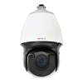
Spec Comparison:
Model | A952 | Z954 | K958 (new)
Photo
Product type | PTZ | PTZ | PTZ
Resolution | 8MP | 8MP | 8MP
Zoom | 22x | 25x | 25x
Maximum Frame Rate | 30@8MP, 30@other | 30@8MP, 30@other | 30@8MP, 60@4MP
IR LED | Yes (250m) | Yes (200m) | Yes (200m)
WDR | 150dB | 145dB | 145dB
Low Light | Extreme | Extreme | Extreme
Analytics | Deep Learning AI | Deep Learning AI | Deep Learning AI
PoE Power | IEEE802.3bt, 51W | IEEE802.3bt, 58W | IEEE802.3at, 23.9W
TLS Security |  |  | TLS v1.2, TLS v1.3
NDAA | Yes | Yes | Yes
Approvals | CE, FCC, IP66, IK10 | CE, FCC, IP66, IK10, UL | CE, FCC, IP68, IK10, BSMI, UL

Slide 9
Built-in Analytics
 | A952 | Z954 | K958
Face Recognition | Y | - | Y
Face Detection | Y | Y | Y
Automatic License Plate Recognition (ALPR) | Y | - | -
License Plate Detection | Y | - | -
Vehicle Detection | Y | - | Y
Smart Motion Detection | - | - | Y
Smart Intrusion Protection | - | - | Y
People (Flow/Density) Counting | Y | Y | Y
People Detection | Y | - | Y
People Enter Area Detection | Y | Y | Y
Vehicle Enter Area Detection | Y | - | Y
Other analytics (object detection, etc.) | Y | Y | Y

Slide 10
Supported VMS and Solutions
 | Standard Features | AI Events/Meta | Solutions
NVR 3 Corporate | Yes | Yes | S110, S111, S112
NVR 3 Business | Yes | Yes | S110, S111, S112
CMS 2 | Yes | Yes | S120, S121, S122
ZNR-Series NVR | Yes | Yes | S60
ENR-Series NVR | Yes |  | S72

