Slide 1
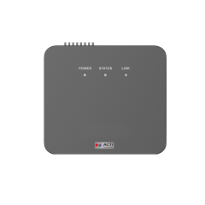
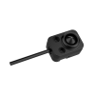
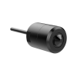
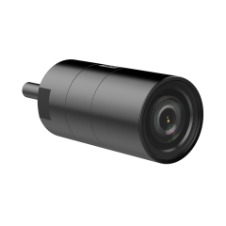
Q120, Q121
New Product Introduction
New generation covert cameras and lens options!

Slide 2
Why Covert Cameras?
Discreet monitoring without behavioral bias
Covert cameras are designed to blend into the environment (e.g., smoke detectors, clocks), allowing subjects to behave naturally without awareness of surveillance—resulting in more authentic data for security analysis.
Effective for internal risk and loss prevention
They are commonly used in retail, offices, and warehouses to detect employee theft, policy violations, or suspicious internal activities that may not be captured by visible cameras.
Enhanced evidence collection in sensitive environments
In areas where overt cameras may be avoided or tampered with, covert IP cameras provide reliable visual evidence for investigations while minimizing the risk of interference.
Flexible deployment with IP-based infrastructure
Modern covert cameras support IP connectivity, enabling remote access, centralized VMS integration, and real-time alerts—making them suitable for scalable, multi-site deployments.
Compliance and ethical considerations are critical
Deployment must follow local privacy laws and organizational policies, especially in private or sensitive spaces, ensuring surveillance is justified, proportionate, and legally compliant.

Slide 3
ACTi is introducing the newest products:
Q120
2MP Deep Learning AI Indoor Covert with WDR 120dB, 5 lens options, lens not included
Q121
4MP Deep Learning AI Indoor Covert with WDR 120dB, 2 lens options, lens not included

Slide 4
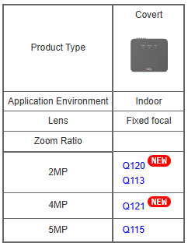
Product Matrix
Value position:
Extend previous covert series to the following features:
H.264 -> H.265
Swappable lenses
Built-in AI
WDR 75dB -> 120dB
Dual -> Triple streams
30fps to higher resolution

Slide 5
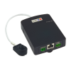
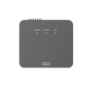
Spec Comparison:
Model | Q113 | Q115 | Q120 (new) | Q121 (new)
Photo
Product type | Covert | Covert | Covert | Covert
Resolution | 2MP | 5MP | 2MP | 4MP
HOR Viewing Angle | 84.5° (3.7mm) | 70.2° (3.7mm) | 107.8° (PLEN-4501) 82.8° (PLEN-4502) 93.9° (PLEN-4503) 75.5° (PLEN-4504) 75.5° (PLEN-4505) | 98° (PLEN-4506) 75° (PLEN-4507)
Lens option | Included | Included | Not included, options | Not included, options
Frame Rates | 30fps @ 2MP | 15fps @ 5MP 30fps @ 2MP | 30fps @ 2MP | 30fps @ 4MP
Compression | H.264 | H.264 | H.264, H.265 | H.264, H.265
Streams | Dual | Dual | Triple | Triple
WDR | 75dB | 75dB | 120dB | 120dB
Audio | 2-way | 2-way | 2-way | 2-way
Analytics | - | - | Deep Learning AI | Deep Learning AI
NDAA | Yes | Yes | No | No

Slide 6
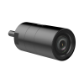
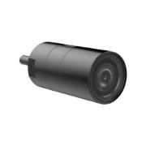
Lenses
 |  | Q120 (new) | Q121 (new)
PLEN-4501 |  | Optional, HOR: 107.8° | -
PLEN-4502 |  | Optional, HOR: 82.8° | -
PLEN-4503 |  | Optional, HOR: 93.9° | -
PLEN-4504 |  | Optional, HOR: 75.5° | -
PLEN-4505 |  | Optional, HOR: 75.5° | -
PLEN-4506 |  | - | Optional, HOR: 98°
PLEN-4507 |  | - | Optional, HOR: 75°
Various mounts included in the lens package.

Slide 7
Bundled Mounts with Lenses
 |  | Mounting Options
 |  | Ceiling/Wall Bracket with gimbal (~10cm) | In-wall mount (for discreet installation) | Fixed mini wall mount | Tiltable mini wall mount
PLEN-4501 |  | Y | Y | - | -
PLEN-4502 |  | Y | Y | - | -
PLEN-4503 |  | - | Y | Y | Y
PLEN-4504 |  | - | Y | Y | Y
PLEN-4505 |  | Y | Y | - | -
PLEN-4506 |  | Y | Y | - | -
PLEN-4507 |  | Y | Y | - | -

Slide 8
Built-in AI
AI Feature | Q113 | Q115 | Q120 | Q121
Object Line Crossing Detection | - | - | Yes | Yes
Intrusion Detection | - | - | Yes | Yes
Object Enter Area Detection | - | - | Yes | Yes
Object Exit Area Detection | - | - | Yes | Yes
Unattended Object Detection | - | - | Yes | Yes
Missing Object Detection | - | - | Yes | Yes

Slide 9
Supported VMS and Solutions
 | Standard Features | AI Events/Meta | Solutions
NVR 3 Corporate | Yes | Yes | S110, S111, S112
NVR 3 Business | Yes | Yes | S110, S111, S112
CMS 2 | Yes | Yes | S120, S121, S122
ZNR-Series NVR | Yes | Yes | S60
ENR-Series NVR | Yes |  | S72

