Slide 1
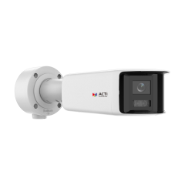
A317
New Product Introduction
16 Megapixel Hemispheric Bullet with Smart Dual Light!

Slide 2
ACTi is introducing the newest product:
A317
16MP Deep Learning AI LightGuard Hemispheric Bullet with IR LED 40m, White LED 40m, Smart Dual Light, WDR 130dB

Slide 3
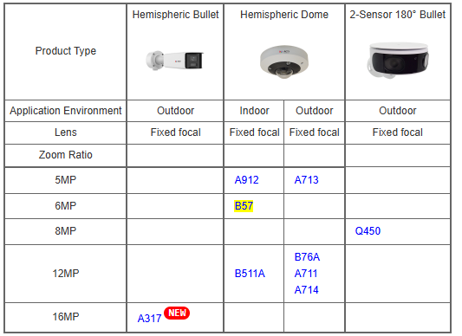
Product Matrix
Value positions:
1. Extend Hemispheric product line from 12MP to 16MP.
2. Extend 180 degree panoramic bullets from 8MP to 16MP.

Slide 4
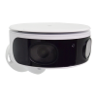
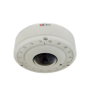
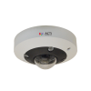
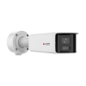
Spec Comparison:
Model | Q450 | B76A | A711 | A317 (new)
Photo
Product type | 2-Sensor 180° Bullet | Hemispheric Dome | Hemispheric Dome | Hemispheric Bullet
Resolution | 8MP | 12MP | 12MP | 16MP
HOR Viewing Angle | 182° | 198.5° | 190° | 182.2°
LED | IR LED | IR LED | IR LED | IR & White LED
Frame Rates | 30fps @ 8MP | 18fps @ 12MP 30fps @ 4MP | 20fps @ 12MP 25fps @ 9MP 50fps @ 2MP | 15fps @ 16MP 15fps @ 8MP 15 fps @ 1MP
Low Light | Superior | Superior | Extreme | Extreme
LightGuard | - | - | - | Yes
Audio | - | Mic, Line-in/out | Line-in/out | Mic, Line-in/out, speaker
DORI | 106/43/21/10m | 33/13/6/3m | 35/14/7/3m | 80/32/16/8m
Analytics | - | Standard AI | Deep Learning AI | Deep Learning AI
NDAA | Yes | Yes | Yes | No
Casing | IP66, IK10 | IP68, IK10, NEMA 4X | IP66, IK10 | IP68, IK10

Slide 5
Built-in AI:
AI Feature | Q450 | B76A | A711 | A317
Smart Motion Detection | - | - | - | Yes
Smart Intrusion Protection | - | - | - | Yes
People Line Crossing | - | - | Yes | Yes
Vehicle Line Crossing | - | - | Yes | Yes
Object Line Crossing | - | Yes | - | -
People Counting | - | - | Yes | -

Slide 6
Supported VMS and Solutions
 | Standard Features | AI Events/Meta | Solutions
NVR 3 Corporate | Yes | Yes | S110, S111, S112
NVR 3 Business | Yes | Yes | S110, S111, S112
CMS 2 | Yes | Yes | S120, S121, S122
ZNR-Series NVR | Yes | Yes | S60
ENR-Series NVR | Yes |  | S72

Slide 7
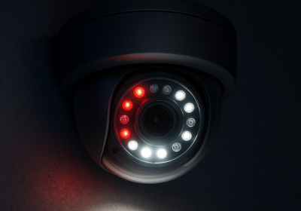
Technology: Smart Dual Light
What is Dual Light?
When the cameras contain both IR LED and White LED as built-in illuminators then these are called dual light cameras. IR LED illuminates the light in the wavelength that is invisible for a human eye but the camera can see it and produce a monochrome image, usually in the grayscale.
The White LED inside the camera illuminates the light in the wavelength of the visible spectrum. It allows the camera to capture and produce the full color image even in the total darkness.
What is Smart Dual Light?
The Smart Dual Light is the intelligent feature of the camera that controls both IR and White LED automatically depending on the actual scene. The built-in AI analyzes the objects and decides when the object is significant so that it is necessary to capture it in full colors as an evidence. In such case the camera will switch from the IR LED mode to the White LED mode during the presence of that object and it switches back to the IR LED mode once the object is gone. Those significant objects may be people or vehicles, for example.
https://www.acti.com/technologies/smart-dual-light

