Slide 1
Y35, Y55
New Product Introduction
New Analog Bullet and Turret Camera

Slide 2
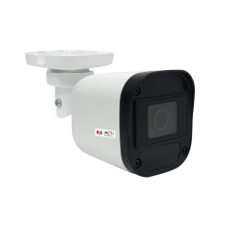
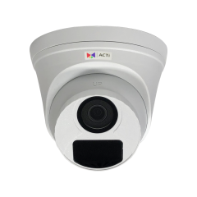
ACTi is introducing the newest products:
Y35
2MP f2.8mm Outdoor Analog Bullet with IR LED 30m, WDR 130dB
Y55
2MP f2.8mm Outdoor Analog Turret with IR LED 30m, WDR 130dB

Slide 3


Product Matrix
Product Type | Analog Bullet | Analog Turret
2MP | Y31 Y35 | Y71 Y55
5MP | Y32 | 72

Slide 4
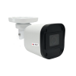
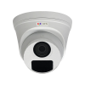
Spec Comparison:
Model | Y31 | Y35 | Y71 | Y55
Photo
Product type | Analog Bullet | Analog Bullet | Analog Turret | Analog Turret
Resolution | 2MP | 2MP | 2MP | 2MP
Lens | f2.8mm | f2.8mm | f2.8mm | f2.8mm
Horizontal Viewing Angle | 90.5° | 90.5° | 90.5° | 90.5°
Analog Video Output | 1 x BNC connector, supports TVI/AHD/CVI/CVBS | 1 x BNC connector, supports TVI/AHD/CVI/CVBS | 1 x BNC connector, supports TVI/AHD/CVI/CVBS | 1 x BNC connector, supports TVI/AHD/CVI/CVBS
Maximum fps vs Resolution | (TVI/AHD/CVI) 30 fps at 1920 x 1080 (CVBS) NTSC, PAL | (TVI/AHD/CVI) 30 fps at 1920 x 1080 (CVBS) NTSC, PAL | (TVI/AHD/CVI) 30 fps at 1920 x 1080 (CVBS) NTSC, PAL | (TVI/AHD/CVI) 30 fps at 1920 x 1080 (CVBS) NTSC, PAL
DNR | DNR | 2D + 3D DNR | DNR | 2D + 3D DNR
Weatherproof | IP67 | IP67 | IP67 | IP67
NDAA | Yes | Yes | Yes | Yes

Slide 5
Analog streaming formats overview
In the analog CCTV world, there are 4 popular formats being used. In order to work seamlessly, both the camera and the DVR must use the same format.
Hardware Brand | Product Branding/ Series Name | Supported Protocols/Formats
 |  | TVI | CVI | AHD | CVBS (old, D1)
 |  | Digital, up to 4K, but also backward compatible with analog, via BNC, 1080p to 300 meters | Digital, up to 4K, 720p to 500 meters, 1080p to 300 meters | Analog, Up to 5MP over coax | D1 equivalent resolution, 480~700 TVL, fully analog
 |  | Techpoint (& Hikvision) | Dahua | NextChip (Korea) | (global standard) | Inventor of the format
Hanwha | Analog HD+ |  |  | Y
Hikvision | HDTVI | Y
Dahua | HDCVI |  | Y
Geovision | Analog HD | Y | - | Y
Bosch | Analog |  |  |  | Y
ACTi | Analog | Y | Y | Y | Y
HDTVI = High Definition Transport Video Interface
HDCVI = High Definition Composite Video Interface
AHD = Analog High Definition
CVBS = Composite Video Broadcast Signal

Slide 6
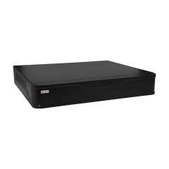
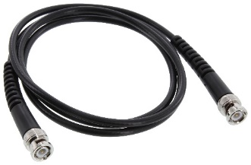
Solutions
ACTi also provides the Hybrid DVR (YVR-xxx) series which can be used together with the Analog camera series (Yxx). Although these hybrid DVRs also support ONVIF IP cameras, our focused solution strategy is to sell them together with the analog cameras.
Yxx Series
Analog cameras
Coaxial Cable
YVR-series
Hybrid DVR

Slide 7
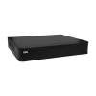
Solutions
Hybrid DVR options:
Models | Images | Storage Bays | Maximum Recording Channels | Bundled Licenses |  | Built-in PoE Connectors
 |  |  |  | IP Devices | Analog Devices
YVR-120 |  | 1 | 6 | 2 | 4 | 0
YVR-121 |  | 1 | 12 | 4 | 8 | 0
YVR-122 |  | 1 | 24 | 8 | 16 | 0

Slide 8


