Slide 1
Z429, Z818
New Product Introduction
8MP Dual Light Zoom Bullet and Zoom Dome

Slide 2
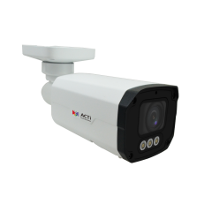
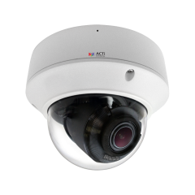
ACTi is introducing the newest products:
Z429
8MP Deep Learning AI 5x Zoom Bullet with IR LED 60m, White LED 60m, Smart Dual Light, ColorVizion, WDR 120dB
Z818
8MP Deep Learning AI 5x Outdoor Zoom Dome with IR LED 40m, White LED 40m, Smart Dual Light, ColorVizion, WDR 120dB

Slide 3
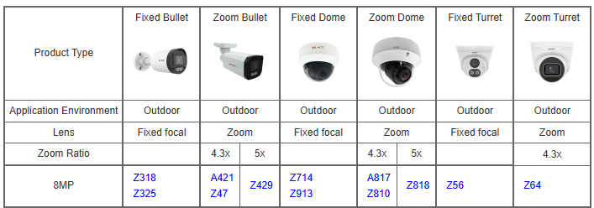
Product Matrix (8MP cluster):

Slide 4
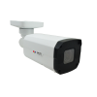
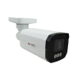
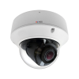
Spec Comparison:
Model | Z47 | Z429 | Z810 | Z818
Photo
Product type | Zoom Bullet | Zoom Bullet | Zoom Dome | Zoom Dome
Resolution | 8MP | 8MP | 8MP | 8MP
Lens | Zoom, 4.3x | Zoom, 5x | Zoom, 4.3x | Zoom, 5x
LED | IR LED | IR LED White LED | IR LED | IR LED White LED
Colorvizion | - | Yes | - | Yes
WDR | 130dB | 120dB | 130dB | 120dB
Audio | 2-way | 2-way + Mic | 2-way + Mic | 2-way + Mic
Analytics | Yes, Deep Learning | Yes, Deep Learning | Yes, Deep Learning | Yes, Deep Learning
NDAA | Yes | Yes | Yes | Yes
Approvals | IP68, IK10, UL | IP68, IK10, UL | IP68, IK10, UL | IP68, IK10, UL

Slide 5
Supported VMS and Solutions
 | Standard Features | AI Events/Meta | Solutions
NVR 3 Corporate | Yes | Yes | S110, S111, S112
NVR 3 Business | Yes | Yes | S110, S111, S112
CMS 2 | Yes | Yes | S120, S121, S122
ZNR-Series NVR | Yes | Yes | S60
ENR-Series NVR | Yes |  | S72

Slide 6
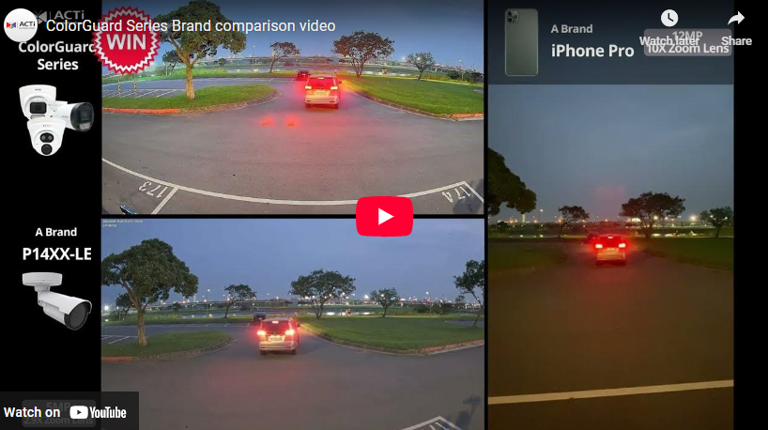
ColorGuard Technology
The most valuable applications of these cameras are the AI-powered physical security surveillance based on true colors.
The cameras collect the precise appearance metadata, such as the color of the jacket, color of the pants, color of hair, color of the vehicle.
Thanks to the color precision, it is possible to identify the same suspect through different locations, which is very challenging for the conventional IP cameras.

Slide 7
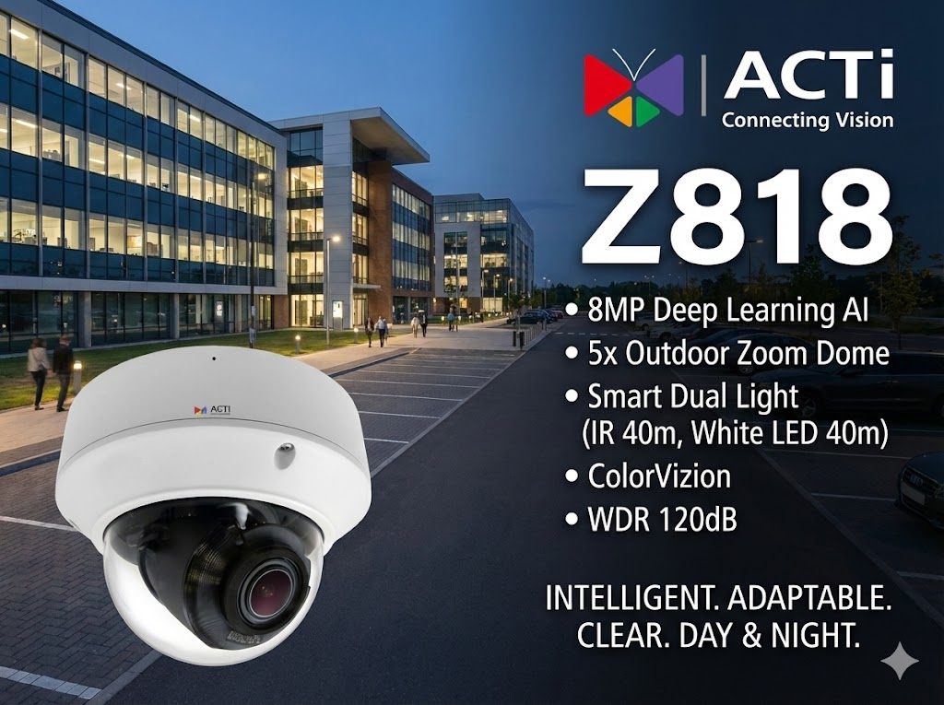

Slide 8


