Slide 1
Q990, Q991, Q992
New Product Introduction
PTZ Positioning Systems with up to 5km Surveillance

Slide 2
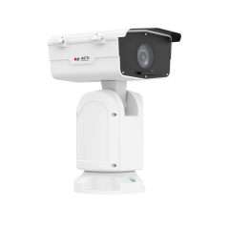
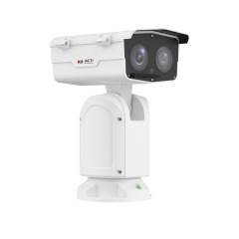
ACTi is introducing the newest products:
Q990
2MP Deep Learning AI LightGuard 45x Outdoor PTZ Positioning System with IR LED 400m, WDR 120dB
Q991
4MP Deep Learning AI LightGuard 41x Outdoor PTZ Positioning System with IR LED 400m, WDR 120dB
Q992
8MP Deep Learning AI LightGuard 41x Outdoor PTZ Positioning System with Laser 1000m, WDR 120dB

Slide 3
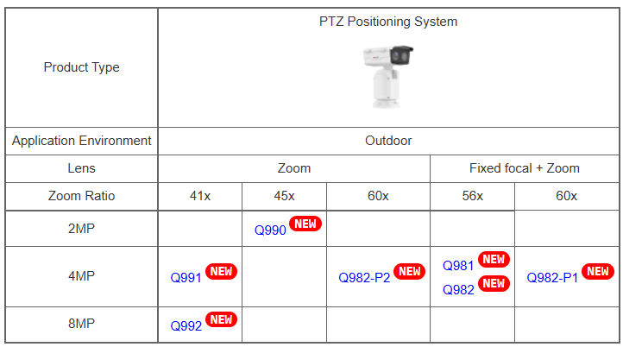
Product Matrix:

Slide 4
Spec Comparison:
Model | Q990 | Q991 | Q992
Photo
Product type | PTZ Positioning System | PTZ Positioning System | PTZ Positioning System
Resolution | 2MP | 4MP | 8MP
Zoom | 45x (f5.7-256.5mm) | 41x (f6.0-246mm) | 41x (f6.0-246mm)
Maximum Frame Rate | 60@2MP | 60@4MP | 30@8MP, 30@2MP
IR LED | Yes (400m) | Yes (400m) | -
Laser | - | - | Yes (1000m)
WDR | 120dB | 120dB | 120dB
Low Light | Extreme | Extreme | Extreme
Analytics | Deep Learning AI | Deep Learning AI | Deep Learning AI
NDAA | Yes | Yes | Yes
Approvals | CE, FCC, IP68, UL | CE, FCC, IP68, UL | CE, FCC, IP66, UL

Slide 5
Built-in Deep Learning AI
AI Feature | Q990 | Q991 | Q992
Smart Motion Detection | Y | Y | Y
Smart Intrusion Protection | Y | Y | Y
People Line Crossing Detection | Y | Y | Y
People Intrusion Detection | Y | Y | Y
People Enter Area Detection | Y | Y | Y
People Exit Area Detection | Y | Y | Y
Vehicle Line Crossing Detection | Y | Y | Y
Vehicle Intrusion Detection | Y | Y | Y
Vehicle Enter Area Detection | Y | Y | Y
Vehicle Exit Area Detection | Y | Y | Y
Missing Object Detection | Y | Y | Y
Unattended Object Detection | Y | Y | Y
Tampering Detection | Y | Y | Y
PTZ Auto Tracking | Y | Y | Y
People Flow Counting | Y | Y | Y
People Density Counting | Y | Y | Y

Slide 6
DORI Distances
AI Feature | Definition | Example | Q990 | Q991 | Q992
Detection | You can detect the presence of a subject (person, vehicle, object) in the scene, but no detail is sufficient to know what or who it is. | Something is moving in that corner. | 107.2m-3330m | 107.2m-3330m | 155.5m-4829.4m
Observation | Enough detail to observe some characteristics (clothing color, vehicle type, object behavior) but still not sufficient for recognition. | That is a car, probably a sedan. That person is wearing a red jacket. | 42m-1332m | 42m-1332m | 62.2m-1931.8m
Recognition | You can reliably say that the subject is the same as one seen before, though not necessarily identify them uniquely. | That is the same person I saw earlier. That is the same white Toyota Corolla. | 21m-666m | 21m-666m | 31.1m-965.9m
Identification | Enough resolution for unique identification - i.e., confirming who the person is (facial ID) or exactly what the object is (vehicle plate, brand/model, etc.). | I can read every symbol of the license plate. That is John's face. | 10m-333m | 10m-333m | 15.5m-482.9m

Slide 7
Supported VMS and Solutions
 | Standard Features | AI Events/Meta | Solutions
NVR 3 Corporate | Yes | Yes | S110, S111, S112
NVR 3 Business | Yes | Yes | S110, S111, S112
CMS 2 | Yes | Yes | S120, S121, S122
ZNR-Series NVR | Yes | Yes | S60
ENR-Series NVR | Yes |  | S72

Slide 8
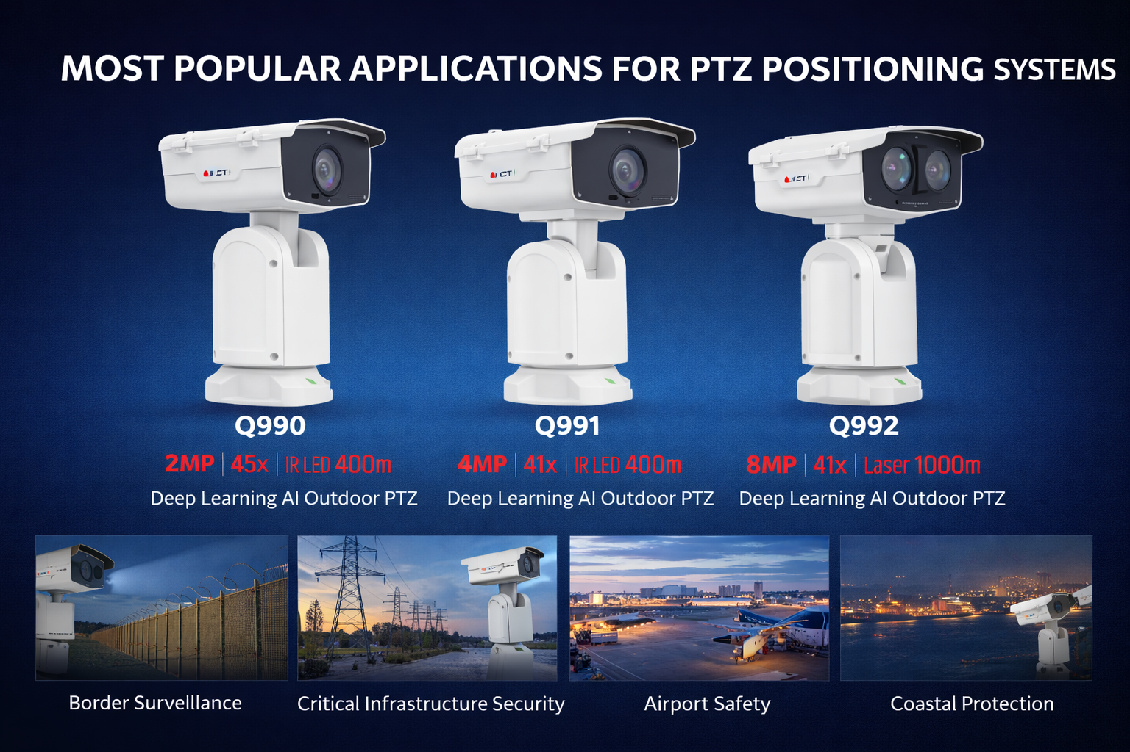

Slide 9


