Slide 1
Z814, Z64
New Product Introduction
4MP and 8MP Outdoor Zoom Turrets

Slide 2
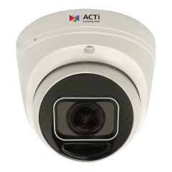
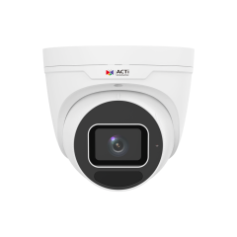
ACTi is introducing the newest products:
Z814
4MP 4.3x Outdoor Zoom Turret with IR LED 60m, WDR 120dB
Z64
8MP Deep Learning AI LightGuard 4.3x Outdoor Zoom Turret with IR LED 40m, WDR 130dB
*All the new turret models will be named with 6xx label.

Slide 3
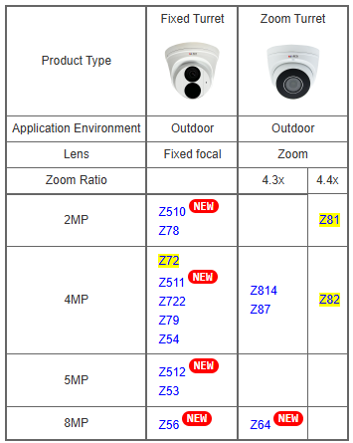
Product Matrix

Slide 4
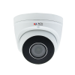
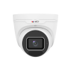
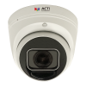
Spec Comparison:
Model | Z814 | Z87 | Z64
Photo
Product type | Zoom Turret | Zoom Turret | Zoom Turret
Resolution | 4MP | 4MP | 8MP
Lens | Zoom, 4.3x | Zoom, 4.3x | Zoom, 4.3x
HOR | 99.8° - 30.7° | 99.8° - 30.7° | 107.4° - 29.2°
LED | IR LED | IR LED | IR LED
LightGuard | - | - | Yes
WDR | 120dB | 120dB | 130dB
Audio | Built-in Mic | Built-in Mic | Built-in Mic
Environment | IP68, IK10 | IP68, IK10 | IP68, IK10
Analytics | Yes | Yes | Yes, Deep Learning
NDAA | Yes | Yes | Yes
UL Listed | Yes | Yes | Yes

Slide 5
Supported VMS and Solutions
 | Standard Features | AI Events/Meta | Solutions
NVR 3 Corporate | Yes | Yes | S110, S111, S112
NVR 3 Business | Yes | Yes | S110, S111, S112
CMS 2 | Yes | Yes | S120, S121, S122
ZNR-Series NVR | Yes | Yes | S60
ENR-Series NVR | Yes |  | S72

Slide 6
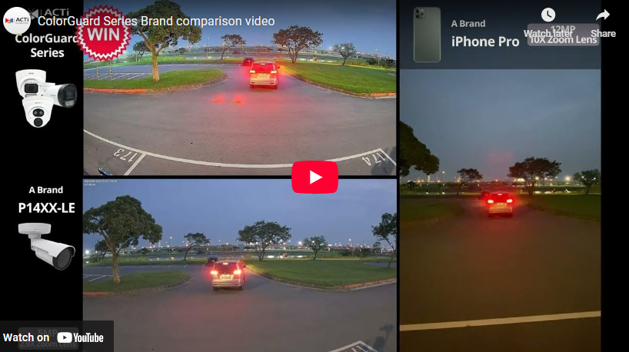
ColorGuard Technology
The most valuable applications of these cameras are the AI-powered physical security surveillance based on true colors.
The cameras collect the precise appearance metadata, such as the color of the jacket, color of the pants, color of hair, color of the vehicle.
Thanks to the color precision, it is possible to identify the same suspect through different locations, which is very challenging for the conventional IP cameras.

Slide 7
Applications
The Zoom Turrets are often used in various ceiling or wall installations due to their very simple design and convenience of installation. The lens gimbal can be easily adjusted without opening up any parts of the camera.
The Zoom lens allows remote adjustment of the viewing angle and the focus.

