Slide 1
PCI-101, PCI-201
New Product Introduction
The vibration proof heavy duty Windows-based servers that can host ACTi Software NVR.

Slide 2
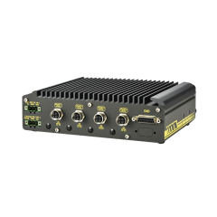
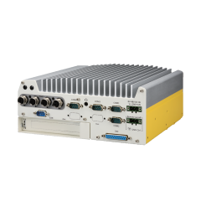
Product Overview
PCI-101
1-Bay Windows-based Ruggedized Transportation Standalone NVR with 4-port M12 PoE Connectors, E-Mark, EN50155
PCI-201
2-Bay Windows-based Ruggedized Transportation Standalone NVR with 4-port M12 PoE Connectors, E-Mark, EN50155

Slide 3

Product Matrix
Maximum Recording Channels | Bundled Licenses | Built-in PoE Connectors | Transportation Standalone NVR
 |  |  | 1 Bay | 2 Bays
4 | 4 | 4 |  | MNR-402P (Linux)
N/A | N/A | 4 | PCI-101 (Windows) | PCI-201 (Windows)
8 | 8 | 8 | MNR-403P (Linux)
PCI-series Windows-based models do not contain pre-installed NVR. NVR 3 can be installed there by the customer.

Slide 4
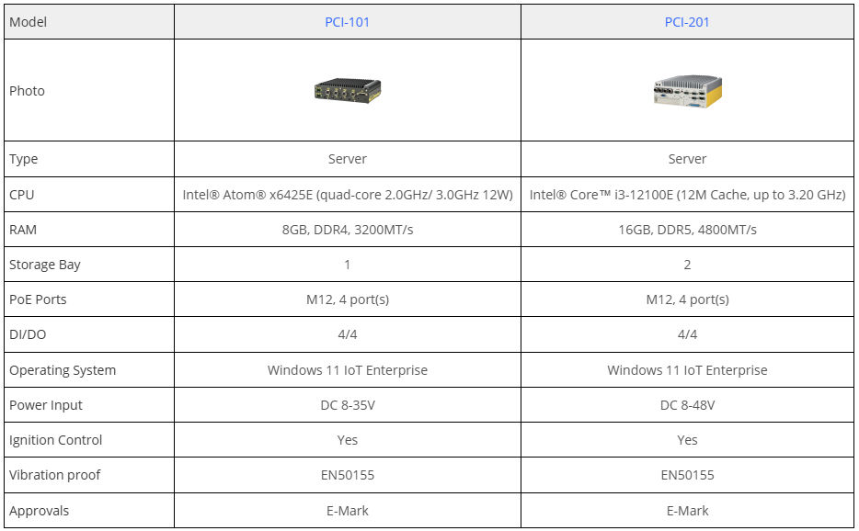
Transportation NVR Server Comparison
Recommended
NVR 3 Corporate edition will be installed in those Servers upon the project.

Slide 5
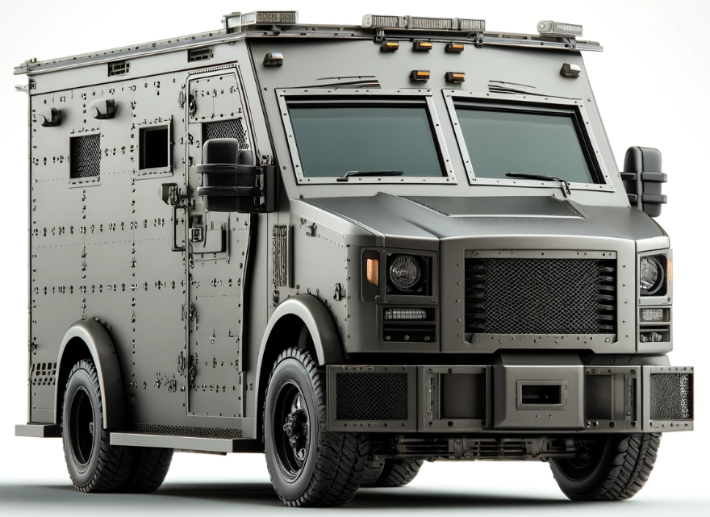

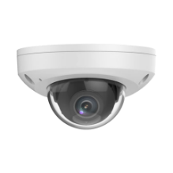
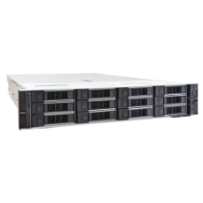

Standard Solution Architecture
Control Station (with CMS)
Truck
Truck
CMS Workstation
Track vehicles on the Map, watch video
Truck
Wi-Fi/4G
Mini Dome
CMS 2 Server
On-board NVR with PoE (MNR or PCI) + Wi-Fi / 4G
Mini Dome

Slide 6
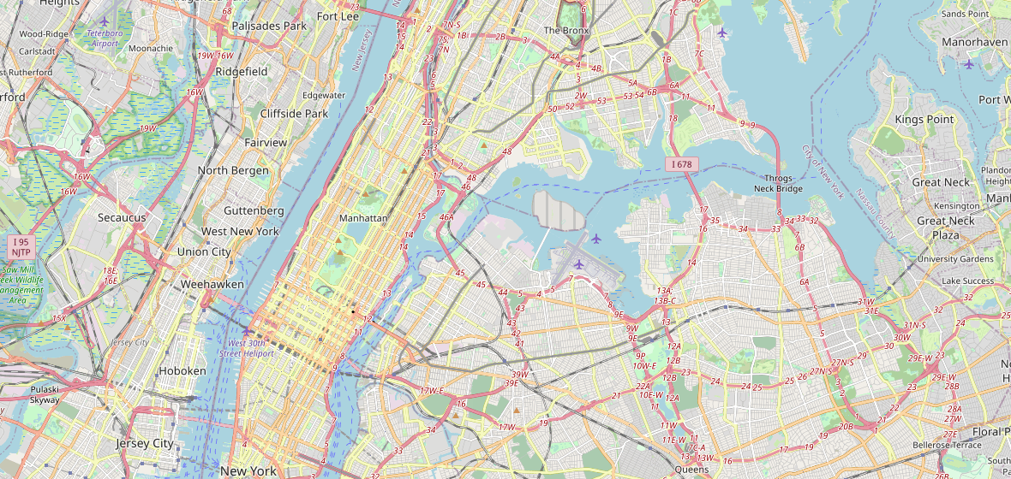
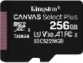
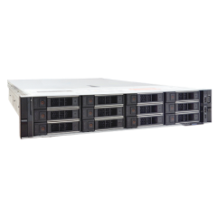
Advanced Solution Architecture
Control Station (with CMS)
Truck
Truck
CMS Workstation
Track vehicles on the Map, watch video
Truck
MicroSDHC
(Failover & Sync solution)
GPS Tracker
Mini Dome
CMS 2 Server
MicroSDHC
(Failover & Sync solution)
Wi-Fi
On-board NVR with PoE (PCI-201) + LTE / Wi-Fi / 5G
Backup Server
Connects to the on-board NVR and backs up the recorded data whenever the vehicle arrives in the Wi-Fi zone.
Mini Dome

Slide 7
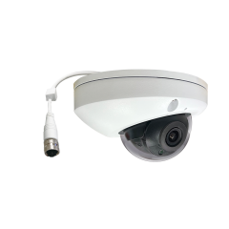
Recommended On-board Camera
Model | Z721
Photo
Product Type | Fixed Rugged Dome
Maximum Resolution | 4MP @ 30fps
HOR Viewing Angle | 101.1°
IR LED | Yes
WDR | 135 dB
Vibration Proof (Transportation grade) | Yes
Environmental Casing | IP67, IK10
Ethernet Cable Connector | M12
NDAA Compliant | Yes

