Slide 1
Auto Snapshot Archiver
New Product Introduction
Backup snapshots from the NVR server automatically

Slide 2
Introduction
Auto Snapshot Archiver (ASA) is a light service application that periodically collects snapshots from the selected NVR channels and backs them up in the FTP server. It requires a product license per channel, using the part number LASA1000.
Application
The periodically stored snapshots can be used for quick inspection and assessment of the situation captured by the surveillance cameras. It does not require any special browsing client software – the stored snapshots are in a simple .jpg format. Any photo viewer can open them.
The user can decide based on those simple snapshots, whether to go to the NVR client and inspect the full video or not.
Example: factory production line.

Slide 3
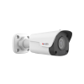
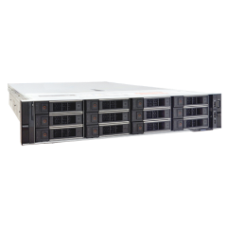
Service flow:
ASA connects to the NVR server
It requests snapshots from the NVR channels periodically, e.g. every 30 seconds.
It stores the retrieved snapshots in the FTP server
The user can access the snapshots later using the FTP client
NVR Client
FTP Server
FTP Client (photo viewer)
Video
Snapshots

Slide 4
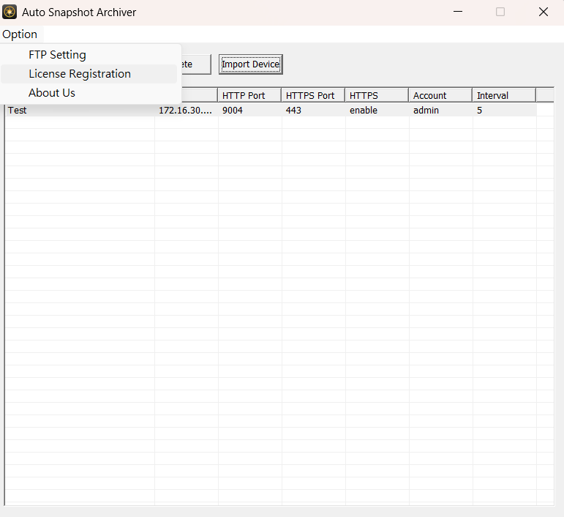
License registration
Use LASA1000 to activate as many channels as you need.

Slide 5
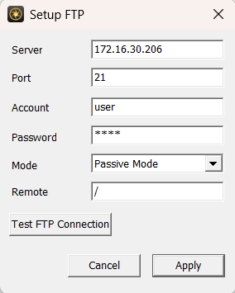
FTP Setup
Configure link to FTP server

Slide 6
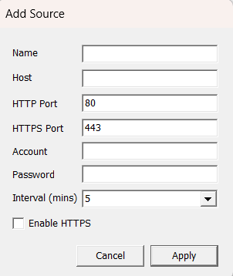
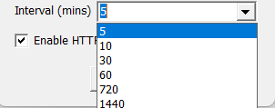
Channel Setup
Configure the link to the NVR channels and define the interval of snapshots for each channel.

Slide 7
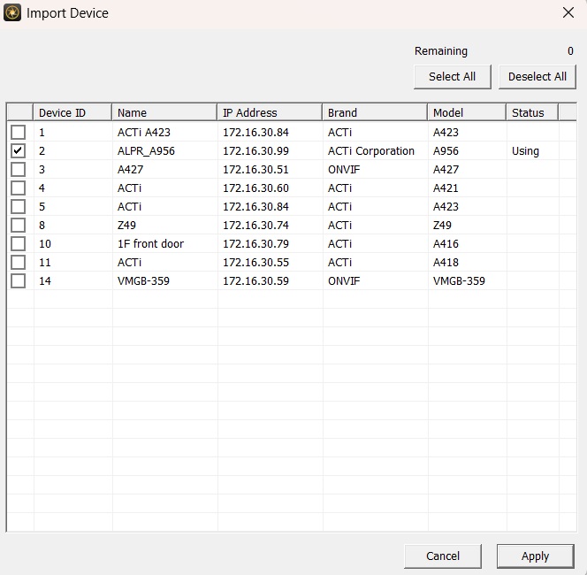
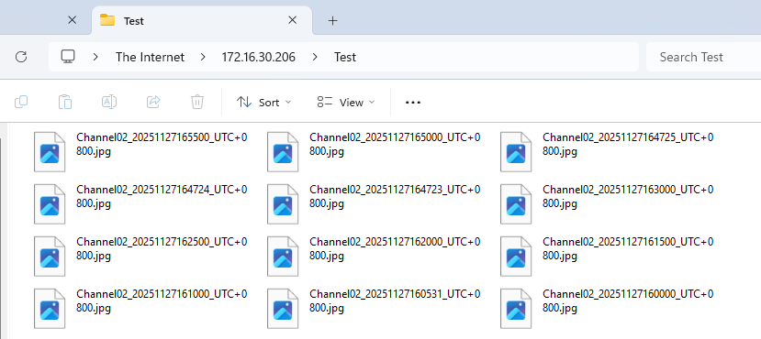
Snapshot Backup Process
Configure the link to the NVR channels and define the interval of snapshots for each channel. You can select as many channels as you have licenses.
Easily access the snapshots later by connecting to the FTP server.

