Slide 1
MNR-402P, MNR-403P
Product Introduction

Slide 2
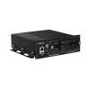
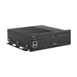
Product Overview
MNR-402P
4-Channel 2-Bay Linux-based Transportation Standalone NVR with 4-port M12 PoE Connectors
MNR-403P
8-Channel 1-Bay Linux-based Transportation Standalone NVR with 8-port M12 PoE Connectors

Slide 3

Product Matrix
Maximum Recording Channels | Bundled Licenses | Built-in PoE Connectors | Transportation Standalone NVR
 |  |  | 1 Bay | 2 Bays
4 | 4 | 4 |  | MNR-402P (Linux)
N/A | N/A | 4 | PCI-101 (Windows) | PCI-201 (Windows)
8 | 8 | 8 | MNR-403P (Linux)
Linux-based models contain pre-installed NVR.
Windows-based models do not contain pre-installed NVR. NVR 3 can be installed there by the customer.

Slide 4
Spec Comparison:
Model | MNR-402P (new) | MNR-403P (new)
Photo
Maximum Channels | 4 | 8
Storage Bays | 2 | 1
PoE Ports | 4 x M12 | 4 x M12
Maximum disk sizes | 2TB x 2 | 2TB x 1
Disk Type | 2.5” | 2.5”
Server Operating System | Linux | Linux
4G | Yes | Yes
Wi-Fi | Via PWLM-0207 Wi-Fi module (IEEE 802.11 a/b/g/n/ac) | Via PWLM-0207 Wi-Fi module (IEEE 802.11 a/b/g/n/ac)
NDAA | Yes | Yes

Slide 5
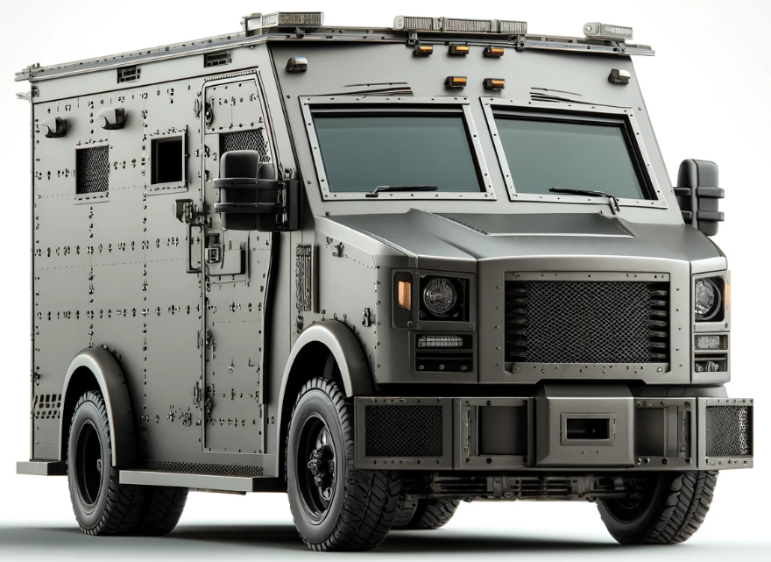

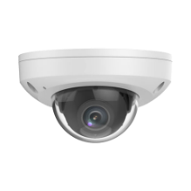
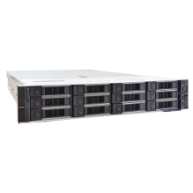
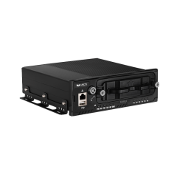
Solution Architecture
Control Station (with CMS)
Truck
Truck
CMS Workstation
Watch video from all the vehicles
Truck
Wi-Fi/4G
Mini Dome
CMS 2 Server
On-board NVR with PoE (MNR or PCI) + Wi-Fi / 4G
Mini Dome

Slide 6
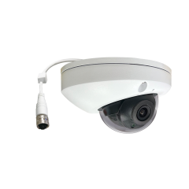
Recommended On-board Camera
Model | Z721
Photo
Product Type | Fixed Rugged Dome
Maximum Resolution | 4MP @ 30fps
HOR Viewing Angle | 101.1°
IR LED | Yes
WDR | 135 dB
Vibration Proof (Transportation grade) | Yes
Environmental Casing | IP67, IK10
Ethernet Cable Connector | M12
NDAA Compliant | Yes

