Slide 1
Z331, Z331-P1, Z511
New Product Introduction
Bullets and Turrets with WHITE LED!

Slide 2
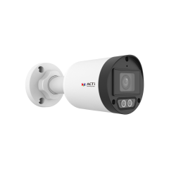
ACTi is introducing the newest products:
Z331
4MP Outdoor Fixed Bullet with D/N, Adaptive IR, White LED (50 meters), Superior WDR 120dB, ELLS, Fixed lens, f2.8mm/F1.6 (HOV: 93.2°), H.265/H.264, 2D+3D DNR, Built-in Microphone, PoE/DC12V, IP67
Z331-P1
4MP Outdoor Fixed Bullet with D/N, Adaptive IR, White LED (50 meters), Superior WDR 120dB, ELLS, Fixed lens, f4mm/F1.6 (HOV: 77.4°), H.265/H.264, 2D+3D DNR, Built-in Microphone, PoE/DC12V, IP67

Slide 3
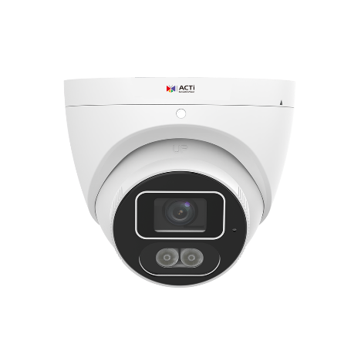
Z511
4MP Outdoor Turret with D/N, Adaptive IR, White LED (50 meters), Superior WDR 120dB, ELLS, Fixed lens, f2.8mm/F1.6 (HOV: 93.2°), H.265/H.264, 2D+3D DNR, Built-in Microphone, MicroSD, PoE/DC12V, IP67

Slide 4
Product Matrix:
Z331 and Z331-P1 are the migration models of Z317
and Z322.
Z511 is the migration model of Z79 and Z722. The new turret form factors are now clearly distinguishable by the model's name Z5x.

Slide 5
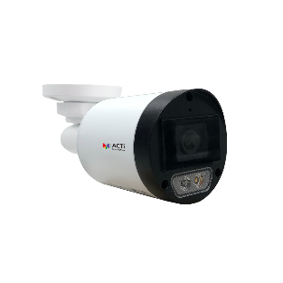
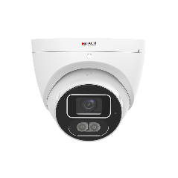
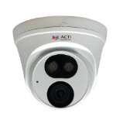
Spec Comparison:
Model | Z322 | Z331/Z331-P1 | Z722 | Z511
Photo
Product type | Fixed Bullet | Fixed Bullet | Fixed Turret | Fixed Turret
Resolution | 4MP | 4MP | 4MP | 4MP
Lens | f2.8mm | f2.8mm/f4mm | f2.8mm | f2.8mm
HOR | 97° | 93.2°/77.4° | 97° | 93.2°
LED | IR & WHITE LED | IR & WHITE LED | IR & WHITE LED | IR & WHITE LED
ColorGuard | Yes | Yes | Yes | Yes
Audio | Built-in Mic | Built-in Mic | Built-in Mic | Built-in Mic
Temperature | -40°C ~ 60°C | -40°C ~ 60°C | -40°C ~ 60°C | -40°C ~ 60°C
Environment | IP67 | IP67 | IP67 | IP67
Analytics | Yes | Yes | Yes | Yes
Material | Metal/Plastic | Graphene/Plastic | Metal/Plastic | Graphene/Plastic
UL Listed |  | Yes |  | Yes

Slide 6
Analytics Comparison:
Analytics | Z322, Z722 | Z331, Z331-P1, Z511
Smart Motion Detection | Y | Y
People Detection | Y | Y
Vehicle Detection | Y | Y
Tampering Detection | Y | Y

Slide 7
Supported VMS and Solutions
 | Standard Features | AI Events/Meta | Solutions
NVR 3 Corporate | Yes | Yes | S110, S111, S112
NVR 3 Business | Yes | Yes | S110, S111, S112
CMS 2 | Yes | Yes | S120, S121, S122
ZNR-Series NVR | Yes | Yes | S60
ENR-Series NVR | Yes |  | S72

Slide 8
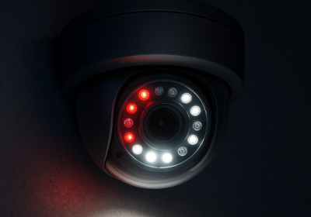
Technology: Smart Dual Light
What is Dual Light?
When the cameras contain both IR LED and White LED as built-in illuminators then these are called dual light cameras. IR LED illuminates the light in the wavelength that is invisible for a human eye but the camera can see it and produce a monochrome image, usually in the grayscale.
The White LED inside the camera illuminates the light in the wavelength of the visible spectrum. It allows the camera to capture and produce the full color image even in the total darkness.
What is Smart Dual Light?
The Smart Dual Light is the intelligent feature of the camera that controls both IR and White LED automatically depending on the actual scene. The built-in AI analyzes the objects and decides when the object is significant so that it is necessary to capture it in full colors as an evidence. In such case the camera will switch from the IR LED mode to the White LED mode during the presence of that object and it switches back to the IR LED mode once the object is gone. Those significant objects may be people or vehicles, for example.
https://www.acti.com/technologies/smart-dual-light

Slide 9
Technology: ColorGuard
What is ColorGuard?
ColorGuard is a set of multiple technologies, combined together to form a fully automatic protection shield using colored images.
The first component of the ColorGuard is the ColorVizion. ColorVizion is the advanced technology that makes the nighttime image appear in true colors. It combines a large sensor, good lens and the superb image processing capabilities.
The second component of the ColorGuard is the additional illumination capabilities using built-in White LED of the cameras - by illuminating the visible spectrum light instead of IR light, the true colors can be preserved.
The third component of ColorGuard is the Artificial Intelligence. The AI will use these perfect color images to accurately analyze each frame of the video to make the correct decisions based on object's true colors.
Additionally, the ColorGuard cameras have the best WDR (120-150dB). Both dark and bright areas of the scene will be processed perfectly so that the true colors are preserved.
https://www.acti.com/technologies/colorguard

