Slide 1
A214
New Product Introduction

Slide 2
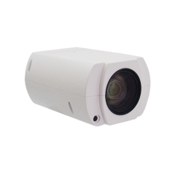
ACTi is introducing the newest product:
A214
5MP Deep Learning AI 40x Zoom Box with f4.3-170mm, WDR 150dB, 60fps, Two-way Audio, Face Recognition, ALPR, NDAA

Slide 3
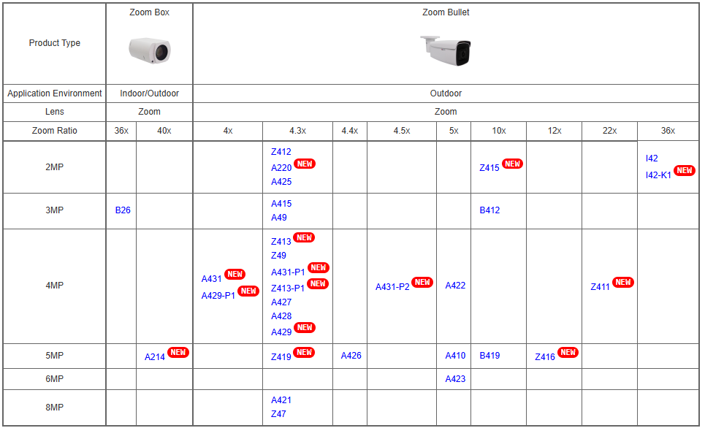
Product Matrix:

Slide 4
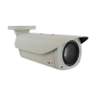
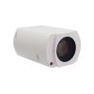
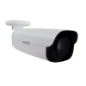
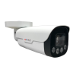
Spec Comparison:
Model | I42 | Z411 | Z416 | A214
Photo
Product type | Zoom Bullet | Zoom Bullet | Zoom Bullet | Zoom Box
Resolution | 2MP | 4MP | 5MP | 5MP
Zoom | 36x | 22x | 12x | 40x
IR LED | Yes | Yes | Yes | No (use external IR with housing)
Fps | 60fps @ 2MP | 30fps @ 4MP | 30fps @ 5MP | 60fps @ 5MP
WDR | Extreme 145dB | Extreme 150dB | Extreme 145dB | Extreme 150dB
Low Light | Extreme | Extreme | Superior | Extreme
Audio | Yes, 2-way | Yes, 2-way | Yes, 2-way | Yes, 2-way
Built-in AI | Basic | Basic | Deep Learning AI | Deep Learning AI

Slide 5
Built-in AI Comparison:
 | I42 | Z411 | Z416 | A214
Face Recognition | - | - | Y | Y
ALPR | - | - | Y | Y
Face Detection | Y | - | Y | Y
Vehicle Detection | - | - | Y | Y
Object Detection | Y | Y | Y | Y
People Counting | - | - | Y | -
Crowd Detection | - | - | Y | -

Slide 6





ACTi AI Solution Architecture
MOBILE CLIENT
E-mail
alerts
alerts
video
video
Realtime
analytics data
Realtime
analytics data, alerts
AI CAMERA
NVR SERVER
(ACTi NVR 3 Corporate)
NVR CLIENT

Slide 7
Supported VMS and Solutions
 | Standard Features | AI Events/Meta | Solutions
NVR 3 Corporate | Yes | Yes | S110, S111, S112
NVR 3 Business | Yes | Yes | S110, S111, S112
CMS 2 | Yes | Yes | S120, S121, S122
ZNR-Series NVR | Yes | Yes | S60
ENR-Series NVR | Yes | Yes | S72

Slide 8
ACTi Advantages compared to Server-Based AI Providers
Hundreds of channels with deep learning analytics can be managed by a single VMS server, using just a common server hardware configuration. The Server-based AI solutions have limited number of channels and require very expensive hardware.
VMS video recording functionality is much better secured when the VMS does not have the burden of running the analytics that may consume the server resource to its limits.
Faster response to the events – AI cameras can control the other nearby PTZ cameras for instant response, to get better video coverage of the scene. The analyses that are processed on the VMS side will be too slow for proper response.
Since the AI features are inside the camera, there are no Analytics related licenses required on the server side. Therefore, the cost of VMS in some cases is up to 10 times lower than the server-side AI solutions.

Slide 9
NVR and CMS Features
ACTi NVR 3 Corporate (and CMS 2) manages the analytics events from the cameras as follows:
Set up the analytic rules and thresholds – for example, how big is the crowd, how long time is considered loitering.
Receive real-time analytic events from all the cameras and respond by the pre-defined actions, such as send e-mail, instant pop-up of the video channel on the VMS screen and more.
Automatically push video to the mobile app of the patrolling security guards.
Search by the specific filter rules, bookmarks, thumbnails.

Slide 10
Security Applications
The Far Zoom AI camera can fulfill the following security applications:
Blacklisted vehicles identification
(using ALPR, 60fps)
Blacklisted persons identification
(using Face Recognition)
Trespassing Detection
(using Far Zoom and Resolution)
The following mission-critical markets can benefit from that:
Utility
Border Control
Airport
Government
Military Base

Slide 11
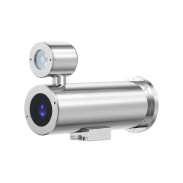
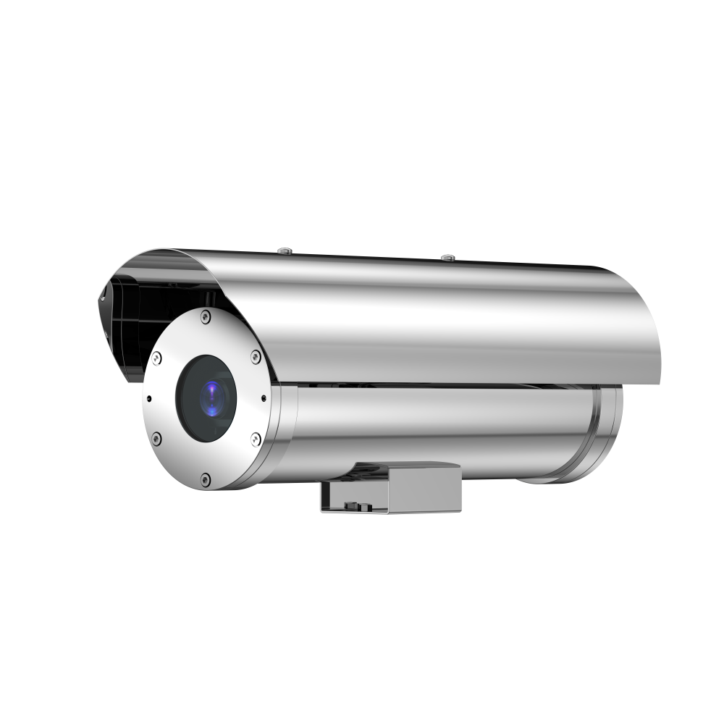
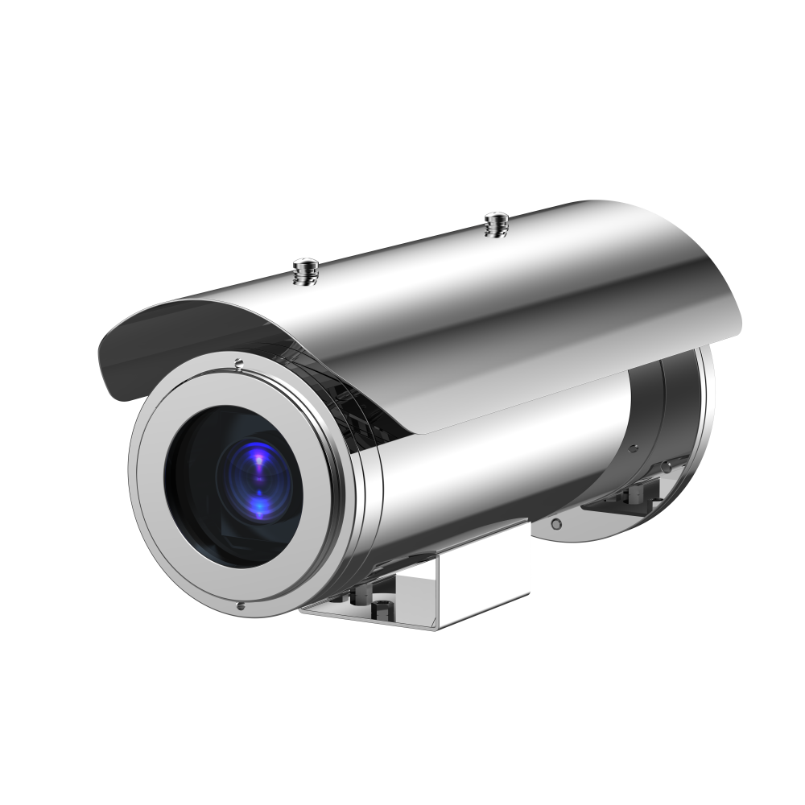
Housing Options of A214
PMAX-0233
PoE Explosion Proof Housing with 100m IR LED, Heater and Fan
PMAX-0234
PoE Stainless Steel Housing with 100m IR LED, Heater and Fan
PMAX-0235
PoE Explosion Proof Housing with Heater and Fan
PMAX-0236
POE Stainless Steel Housing with Heater and Fan

Slide 12
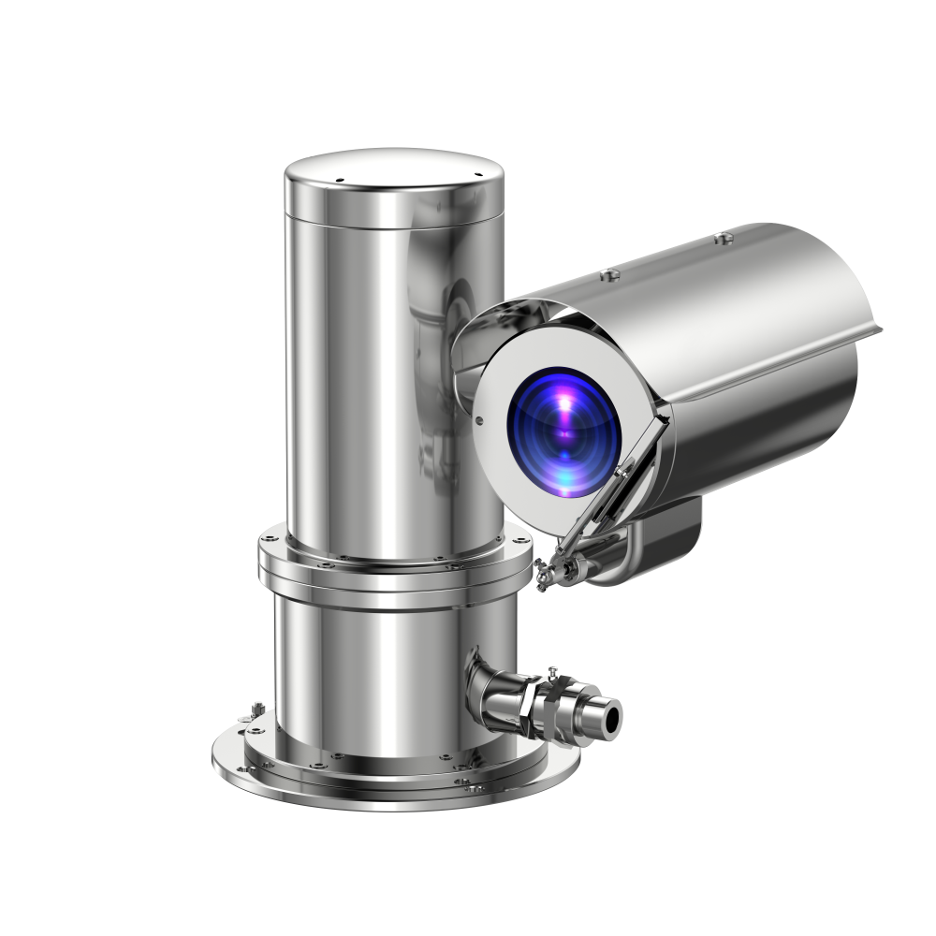
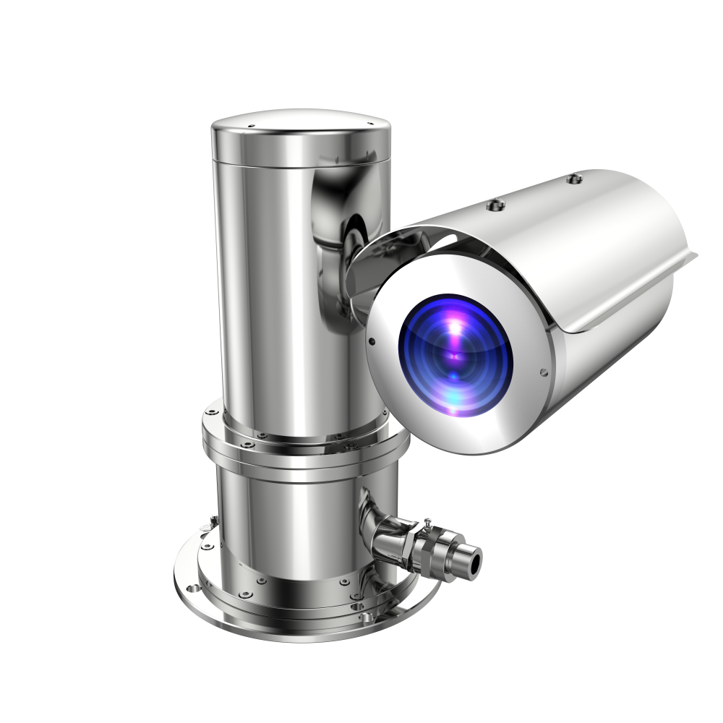
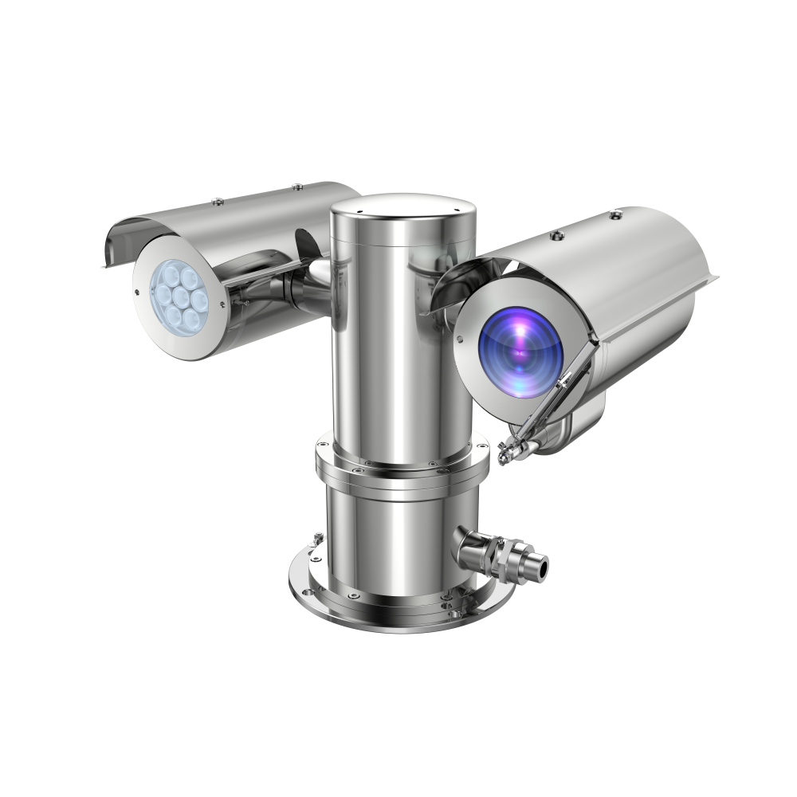
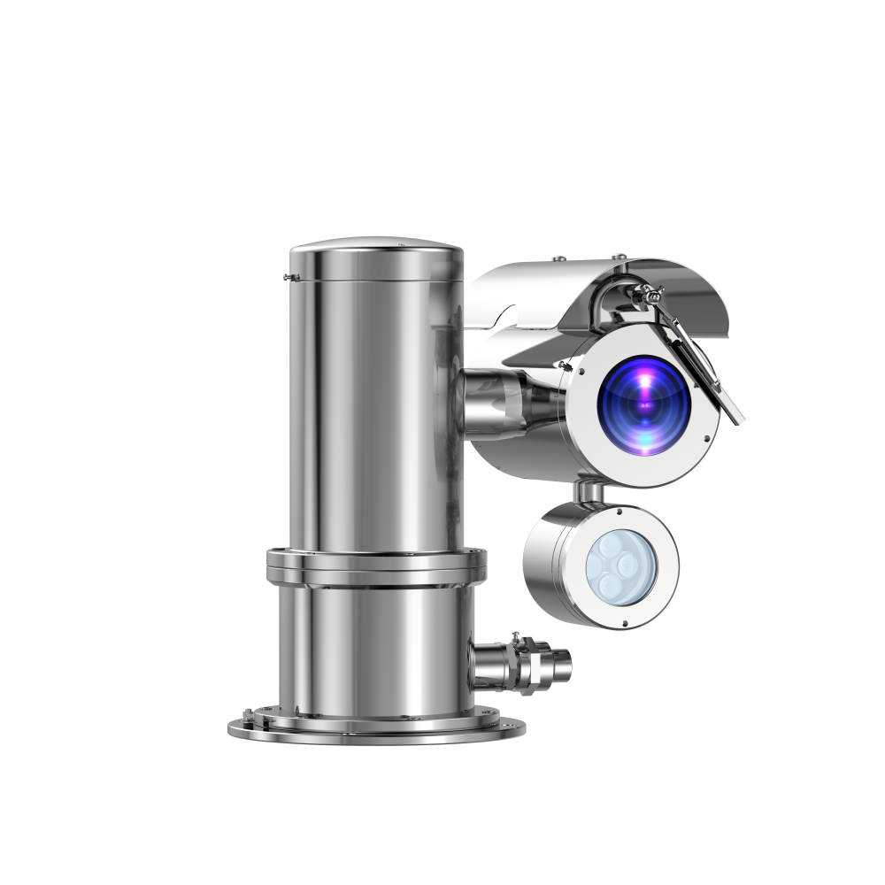
Housing Options of A214
PMAX-0239
POE Explosion Proof PTZ Housing, with Fan, Heater and wiper
PMAX-0240
Stainless Steel Proof PTZ Housing, with Fan and Heater
PMAX-0241
Explosion Proof PTZ Housing, with Fan, Heater, IR and wiper
PMAX-0242
Stainless Steel Proof PTZ Housing, with Fan, Heater, IR and wiper

Slide 13
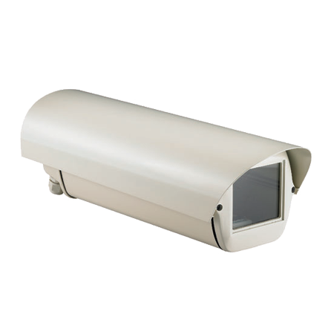
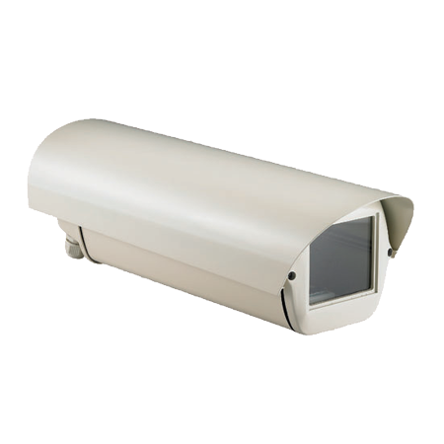
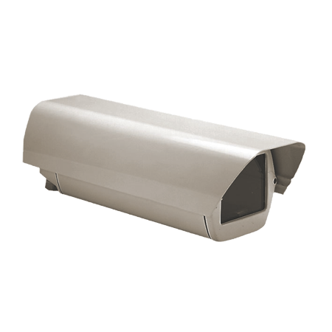
Housing Options of A214
PMAX-0200
Outdoor Housing with Heater and Fan
PMAX-0201
Outdoor Housing with Heater and Fan
PMAX-0202
Outdoor Housing

Slide 14
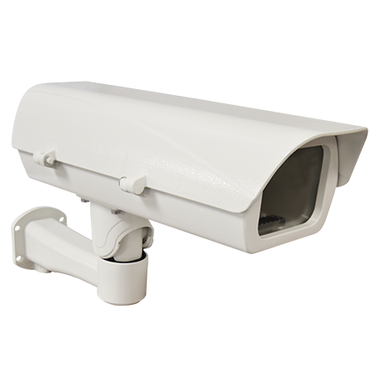
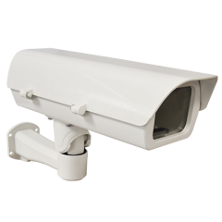
Housing Options of A214
PMAX-0203
Heavy Duty Outdoor Housing with Heater and Fan and Bracket
PMAX-0204
Heavy Duty Outdoor Housing with Heater and Fan and Bracket
PMAX-0206
PoE Heavy Duty Outdoor Housing with Heater, Fan, Defogger and Bracket

