Slide 1
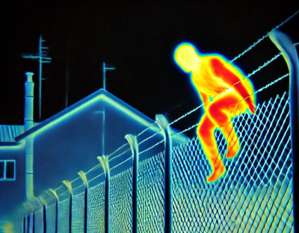
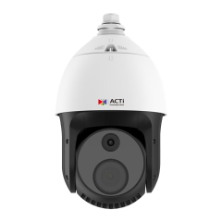
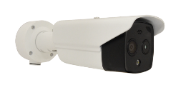

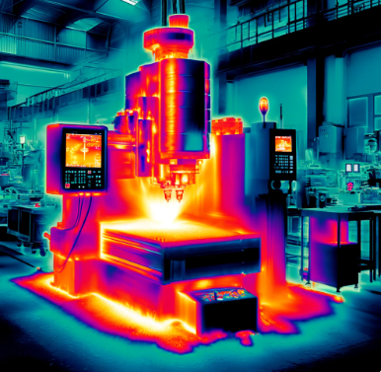
ACTi Thermal Cameras
New Product Introduction

Slide 2
Overview
ACTi thermal cameras combine advanced dual-sensor technology, integrating thermal imaging and visible light sensors to deliver a comprehensive monitoring solution.
The thermal sensor excels in detecting fires, abnormal human body temperatures, and equipment overheating, while the visible light sensor captures high-resolution images up to 5MP, providing clear details to verify incidents and respond swiftly to alerts.
Available in versatile form factors, including thermal bullets, thermal turrets and thermal PTZ, these cameras meet diverse installation needs.
The thermal sensors operate within an 8-14μm spectral range, achieving exceptional sensitivity with NETD <25mK and spatial resolution between 1.24 and 5.71 mrad. With a detection range extending up to 2 kilometers, they are ideal for precise, wide-area monitoring in various environments.

Slide 3
Features
Long-Range Security : Effective up to 2100m for large-area surveillance
Versatile Temperature Monitoring : Suitable for various equipment sizes and cabinets, ensuring precise thermal measurement
Flexible Camera Types : Choose from Bullet, Turret, PTZ, and specialized bi-spectrum models to fit unique installation needs.
High Sensitivity : NETD down to 35mk for accurate detection, even in challenging conditions
High Resolution : Crisp imaging up to 640x512, delivering clear and reliable visuals
Built-in AI Analytics : Real-time detection for people, vehicles, line crossing, and intrusion to enhance security operations

Slide 4
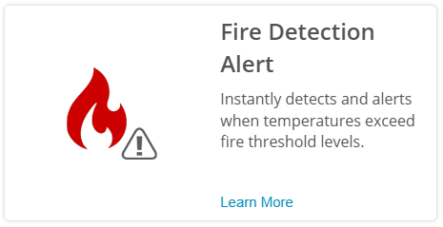
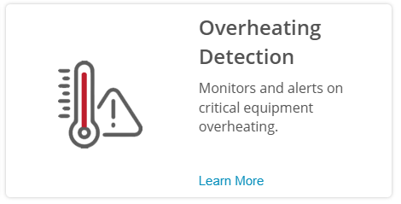
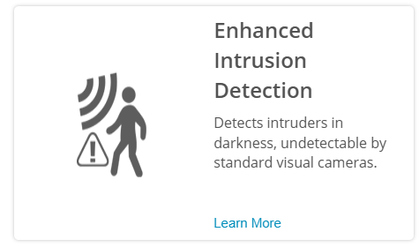
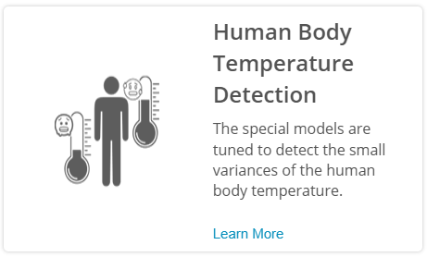
Thermal Applications

Slide 5
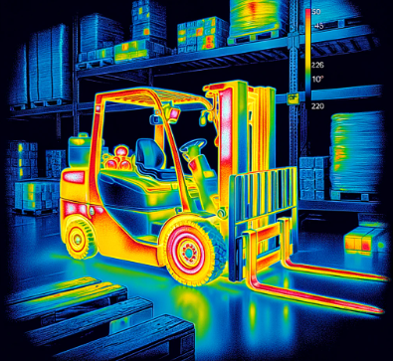
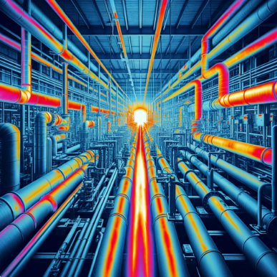
Examples of Overheating Related Applications
Overheated vehicle components
Overheated manufacturing equipment, such as CNC
Overheated infrastructure, such as pipes, tanks, electric cables
Overheating can be observed visually using the thermal image, or automatically, using pre-defined temperature thresholds and automated warnings. Early warning of the overheating can protect valuable assets in the factory and the warehouse.

Slide 6



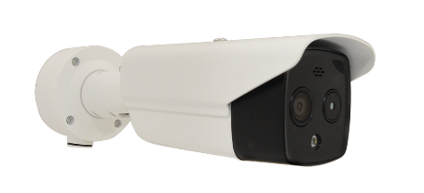

ACTi Thermal Surveillance Solution Architecture #1
Solution with NVR
MOBILE CLIENT
Push notification alerts
E-mail
alerts
Dual video
video
Thermal alerts metadata
Thermal alerts metadata
THERMAL CAMERA
NVR SERVER
(ACTi NVR 3 Corporate)
NVR CLIENT

Slide 7


ACTi Thermal Surveillance Solution Architecture #2
Solution without NVR
Video
Mobile Client
Events
Events
Dual video
Dual snapshots
Snapshots
E-mail
THERMAL CAMERA
Thermal events
Video
Camera’s Web Interface Access

Slide 8
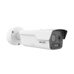
ACTi is introducing the newest thermal cameras:
K371
4MP Outdoor Thermal Fixed Bullet with IR LED 50m, thermal f10mm, visual f6.0mm, WDR 120dB, two-way audio, built-in analytics, temperature range up to 550°C
K371-P1
4MP Outdoor Thermal Fixed Bullet with IR LED 100m, thermal f25mm, visual f12mm, WDR 120dB, two-way audio, built-in analytics, temperature range up to 550°C
K371-P2
4MP Outdoor Thermal Fixed Bullet with IR LED 100m, thermal f35mm, visual f12mm, WDR 120dB, two-way audio, built-in analytics, temperature range up to 550°C

Slide 9
K372
4MP Outdoor Thermal Fixed Bullet with IR LED 50m, thermal f10mm, visual f4.0mm, WDR 120dB, two-way audio, built-in analytics, temperature range up to 550°C
K372-P1
4MP Outdoor Thermal Fixed Bullet with IR LED 100m, thermal f25mm, visual f8.0mm, WDR 120dB, two-way audio, built-in analytics, temperature range up to 550°C
K372-P2
4MP Outdoor Thermal Fixed Bullet with IR LED 100m, thermal f35mm, visual f12mm, WDR 120dB, two-way audio, built-in analytics, temperature range up to 550°C

Slide 10
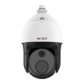
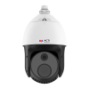
Thermal PTZ
Model | A972 | A973
Photo
Type | Thermal PTZ | Thermal PTZ
Applications | Overheating Detection, Fire Detection, Thermal Surveillance | Overheating Detection, Fire Detection, Thermal Surveillance
Maximum Resolution | 4MP | 4MP
Image Sensor | Thermal | Thermal
Thermal Resolution | Thermal: 256(H) X 192(V) | Thermal: 256(H) X 192(V)
Thermal Sensitivity | NETD <35mK | NETD <35mK
Lens | Optical: 32x Optical Zoom, f4.8-153mm Thermal: Fixed, f10mm | Optical: 32x Optical Zoom, f4.8-153mm Thermal: Fixed, f10mm
Horizontal Viewing Angle | Optical: 58.8° - 2.18°, Thermal: 18.1° | Optical: 58.8° - 2.18°, Thermal: 18.1°
Maximum fps vs Resolution | 30@4MP | 30@4MP
Analytics | Temperature Detection Fire Detection | Temperature Detection Fire Detection
Temperature Measurement | Yes | Yes
Temperature Detection Range | -20°C ~ 150°C (-4°F ~ 302°F) | -20°C ~ 550°C (-4°F ~ 1022°F)
Temperature Accuracy | ±8°C, ±8% | ±2°C, ±2%
Analytics Detection Range | People: 417m Vehicle: 833m | People: 417m Vehicle: 833m
Fire Detection Range | 150m | 150m
Audio | 2-way, Mic-in, Line-in/out | 2-way, Mic-in, Line-in/out

Slide 11
Thermal Bullets
Model | K371 (new) | K371-P1 (new) | K371-P2 (new)
Photo
Type | Thermal Bullet | Thermal Bullet | Thermal Bullet
Applications | Overheating Detection, Fire Detection, Thermal Surveillance | Overheating Detection, Fire Detection, Thermal Surveillance | Overheating Detection, Fire Detection, Thermal Surveillance
Maximum Resolution | 4MP | 4MP | 4MP
Image Sensor | Thermal | Thermal | Thermal
Resolution | Thermal: 400(H) X 300(V) | Thermal: 400(H) X 300(V) | Thermal: 400(H) X 300(V)
Thermal Sensitivity | NETD <30mK | NETD <30mK | NETD <30mK
Lens (thermal/visual) | f10mm / f6.0mm | f25mm / f12mm | f35mm / f12mm
Horizontal Viewing Angle | 26.5° / 52.1° | 10.5° / 25.25° | 7.6° / 25.25°
Analytics | Smart Intrusion Protection (, People Line Crossing Detection, People Intrusion Detection, People Enter Area Detection, People Exit Area Detection, Vehicle Line Crossing Detection, Vehicle Intrusion Detection, Vehicle Enter Area Detection, Vehicle Exit Area Detection), Tampering Detection, Temperature Detection, Fire Detection
Temperature Range | -20°C ~ 550°C (-4°F ~ 1022°F) | -20°C ~ 550°C (-4°F ~ 1022°F) | -20°C ~ 550°C (-4°F ~ 1022°F)
Temperature Accuracy | ±8°C, ±8% | ±8°C | ±8°C
Audio | 2-way, Built-in Microphone, Built-in Speaker, Line-in, Line-out | 2-way, Built-in Microphone, Built-in Speaker, Line-in, Line-out | 2-way, Built-in Microphone, Built-in Speaker, Line-in, Line-out

Slide 12
Thermal Bullets
Model | K372 (new) | K372-P1 (new) | K372-P2 (new)
Photo
Type | Thermal Bullet | Thermal Bullet | Thermal Bullet
Applications | Overheating Detection, Fire Detection, Thermal Surveillance | Overheating Detection, Fire Detection, Thermal Surveillance | Overheating Detection, Fire Detection, Thermal Surveillance
Maximum Resolution | 4MP | 4MP | 4MP
Image Sensor | Thermal | Thermal | Thermal
Resolution | Thermal: 640(H) X 512(V) | Thermal: 640(H) X 512(V) | Thermal: 640(H) X 512(V)
Thermal Sensitivity | NETD <30mK | NETD <30mK | NETD <30mK
Lens (thermal/visual) | f10mm / f4.0mm | f25mm / f8.0mm | f35mm / f12mm
Horizontal Viewing Angle | 48° / 77.4° | 17.4° / 38.3° | 12.2° / 24.5°
Analytics | Smart Intrusion Protection (, People Line Crossing Detection, People Intrusion Detection, People Enter Area Detection, People Exit Area Detection, Vehicle Line Crossing Detection, Vehicle Intrusion Detection, Vehicle Enter Area Detection, Vehicle Exit Area Detection), Tampering Detection, Temperature Detection, Fire Detection
Temperature Range | -20°C ~ 550°C (-4°F ~ 1022°F) | -20°C ~ 550°C (-4°F ~ 1022°F) | -20°C ~ 550°C (-4°F ~ 1022°F)
Temperature Accuracy | ±8°C, ±8% | ±8°C | ±8°C
Audio | 2-way, Built-in Microphone, Built-in Speaker, Line-in, Line-out | 2-way, Built-in Microphone, Built-in Speaker, Line-in, Line-out | 2-way, Built-in Microphone, Built-in Speaker, Line-in, Line-out

Slide 13

Thermal Bullets
Model | A370 | A370-P1 | A370-P2
Photo
Type | Thermal Bullet | Thermal Bullet | Thermal Bullet
Applications | Overheating Detection, Fire Detection | Overheating Detection, Fire Detection | Overheating Detection, Fire Detection
Maximum Resolution | 1MP | 1MP | 1MP
Image Sensor | Thermal | Thermal | Thermal
Resolution | Thermal: 640(H) X 512(V) | Thermal: 640(H) X 512(V) | Thermal: 640(H) X 512(V)
Thermal Sensitivity | NETD <35mK | NETD <35mK | NETD <35mK
Lens | Fixed focal, f75mm | Fixed focal, f50mm | Fixed focal, f100mm
Horizontal Viewing Angle | 8.3° | 12.4° | 6.22°
Maximum fps vs Resolution | 25@1MP | 25@1MP | 25@1MP
Analytics | Temperature Detection Fire Detection | Temperature Detection Fire Detection | Temperature Detection Fire Detection
Temperature Measurement | Yes | Yes | Yes
Temperature Range | -20°C ~ 150°C (-4°F ~ 302°F) | -20°C ~ 150°C (-4°F ~ 302°F) | -20°C ~ 150°C (-4°F ~ 302°F)
Temperature Accuracy | ±8°C, ±8% | ±8°C | ±8°C
Temperature Detection Range | 45m | 45m | 45m
Analytics Detection Range | People: 551m Vehicle: 1544m | People: 368m Vehicle: 1029m | People: 735m Vehicle: 2059m
Fire Detection Range | 150m | 150m | 150m
Audio | 2-way, Mic-in, Line-in/out | 2-way, Mic-in, Line-in/out | 2-way, Mic-in, Line-in/out

Slide 14


Thermal Bullets
Model | A371 | A371-P1 | A371-P2 | A372 | A372-P1
Photo
Type | Thermal Bullet | Thermal Bullet | Thermal Bullet | Thermal Bullet | Thermal Bullet
Applications | Overheating & Fire Detection, Thermal Surveillance | Overheating & Fire Detection, Thermal Surveillance | Overheating & Fire Detection, Thermal Surveillance | Thermal Surveillance | Thermal Surveillance
Max Resolution | 4MP | 4MP | 4MP | 4MP | 4MP
Image Sensor | Visual + Thermal | Visual + Thermal | Visual + Thermal | Visual + Thermal | Visual + Thermal
Thermal Resolution | 256(H) X 192(V) | 256(H) X 192(V) | 256(H) X 192(V) | 256(H) X 192(V) | 256(H) X 192(V)
Thermal Sensitivity | NETD <40mK | NETD <40mK | NETD <40mK | NETD <55mK | NETD <55mK
Lens (Therm/Visual) | f3.6mm / f4.3mm | f6.9mm / f6.4mm | f9.7mm / f8.0mm | f1.35mm / f4.3mm | f3.6mm / f4.3mm
HOR | Therm: 50°,Vis:84° | Therm:24.9°,Vis:53° | Therm:18°,Vis:39.4° | Therm:50°,Vis:94° | Therm:25°, Vis:56°
IR LED / White LED | 30m / 30m | 30m / 30m | 30m / 30m | - / 30m | - / 30m T
Thermal Analytics | Temp, Smoke, Fire | Temp, Smoke, Fire | Temp, Smoke, Fire | - | -
Temp.Measurement | Yes | Yes | Yes | - | -
Temperature Range | -20°C ~ 150°C | -20°C ~ 150°C | -20°C ~ 150°C | - | -
Temp Accuracy | ±8°C | ±8°C | ±8°C | - | -
Temp Detect Range | 58.3m | 116.7m | 61.7m
Analytics Detection Range | People: 28.8m, Vehicle: 75.6m | People: 55.2m Vehicle: 144.9m | People: 77.6m Vehicle: 203.7m | People: 11m Vehicle: 33m | People: 21m Vehicle: 63m
Fire Detect. Range | 43.2m | 82.8m | 116.4m | - | -
Audio | Mic-in, Line-in/out | Mic-in, Line-in/out | Mic-in, Line-in/out | - | -

Slide 15
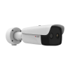
Thermal Bullets
Model | A375 | A375-P1 | A375-P2
Photo
Type | Thermal Bullet | Thermal Bullet | Thermal Bullet
Applications | Overheating & Fire Detection, Thermal Surveillance | Overheating & Fire Detection, Thermal Surveillance | Overheating & Fire Detection, Thermal Surveillance
Max Resolution | 4MP | 4MP | 4MP
Image Sensor | Visual + Thermal | Visual + Thermal | Visual + Thermal
Thermal Resolution | 348(H) X 288(V) | 348(H) X 288(V) | 348(H) X 288(V)
Thermal Sensitivity | NETD <35mK | NETD <35mK | NETD <35mK
Lens (Therm/Visual) | f6.5mm / f4.0mm | f9.7mm / f4.0mm | f15mm / f6.0mm
HOR | Therm: 60°,Vis:84.4° | Therm:37.5°,Vis:84° | Therm:24.5°,Vis:51.7°
IR LED / White LED | 30m / - | 30m / - | 30m / -
Thermal Analytics | Temp, Smoke, Fire | Temp, Smoke, Fire | Temp, Smoke, Fire
Temp.Measurement | Yes | Yes | Yes
Temperature Range | -20°C ~ 550°C | -20°C ~ 550°C | -20°C ~ 550°C
Temp Accuracy | ±2°C | ±2°C | ±2°C
Audio | Mic-in, Line-in/out | Mic-in, Line-in/out | Mic-in, Line-in/out
Approvals | CE, FCC, IP67, IK10 (metal casing), NEMA 4X (NEMA 250-2018 Type 4X) | CE, FCC, IP67, IK10 (metal casing), NEMA 4X (NEMA 250-2018 Type 4X) | CE, FCC, IP67, IK10 (metal casing), NEMA 4X (NEMA 250-2018 Type 4X)

Slide 16
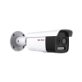
Thermal Bullets
Model | A376 | A376-P1 | A376-P2
Photo
Type | Thermal Bullet | Thermal Bullet | Thermal Bullet
Applications | Overheating & Fire Detection, Thermal Surveillance | Overheating & Fire Detection, Thermal Surveillance | Overheating & Fire Detection, Thermal Surveillance
Max Resolution | 4MP | 4MP | 4MP
Image Sensor | Visual + Thermal | Visual + Thermal | Visual + Thermal
Thermal Resolution | 160(H) X 120(V) | 160(H) X 120(V) | 160(H) X 120(V)
Thermal Sensitivity | NETD <35mK | NETD <35mK | NETD <35mK
Lens (Therm/Visual) | f3.6mm / f4.3mm | f6.9mm / f8.0mm | f9.7mm / f12.4mm
HOR | Therm: 50°,Vis:84° | Therm:24.9°,Vis:39.4° | Therm:18°,Vis:24.6°
IR LED / White LED | 30m / 30m | 30m / 30m | 80m / 80m
Thermal Analytics | Temp, Smoke, Fire | Temp, Smoke, Fire | Temp, Smoke, Fire
Temp.Measurement | Yes | Yes | Yes
Temperature Range | -20°C ~ 300°C | -20°C ~ 300°C | -20°C ~ 300°C
Temp Accuracy | ±8°C | ±8°C | ±8°C
Audio | Mic-in, Line-in/out | Mic-in, Line-in/out | Mic-in, Line-in/out

Slide 17
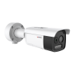
Thermal Bullets
Model | A377 | A377-P1 | A377-P2
Photo
Type | Thermal Bullet | Thermal Bullet | Thermal Bullet
Applications | Overheating & Fire Detection, Thermal Surveillance | Overheating & Fire Detection, Thermal Surveillance | Overheating & Fire Detection, Thermal Surveillance
Max Resolution | 5MP | 5MP | 5MP
Image Sensor | Visual + Thermal | Visual + Thermal | Visual + Thermal
Thermal Resolution | 256(H) X 192(V) | 256(H) X 192(V) | 256(H) X 192(V)
Thermal Sensitivity | NETD <25mK | NETD <25mK | NETD <25mK
Lens (Therm/Visual) | f3.6mm / f4.3mm | f6.9mm / f8.0mm | f9.7mm / f12.4mm
HOR | Therm: 50°,Vis:84° | Therm:24.9°,Vis:39.4° | Therm:18°,Vis:24.6°
IR LED / White LED | 30m / 30m | 60m / 60m | 80m / 80m
Thermal Analytics | Temp, Smoke, Fire | Temp, Smoke, Fire | Temp, Smoke, Fire
Temp.Measurement | Yes | Yes | Yes
Temperature Range | -20°C ~ 150°C | -20°C ~ 150°C | -20°C ~ 150°C
Temp Accuracy | ±8°C | ±8°C | ±8°C
Audio | Mic-in, Line-in/out | Mic-in, Line-in/out | Mic-in, Line-in/out

Slide 18

Thermal Bullets
Model | VMGB-359 | VMGB-359-P1 | VMGB-371
Photo
Type | Thermal Bullet | Thermal Bullet | Thermal Bullet
Applications | Overheating & Fire Detection, Thermal Surveillance | Overheating & Fire Detection, Thermal Surveillance | Human Body Temperature Detection (fever alert)
Resolution | 4MP | 4MP | 4MP
Lens | (Thermal camera) Fixed focal, f6.2mm (Visual camera) Fixed focal, f8.0mm | (Thermal camera) Fixed focal, f3.1mm (Visual camera) Fixed focal, f4.0mm | (Thermal camera) Fixed focal, f3.1mm (Visual camera) Fixed focal, f4.0mm
Horizontal Viewing Angle | (Thermal camera) 25.0° (Visual camera) 39.42° | (Thermal camera) 50° (Visual camera) 84° | (Thermal camera) 50° (Visual camera) 84°
WDR | Superior WDR (120 dB) | Superior WDR (120 dB) | Superior WDR (120 dB)
Analytics | Yes | Yes | Yes
Audio | 2-way, Mic-in, Stereo Line-in, Line-out | 2-way, Mic-in, Stereo Line-in, Line-out | 2-way, Mic-in, Stereo Line-in, Line-out

Slide 19

Thermal Turrets
Model | A570 | A570-P1 | A570-P2
Photo
Type | Thermal Turret | Thermal Turret | Thermal Turret
Applications | Overheating Detection, Fire Detection | Overheating Detection, Fire Detection | Overheating Detection, Fire Detection
Resolution | 4MP | 4MP | 4MP
Image Sensor | Visual + Thermal | Visual + Thermal | Visual + Thermal
Thermal Resolution | 256(H) X 192(V) | 256(H) X 192(V) | 256(H) X 192(V)
Thermal Sensitivity | NETD <40mK | NETD <40mK | NETD <40mK
Lens (thermal/visual) | Fixed focal, f2.1mm / Fixed focal, f2.2mm | Fixed focal, f3.6mm / Fixed focal, f4.3mm | Fixed focal, f6.9mm / Fixed focal, f6.4mm
Horizontal Viewing Angle | Thermal: 90°, Visual: 117.8° | Thermal: 50°, Visual: 84° | Thermal: 24.9°, Visual: 53°
IR LED | Yes, 15m | Yes, 15m | Yes, 15m
White LED | Yes, 30m | Yes, 30m | Yes, 30m
Analytics | Temperature, Smoke and Fire Detection | Temperature, Smoke and Fire Detection | Temperature, Smoke and Fire Detection
Temperature Measurement | Yes | Yes | Yes
Temperature Range | -20°C ~ 150°C (-4°F ~ 302°F) | -20°C ~ 150°C (-4°F ~ 302°F) | -20°C ~ 150°C (-4°F ~ 302°F)
Temperature Accuracy | ±8°C (14.4°F) | ±8°C (14.4°F) | ±8°C (14.4°F)
Temperature Detection Range | 35m | 58.3m | 116.7m
Analytics Detection Range | People: 30m | People: 28m | People: 55.2m
 | Vehicle: 85m | Vehicle: 75.6m | Vehicle: 144.9m
Fire Detection Range | 21.6m | 43.2m | 82.8m
Audio | 2-way, Mic-in, Line-in/out | 2-way, Mic-in, Line-in/out | 2-way, Mic-in, Line-in/out

Slide 20
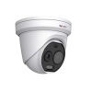
Thermal Turrets
Model | A571 | A571-P1 | A571-P2
Photo
Type | Thermal Turret | Thermal Turret | Thermal Turret
Applications | Overheating Detection, Fire Detection | Overheating Detection, Fire Detection | Overheating Detection, Fire Detection
Resolution | 4MP | 4MP | 4MP
Image Sensor | Visual + Thermal | Visual + Thermal | Visual + Thermal
Thermal Resolution | 160(H) X 120(V) | 160(H) X 120(V) | 160(H) X 120(V)
Thermal Sensitivity | NETD <35mK | NETD <35mK | NETD <35mK
Lens (thermal/visual) | Fixed focal, f1.8mm / Fixed focal, f2.0mm | Fixed focal, f3.6mm / Fixed focal, f4.3mm | Fixed focal, f6.9mm / Fixed focal, f8.0mm
Horizontal Viewing Angle | Thermal: 90°, Visual: 119.3° | Thermal: 50°, Visual: 84° | Thermal: 24.9°, Visual: 39.4°
IR LED | Yes, TBCm | Yes, TBCm | Yes, TBCm
White LED | Yes, 30m | Yes, 30m | Yes, TBCm
Analytics | Temperature, Smoke and Fire Detection | Temperature, Smoke and Fire Detection | Temperature, Smoke and Fire Detection
Temperature Measurement | Yes | Yes | Yes
Temperature Range | TBC | TBC | TBC
Temperature Accuracy | ±8°C (14.4°F) | ±8°C (14.4°F) | ±8°C (14.4°F)
Audio | 2-way, Mic-in, Line-in/out | 2-way, Mic-in, Line-in/out | 2-way, Mic-in, Line-in/out

Slide 21
Thermal Technology Introduction
What is Thermal Surveillance?
Thermal surveillance cameras play a critical role in security by enabling night vision, zero-light operation, and penetration through smoke, fog, and adverse weather conditions. Unlike optical imaging, which relies on visible light, thermal imaging detects infrared radiation emitted by objects. Understanding the parameters of thermal imaging is essential for accurate performance evaluation, procurement decisions, and regulatory compliance.
Key Technical Parameters and Their Definitions
NETD (Noise Equivalent Temperature Difference)
Definition: The smallest temperature difference a thermal camera can detect between two adjacent points, measured in millikelvins (mK). Lower NETD values represent higher sensitivity. For example, a camera with NETD 40 mK can distinguish a target at 36.04°C from a background at 36.00°C.
Spatial Resolution
Definition: The ability of the camera to resolve fine details of an object, determined by sensor pixel pitch and optics. Expressed in milliradians (mrad) or Instantaneous Field of View (IFOV). A smaller IFOV means sharper details at longer distances.

Slide 22
Thermal Technology Introduction
Thermal Sensitivity vs. Resolution
Sensitivity (NETD) measures the ability to detect small temperature differences, while resolution measures the ability to distinguish small physical details. Both factors are critical in evaluating camera performance.
Wavelength Range
Definition: Thermal cameras generally operate in LWIR (8–14 μm) or MWIR (3–5 μm). LWIR is best for passive human detection, while MWIR is more suitable for high-temperature industrial applications.
Thermal Camera Events
The thermal cameras can be configured to detect specific kind of exceptional situations, such as fire, smoke, overheating and others. When the situation occurs, the thermal camera will send an alert to the NVR along with the thermal values.
Bi-Spectrum Surveillance
Some of the thermal cameras come with two lenses - one is used for thermal imaging and another is for the standard visual imaging with full color range. The benefit of the bi-spectrum cameras is the accuracy of the events (thermal) combined with the accurate color proof (visual).
https://www.acti.com/technologies/thermal-surveillance

Slide 23
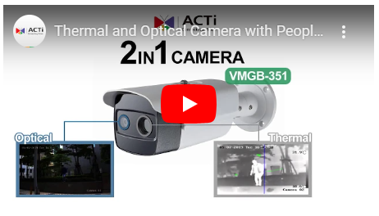
Video Clips
Thermal camera 2-in-1 benefits demo:
http://www.acti.com/video/v2058

