Slide 1
Q981, Q982, Q982-P1, Q982-P2
New Product Introduction
Dual Lens Thermal and Visual AI PTZ Positioning Systems for Mission Critical Surveillance

Slide 2
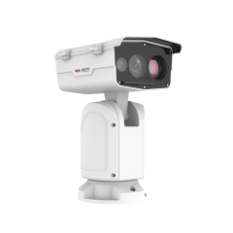
ACTi is introducing the newest products:
Q981
4MP Deep Learning AI ColorGuard 56x Outdoor Thermal PTZ Positioning System with WDR 120dB

Slide 3
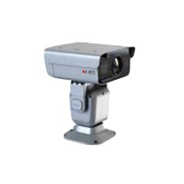
Q982
4MP Deep Learning AI 56x Outdoor Thermal PTZ Positioning System with IR LED 2000m, WDR 120dB
Q982-P1
4MP Deep Learning AI 60x Outdoor Thermal PTZ Positioning System with IR LED 2000m, WDR 120dB
Q982-P2
4MP Deep Learning AI 60x Outdoor Thermal PTZ Positioning System with IR LED 2000m, WDR 120dB

Slide 4
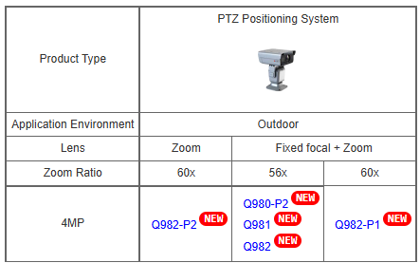
Product Matrix:

Slide 5

Spec Comparison:
Model | Q981 | Q982 | Q982-P1 | Q982-P2
Photo
Product type | PTZ Positioning System | PTZ Positioning System | PTZ Positioning System | PTZ Positioning System
Resolution | 4MP | 4MP | 4MP | 4MP
Thermal Resolution | 2MP | 2MP | 2MP | 2MP
Thermal Effective Pixels | 640x512 | 640x512 | 640x512 | 640x512
In/Outdoor | Outdoor | Outdoor | Outdoor | Outdoor
Zoom | Visual: 56x Thermal: fixed | Visual: 56x Thermal: fixed | Visual: 60x Thermal: fixed | Visual: 60x Thermal: 10x
Visual lens | f6.0-336mm | f6.0-336mm | f6.0-360mm | f6.0-360mm
Thermal lens | f75mm | f50mm | f100mm | f13-130mm
Illuminator | Laser, 800m | IR LED, 2000m | IR LED, 2000m | IR LED, 2000m
PTZ | Remote pan, tilt, rotation | Remote pan, tilt, rotation | Remote pan, tilt, rotation | Remote pan, tilt, rotation
Built-in Deep Learning AI | Yes | Yes | Yes | Yes
NDAA | Yes | No | No | No

Slide 6
Analytics Comparison:
Analytics | Q981 | Q982 | Q982-P1 | Q982-P2
Smart Intrusion Protection | Y | Y | Y | Y
Smart Motion Detection | N | N | N | N
People Intrusion Detection | Y | Y | Y | Y
Vehicle Intrusion Detection | Y | Y | Y | Y
Smoke Detection | Y | Y | Y | Y
Fire Detection | Y | Y | Y | Y
PTZ Auto Tracking | Y | Y | Y | Y

Slide 7
Supported VMS and Solutions
 | Standard Features | AI Events/Meta | Solutions
NVR 3 Corporate | Yes | Yes | S110, S111, S112
NVR 3 Business | Yes | Yes | S110, S111, S112
CMS 2 | Yes | Yes | S120, S121, S122
ZNR-Series NVR | Yes |  | S60
ENR-Series NVR | Yes |  | S72

Slide 8
Applications
High Security Mission Critical Surveillance of the Large Areas and Long Distances:
Border Control
Coast Guard
Utility
Military
Airport

