Slide 1
Z325, Z56
New Product Introduction
4K (8MP) Fixed Bullet and Turret with AI and Best Colors

Slide 2
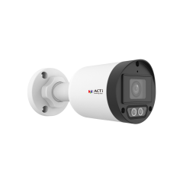
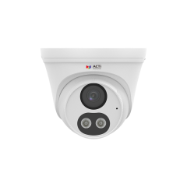
ACTi is introducing the newest products:
Z325
8MP Deep Learning AI ColorGuard f2.8mm Mini Bullet with IR LED 50m, White LED 50m, Smart Dual Light, WDR 130dB
Z56
8MP Deep Learning AI ColorGuard Outdoor Turret with IR LED 50m, White LED 50m, Smart Dual Light, WDR 130dB

Slide 3
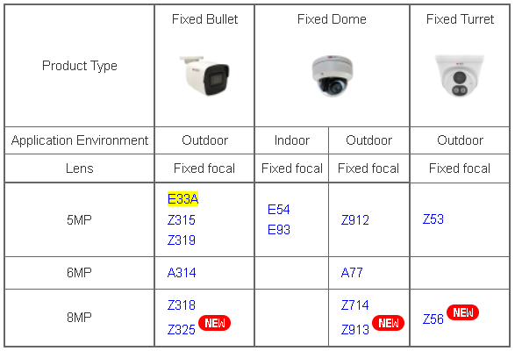
Product Matrix:
Expanding the 8MP AI product line

Slide 4
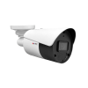
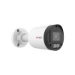
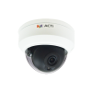
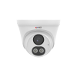
Spec Comparison:
Model | Z318 | Z325 (new) | Z714 | Z56 (new)
Photo
Product type | Fixed Bullet | Fixed Bullet | Fixed Dome | Fixed Turret
Resolution | 8MP | 8MP | 8MP | 8MP
Lens / HOR | f2.8mm / 98.7° | f2.8mm / 107° | f2.8mm / 99° | f2.8mm / 107°
LightGuard | Yes |  | Yes
ColorGuard |  | Yes |  | Yes
LED | IR LED | IR & WHITE LED | IR LED | IR & WHITE LED
Min. Illumination | 0.005 lux (color), 0 lux (IR on) | 0.005 lux (color), 0 lux (IR on) | 0.005 lux (color), 0 lux (IR on) | 0.005 lux (color), 0 lux (IR on)
Resolution/fps | 8MP/20fps 5MP/30fps | 8MP/20fps 4MP/30fps | 8MP/20fps 5MP/30fps | 8MP/20fps 4MP/30fps
Deep Learning AI | SMD and others | SMD and others | SMD and others | SMD and others

Slide 5
Supported VMS and Solutions
 | Standard Features | AI Events/Meta | Solutions
NVR 3 Corporate | Yes | Yes | S110, S111, S112
NVR 3 Business | Yes | Yes | S110, S111, S112
CMS 2 | Yes | Yes | S120, S121, S122
ZNR-Series NVR | Yes | Yes | S60
ENR-Series NVR | Yes |  | S72

Slide 6
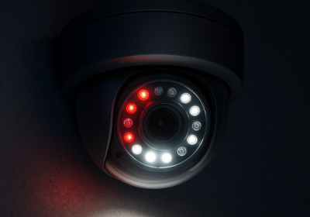
Technology: Smart Dual Light
What is Dual Light?
When the cameras contain both IR LED and White LED as built-in illuminators then these are called dual light cameras. IR LED illuminates the light in the wavelength that is invisible for a human eye but the camera can see it and produce a monochrome image, usually in the grayscale.
The White LED inside the camera illuminates the light in the wavelength of the visible spectrum. It allows the camera to capture and produce the full color image even in the total darkness.
What is Smart Dual Light?
The Smart Dual Light is the intelligent feature of the camera that controls both IR and White LED automatically depending on the actual scene. The built-in AI analyzes the objects and decides when the object is significant so that it is necessary to capture it in full colors as an evidence. In such case the camera will switch from the IR LED mode to the White LED mode during the presence of that object and it swiches back to the IR LED mode once the object is gone. Those significant objects may be people or vehicles, for example.
https://www.acti.com/technologies/smart-dual-light

Slide 7
Technology: LightGuard
What is LightGuard?
LightGuard is the low light image processing technology that combines a large sensor with fast shutter speed and large aperture lens together with AI-based image enhancement, in order to provide undisputable evidence and identity of the moving targets.
The moving objects at night are the challenge for most surveillance cameras in the world. When there is not enough light, the conventional camera would gain more light by using slower shutter speed. That however will make the moving objects appear as blurred. When the moving object is blur then it is impossible to identify it.
It is extremely important to have clearly identifiable images, so that the faces or the license plates of the vehicles can clearly be identified even when they are moving fast in the darkness.
The LightGuard technology is able to produce the clear evidence even in the darkness. The license plate of the vehicle will be clearly enhanced with the help of the sensor, lens and AI, so that it is possible to read it even when the vehicles is driving very fast at night.
The LightGuard camera prioritizes the identity of the targets rather than the overall appearance of the image.
Its newest algorithm is capable of efficiently reducing any noise or blur while increasing the sharpness of the objects. As a result, any license plate, facial details or other smaller but important objects become much more distinguishable. You can evaluate the lack of noise by checking the Signal-to-Noise ratio (S/N ratio) of the camera.
https://www.acti.com/technologies/lightguard

Slide 8
Technology: ColorGuard
What is ColorGuard?
ColorGuard is a set of multiple technologies, combined together to form a fully automatic protection shield using colored images.
The first component of the ColorGuard is the ColorVizion. ColorVizion is the advanced technology that makes the night time image appear in true colors. It combines a large sensor, good lens and the superb image processing capabilities.
The second component of the ColorGuard is the additional illumination capabilities using built-in White LED of the cameras - by illuminating the visible spectrum light instead of IR light, the true colors can be preserved.
The third component of ColorGuard is the Artificial Intelligence. The AI will use these perfect color images to accurately analyze each frame of the video to make the correct decisions based on object's true colors.
Additionally, the ColorGuard cameras have the best WDR (130-150dB). Both dark and bright areas of the scene will be processed perfectly so that the true colors are preserved.
https://www.acti.com/technologies/colorguard

