Slide 1
ZNR-431
Product Introduction
The largest channel and storage capacity Linux-based NVR

Slide 2
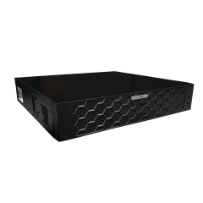
Product Overview
ZNR-431
128-Channel 8-Bay 2U Hot Swap RAID Linux-Based Rackmount Standalone NVR

Slide 3
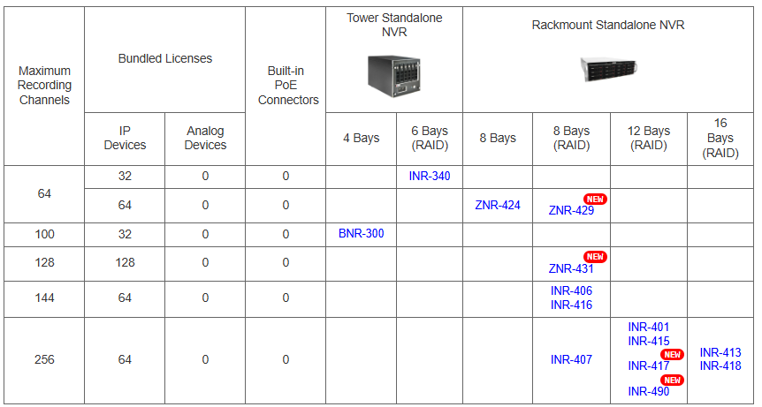
Product Matrix
Budget friendly Linux-based alternative for the high capacity and RAID required applications, compared to the Windows based INR-series NVR servers.

Slide 4
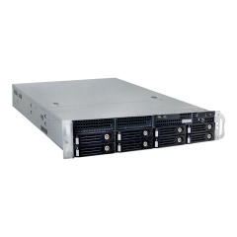
Spec Comparison:
Model | ZNR-429 | ZNR-431 (new) | INR-406/INR-416
Photo
Maximum Channels | 64 | 128 | 144
Storage Bays | 8 | 8 | 8
Hardware RAID | 0, 1, 5, 6, 10 | 0, 1, 5, 6, 10 | 0, 1, 5, 6, 10, 50, 60
Hot Swappable |  | Yes
Operating System | Linux | Linux | Windows
CPU | ARM SoC | ARM Soc | i7-7700/i7-8700
NVR Built-in Analytics | Yes
Maximum Recording Throughput | 384 Mbps | 384 Mbps | 340 Mbps
NDAA | Yes | Yes | Yes

Slide 5

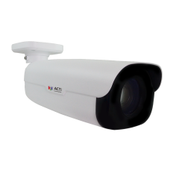



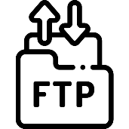
Architecture
Processing Events from Camera’s AI
Web Client
Z-Series AI Cameras (smart motion detection)
E-Mail Notification with Snapshots
ZNR-431
Other Cameras
Automatic Alarm
Auto Upload to FTP

Slide 6
AI Related Features
Camera Analytics | Receive analytics based events from the cameras and respond to the events:, Face Detection; Smart Motion Detection (People Detection, Vehicle Detection); Smart Intrusion Protection (Intrusion Detection, Line Crossing Detection, Enter Area Detection, Exit Area Detection); People Counting (People Line Counting, People Area Counting, People Flow Counting, Crowd Detection); Object Metadata; Object Recognition; Temperature Detection (Fire Detection, Smoking Detection, Smoke Detection, Temperature Measurement); Traffic Monitoring
Z-Series AI Cameras (smart motion detection)
ZNR-431
Other Cameras

Slide 7
AI Related Event Features
Event Trigger | [NVR]: IP address conflict, Network Loss, Disk full, Disk not found, Disk abnormal, Low disk space, Illegal access, Recording/Snapshot abnormal, Crowd detection with three different concurrent thresholds with priority, Smart Intrusion Protection, Smart Motion Detection
 | [Video Device]: Video motion detection, Tampering detection, Defocus detection, External device through digital input, Sound detection, Video loss, Smart Intrusion Protection, Smart Motion Detection, Face Detection, People detection, Vehicle Detection, People Line Crossing Detection, People Enter Area Detection, People Exit Area Detection, Vehicle Line Crossing Detection, Vehicle Enter Area Detection, Vehicle Exit Area Detection, Temperature Detection, Fire Detection, Smoke Detection, Temperature Measurement, Missing Object Detection, Unattended Object Detection, PTZ Auto Tracking, People Counting, Crowd detection, Automatic License Plate Recognition, Traffic Monitoring
Event Response | Command a PTZ device to go to a preset point, Play alert sound, Activate external device through digital output, Send command over HTTPS, Save snapshot, Upload video or snapshot to FTP server, E-mail notification with snapshots

Slide 8
Popular AI Applications
Smart Intrusion Protection - detect people, vehicles entering/ exiting area or crossing the line).
Useful for the perimeter surveillance to prevent trespassing while avoiding false alarms. Very accurate!
Smart Motion Detection - detect when the people, vehicles or other objects move in the predefined area.
Used to strictly focus on moving objects and ignore the still objects. For example, the security personnel will be notified when the vehicle in the parking lot is being moved.

Slide 9
Popular AI Applications
Object Metadata - Gender, age, glasses, mask, vehicle type, vehicle color, vehicle brand, vehicle direction, license plate type, license plate color, license plate number.
This allows quick investigations of the incidents or find suspects very fast using the combination of various attributes together, such as the vehicle color and vehicle brand together with the vehicle’s direction of driving.

