Slide 1
ZNR-425
Product Introduction
The AI-Powered Migration model of ZNR-423

Slide 2
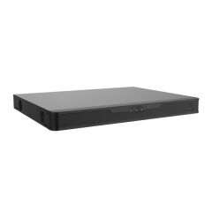
Product Overview
ZNR-425
AI
32-Channel 4-Bay Deep Learning AI Linux-Based Rackmount Standalone NVR

Slide 3
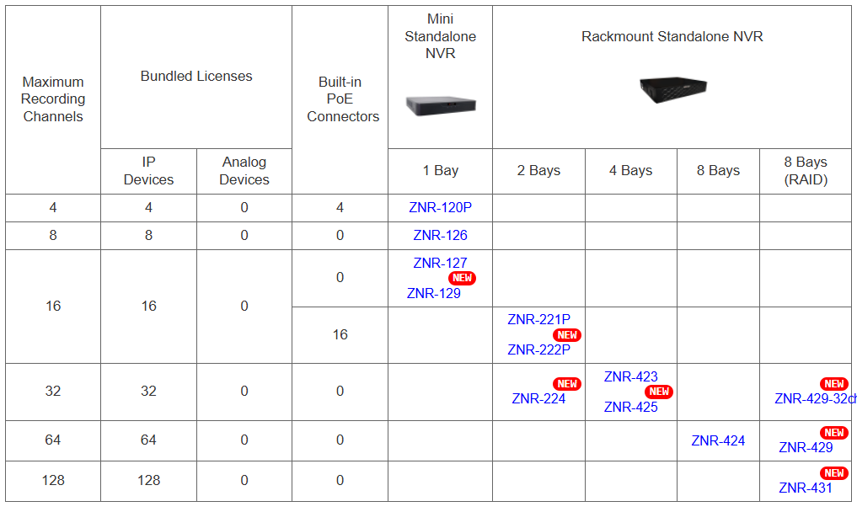
Product Matrix

Slide 4
Spec Comparison:
Model | ZNR-423 | ZNR-425
Photo
Maximum Channels | 32 | 32
Storage Bays | 4 | 4
Analytics | Deep Learning AI | Extended Deep Learning AI
AI Event Search & Smart Search | No | Yes
Forensic Search | No | Yes
Object Visual Tracking | No | Yes
Recording Throughput | 160 Mbps | 160 Mbps
Outgoing Throughput | 64 Mbps | 128 Mbps
Maximum Hard Drive Size | 22TB per disk | 24TB per disk
NDAA | Yes | Yes

Slide 5

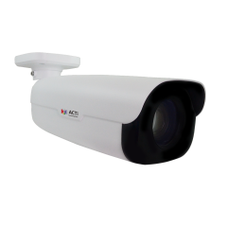

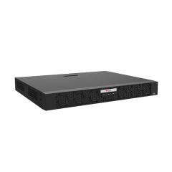


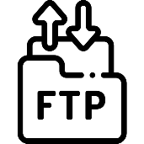
Architecture
Processing Events by Built-in AI or Camera AI
Web Client
Z-Series AI Cameras (smart motion detection)
E-Mail Notification with Snapshots
ZNR-425
Other Cameras
Automatic Alarm
Auto Upload to FTP

Slide 6
AI Related Features
NVR Analytics | Smart Intrusion Protection (detect people, vehicles entering/ exiting area or crossing the line)
 | Smart Motion Detection (detect when the people, vehicles or other objects move in the predefined area)
 | Face Recognition, Face Detection, Face Comparing
NVR Analytics Maximum Channels | Smart Intrusion Protection up to 2 channels
 | Smart Motion Detection up to 4 channels
Deep Learning AI | 2.0
Object Recognition Database | Face Picture Capacity: 50,000
 | Vehicle Picture Capacity: 25,000
Maximum Snapshot Capacity | Captured Face Snapshots: 500
 | Captured Vehicle Snapshots: 500
 | Captured Object Snapshots via Smart Intrusion Prevention: 500

Slide 7
AI Related Features
Camera Analytics | Receive analytics-based events from the cameras and respond to the events: Face Detection; Smart Motion Detection (People Detection, Vehicle Detection); Smart Intrusion Protection (Intrusion Detection, Line Crossing Detection, Enter Area Detection, Exit Area Detection); People Counting (People Line Counting, People Area Counting, People Flow Counting, Crowd DetectionTraffic Monitoring
Z-Series AI Cameras (smart motion detection)
ZNR-425
Other Cameras

Slide 8
AI Related Search and Playback Features
Excellent search capabilities are the core of the AI solutions. The productivity comes from the convenient search options.
Event Search | Search within previously recorded AI events
Smart Search | Set ROI and look for the people and vehicles appearing in the ROI in the past recordings (requires cameras with Smart Motion Detection feature)
Forensic Search | Select target object (people, vehicle) and search for the similar object through all the channels
Metadata Search | Select attribute filters (color, gender, age, etc) and find thumbnails matching the criteria
Object Visual Tracking | View thumbnails generated by Forensic Search and playback by time sequence

Slide 9
AI Related Event Features
Event Trigger | [NVR]: IP address conflict, Network Loss, Disk full, Disk not found, Disk abnormal, Low disk space, Disk full, Illegal access, Recording/Snapshot abnormal, Crowd detection with three different concurrent thresholds with priority, Smart Intrusion Protection, Smart Motion Detection, Face Recognition
 | [Video Device]: Video motion detection, Tampering detection, Defocus detection, External device through digital input, Sound detection, Video loss, Smart Intrusion Protection, Smart Motion Detection, Face Recognition, Face Detection, People detection, Vehicle Detection; People Line Crossing Detection, People Enter Area Detection, People Exit Area Detection, Vehicle Detection, Vehicle Line Crossing Detection, Vehicle Enter Area Detection, Vehicle Exit Area Detection, Temperature Detection, Fire Detection, Smoke Detection, Temperature Measurement, Missing Object Detection, Unattended Object Detection, PTZ Auto Tracking, People Counting, Crowd detection, Automatic License Plate Recognition, Traffic Monitoring
Event Response | Command a PTZ device to go to a preset point, Play alert sound, Activate external device through digital output, Send command over HTTPS, Save snapshot, Upload video or snapshot to FTP server, E-mail notification with snapshots

Slide 10
Popular AI Applications
Smart Intrusion Protection - detect people, vehicles entering/ exiting area or crossing the line).
Useful for the perimeter surveillance to prevent trespassing while avoiding false alarms. Very accurate!
Smart Motion Detection - detect when the people, vehicles or other objects move in the predefined area.
Used to strictly focus on moving objects and ignore the still objects. For example, the security personnel will be notified when the vehicle in the parking lot is being moved.

Slide 11
Popular AI Applications
Face Recognition – identify the people by their face.
Can be used as whitelist (for example employees) or blacklist (unwanted or dangerous people)
Object Metadata - Gender, age, glasses, mask, vehicle type, vehicle color, vehicle brand, vehicle direction, license plate type, license plate color, license plate number.
This allows quick investigations of the incidents or find suspects very fast using the combination of various attributes together, such as the vehicle color and vehicle brand together with the vehicle’s direction of driving.

