Slide 1
Q711
New Product Introduction
2-Sensor Dome – two dome cameras in one body.

Slide 2
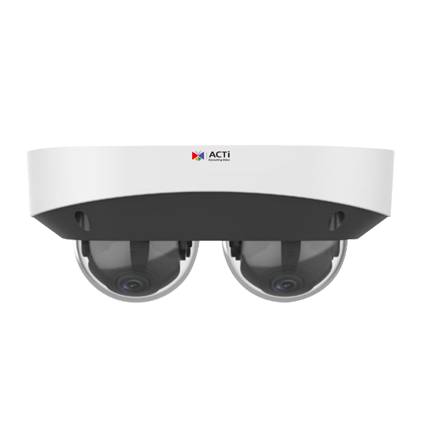
ACTi is introducing the newest product:
Q711
8MP (2x4MP) LightGuard f2.8mm x2 Outdoor 2-Sensor Dome with IR LED 50m, WDR 120dB

Slide 3
LightGuard Technology
What is LightGuard?
LightGuard is the low light image processing technology that combines a large sensor with fast shutter speed and large aperture lens together with AI-based image enhancement, in order to provide undisputable evidence and identity of the moving targets. The moving objects at night are the challenge for most surveillance cameras in the world.
When there is not enough light, the conventional camera would gain more light by using slower shutter speed. That however will make the moving objects appear as blurred. When the moving object is blur then it is impossible to identify it.
It is extremely important to have clearly identifiable images, so that the faces or the license plates of the vehicles can clearly be identified even when they are moving fast in the darkness. The LightGuard technology is able to produce the clear evidence even in the darkness. The license plate of the vehicle will be clearly enhanced with the help of the sensor, lens and AI, so that it is possible to read it even when the vehicles is driving very fast at night.

Slide 4
LightGuard Technology
The LightGuard camera prioritizes the identity of the targets rather than the overall appearance of the image.
Its newest algorithm is capable of efficiently reducing any noise or blur while increasing the sharpness of the objects. As a result, any license plate, facial details or other smaller but important objects become much more distinguishable.
You can evaluate the lack of noise by checking the Signal-to-Noise ration (S/N ratio) of the camera. ACTi offers a wide range of Lightguard cameras, including fixed and zoom bullets, fixed domes and turrets, PTZ and multi-imagers.
Applications
The most typical application is the monitoring of the night-time traffic. Every moving vehicle can clearly be identified. Especially, the license plate of each vehicle will be clearly readable even in the darkness.
The LightGuard cameras can be used in the wide range of night-time monitoring applications, including city surveillance, parking lots, retail stores, schools and others.
Read More

Slide 5
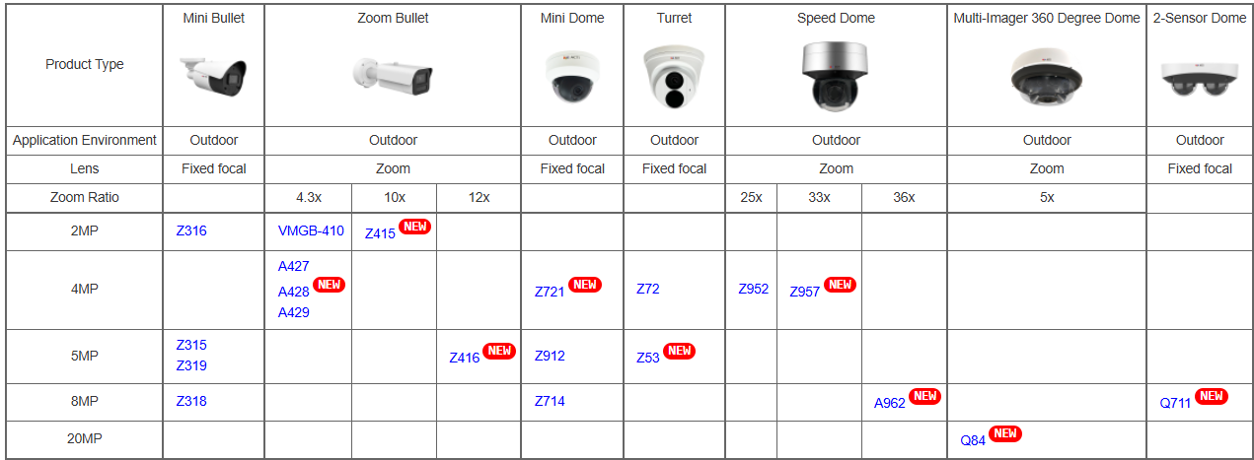
LightGuard Product Offering
In addition to dual dome Q711, ACTi also offers a wide range of LightGuard models:

Slide 6
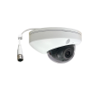
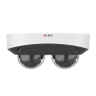
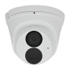
Spec Comparison:
Model | Z721 | Z72 | Q711 (new)
Photo
Product type | Fixed Dome | Fixed Turret | Dual Dome
In/Outdoor | Outdoor | Outdoor | Outdoor
Resolution | 4MP | 4MP | 8MP (2x4MP)
LightGuard | Yes | Yes | Yes
S/N Ratio | 75 dB | 75 dB | 75 dB
Lens | f2.8mm | f2.8mm | f2.8mm x 2
Horizontal Viewing Angle | 101.1° | 101.1° | 97.68°
NDAA | Yes | Yes | Yes

Slide 7
Supported VMS and Solutions
 | Standard Features | AI Events/Meta | Solutions
NVR 3 Corporate | Yes | Yes | S110, S111, S112
NVR 3 Business | Yes | Yes | S110, S111, S112
CMS 2 | Yes | Yes | S120, S121, S122
ZNR-Series NVR | Yes | Yes | S60
ENR-Series NVR | Yes |  | S72

Slide 8
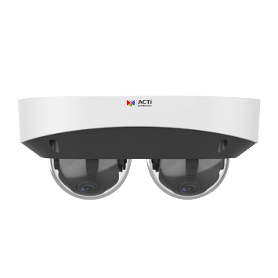
Applications
Dual Domes are used usually in one of the two ways:
Lenses are turned towards the opposite direction.
Typical application: Corridor Surveillance
Lenses are turned so that they fully cover one side.
Typical application: Perimeter Surveillance

