Slide 1
A955
New Product Introduction

Slide 2
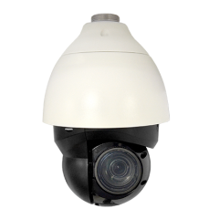
ACTi is introducing the newest high range zoom product:
A955
5MP Deep Learning AI 40x Outdoor PTZ with IR LED 250m, WDR 150dB
40x

Slide 3
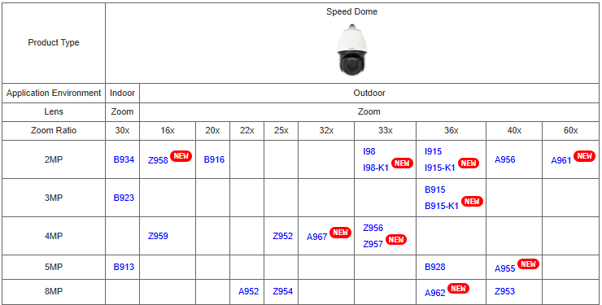
Product Matrix:
A955 is the migration model of B928.

Slide 4
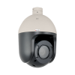

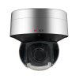
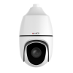
Spec Comparison:
Model | B928 | A955 (new) | A962 | Z953
Photo
Product type | PTZ | PTZ | PTZ | PTZ
Resolution | 5MP | 5MP | 8MP | 8MP
Zoom | 36x | 40x | 36x | 40x
IR LED | Yes | Yes | Yes | Yes
WDR | 120dB | 150dB | 140dB | 145dB
Low Light | Superior | Extreme | Extreme | Superior
Analytics | Standard | Deep Learning AI | Deep Learning AI | Deep Learning AI
NDAA | No | Yes | No | Yes
Taiwan IoT Cyber Security | No | Yes | No | No

Slide 5
Supported VMS and Solutions
 | Standard Features | AI Events/Meta | Solutions
NVR 3 Corporate | Yes | Yes | S110, S111, S112
NVR 3 Business | Yes | Yes | S110, S111, S112
CMS 2 | Yes | Yes | S120, S121, S122
ZNR-Series NVR | Yes | Yes | S60
ENR-Series NVR | Yes |  | S72

Slide 6





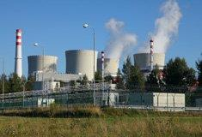
Applications
High-range zoom speed domes (25x-60x) are good when the pan-tilt is required, and longer zoom ration gives the flexibility to capture details from farther distances.
Traffic
Airport
Seaport
Train Station
Stadium
Utility

