Slide 1
A966, A967
New Product Introduction
Smart Dual Light PTZ – the visible light LED for the colored evidence at night or as a deterrence by showing a scanning spotlight moving across the perimeter.

Slide 2
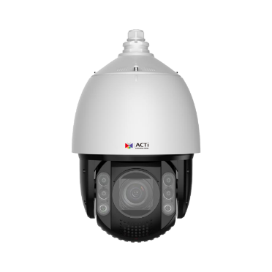
ACTi is introducing the newest products:
A966
2MP Deep Learning AI ColorGuard 33x Outdoor Speed Dome with IR LED 250m, White LED 100m, Smart Dual Light, WDR 150dB, CNS-16120
A967
5MP Deep Learning AI ColorGuard 33x Outdoor Speed Dome with IR LED 250m, White LED 100m, Smart Dual Light, WDR 150dB, CNS-16120

Slide 3
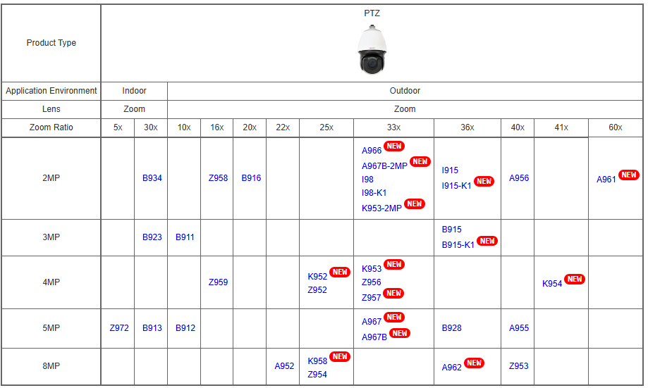
Product Matrix:

Slide 4

Spec Comparison:
Model | A966 (new) | A967 (new) | A967B
Photo
Product type | PTZ | PTZ | PTZ
Resolution | 2MP | 5MP | 5MP
Zoom | 33x | 33x | 33x
Maximum Frame Rate | 60@2MP | 30@5MP, 60@2MP | 30@5MP, 60@2MP
IR LED | Yes (250m) | Yes (250m) | Yes (250m)
WHITE LED | Yes (100m) | Yes (100m) | Yes (100m)
WDR | 150dB | 150dB | 150dB
Low Light | Extreme | Extreme | Extreme
Analytics | Deep Learning AI | Deep Learning AI | Deep Learning AI
NDAA | No | No | No
Approvals | CE, FCC, IP66, IK10, CNS-16120 | CE, FCC, IP66, IK10, CNS-16120 | CE, FCC, IP66, IK10

Slide 5
ColorGuard Technology
What is ColorGuard?
ColorGuard is a set of multiple technologies, combined together to form a fully automatic protection shield using colored images.
The first component of the ColorGuard is the ColorVizion. ColorVizion is the advanced technology that makes the night time image appear in true colors. It combines a large sensor, good lens and the superb image processing capabilities.
The second component of the ColorGuard is the additional illumination capabilities using built-in White LED of the cameras - by illuminating the visible spectrum light instead of IR light, the true colors can be preserved.
The third component of ColorGuard is the Artificial Intelligence. The AI will use these perfect color images to accurately analyze each frame of the video to make the correct decisions based on object's true colors.
Additionally, the ColorGuard cameras have the best WDR (130-150dB). Both dark and bright areas of the scene will be processed perfectly so that the true colors are preserved.

Slide 6
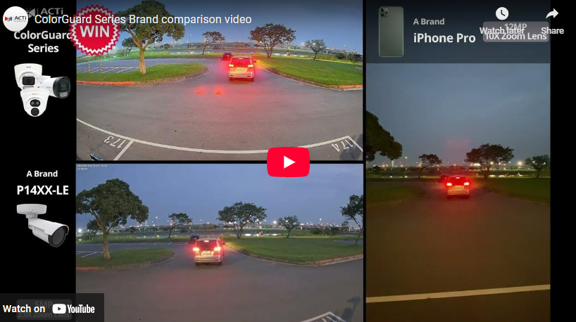
ColorGuard Technology
The most valuable applications of these cameras are the AI-powered physical security surveillance based on true colors.
The cameras collect the precise appearance metadata, such as the color of the jacket, color of the pants, color of hair, color of the vehicle.
Thanks to the color precision, it is possible to identify the same suspect through different locations, which is very challenging for the conventional IP cameras.

Slide 7
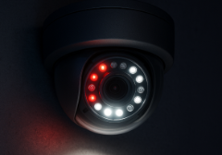
Smart Dual Light Technology
What is Dual Light?
When the cameras contain both IR LED and White LED as built-in illuminators then these are called dual light cameras. IR LED illuminates the light in the wavelength that is invisible for a human eye but the camera can see it and produce a monochrome image, usually in the grayscale.
The White LED inside the camera illuminates the light in the wavelength of the visible spectrum. It allows the camera to capture and produce the full color image even in the total darkness.
What is Smart Dual Light?
The Smart Dual Light is the intelligent feature of the camera that controls both IR and White LED automatically depending on the actual scene. The built-in AI analyzes the objects and decides when the object is significant so that it is necessary to capture it in full colors as an evidence. In such case the camera will switch from the IR LED mode to the White LED mode during the presence of that object and it switches back to the IR LED mode once the object is gone. Those significant objects may be people or vehicles, for example.

Slide 8
Smart Dual Light Technology
Applications
The Smart Dual Light models are designed for the applications where white LED is required. While invisible IR LED is always ON at night and the people do not even notice it, the white LED is illuminating visible light spectrum and therefore it is very obvious.
Therefore, user can decide when the white LED is ON.
It can be ON all the time, or only upon the events, such as people detection or sound detection. When it is turned on by the events only, then it is using the Smart Dual Light mode.
Use WHITE LED when …
1. You want to deter the intruder with the White LED that turns on upon intrusion.
2. You want to capture the color evidence of the intruder, as the camera will be in the color mode while the white LED is on.

Slide 9
Built-in Analytics
 | A966 | A967 | A967B
Smart Motion Detection | Y | Y | Y
Smart Intrusion Protection | Y | Y | Y
People Intrusion Detection | Y | Y | Y
People Enter Area Detection | Y | Y | Y
People Exit Area Detection | Y | Y | Y
Vehicle Line Crossing Detection | Y | Y | Y
Vehicle Intrusion Detection | Y | Y | Y
Vehicle Enter Area Detection | Y | Y | Y
Vehicle Exit Area Detection) | Y | Y | Y
Missing Object Detection | Y | Y | Y
Unattended Object Detection | Y | Y | Y
Tampering Detection | Y | Y | Y
PTZ Auto Tracking | Y | Y | Y

Slide 10
Supported VMS and Solutions
 | Standard Features | AI Events/Meta | Solutions
NVR 3 Corporate | Yes | Yes | S110, S111, S112
NVR 3 Business | Yes | Yes | S110, S111, S112
CMS 2 | Yes | Yes | S120, S121, S122
ZNR-Series NVR | Yes | Yes | S60
ENR-Series NVR | Yes |  | S72

Slide 11
Applications
Mission critical PTZ-based surveillance solutions requiring true colors:
Government
Bank
City Surveillance
Airport

