Slide 1
ALPR Cameras
New Product Introduction
Deep Learning AI based ALPR and database inside cameras, no license required

Slide 2
Features:
Various ALPR camera types - zoom bullet and PTZ
Resolution up to 9MP
Optical Zoom up to 60x
Frame rate up to 120fps under 2MP mode
Capturing vehicles moving up to 320 km/h Front and side installations
ALPR recognition distance ranging from 4.5 to 900 meters
Monitor up to 3 lanes simultaneously

Slide 3
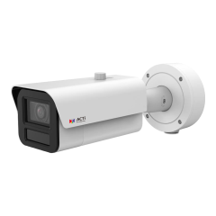
ACTi is introducing the newest ALPR products:
A429
4MP Deep Learning AI LightGuard 4.3x Zoom Bullet with IR LED 60m, WDR 150dB ALPR up to 120km/h
A429-P1
4MP Deep Learning AI 4x Zoom Bullet with IR LED 100m, WDR 150dB ALPR up to 120km/h

Slide 4
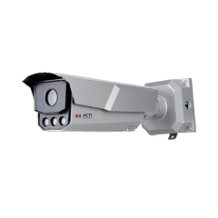
ACTi is introducing the newest ALPR products:
A431
4MP Deep Learning AI 4x Zoom Bullet with IR LED 50m, WDR 150dB ALPR up to 120km/h
A431-P1
4MP Deep Learning AI 4.3x Zoom Bullet with IR LED 50m, WDR 150dB ALPR up to 120km/h
A431-P2
4MP Deep Learning AI 4.5x Zoom Bullet with IR LED 50m, WDR 150dB ALPR up to 120km/h

Slide 5
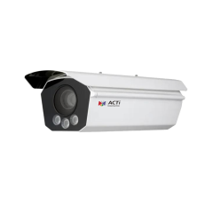
ACTi is introducing the newest ALPR products:
A432
9MP Deep Learning AI 3.6x Zoom Bullet with IR LED 30m, ALPR up to 320km/h
A432-P1
9MP Deep Learning AI Vari-Focal Bullet with IR LED 30m, ALPR up to 320km/h

Slide 6
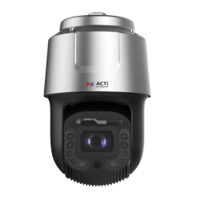
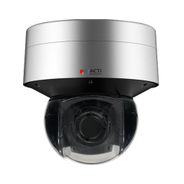
ACTi is introducing the newest ALPR products:
A961
2MP 60x Outdoor PTZ with WDR 140dB, ALPR up to 120km/h
A962
8MP Deep Learning AI LightGuard 36x Outdoor Speed Dome with IR LED 300m, WDR 140dB, ALPR up to 180km/h

Slide 7
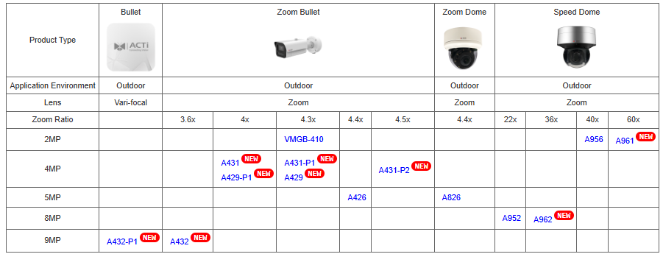
Product Matrix:

Slide 8
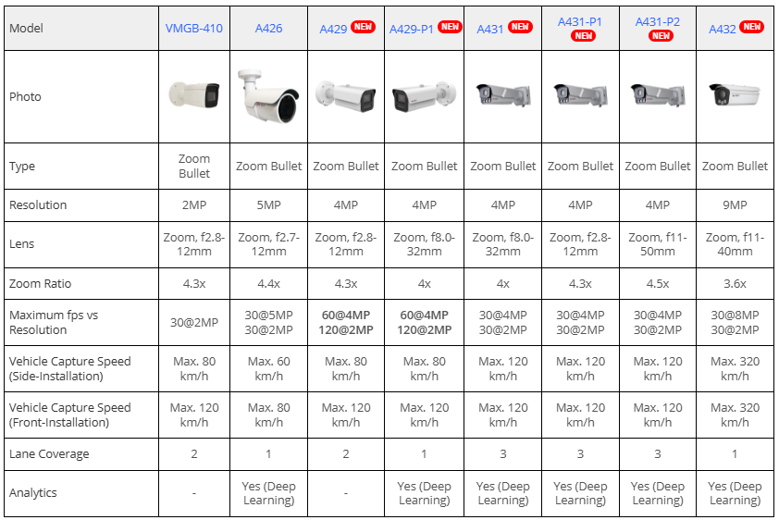
Spec Comparison:

Slide 9
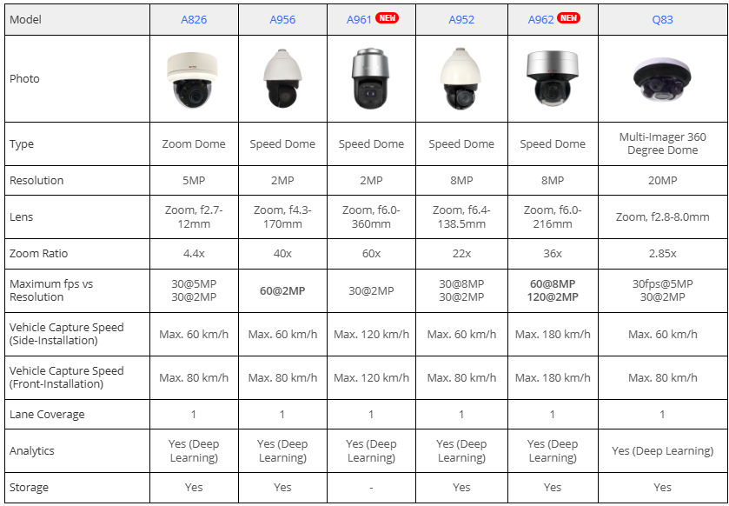
Spec Comparison:

Slide 10


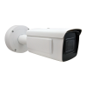

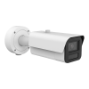

ACTi AI Solution Architecture #1
ALPR-based Surveillance
MOBILE CLIENT
E-mail
alerts
alerts
video
video
Realtime
analytics data
Realtime
analytics data, alerts
AI CAMERA
NVR SERVER
(ACTi NVR 3 Corporate)
NVR CLIENT

Slide 11
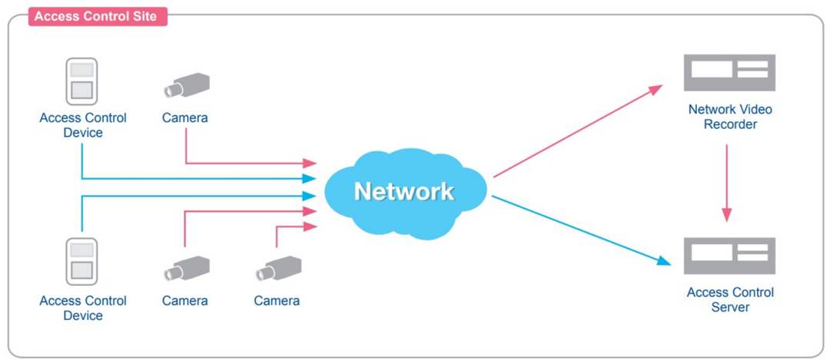
ACTi AI Solution Architecture
ALPR-based Access Control
MetaData
Video

Slide 12
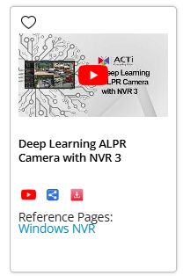
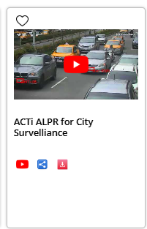
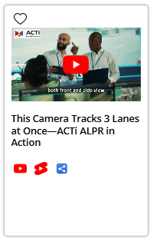
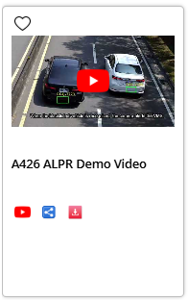
Videos

Slide 13
More information on ACTi’s ALPR Cameras:
https://www.acti.com/products/alpr-cameras

Slide 14


ACTi
ALPR Surveillance Solution

Slide 15
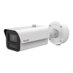
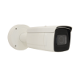
ALPR Camera Options
Model | A429 | VMGB-410
Photo
Product Type | ALPR Zoom Bullet | ALPR Zoom Bullet
Maximum Resolution | 4MP @ 60 fps, 2MP @ 120fps | 2MP @ 60fps
Lens | Zoom, f2.8-12mm | Zoom, f2.8-12mm
Digital Image Stabilizer | Yes | Yes
WDR | 150 dB | 140 dB
Environmental Casing | IP67, IK10, Vibration proof | IP67, IK10, Vibration proof
Vehicle Analytics | Automatic License Plate Recognition (ALPR), License Plate Detection, Smart Motion Detection, Vehicle Detection, Smart Intrusion Protection, Vehicle Line Crossing Detection, Vehicle Enter Area Detection, Vehicle Counting | Automatic License Plate Recognition (ALPR), License Plate Detection, Smart Motion Detection, Vehicle Detection, Smart Intrusion Protection, Vehicle Line Crossing Detection, Vehicle Enter Area Detection, Vehicle Counting
Vehicle Metadata | Vehicle type, Vehicle color, Vehicle brand, Vehicle direction | Vehicle type, Vehicle color, Vehicle brand, Vehicle direction
Vehicle Capture Speed | Front-Installation: 120 km/h Side-Installation: 80 km/h | Front-Installation: 120 km/h Side-Installation: 80 km/h

Slide 16
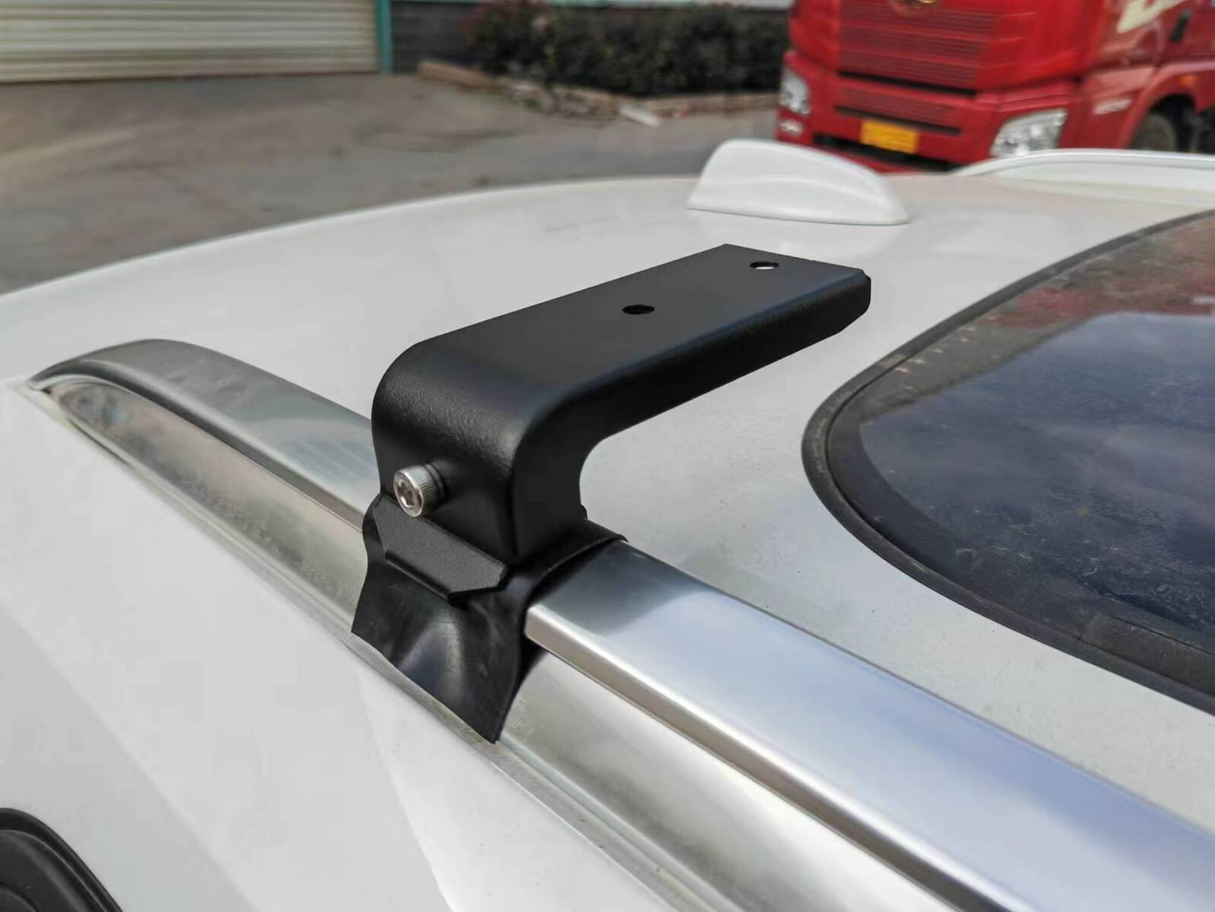
Roof Mounting
There are various mounts available from the local suppliers which can be attached to the roof frame and has screw holes for connecting the camera.
Such as this example:
The camera’s own bracket has 360-degree surround gimbal, so it can be adjusted to point at any direction.

Slide 17


In-Vehicle NVR Server Options
Model | PCI-101 | PCI-201
Photo
Type | Server | Server
CPU | Intel® Atom® x6425E (quad-core 2.0GHz/ 3.0GHz 12W) | Intel® Core™ i3-12100E (12M Cache, up to 3.20 GHz)
RAM | 8GB, DDR4, 3200MT/s | 16GB, DDR5, 4800MT/s
Storage Bay | 1 | 2
PoE Ports | M12, 4 port(s) | M12, 4 port(s)
DI/DO | 4/4 | 4/4
Operating System | Windows 11 IoT Enterprise | Windows 11 IoT Enterprise
Power Input | DC 8-35V | DC 8-48V
Ignition Control | Yes | Yes
Vibration proof | EN50155 | EN50155
Approvals | E-Mark | E-Mark
Recommended
NVR 3 Corporate edition will be installed in those Servers upon the project.

Slide 18

The software inside the NVR server
NVR 3 is one of the most famous ACTi products – it is a professional and elegant network video recorder platform with wide range of features and extremely reliable performance, available in two editions (read more).
Feature | NVR 3 Business | NVR 3 Corporate
Maximum Number of Channels | 100 | 200 (Standalone NVR 256)
Free ACTi Camera Channels Included | 32 | 1
Free 3rd Party Camera Channels Included | 1 | 1
CMS Support | No | Yes
POS, Access Control, Network IO Support | No | Yes
eMap | Yes | Yes
Google Map | No | Yes
Embedded Websites within Display | No | Yes
PTZ Control | Yes | Yes
Redundancy Support (N+1, N-to-N) | Yes | Yes
Workstation, Web Client, Mobile Client | Yes | Yes
Display Layouts (maximum grid size) | 225 | 225

Slide 19



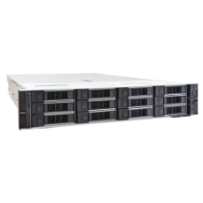
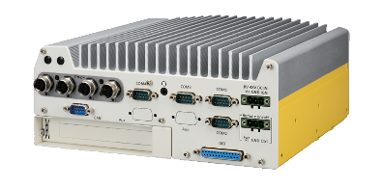
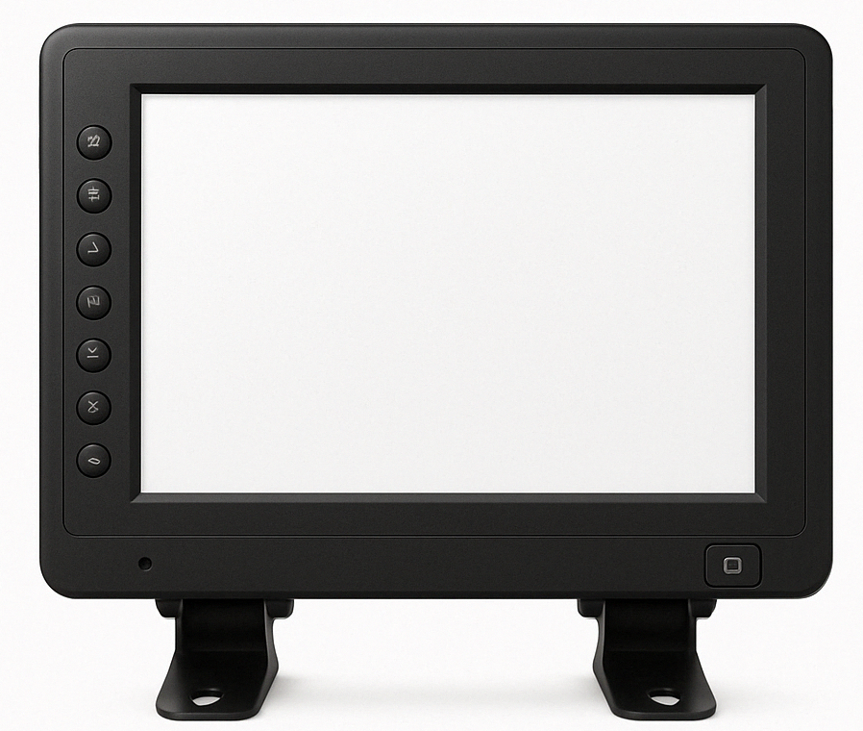
MOBILE SOLUTION
Control Station
Vehile
Vehicle
Displays the ALERT when the blacklisted vehicle is detected!
Vehicle
Remote Workstation
Access the vehicles’ NVR.
ALPR Camera #1
(use vehicle’s DC power)
Wireless
CMS 2
Control Station is optional.
It is also possible to fully manage the ALPR database locally from each vehicle.
ALPR Camera #2
(use vehicle’s DC power)
On-board NVR (PCI-201) + LTE / Wi-Fi / 5G
Local Display
Displays the ALERT when the blacklisted vehicle is detected!

Slide 20
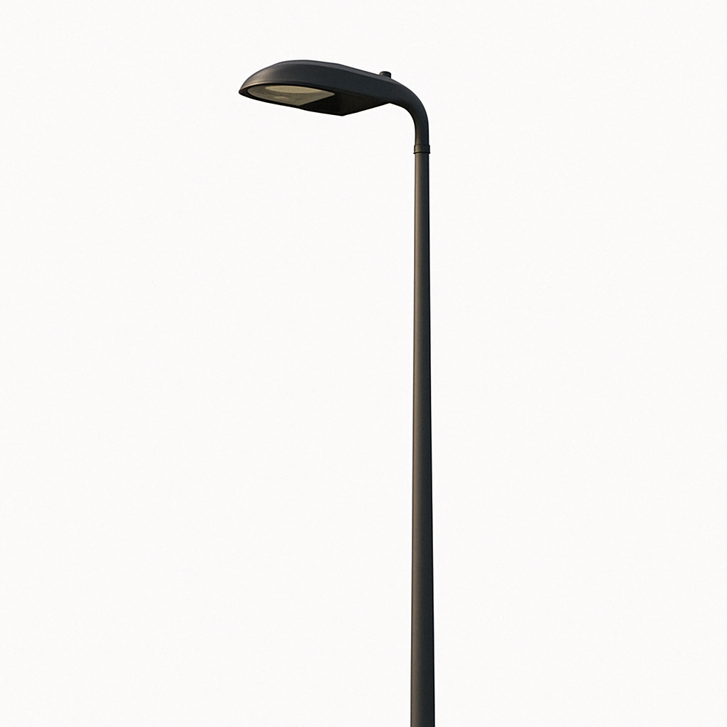


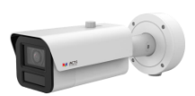

STATIC SOLUTION
Control Station
Displays the ALERT when the blacklisted vehicle is detected!
Remote Workstation
Access the Static locations’ NVR.
CMS 2
Lamp post with ALPR camera and NVR (requires weatherproof cabinet on the pole)

Slide 21


ALPR Camera
The AI camera can recognize multiple license plates across multiple lanes at the same time.
WATCH THE VIDEO
https://www.acti.com/video/v2902
ALPR Camera + NVR 3
ACTi NVR 3 supports the deep learning AI events and metadata. When the blacklisted vehicle is detected, the NVR will display instant alert.
WATCH THE VIDEO
https://www.acti.com/video/v2904

