Slide 1
A427, A428
New Product Introduction
Deep Learning AI Cameras with Built-in or Plug-in AI capabilities

Slide 2
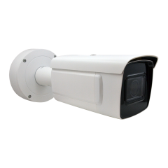
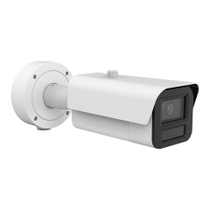
ACTi is introducing the newest products:
A427
4MP Deep Learning AI LightGuard 4.3x Zoom Bullet with IR LED 50m, WDR 140dB with Built-in Analytics
A428
4MP Deep Learning AI LightGuard 4.3x Zoom Bullet with IR LED 60m, WDR 150dB with Built-in and Plug-in Analytics

Slide 3
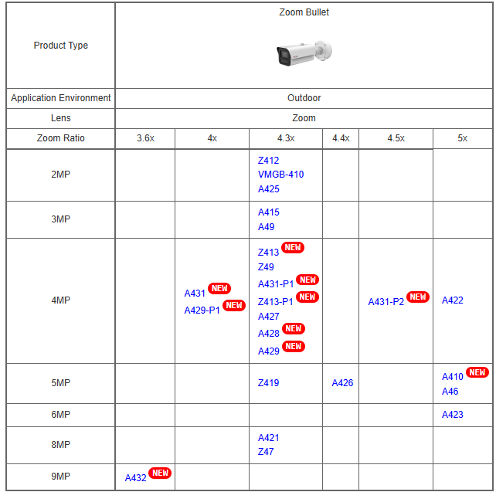
Product Matrix:

Slide 4
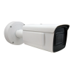

Spec Comparison:
 | A427 | A428
Product type | Zoom Bullet | Zoom Bullet
Resolution | 4MP | 4MP
Zoom | 4.3x | 4.3x
IR LED | Yes, 50m | Yes, 60m
WDR | Extreme 140dB | Extreme 150dB
Frame Rate | 60 fps @ 4MP | 60 fps @ 4MP 120 fps @ 2MP
Audio | No | Yes
Simultaneous streams | 5 Streams | 5 Streams
Built-in Deep Learning AI | Yes | Yes
Plug-in Deep Learning AI | No | Yes

Slide 5
Built-in Deep Learning AI:
 | A427 | A428
Smart Motion Detection | Yes | Yes
Smart Intrusion Protection | Yes | Yes
People Detection, Vehicle Detection | Yes | Yes
Object Metadata | Yes | Yes
People/Vehicle Enter/Exit Area Detection | Yes | Yes
People/Vehicle Line Crossing Detection | Yes | Yes
Face Recognition, Face Detection, Face Snapshot | Yes | Yes
People Counting, Vehicle Counting | Yes | Yes
Hard Hat / Helmet Detection | Yes | Yes

Slide 6
Plug-in Deep Learning AI:
Plug-in analytics is a value-added free service by ACTi. Upon the project, the customers may specify which of the additional analytics they would need, and ACTi will provide the updated firmware with the requested plug-in analytics. Only 1 analytics function can be enabled at a time while using it.
 | A427 | A428
Mask Wearing or Absence Detection | No | Yes
Helmet Wearing or Absence Detection | No | Yes
Construction Site Safety Violation Detection | No | Yes
Fire & Hazardous Materials Control Room Rules Violation Detection | No | Yes
Gas Station & Control Room Rules Violation Detection | No | Yes

Slide 7




ACTi AI Solution Architecture
MOBILE CLIENT
E-mail
alerts
alerts
video
video
Realtime
analytics data
Realtime
analytics data, alerts
AI CAMERA
NVR SERVER
(ACTi NVR 3 Corporate)
NVR CLIENT

Slide 8
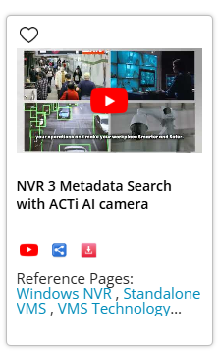
Supported VMS and Solutions
 | Standard Features | AI Events/Meta | Solutions
NVR 3 Corporate | Yes | Yes | S110, S111, S112
NVR 3 Business | Yes | Yes | S110, S111, S112
CMS 2 | Yes | Yes | S120, S121, S122
ZNR-Series NVR | Yes |  | S60
ENR-Series NVR | Yes |  | S72

Slide 9
ACTi Advantages compared to Server-Based AI Providers
Hundreds of channels with deep learning analytics can be managed by a single VMS server, using just a common server hardware configuration. The Server-based AI solutions have limited number of channels and require very expensive hardware.
VMS video recording functionality is much better secured when the VMS does not have the burden of running the analytics that may consume the server resource to its limits.
Faster response to the events – AI cameras can control the other nearby PTZ cameras for instant response, to get better video coverage of the scene. The analyses that are processed on the VMS side will be too slow for proper response.
Since the AI features are inside the camera, there are no Analytics related licenses required on the server side. Therefore, the cost of VMS in some cases is up to 10 times lower than the server-side AI solutions.

Slide 10
NVR and CMS Features
ACTi NVR 3 Corporate (and CMS 2) manages the analytics events from the cameras as follows:
Set up the analytic rules and thresholds – for example, how big is the crowd, how long time is considered loitering.
Receive real-time analytic events from all the cameras and respond by the pre-defined actions, such as send e-mail, instant pop-up of the video channel on the VMS screen and more.
Automatically push video to the mobile app of the patrolling security guards.
Search by the specific filter rules, bookmarks, thumbnails.

