Slide 1
Windows 11 Standalone NVR
New Product Introduction

Slide 2
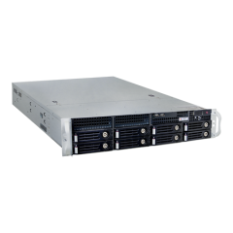


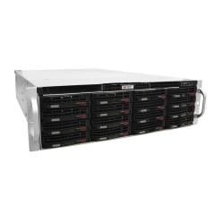
ACTi is introducing the newest RACKMOUNT Windows 11 NVR products:
INR-407
256-Channel 8-Bay RAID Win 11 Rackmount Standalone NVR with NVR 3 Corporate
INR-416
144-Channel 8-Bay RAID Win 11 Rackmount Standalone NVR with NVR 3 Corporate
INR-417
256-Channel 12-Bay RAID Win 11 Rackmount Standalone NVR with NVR 3 Corporate
INR-418
256-Channel 16-Bay RAID Win 11 Rackmount Standalone NVR with NVR 3 Corporate

Slide 3
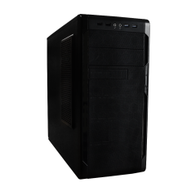
ACTi is introducing the newest TOWER Windows 11 NVR products:
GNR-350
100-Channel 6-Bay Win 11 Tower Standalone NVR with NVR 3 Corporate
BNR-300
100-Channel 4-Bay Win 11 Tower Standalone NVR with NVR 3 Business

Slide 4
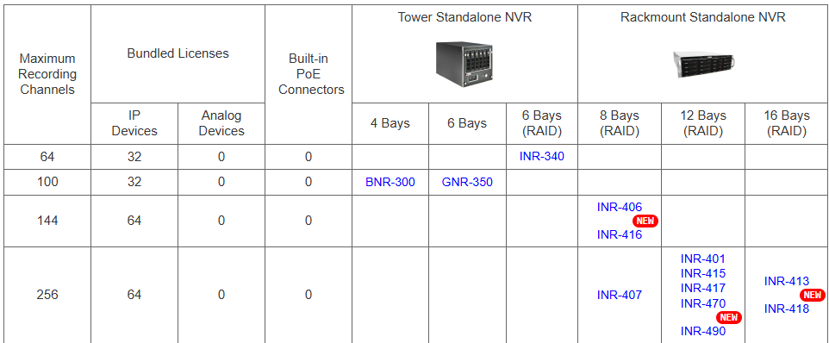
Product Matrix:
INR-407, GNR-350 and BNR-300 have upgraded from Windows 10 to Windows 11.
INR-406 (Windows 10) is migrating to INR-416 (Windows 11).
INR-415 (Windows 10) is migrating to INR-417 (Windows 11).
INR-413 (Windows 10) is migrating to INR-418 (Windows 11).

Slide 5
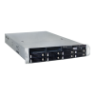

Spec Comparison:
Model | INR-406 | INR-416
Photo
Maximum Channels | 144 | 144
Storage Bays | 8 | 8
RAID | 0, 1, 5, 6, 10, 50, 60 | 0, 1, 5, 6, 10, 50, 60
Recording Throughput | 340 Mbps | 340 Mbps
CPU | Intel Core i7-7700 | Intel Core i7-8700
RAM | 16GB, DDR4, 2400MT/s | 16GB, DDR4, 2400MT/s
Operating System | Windows 10 IoT | Windows 11
Bundled NVR Software | NVR 3 Corporate | NVR 3 Corporate

Slide 6
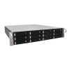
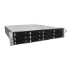
Spec Comparison:
Model | INR-415 | INR-417
Photo
Maximum Channels | 256 | 256
Storage Bays | 12 | 12
RAID | 0, 1, 5, 6, 10, 50, 60 | 0, 1, 5, 6, 10, 50, 60
Recording Throughput | 550 Mbps | 550 Mbps
CPU | Intel Core i7-7700 | Intel Core i7-8700
RAM | 16GB, DDR4, 2400MT/s | 16GB, DDR4, 2400MT/s
Operating System | Windows 10 IoT | Windows 11
Bundled NVR Software | NVR 3 Corporate | NVR 3 Corporate

Slide 7
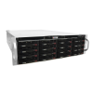
Spec Comparison:
Model | INR-413 | INR-418
Photo
Maximum Channels | 256 | 256
Storage Bays | 16 | 16
RAID | 0, 1, 5, 6, 10, 50, 60 | 0, 1, 5, 6, 10, 50, 60
Recording Throughput | 550 Mbps | 550 Mbps
CPU | Intel Core i7-7700 | Intel Core i7-8700
RAM | 16GB, DDR4, 2400MT/s | 16GB, DDR4, 2400MT/s
Operating System | Windows 10 IoT | Windows 11
Bundled NVR Software | NVR 3 Corporate | NVR 3 Corporate

Slide 8
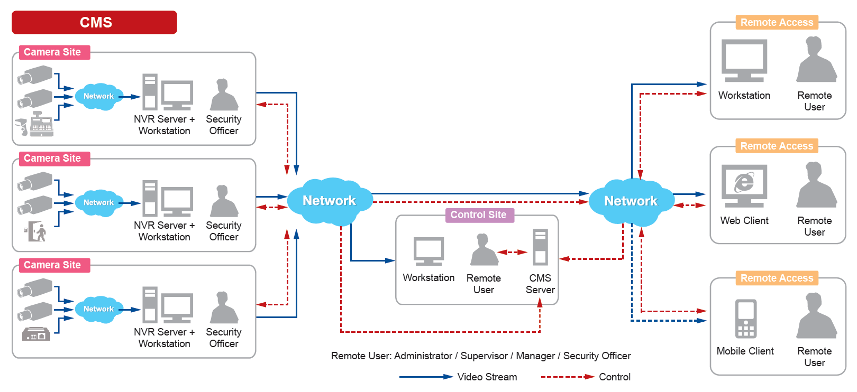
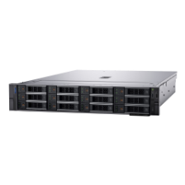
Typical High Level Solution Architecture
INR-series and GNR-series NVR are often used in the multi-site mission critical projects together with the Control Center.

Slide 9
Supported VMS and Solutions
INR-series and GNR-series NVR are used in the following solutions:
Solution Name | Solution ID
Windows-Based NVR Solution | S110
Windows-Based NVR and Decoder Client Solution | S111
Windows-Based NVR and Redundancy Solution | S112
Windows-Based NVR and Control Center Solution | S120
Windows-Based NVR, Control Center and TV Wall Solution | S121
Windows-Based NVR, Control Center and Decoder Client Solution | S122

Slide 10
More Information about Windows 11 Migration
This knowledge base article contains detailed information about the migration from Windows 10 to Windows 11:
https://download.acti.com/?id=32818

