Slide 1
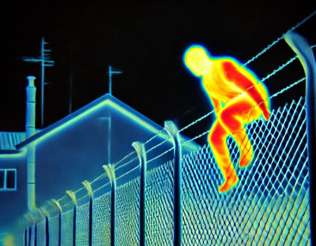
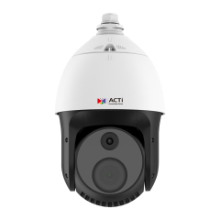
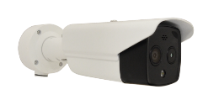

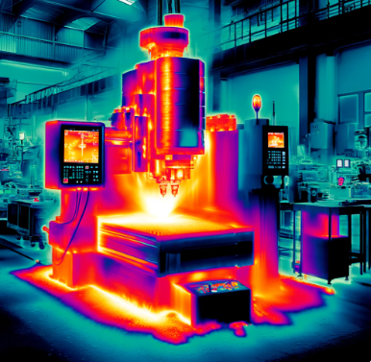
A972 and Other Thermal Cameras
New Product Introduction

Slide 2
Overview
ACTi thermal cameras combine advanced dual-sensor technology, integrating thermal imaging and visible light sensors to deliver a comprehensive monitoring solution.
The thermal sensor excels in detecting fires, abnormal human body temperatures, and equipment overheating, while the visible light sensor captures high-resolution images up to 4MP, providing clear details to verify incidents and respond swiftly to alerts.
Available in versatile form factors, including thermal bullets, thermal turrets and thermal PTZ, these cameras meet diverse installation needs.
The thermal sensors operate within an 8-14μm spectral range, achieving exceptional sensitivity with NETD <35mK and spatial resolution between 2.74 and 5.71 mrad. With a detection range extending up to 2 kilometers, they are ideal for precise, wide-area monitoring in various environments.

Slide 3
Features
Long-Range Security : Effective up to 2100m for large-area surveillance
Versatile Temperature Monitoring : Suitable for various equipment sizes and cabinets, ensuring precise thermal measurement
Flexible Camera Types : Choose from Bullet, Turret, PTZ, and specialized bi-spectrum models to fit unique installation needs.
High Sensitivity : NETD down to 35mk for accurate detection, even in challenging conditions
High Resolution : Crisp imaging up to 640x512, delivering clear and reliable visuals
Built-in AI Analytics : Real-time detection for people, vehicles, line crossing, and intrusion to enhance security operations

Slide 4
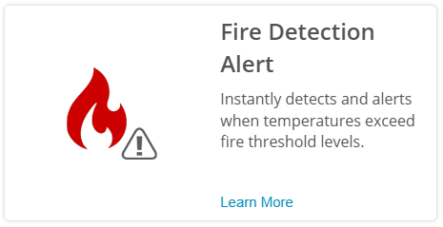
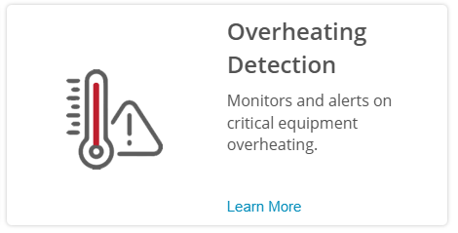
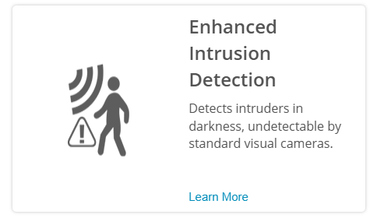
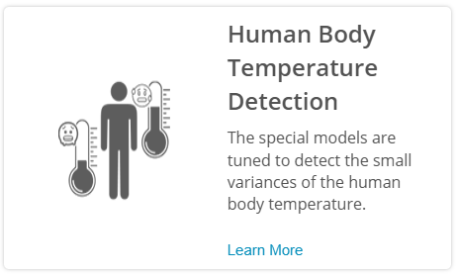
Thermal Applications

Slide 5
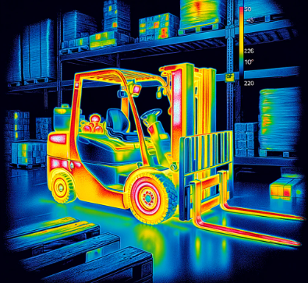

Examples of Overheating Related Applications
Overheated vehicle components
Overheated manufacturing equipment, such as CNC
Overheated infrastructure, such as pipes, tanks, electric cables
Overheating can be observed visually using the thermal image, or automatically, using pre-defined temperature thresholds and automated warnings. Early warning of the overheating can protect valuable assets in the factory and the warehouse.

Slide 6



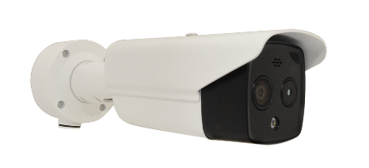

ACTi Thermal Surveillance Solution Architecture #1
Solution with NVR
MOBILE CLIENT
Push notification alerts
E-mail
alerts
Dual video
video
Thermal alerts metadata
Thermal alerts metadata
THERMAL CAMERA
NVR SERVER
(ACTi NVR 3 Corporate)
NVR CLIENT

Slide 7


ACTi Thermal Surveillance Solution Architecture #2
Solution without NVR
Video
Mobile Client
Events
Events
Dual video
Dual snapshots
Snapshots
E-mail
THERMAL CAMERA
Thermal events
Video
Camera’s Web Interface Access

Slide 8
ACTi is introducing the newest thermal camera:
A972
4MP 32x Outdoor Thermal PTZ with IR LED 100m, WDR 120dB, two-way audio, built-in analytics

Slide 9
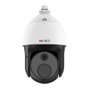
Thermal PTZ
Model | A972
Photo
Type | Thermal PTZ
Applications | Overheating Detection, Fire Detection
Maximum Resolution | 4MP
Image Sensor | Thermal
Thermal Resolution | Thermal: 256(H) X 192(V)
Thermal Sensitivity | NETD <35mK
Lens | Optical: 32x Optical Zoom, f4.8-153mm Thermal: Fixed, f10mm
Horizontal Viewing Angle | Optical: 58.8° - 2.18°, Thermal: 18.1°
Maximum fps vs Resolution | 30@4MP
Analytics | Temperature Detection Fire Detection
Temperature Measurement | Yes
Temperature Detection Range | -20°C ~ 150°C (-4°F ~ 302°F)
Temperature Accuracy | ±8°C, ±8%
Analytics Detection Range | People: 417m Vehicle: 833m
Fire Detection Range | 150m
Audio | 2-way, Mic-in, Line-in/out

Slide 10

Thermal Bullets
Model | A370 | A370-P1 | A370-P2
Photo
Type | Thermal Bullet | Thermal Bullet | Thermal Bullet
Applications | Overheating Detection, Fire Detection | Overheating Detection, Fire Detection | Overheating Detection, Fire Detection
Maximum Resolution | 1MP | 1MP | 1MP
Image Sensor | Thermal | Thermal | Thermal
Resolution | Thermal: 640(H) X 512(V) | Thermal: 640(H) X 512(V) | Thermal: 640(H) X 512(V)
Thermal Sensitivity | NETD <35mK | NETD <35mK | NETD <35mK
Lens | Fixed focal, f75mm | Fixed focal, f50mm | Fixed focal, f100mm
Horizontal Viewing Angle | 8.3° | 12.4° | 6.22°
Maximum fps vs Resolution | 25@1MP | 25@1MP | 25@1MP
Analytics | Temperature Detection Fire Detection | Temperature Detection Fire Detection | Temperature Detection Fire Detection
Temperature Measurement | Yes | Yes | Yes
Temperature Range | -20°C ~ 150°C (-4°F ~ 302°F) | -20°C ~ 150°C (-4°F ~ 302°F) | -20°C ~ 150°C (-4°F ~ 302°F)
Temperature Accuracy | ±8°C, ±8% | ±8°C | ±8°C
Temperature Detection Range | 45m | 45m | 45m
Analytics Detection Range | People: 551m Vehicle: 1544m | People: 368m Vehicle: 1029m | People: 735m Vehicle: 2059m
Fire Detection Range | 150m | 150m | 150m
Audio | 2-way, Mic-in, Line-in/out | 2-way, Mic-in, Line-in/out | 2-way, Mic-in, Line-in/out

Slide 11


Thermal Bullets
Model | A371 | A371-P1 | A371-P2 | A372 | A372-P1
Photo
Type | Thermal Bullet | Thermal Bullet | Thermal Bullet | Thermal Bullet | Thermal Bullet
Applications | Overheating & Fire Detection | Overheating & Fire Detection | Overheating & Fire Detection | Thermal Surveillance | Thermal Surveillance
Max Resolution | 4MP | 4MP | 4MP | 4MP | 4MP
Image Sensor | Visual + Thermal | Visual + Thermal | Visual + Thermal | Visual + Thermal | Visual + Thermal
Thermal Resolution | 256(H) X 192(V) | 256(H) X 192(V) | 256(H) X 192(V) | 256(H) X 192(V) | 256(H) X 192(V)
Thermal Sensitivity | NETD <40mK | NETD <40mK | NETD <40mK | NETD <55mK | NETD <55mK
Lens (Therm/Visual) | f3.6mm / f4.3mm | f6.9mm / f6.4mm | f9.7mm / f8.0mm | f1.35mm / f4.3mm | f3.6mm / f4.3mm
HOR | Therm: 50°,Vis:84° | Therm:24.9°,Vis:53° | Therm:18°,Vis:39.4° | Therm:50°,Vis:94° | Therm:25°, Vis:56°
IR LED / White LED | 30m / 30m | 30m / 30m | 30m / 30m | - / 30m | - / 30m T
Thermal Analytics | Temp, Smoke, Fire | Temp, Smoke, Fire | Temp, Smoke, Fire | - | -
Temp.Measurement | Yes | Yes | Yes | - | -
Temperature Range | -20°C ~ 150°C | -20°C ~ 150°C | -20°C ~ 150°C | - | -
Temp Accuracy | ±8°C | ±8°C | ±8°C | - | -
Temp Detect Range | 58.3m | 116.7m | 61.7m
Analytics Detection Range | People: 28.8m, Vehicle: 75.6m | People: 55.2m Vehicle: 144.9m | People: 77.6m Vehicle: 203.7m | People: 11m Vehicle: 33m | People: 21m Vehicle: 63m
Fire Detect. Range | 43.2m | 82.8m | 116.4m | - | -
Audio | Mic-in, Line-in/out | Mic-in, Line-in/out | Mic-in, Line-in/out | - | -

Slide 12

Thermal Bullets
Model | VMGB-359 | VMGB-359-P1 | VMGB-371
Photo
Type | Thermal Bullet | Thermal Bullet | Thermal Bullet
Applications | Fire Detection, Overheating Detection | Fire Detection, Overheating Detection | Human Body Temperature Detection (fever alert)
Resolution | 4MP | 4MP | 4MP
Lens | (Thermal camera) Fixed focal, f6.2mm (Visual camera) Fixed focal, f8.0mm | (Thermal camera) Fixed focal, f3.1mm (Visual camera) Fixed focal, f4.0mm | (Thermal camera) Fixed focal, f3.1mm (Visual camera) Fixed focal, f4.0mm
Horizontal Viewing Angle | (Thermal camera) 25.0° (Visual camera) 39.42° | (Thermal camera) 50° (Visual camera) 84° | (Thermal camera) 50° (Visual camera) 84°
WDR | Superior WDR (120 dB) | Superior WDR (120 dB) | Superior WDR (120 dB)
Analytics | Yes | Yes | Yes
Audio | 2-way, Mic-in, Stereo Line-in, Line-out | 2-way, Mic-in, Stereo Line-in, Line-out | 2-way, Mic-in, Stereo Line-in, Line-out

Slide 13

Thermal Turrets
Model | A570 | A570-P1 | A570-P2
Photo
Type | Thermal Turret | Thermal Turret | Thermal Turret
Applications | Overheating Detection, Fire Detection | Overheating Detection, Fire Detection | Overheating Detection, Fire Detection
Resolution | 4MP | 4MP | 4MP
Image Sensor | Visual + Thermal | Visual + Thermal | Visual + Thermal
Thermal Resolution | 256(H) X 192(V) | 256(H) X 192(V) | 256(H) X 192(V)
Thermal Sensitivity | NETD <40mK | NETD <40mK | NETD <40mK
Lens (thermal/visual) | Fixed focal, f2.1mm / Fixed focal, f2.2mm | Fixed focal, f3.6mm / Fixed focal, f4.3mm | Fixed focal, f6.9mm / Fixed focal, f6.4mm
Horizontal Viewing Angle | Thermal: 90°, Visual: 117.8° | Thermal: 50°, Visual: 84° | Thermal: 24.9°, Visual: 53°
IR LED | Yes, 15m | Yes, 15m | Yes, 15m
White LED | Yes, 30m | Yes, 30m | Yes, 30m
Analytics | Temperature, Smoke and Fire Detection | Temperature, Smoke and Fire Detection | Temperature, Smoke and Fire Detection
Temperature Measurement | Yes | Yes | Yes
Temperature Range | -20°C ~ 150°C (-4°F ~ 302°F) | -20°C ~ 150°C (-4°F ~ 302°F) | -20°C ~ 150°C (-4°F ~ 302°F)
Temperature Accuracy | ±8°C (14.4°F) | ±8°C (14.4°F) | ±8°C (14.4°F)
Temperature Detection Range | 35m | 58.3m | 116.7m
Analytics Detection Range | People: 30m | People: 28m | People: 55.2m
 | Vehicle: 85m | Vehicle: 75.6m | Vehicle: 144.9m
Fire Detection Range | 21.6m | 43.2m | 82.8m
Audio | 2-way, Mic-in, Line-in/out | 2-way, Mic-in, Line-in/out | 2-way, Mic-in, Line-in/out

Slide 14
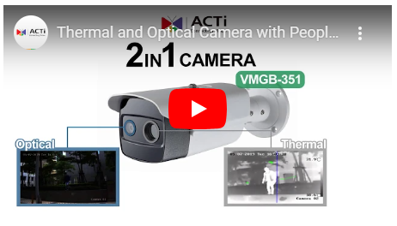
Video Clips
Thermal camera 2-in-1 benefits demo:
http://www.acti.com/video/v2058

