Slide 1
Z914
New Product Introduction
Fixed Dome with White LED and Speaker for deterrence!

Slide 2
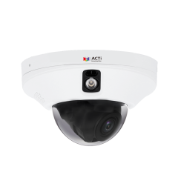
ACTi is introducing the newest product:
Z914
2MP Deep Learning AI ColorGuard f2mm Indoor Fixed Dome with IR LED 50m, White LED as a Warning, Built-in Microphone, Built-in Speaker, TOF Sensor, WDR 120dB

Slide 3
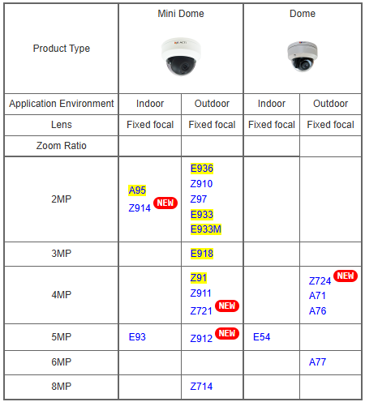
Product Matrix:
Z914 is an indoor deterrence camera with both IR LED and warning white LED with the speaker. It has the unique value; therefore it is not a migration model.

Slide 4
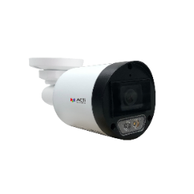
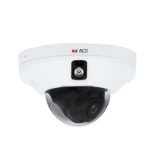
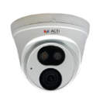
Spec Comparison (IR and WHITE LED cameras):
Model | Z322 (new) | Z722 (new) | Z914 (new)
Photo
Product type | Fixed Bullet | Turret | Fixed Dome
Resolution | 4MP | 4MP | 2MP
Lens | f2.8mm | f2.8mm | f2.0mm
HOR | 97° | 97° | 126°
LED | IR & ILLUMINATION WHITE LED | IR & ILLUMINATION WHITE LED | IR & DETERRENCE WHITE LED
Min. Illumination | 0.003 lux (color) | 0.003 lux (color) | 0.003 lux (color)
Audio | Built-in Mic | Built-in Mic | Built-in Mic, Built-in Speaker, Line-in/out
Temperature | -30°C ~ 60°C | -30°C ~ 60°C | -10°C ~ 50°C
Environment | IP67 | IP67 | Indoor
Deep Learning AI | Yes | Yes | Yes

Slide 5
Analytics Comparison:
Analytics | Z322, Z722 | Z914
Smart Motion Detection | Y | Y
Smart Intrusion Protection | - | Y
Object Metadata | - | Y
People/Vehicle Detection | Y | Y
Tampering Detection by TOF (time-of-flight) sensor | - | Y
Other | Y | Y

Slide 6
Supported VMS and Solutions
 | Standard Features | AI Events/Meta | Solutions
NVR 3 Corporate | Yes | Yes | S110, S111, S112
NVR 3 Business | Yes | Yes | S110, S111, S112
CMS 2 | Yes | Yes | S120, S121, S122
ZNR-Series NVR | Yes | Yes | S60
ENR-Series NVR | Yes |  | S72

Slide 7
Applications
Z914 is especially suitable in the elevators due to its small size and super wide viewing angle.
It has two ways to actively deter unwanted situations – the built-in speaker can be used to play an automatic voice recording with the warning or simply an alarm sound. It has a White LED that turns on during the pre-defined event, as an additional deterrence.
The built-in Microphone and the Speaker can also be used as an elevator intercom, where the security officer can give live voice commands, for example when the person is entering the elevator with forbidden items, such as a motorcycle.
When someone tries to hide their activity in the elevator by blocking or altering the camera’s view, then the built-in TOF sensor will detect the distance change and alert instantly.

