Slide 1
Z419, Z819
New Product Introduction
Z-Series 5MP AI Zoom Bullet and Dome

Slide 2
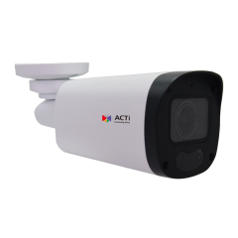
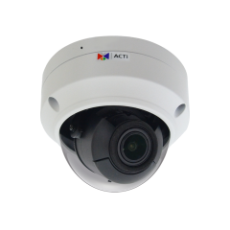
ACTi is introducing the newest products:
Z419
5MP Deep Learning AI 4.3x Zoom Bullet with D/N, IR LED 60m, WDR 130dB
Z819
5MP Deep Learning AI 4.3x Outdoor Zoom Dome with D/N, IR LED 60m, WDR 130dB

Slide 3
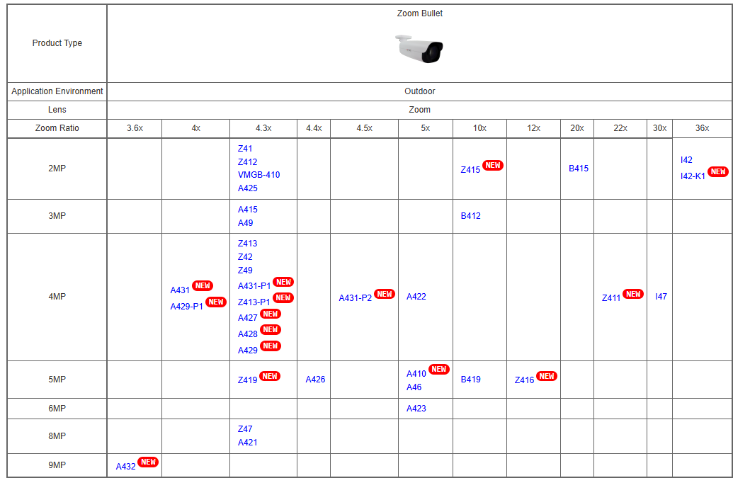
Product Matrix:

Slide 4
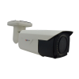



Spec Comparison:
Model | A46 | A410 | A426 | Z419 (new)
Photo
Product type | Zoom Bullet | Zoom Bullet | Zoom Bullet | Zoom Bullet
Resolution | 5MP @ 30fps | 5MP @ 30fps | 5MP @ 30fps | 5MP @ 25fps 3MP @ 30fps
Main AI Features | - | People/ Vehicle Detection | ALPR, Face Recognition | SMD, SIP
Zoom Lens | 5x, f2.7-13.5mm | 5x, f2.7-13.5mm | 4.4x, f2.7-12mm | 4.3x, f2.8-12mm
Min Illumination | Color 0.018 lux | Color 0.018 lux | Color 0.001 lux | Color 0.001 lux
WDR | Extreme 125dB | Extreme 125dB | Extreme 135dB | Extreme 130dB
Audio | Line in, Line out | Line in, Line out | Line in, Line out | Built-in Mic
Temperature | -30°C ~ 50°C | -30°C ~ 50°C | -40°C ~ 60°C | -30°C ~ 60°C
NDAA | Yes | Yes | Yes | Yes

Slide 5
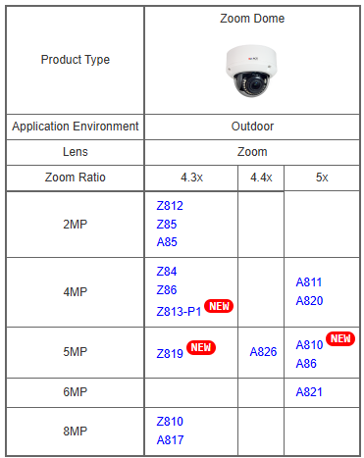
Product Matrix:

Slide 6
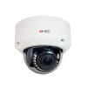

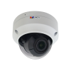
Spec Comparison:
Model | A86 | A810 | A826 | Z819 (new)
Photo
Product type | Zoom Dome | Zoom Dome | Zoom Dome | Zoom Dome
Resolution | 5MP @ 30fps | 5MP @ 30fps | 5MP @ 30fps | 5MP @ 25fps 3MP @ 30fps
Main AI Features | - | People/ Vehicle Detection | ALPR, Face Recognition | SMD, SIP
Zoom Lens | 5x, f2.7-13.5mm | 5x, f2.7-13.5mm | 4.4x, f2.7-12mm | 4.3x, f2.8-12mm
Min Illumination | Color 0.018 lux | Color 0.018 lux | Color 0.001 lux | Color 0.001 lux
WDR | Extreme 125dB | Extreme 125dB | Extreme 135dB | Extreme 130dB
Audio | Line in, Line out | Line in, Line out | Line in, Line out | Built-in Mic
Temperature | -40°C ~ 50°C | -30°C ~ 50°C | -55°C ~55°C | -30°C ~ 60°C
NDAA | Yes | Yes | Yes | Yes

Slide 7
Supported VMS and Solutions
 | Standard Features | AI Events/Meta | Solutions
NVR 3 Corporate | Yes | Yes | S110, S111, S112
NVR 3 Business | Yes | Yes | S110, S111, S112
CMS 2 | Yes | Yes | S120, S121, S122
ZNR-Series NVR | Yes | Yes | S60
ENR-Series NVR | Yes |  | S72

Slide 8

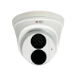

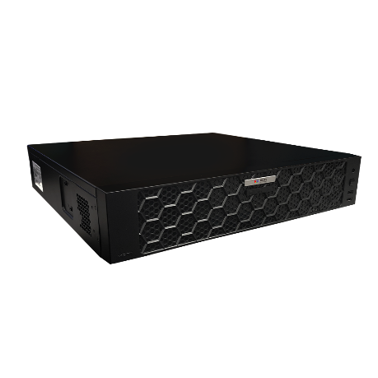



ZNR-Based Architecture Example
Processing Events by Built-in AI or Camera AI
Web Client
Z-Series AI Cameras (smart motion detection)
E-Mail Notification with Snapshots
ZNR-Series NVR
Other Cameras
Automatic Alarm
Auto Upload to FTP

