Slide 1
Z721
New Product Introduction
Mobile Vehicle and Static Location All-Purpose AI Dome Camera

Slide 2
Introduction:
Z721 is a mini-sized compact AI dome camera with the dome cover near the side of the camera, making it a perfect transportation camera as well as a discreet camera for any static location. The transportation can be a harsh environment. The camera is fully vibration proof with EN50155, vandal proof with IK10, waterproof with IP68 and works in various temperature conditions from -40°C up to +60°C. The lighting conditions can be unpredictable; therefore, this camera can manage clear colors even at 0.002 lux conditions. The smart IR LED illumination up to 30 meters is more than enough for any transportation, including long buses and train carriages. Since the windows can expose high contrast lights from the outside of the vehicles, the camera can handle it well with its powerful 135dB WDR. Additionally, the camera comes with the built-in microphone along with AI-based audio detection, supports MicroSD cards and much more. The most valuable features are the built-in deep learning AI capabilities - the camera can detect people, faces and vehicles when used as intrusion detection devices and they can collect and transmit metadata of the objects as a critical evidence. The built-in AI does not require any license.

Slide 3
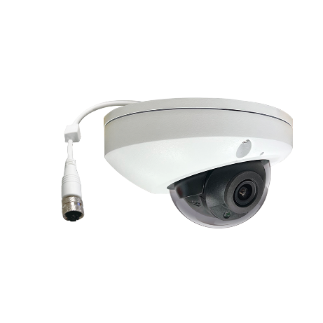
ACTi is introducing the newest product:
Z721
4MP LightGuard f2.8mm Outdoor Fixed Dome with D/N, IR LED 30m, WDR 135dB, Vibration Proof, M12 Connector

Slide 4
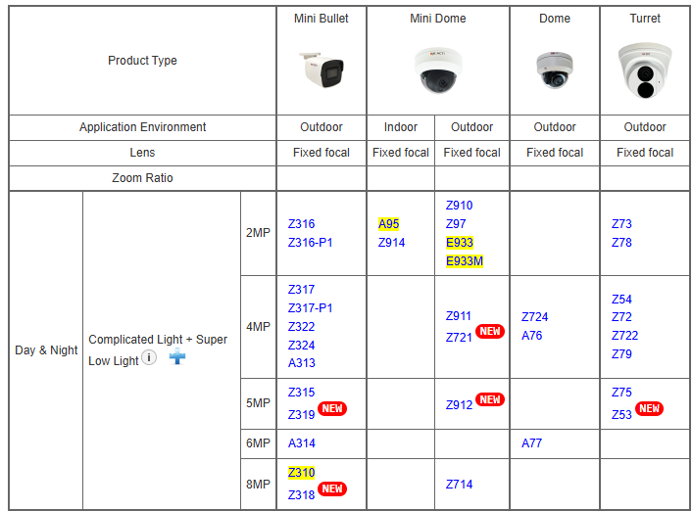
Product Matrix:
Z721 has its unique value in the 4MP cluster, for being transportation-ready camera.

Slide 5
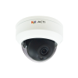
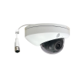
Spec Comparison:
Model | Z911 | Z721
Photo
Product type | Fixed Dome | Fixed Dome
Resolution | 4MP | 4MP
Lens | f2.8mm/F2.0 | f2.8mm/F1.6
HOR | 99° | 101.1°
LED | IR LED | IR LED
WDR | Superior 120dB | Extreme 135dB
Min Illumination | Color 0.003 lux | Color 0.002 lux
Audio | Built-in Mic | Built-in Mic, 2-way
Temperature | -40°C ~ 60°C | -40°C ~ 60°C
Environment | IP68, IK10 | IP68, IK10
Analytics | Yes | Yes (SIP, SMD)
Connector | RJ-45 | M12
Power Source | DC 12V, PoE (IEEE802.3af) | DC 12V, PoE (IEEE802.3af)

Slide 6
Supported VMS and Solutions
 | Standard Features | AI Events/Meta | Solutions
NVR 3 Corporate | Yes | Yes | S110, S111, S112
NVR 3 Business | Yes | Yes | S110, S111, S112
CMS 2 | Yes | Yes | S120, S121, S122
ZNR-Series NVR | Yes | Yes | S60
ENR-Series NVR | Yes |  | S72

Slide 7
Application:
The most common application of Z721 is transportation - these cameras are often installed inside the buses and trains. Additionally, the cameras are often used as surveillance devices in the buildings. Their small size makes it very discreet.

Slide 8
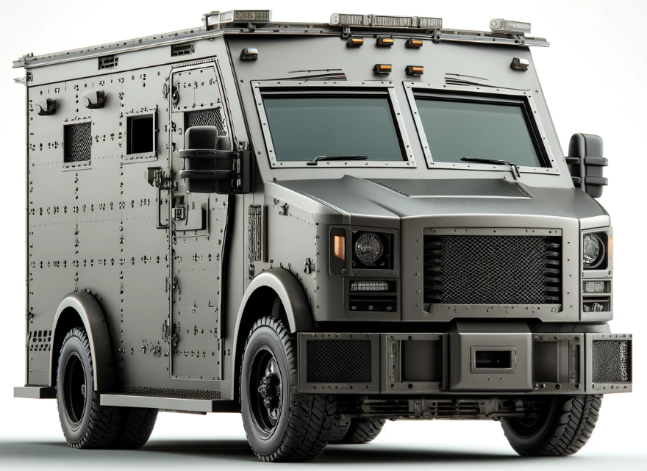
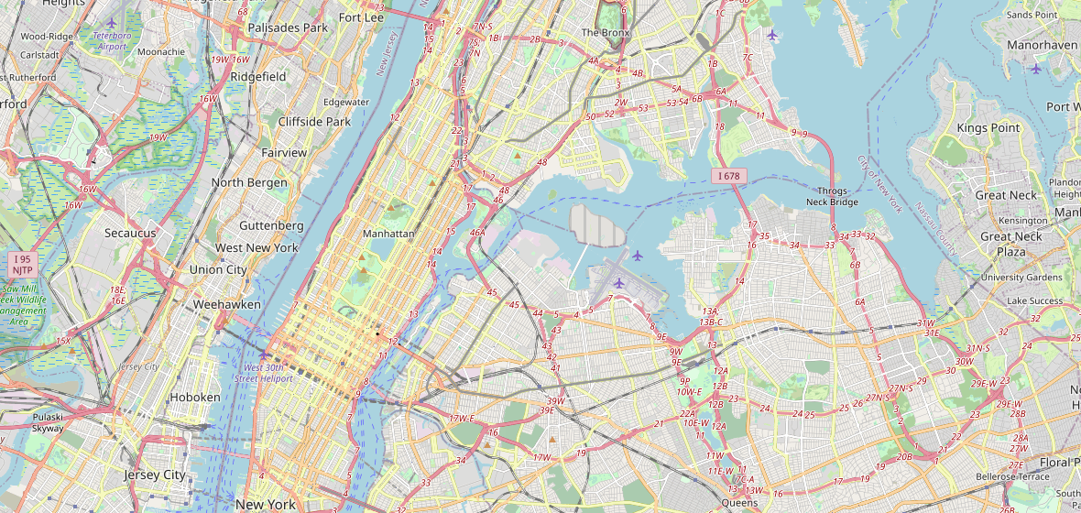

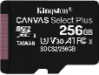
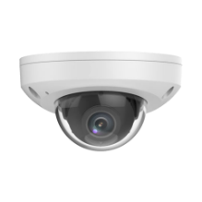
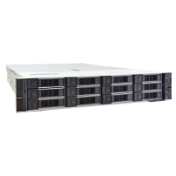
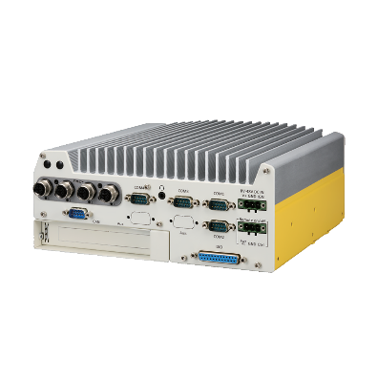
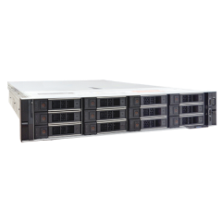

Transportation Solution Example:
Control Station (with CMS)
Truck
Truck
CMS Workstation
Track vehicles on the Map, watch video
Truck
MicroSDHC
(Failover & Sync solution)
GPS Tracker
Z721
CMS 2 Server
MicroSDHC
(Failover & Sync solution)
Wi-Fi
On-board NVR with PoE (PCI-201) + LTE / Wi-Fi / 5G
Backup Server
Connects to the on-board NVR and backs up the recorded data whenever the vehicle arrives in the Wi-Fi zone.
Z721

