Slide 1
Z54, Z324, Z724
New Product Introduction
ColorVizion Technology – always true colors, even at night!

Slide 2
Introduction:
These ColorVizion cameras can see clear and true colors even at 0.0003 lux. The cameras come with the large 1/1.8" sensors and the F1.0 aperture and collect so much visible light that the colors look excellent even at night when the human eye barely sees anything. Additionally, all these cameras are equipped with the smart white LED which can be configured to illuminate automatically upon the intrusion to capture even clearer images or to deter the intrusion, up to 40 meters. The true color technology is combined with the built-in artificial intelligence capabilities - while the smart ISP ensures the colors are accurate, the deep learning-based AI can use these precise colors to analyze and record specific appearance properties of the target people and vehicles in the view. Having the precise colors, it would be possible to track and find the same suspect across different channels regardless of the differences in lighting conditions.

Slide 3
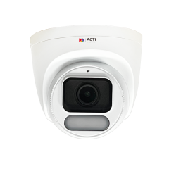
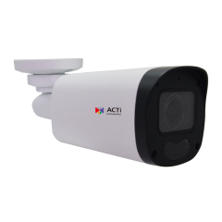
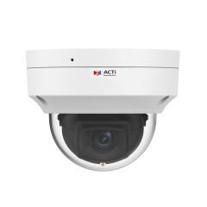
ACTi is introducing the newest products:
Z54
4MP Deep Learning AI ColorGuard f2.8mm Outdoor Turret with D/N, White LED 40m, ColorVizion, WDR 135dB
Z324
4MP Deep Learning AI ColorGuard f2.8mm Mini Bullet with D/N, White LED 40m, ColorVizion, WDR 135dB
Z724
4MP Deep Learning AI ColorGuard f2.8mm Outdoor Dome with D/N, White LED 40m, ColorVizion, WDR 135dB

Slide 4
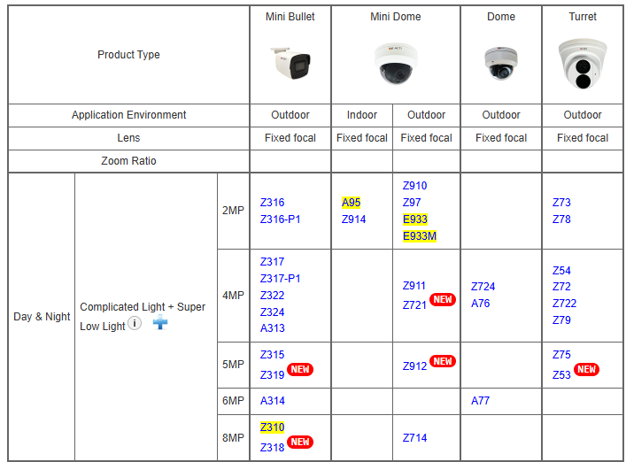
Product Matrix:
Z54 (and previously announced Z722) can be considered as the migration of Z79 eventually.
Z324 (and previously announced Z322) can be considered as the migration of Z317 eventually.
Z724 adds the ColorVizion value to the 4MP cluster of domes.

Slide 5
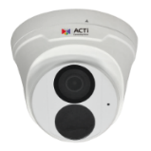
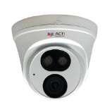
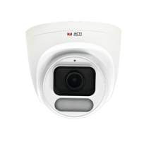
Spec Comparison:
Model | Z79 | Z722 | Z54 (new)
Photo
Product type | Turret | Turret | Turret
Resolution | 4MP | 4MP | 4MP
ColorVizion | - | - | Yes
Sensor Size | 1/3” | 1/3" | 1/1.8”
Lens | f2.8mm/F2.0 | f2.8mm/F1.6 | f2.8/F1.0
HOR | 101.1° | 97° | 110.4°
LED | IR LED | IR & WHITE LED | WHITE LED
WDR | Superior 120dB | Superior 120dB | Extreme 135dB
Min Illumination | Color 0.003 lux | Color 0.01 lux | Color 0.0003 lux
Audio | Built-in Mic | Built-in Mic | Built-in Mic
Temperature | -40°C ~ 60°C | -40°C ~ 60°C | -40°C ~ 60°C
Environment | IP68, IK10 | IP68, IK10 | IP68, IK10

Slide 6
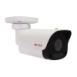
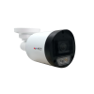

Spec Comparison:
Model | Z317 | Z322 | Z324 (new)
Photo
Product type | Fixed Bullet | Fixed Bullet | Fixed Bullet
Resolution | 4MP | 4MP | 4MP
ColorVizion | - | - | Yes
Sensor Size | 1/3" | 1/3" | 1/1.8”
Lens | f2.8mm/F2.0 | f2.8mm/F1.6 | f2.8/F1.0
HOR | 99° | 97° | 110.4°
LED | IR LED | IR & WHITE LED | WHITE LED
WDR | Superior 120dB | Superior 120dB | Extreme 135dB
Min Illumination | Color 0.003 lux | Color 0.01 lux | Color 0.0003 lux
Audio | Built-in Mic | Built-in Mic | Built-in Mic
Temperature | -40°C ~ 60°C | -40°C ~ 60°C | -40°C ~ 60°C
Environment | IP68, IK10 | IP68, IK10 | IP68, IK10

Slide 7
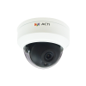
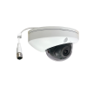
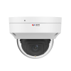
Spec Comparison:
Model | Z911 | Z721 | Z724 (new)
Photo
Product type | Fixed Dome | Fixed Dome | Fixed Dome
Resolution | 4MP | 4MP | 4MP
ColorVizion | - | - | Yes
Sensor Size | 1/3" | 1/3" | 1/1.8”
Lens | f2.8mm/F2.0 | f2.8mm/F1.6 | f2.8/F1.0
HOR | 99° | 101.1° | 110.4°
LED | IR LED | IR LED | WHITE LED
WDR | Superior 120dB | Extreme 135dB | Extreme 135dB
Min Illumination | Color 0.003 lux | Color 0.002 lux | Color 0.0003 lux
Audio | Built-in Mic | Built-in Mic, 2-way | Built-in Mic
Temperature | -40°C ~ 60°C | -40°C ~ 60°C | -40°C ~ 60°C
Environment | IP68, IK10 | IP68, IK10 | IP68, IK10

Slide 8
Supported VMS and Solutions
 | Standard Features | AI Events/Meta | Solutions
NVR 3 Corporate | Yes | Yes | S110, S111, S112
NVR 3 Business | Yes | Yes | S110, S111, S112
CMS 2 | Yes | Yes | S120, S121, S122
ZNR-Series NVR | Yes |  | S60
ENR-Series NVR | Yes |  | S72

Slide 9

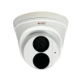

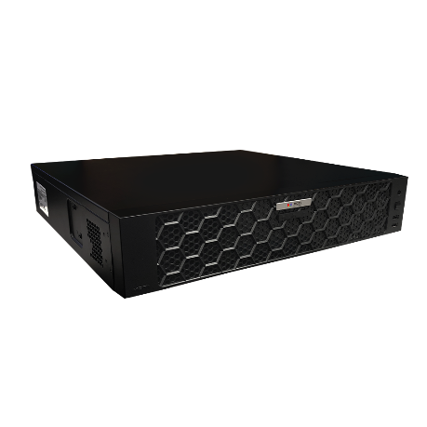



ZNR-Based Architecture Example
Processing Events by Built-in AI or Camera AI
Web Client
Z-Series AI Cameras (smart motion detection)
E-Mail Notification with Snapshots
ZNR-Series NVR
Other Cameras
Automatic Alarm
Auto Upload to FTP

Slide 10
Application:
The most valuable applications of these cameras are the AI-powered physical security surveillance based on true colors. The cameras collect the precise appearance metadata, such as the color of the jacket, color of the pants, color of hair, color of the vehicle. Thanks to the color precision, it is possible to identify the same suspect through different locations, which is very challenging for the conventional IP cameras.

Slide 11
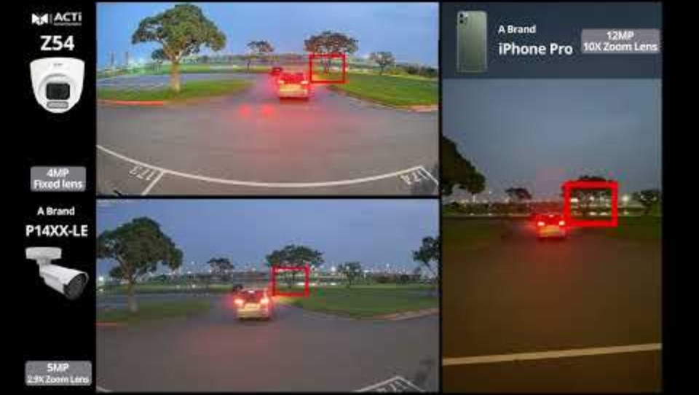
Brand Comparison Video:
https://Download.acti.com?id=33868

