Slide 1
Z318, Z319, Z53, Z912, Z913
New Product Introduction
More powerful built-in AI and WDR

Slide 2
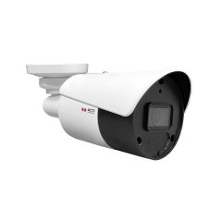
ACTi is introducing the newest products:
Z318
8MP LightGuard Fixed Bullet with D/N, Adaptive IR, Extreme WDR 130dB, SLLS, Fixed lens, f2.8mm/F1.6 (HOV:112.9°), H.265/H.264, 1440p/30fps, 2D+3D DNR, Built-in Microphone, PoE/DC12V, IP67, Deep Learning AI, Smart Motion Detection, Sound Detection
Z319
5MP LightGuard Fixed Bullet with D/N, Adaptive IR, Extreme WDR 130dB, SLLS, Fixed lens, f2.8mm/F1.6 (HOV:112.9°), H.265/H.264, 2D+3D DNR, Built-in Microphone, PoE/DC12V, IP67, Deep Learning AI, Smart Motion Detection, Sound Detection

Slide 3
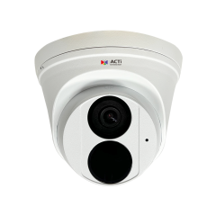
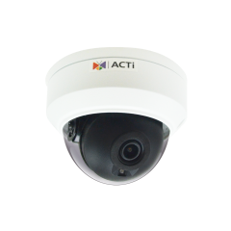
ACTi is introducing the newest products:
Z53
5MP Deep Learning AI f2.8mm Outdoor Turret with D/N, IR LED 30m, Smart Motion Detection
Z912
5MP Deep Learning AI f2.8mm Outdoor Dome with D/N, IR LED 30m, Smart Motion Detection
Z913
8MP Deep Learning AI f2.8mm Outdoor Dome with D/N, IR LED 30m, Smart Motion Detection

Slide 4
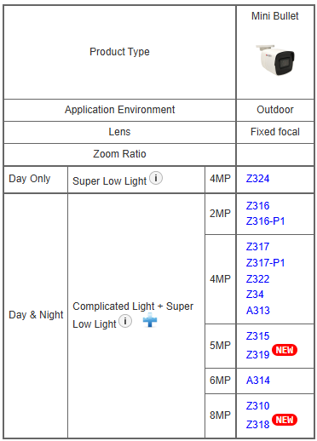
Product Matrix:
Z319 is the migration model of Z315 with more powerful AI and the newest chipset.
Z318 is the migration model of Z310 with more powerful AI and the newest chipset.
The previous models will be available until the remaining stock is sold out.

Slide 5
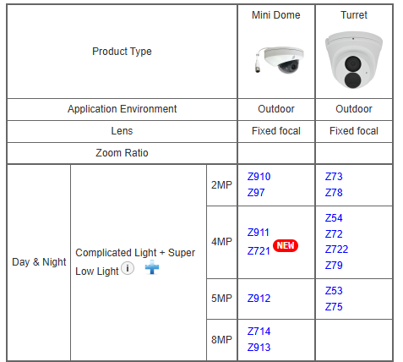
Product Matrix:
Z53 is the migration model of Z75 with more powerful AI and the newest chipset.
Z912 is the migration model of Z715 with more powerful AI and the newest chipset.
Z913 is the migration model of Z714 with more powerful AI and the newest chipset.
Z715

Slide 6
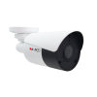
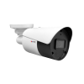
Spec Comparison:
Model | Z315 | Z319 (new) | Z310 | Z318 (new)
Photo
Product type | Fixed Bullet | Fixed Bullet | Fixed Bullet | Fixed Bullet
Resolution | 5MP | 5MP | 8MP | 8MP
Lens | f2.8mm | f2.8mm | f2.8mm | f2.8mm
HOR | 112.9° | 112.9° | 99° | 98.7°
LightGuard | Yes | Yes | Yes | Yes
WDR | Superior 120dB | Extreme 130dB | Superior 120dB | Extreme 130dB
IR Distance | 50m | 50m | 50m | 60m
Audio | Built-in Mic | Built-in Mic | Built-in Mic | Built-in Mic
Environment | IP68, IK10 | IP68, IK10 | IP68, IK10 | IP68, IK10
Analytics | Yes | Yes | Yes | Yes

Slide 7
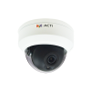
Spec Comparison:
Model | Z715 | Z912 (new) | Z714 | Z913 (new)
Photo
Product type | Fixed Dome | Fixed Dome | Fixed Dome | Fixed Dome
Resolution | 5MP | 5MP | 8MP | 8MP
Lens | f2.8mm | f2.8mm | f2.8mm | f2.8mm
HOR | 112.9° | 112.9° | 99° | 99°
LightGuard | Yes | Yes | Yes | Yes
WDR | Superior 120dB | Extreme 130dB | Superior 120dB | Extreme 130dB
IR Distance | 40m | 50m | 40m | 60m
Audio | Built-in Mic | Built-in Mic | Built-in Mic | Built-in Mic
Environment | IP68, IK10 | IP68, IK10 | IP68, IK10 | IP68, IK10
Analytics | Yes | Yes | Yes | Yes

Slide 8
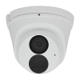
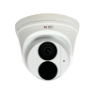
Spec Comparison:
Model | Z75 | Z53 (new)
Photo
Product type | Fixed Turret | Fixed Turret
Resolution | 5MP | 5MP
Lens | f2.8mm | f2.8mm
HOR | 112.9° | 112.9°
LightGuard | Yes | Yes
WDR | Superior 120dB | Extreme 130dB
IR Distance | 30m | 50m
Audio | Built-in Mic | Built-in Mic
Environment | IP68, IK10 | IP68, IK10
Analytics | Yes | Yes

Slide 9
Popular Analytics
 | Z715 | Z912 | Z75 | Z53 | Z714 | Z913
Smart Motion Detection | Y | Y | Y | Y | Y | Y
Intrusion Detection | Y | Y | Y | Y | Y | Y
People Detection | Y | Y | Y | Y | Y | Y
Vehicle Detection | Y | Y | Y | Y | Y | Y
 | Z315 | Z319 | Z310 | Z318
Smart Motion Detection | Y | Y | Y | Y
Intrusion Detection | Y | Y | Y | Y
People Detection | Y | Y | Y | Y
Vehicle Detection | Y | Y | Y | Y

Slide 10
Supported VMS and Solutions
 | Standard Features | AI Events/Meta | Solutions
NVR 3 Corporate | Yes | Yes | S110, S111, S112
NVR 3 Business | Yes | Yes | S110, S111, S112
CMS 2 | Yes | Yes | S120, S121, S122
ZNR-Series NVR | Yes |  | S60
ENR-Series NVR | Yes |  | S72

Slide 11


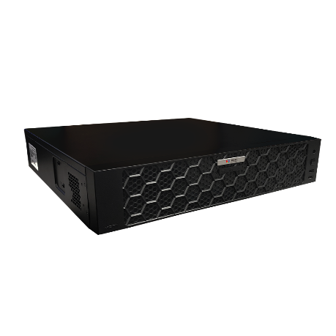



ZNR-Based Architecture Example
Processing Events by Built-in AI or Camera AI
Web Client
Z-Series AI Cameras (smart motion detection)
E-Mail Notification with Snapshots
ZNR-Series NVR
Other Cameras
Automatic Alarm
Auto Upload to FTP

