Slide 1
ZNR-429, ZNR-429-32ch
Product Introduction

Slide 2
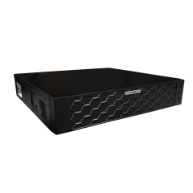
Product Overview
ZNR-429
64-Channel 8-Bay RAID Deep Learning AI Linux-Based Rackmount Standalone NVR
ZNR-429-32ch
32-Channel 8-Bay RAID Deep Learning AI Linux-Based Rackmount Standalone NVR

Slide 3
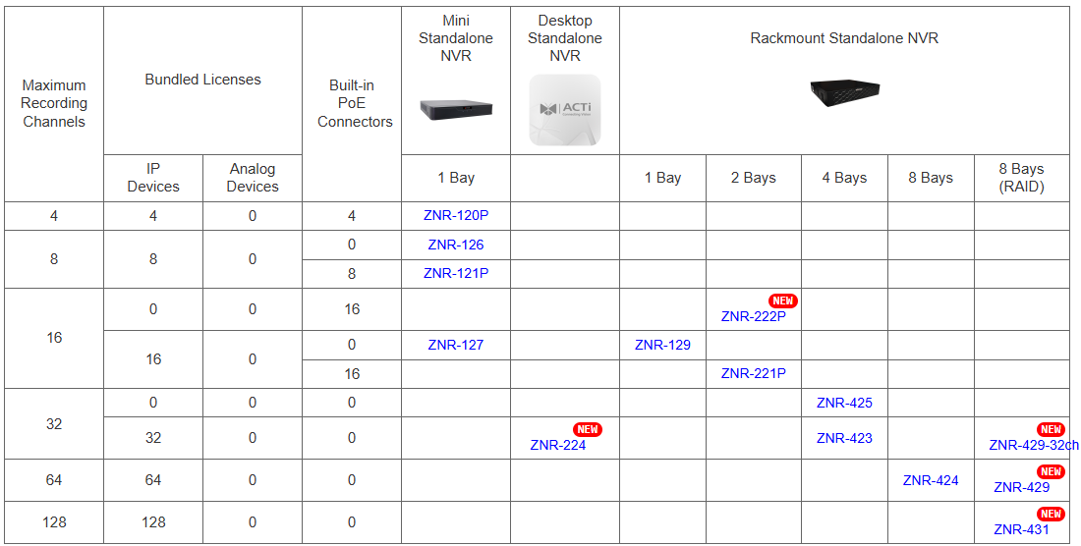
Product Matrix
2 Bay

Slide 4
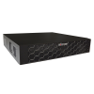
Spec Comparison:
Model | ZNR-424 | ZNR-429 (new) | ZNR-429-32ch (new)
Photo
Maximum Channels | 64 | 64 | 32
Storage Bays | 8 | 8 | 8
RAID | No | RAID 0,1,5,6,10 | RAID 0,1,5,6,10
Maximum disk sizes | 22TB x 8 | 22TB x 8 | 22TB x 8
Camera Analytics | Yes | Yes | Yes
NVR Analytics | No | Deep Learning AI | Deep Learning AI
Recording Throughput | 320 Mbps | 384 Mbps | 384 Mbps
Outgoing Throughput | 160 Mbps | 384 Mbps | 384 Mbps
NDAA | Yes | Yes | Yes

Slide 5

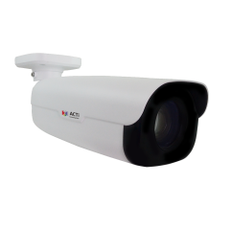

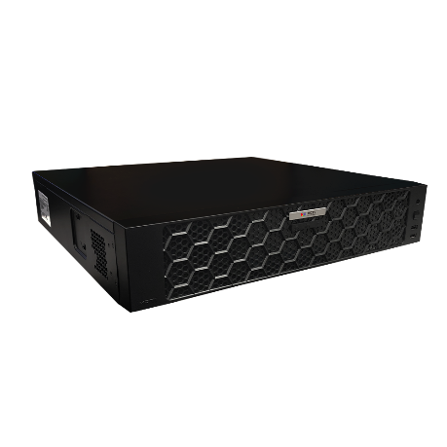


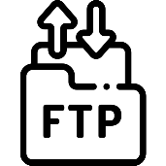
Architecture
Processing Events by Built-in AI or Camera AI
Web Client
Z-Series AI Cameras (smart motion detection)
E-Mail Notification with Snapshots
ZNR-429
Other ONVIF IP Cameras
Automatic Alarm
Auto Upload to FTP

Slide 6
AI Related Features
NVR Analytics | Smart Intrusion Protection (detect people, vehicles entering/ exiting area or crossing the line),
 | Smart Motion Detection (detect when the people, vehicles or other objects move in the predefined area),
 | Face Recognition, Face Detection, Object Metadata
NVR Analytics Maximum Channels | Smart Intrusion Protection up to 8 channels
 | Other analytics up to 16 channels
NVR Object Metadata | Gender, age, glasses, mask, vehicle type, vehicle color, vehicle brand, vehicle direction, license plate type, license plate color, license plate number.
Deep Learning AI | 2.0
Object Recognition Database | Face Picture Capacity: 40,000
 | Vehicle Picture Capacity: 25,000
Maximum Snapshot Capacity | Captured Face Snapshots: 3,000,000
 | Captured Vehicle Snapshots: 2,000,000
 | Captured Object Snapshots via Smart Intrusion Prevention: 2,000,000
 | Object Metadata Snapshots: 2,000,000

Slide 7

AI Related Features
Camera Analytics | Receive analytics-based events from the cameras (Smart Intrusion Protection, Smart Motion Detection, etc) and respond to the events
Z-Series AI Cameras (smart motion detection)
ZNR-429
Other ONVIF IP Cameras

Slide 8
AI Related Search and Playback Features
Excellent search capabilities are the core of the AI solutions. The productivity comes from the convenient search options.
Features | Description | ZNR-424 | ZNR-429
Event Search | Search within previously recorded AI events | Yes | Yes
Smart Search | Set ROI and look for the people and vehicles appearing in the ROI in the past recordings (requires cameras with Smart Motion Detection feature) |  | Yes
Forensic Search | Select target object (people, vehicle) and search for the similar object through all the channels |  | Yes
Metadata Search | Select attribute filters (color, gender, age, etc) and find thumbnails matching the criteria |  | Yes
Synchronized Playback | View synchronized playback of multiple channels (ZNR-424 and ZNR-429 up to 32 concurrent channels, ZNR-429-32ch up to 16 concurrent channels) | Yes | Yes
Object Visual Tracking | View thumbnails generated by Forensic Search and playback by time sequence |  | Yes

Slide 9
AI Related Event Features
Event Trigger | [NVR]: IP address conflict, Network Loss, Disk full, Disk not found, Disk abnormal, Low disk space, Disk full, Illegal access, Recording/Snapshot abnormal, Crowd detection with three different concurrent thresholds with priority, Smart Intrusion Protection, Smart Motion Detection, Face Recognition
 | [Video Device]: Video motion detection, Tampering detection, Defocus detection, External device through digital input, Sound detection, Video loss, Smart Intrusion Protection, Smart Motion Detection, Face Recognition, Face Detection, People detection, Vehicle Detection; People Line Crossing Detection, People Enter Area Detection, People Exit Area Detection, Vehicle Detection, Vehicle Line Crossing Detection, Vehicle Enter Area Detection, Vehicle Exit Area Detection, Temperature Detection, Fire Detection, Smoke Detection, Temperature Measurement, Missing Object Detection, Unattended Object Detection, PTZ Auto Tracking, People Counting, Crowd detection, Automatic License Plate Recognition, Traffic Monitoring
Event Response | Command a PTZ device to go to a preset point, Play alert sound, Activate external device through digital output, Send command over HTTPS, Save snapshot, Upload video or snapshot to FTP server, E-mail notification with snapshots

Slide 10
Popular AI Applications
Smart Intrusion Protection - detect people, vehicles entering/ exiting area or crossing the line).
Useful for the perimeter surveillance to prevent trespassing while avoiding false alarms. Very accurate!
Smart Motion Detection - detect when the people, vehicles or other objects move in the predefined area.
Used to strictly focus on moving objects and ignore the still objects. For example, the security personnel will be notified when the vehicle in the parking lot is being moved.

Slide 11
Popular AI Applications
Face Recognition – identify the people by their face.
Can be used as whitelist (for example employees) or blacklist (unwanted or dangerous people)
Object Metadata - Gender, age, glasses, mask, vehicle type, vehicle color, vehicle brand, vehicle direction, license plate type, license plate color, license plate number.
This allows quick investigations of the incidents or find suspects very fast using the combination of various attributes together, such as the vehicle color and vehicle brand together with the vehicle’s direction of driving.

