Slide 1
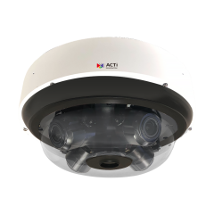
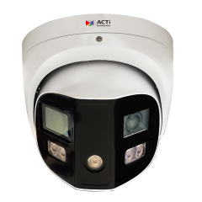
Q84, Q550
New Product Introduction

Slide 2
ACTi is introducing the newest products:
Q84
20MP Outdoor Multi-Imager 360 Degree Dome with D/N, Adaptive IR, Extreme WDR, SLLS, four 5x Zoom lenses
Q550
8MP Outdoor Multi-Imager 180 Degree Turret with Adaptive IR, White LED, Extreme WDR, SLLS, 2 Fixed lenses

Slide 3
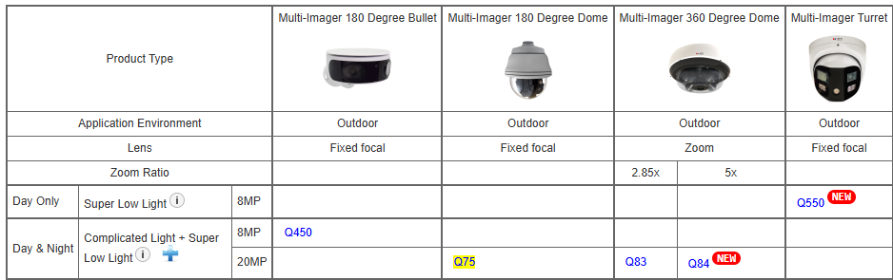
Product Matrix:

Slide 4

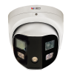
Spec Comparison:
Model | Q84 | Q550
Photo
Product type | Multi-Imager Dome | Multi-Imager Turret
Resolution | 20MP | 8MP
Lenses | 4 Zoom Lenses | 2 Fixed Lenses
View | 4 independent views | Stitched into a single panoramic view
Zoom | 5x | -
IR LED | Yes | Yes
White LED | No | Yes
WDR | 130dB | 130dB
Low Light | Superior | Superior
Audio | Yes (2-way) | Yes (2-way)
Analytics | Yes | Yes
In/Outdoor | Outdoor | Outdoor

Slide 5
Popular Analytics Comparison:
Analytics | Q84 | Q550
Object Based Motion Detection | Y | Y
Object Line Crossing Detection | Y | Y
People Line Crossing Detection | Y | Y
Vehicle Line Crossing Detection | Y | Y
People Detection | Y | Y
Vehicle Detection | Y | Y
People Counting | Y | Y
To see the full list of analytics, please visit ACTi website.

Slide 6
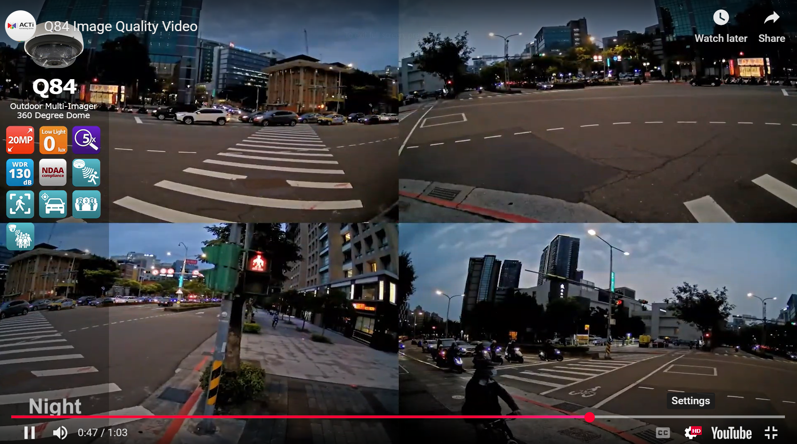
Q84 Demo Video
https://www.acti.com/video/v3159

Slide 7
Supported VMS and Solutions
 | Standard Features | AI Events/Meta | Solutions
NVR 3 Corporate | Yes | Yes | S110, S111, S112
NVR 3 Business | Yes | Yes | S110, S111, S112
CMS 2 | Yes | Yes | S120, S121, S122
ZNR-Series NVR | Yes |  | S60
ENR-Series NVR | Yes |  | S72

Slide 8
Highly Useful Applications
Traffic Intersections
Perimeter
City Squares and Parks
Parking Lots
Campuses
Factories & Warehouses
Airports
Railway Stations

