Slide 1
Z972
New Product Introduction

Slide 2
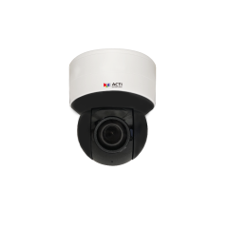
ACTi is introducing the newest product:
Z972
5MP Wireless Indoor Mini PTZ with D/N, Adaptive IR, Extreme WDR, SLLS, 5x Zoom Lens
A wireless version of the short-range zoom PTZ with IR LED!

Slide 3
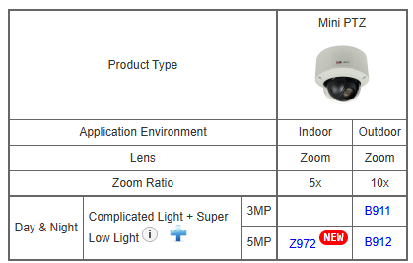
Product Matrix:

Slide 4
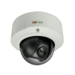
Spec Comparison:
 | B911 | B912 | Z972
Product type | Mini PTZ | Mini PTZ | Mini PTZ
Resolution | 3MP | 5MP | 5MP
Zoom | 10x | 10x | 5x
IR LED | No | No | Yes
WDR | 145dB | 120dB | 130dB
Low Light | Superior | Superior | Superior
Wireless | No | No | Yes*
Audio | Yes | Yes | Yes
Analytics | Less | Less | More
In/Outdoor | Outdoor | Outdoor | Indoor
NDAA | No | No | Yes
* Wireless feature available but not shown in public spec sheet.

Slide 5
Analytics Comparison:
Analytics | B911, B912 | Z972
Tampering Detection | Y | Y
Object Based Motion Detection | Y | Y
People Line Crossing Detection | - | Y
Vehicle Line Crossing Detection | - | Y
People Detection | - | Y
Vehicle Detection | - | Y

Slide 6
Supported VMS and Solutions
 | Standard Features | AI Events/Meta | Solutions
NVR 3 Corporate | Yes | Yes | S110, S111, S112
NVR 3 Business | Yes | Yes | S110, S111, S112
CMS 2 | Yes | Yes | S120, S121, S122
ZNR-Series NVR | Yes |  | S60
ENR-Series NVR | Yes |  | S72

Slide 7
Applications
Budget driven indoor PTZ applications, with convenient installation
Retail
Hospital
School

