Slide 1
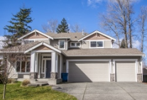
ACTi Residential Surveillance Solutions

Slide 2
Residential: Overview
ACTi's end-to-end smart residential management solutions optimize the security and operation management of the living environment using video analytics along with the integration of access control, intercom, alarm and surveillance systems.
ACTi offers an end-to-end IP video surveillance solution for three different scopes of residential market:
- Single-Family House, Villa, Bungalow
- Condominium, Apartment Building, Townhouse
- Apartment Block, Tower Block
The security or business management related challenges and solution requirements vary for each residential type. For example, the common challenges may include trespassing, theft, suspicious activities around the area, etc.
ACTi's end-to-end residential surveillance solution consists of IP cameras, video management system, mobile surveillance, video analytics, access control, alarm system, and much more.

Slide 3
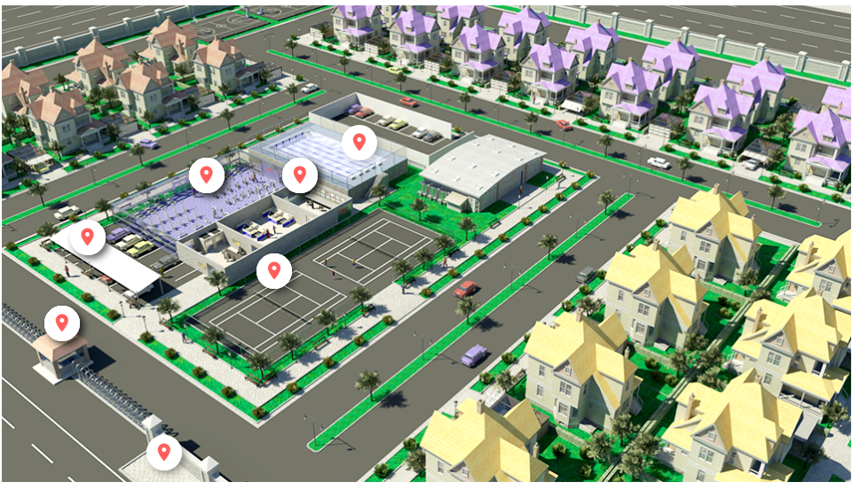
Residential: Map
Residential Buildings
Residential Buildings
Swimming Pool
Gym
Control Room
Outdoor Parking
Sports Court
Residential Buildings
Area Entrance
Surrounding
Area Gate

Slide 4
Residential: Applications vs Locations
 | Area Entrance | Area Gate | Control Room | Residential Buildings | Swimming Pool | Sports Court | Parking | Surrounding
Unauthorized Access Detection | Y |  | Y | Y | Y | Y
Tailgating Detection |  |  | Y
Real-time Suspect Tracking | Y | Y | Y | Y | Y | Y | Y | Y
Vehicle Access Control |  | Y |  |  |  |  | Y
Intercom Service | Y | Y |  | Y | Y | Y | Y
Trespassing Detection | Y |  | Y |  | Y | Y |  | Y
Suspicious Littering Detection |  |  |  |  |  |  | Y | Y
On-the-Go Surveillance | Y | Y | Y | Y | Y | Y | Y | Y
Safety Assurance | Y | Y | Y | Y | Y | Y | Y | Y
Video Evidence Push to NVR by Mobile Phone | Y | Y | Y | Y | Y | Y | Y | Y

Slide 5





Residential: Applications
Unauthorized Access Detection
Detect the intrusion attempts using video analytics and notify the security personnel.
Tailgating Detection
Detect tailgating at the entrance of restricted area by comparing the detected head count with number of presented access credentials.
Real-time Suspect Tracking
Track the suspect seamlessly by switching between video channels using transparent video overlay buttons in video management system.
Vehicle Access Control
The access control at the gate can be done conveniently using ALPR technology.
Intercom Service
Interact with other individuals by local voice-based communication system.

Slide 6






Residential: Applications
Trespassing Detection
Detecting the person entering the area without permission.
Suspicious Littering Detection
Detect the items that are left unattended to prevent security and environmental hazards.
On-the-Go Surveillance
Monitor the views from surveillance cameras using a mobile device while walking around the premises, to respond to incidents instantly.
Safety Assurance
Ensure safety of people using video surveillance system.
Video Evidence Push to NVR by Mobile Phone
Use the built-in camera of the mobile phone to stream the video evidence of the incident to NVR.

Slide 7


Residential: Applications
Unauthorized Access Detection
Detect the intrusion attempts using video analytics and notify the security personnel.
Without surveillance videos, it is hard to be sure if the identity shown in the entry log matches the accessing person. Access control integrated with the surveillance system can remarkably prevent the crises and loss resulted from unauthorized access.
This is based on the Face Recognition analytics in ACTi’s Door Stations.
Solutions
Read

Slide 8

Residential: Applications
Tailgating Detection
Detect tailgating at the entrance of restricted area by comparing the detected head count with number of presented access credentials.
Whenever the RFID card is swiped, the system will count the number of the actual entries. When mismatched, the system will create the alarm. This prevents both tailgating and piggybacking.
This is based on the People Counting analytics and RFID technology. Read More.
Solutions
Read

Slide 9




Residential: Applications
Real-Time Suspect Tracking
Track the suspect seamlessly by switching between video channels using transparent video overlay buttons in video management system.
Track the suspect using the video management system interface by using the convenient feature of switching the views with 1 click on the video which opens up the next view of the area the suspect is moving towards to. This method works for both live view and playback. By this method it is possible to instantly find out where the suspect is going and dispatch officers to handle the situation immediately.
This is based on the unique Visual Tracking feature of ACTi’s NVR 3 and CMS 2.
Solutions
Read
Read
Read

Slide 10

Residential: Applications
Vehicle Access Control
The access control at the gate can be done conveniently using ALPR technology.
Except for the highest security facilities, most locations can benefit from the automatic gate control without requiring the gate officer to be present all the time. Only the white-listed vehicles can enter the premises. Furthermore, it is possible to set up a blacklist which alerts the security officers instantly when the blacklisted vehicle appears.
This is based on the ALPR analytics inside ACTi cameras. Read More.
Solutions
Read

Slide 11

Residential: Applications
Intercom Service
Interact with other individuals by local voice-based communication system.
There will be voice access points as intercoms in various locations across the Residential, such as gates and entrances, loading area, parking lot and others. The employees and the visitors can talk to the security staff immediately using that feature.
This is based on the NVR 3 or CMS 2 along with intercom devices such as Q950.
Solutions
Read
Read
Read

Slide 12



Utility: Applications
Trespassing Detection
Detecting the person entering the area without permission.
When a person enters someone's land or property without permission, it is considered trespassing, and it is illegal. There are places that are restricted for strangers nearly all the time, such as the whole territory of the Utility plant. There are also some places that are open for anyone during daytime but are closed at night due to safety reasons. Entering those areas at night would be considered trespassing.
This is based on the People Enter Area Detection analytics inside ACTi cameras. Read More.
Solutions
Read
Read
Read
Read
Read

Slide 13

Residential: Applications
Suspicious Littering Detection
Detect the items that are left unattended to prevent security and environmental hazards.
The unattended objects, such as trash bags and other bulky items are considered risk items that should be handled quickly. Some objects can sometimes be accidentally forgotten there. An early detection saves them from being stolen. Rarely, these items could also pose threats as being malicious.
This is based on the Unattended Object Detection analytics inside ACTi cameras. Read More.
Solutions
Read
Read
Read
Read

Slide 14

Residential: Applications
On-the-Go Surveillance
Monitor the views from surveillance cameras using a mobile device while walking around the premises, in order to respond to incidents instantly.
Universal mobile application designed to remotely access NVR, CMS or camera for video playback and management.
Features: Live view and playback, Search video recordings by events, PTZ Control, Google Maps, Activate Digital Output, Playback from camera's memory card
This is based on the ACTi Mobile Client, both for Android and iOS. It is free.
Solutions
Read
Read
Read

Slide 15

Residential: Applications
Safety Assurance
Ensure safety of people using video surveillance system.
ACTi provides surveillance solution for ensuring the safety with both overview and details monitoring. By installing a camera with wide viewing angle at the center or the corner of the store, the whole area can be perfectly covered. Meanwhile, the faces of people entering the premises can be captured by the covert camera discreetly installed into the height strip at the entrance.
For large scale projects, ACTi TV Wall enables multiple views to be displayed on different monitors at the same time. Get the complete overview to improve situational awareness and operational efficiency.
Solutions
Read
Read
Read
Read
Read

Slide 16

Residential: Applications
Video Evidence Push to NVR by Mobile Phone
Use the built-in camera of the mobile phone to stream the video evidence of the incident to NVR.
The patrolling security guard can now use his smartphone with ACTi Mobile Client to capture live video and "push" it through wireless network to NVR 3 in real time. Moreover, the recording can be reviewed later during incident investigation using advanced features that apply to surveillance cameras including synchronized playback, bookmarks, timeline search, and more.
This is based on the ACTi Mobile Client, both for Android and iOS. It is a free app.
Solutions
Read
Read

Slide 17
Recommended Products vs Locations
 | Area Entrance | Area Gate | Control Room | Residential Buildings | Swimming Pool | Sports Court | Parking | Surrounding
Thermal Cameras (A-Series, VMGB-Series) |  |  |  |  | Y | Y | Y | Y
Intercom (Q950) | Y | Y |  | Y | Y | Y | Y
ALPR Bullet Camera (A426) |  | Y |  |  |  |  | Y
Access Control Door Station (R1- R7- series readers/controllers) | Y |  | Y | Y | Y | Y
People Counter for Tailgating prevention (Q963) |  |  | Y
General Surveillance Bullets (3xx, 4xx series) | Y | Y | Y | Y | Y | Y | Y | Y
General Surveillance Domes (91x, 7xx, 8xx series) | Y | Y | Y | Y | Y | Y | Y | Y

Slide 18
Products vs Management Servers
 | Windows NVR (NVR 3) | Access Control Smart Server
Thermal Cameras (A-Series, VMGB-Series) | Y | Y
Intercom (Q950) | Y | -
ALPR Bullet Camera (A426) | Y | Y
Access Control Door Station (R1- R7- series readers/controllers) | - | Y
People Counter for Tailgating prevention (Q963) | Y | Y
General Surveillance Bullets (3xx, 4xx series) | Y | Y
General Surveillance Domes (91x, 7xx, 8xx series) | Y | Y

Slide 19

Windows NVR (NVR 3)
NVR 3 is one of the most famous ACTi products – it is a professional and elegant network video recorder platform with wide range of features and extremely reliable performance, available in two editions (read more).
Feature | NVR 3 Business | NVR 3 Corporate
Maximum Number of Channels | 100 | 200 (Standalone NVR 256)
Free ACTi Camera Channels Included | 32 | 1
Free 3rd Party Camera Channels Included | 1 | 1
CMS Support | No | Yes
POS, Access Control, Network IO Support | No | Yes
eMap | Yes | Yes
Google Map | No | Yes
Embedded Websites within Display | No | Yes
PTZ Control | Yes | Yes
Redundancy Support (N+1, N-to-N) | Yes | Yes
Workstation, Web Client, Mobile Client | Yes | Yes
Display Layouts (maximum grid size) | 225 | 225

Slide 20


Access Control Smart Server
Access Control Smart Server (ACSS) is an easy-to-use access control software for managing employees and visitors access through the doors and gates as well as managing employee attendance. (read more)
Core Function
Access Control Management Doors, gates, locks, identification of face*, card, ALPR*, tailgating* detection
Attendance Management Work shifts, clock-in, clock-out, late, absent
Visitor management Visitor enrollment for temporary access
Construction site management Temporary sites management
Food ordering management Conveniently manage the employee services
Conference room management Book the available meeting rooms in your company
Customer arrival management Track when the customers arrive to the appointments

Slide 21





ACTi Deep Learning AI Camera Product Line
Deep learning is a method in artificial intelligence (AI) that teaches computers to process data in a way that is inspired by the human brain. Deep learning models can recognize complex patterns in pictures, text, sounds, and other data to produce accurate insights and predictions.
Model | A426 | A826 | A952 | A956 | Q83
Photo
Type | Zoom Bullet | Zoom Dome | Speed Dome | Speed Dome | Multi-Imager
Resolution | 5MP | 5MP | 8MP | 2MP | 20MP
Lens | 4.4x Zoom | 4.4x Zoom | 22x Zoom | 40x Zoom | 4 zoom lenses
Built-in Vehicle Related Analytics | Vehicle Counting, Vehicle Line Crossing Detection, Vehicle Enter Area Detection, Vehicle Incorrect Direction Detection, Vehicle Loitering Detection, Vehicle Tracking, Stopped vehicle detection, License Plate Detection, Automatic License Plate Recognition

Slide 22


A426 Residential Installation
PMAX-0534
Pole Mount with Junction Box, supports 3.25" to 7.0" Poles
A426
5MP Zoom Bullet with D/N, Adaptive IR, Extreme WDR, SLLS, 4.4x Zoom Lens, Deep Learning AI

Slide 23


ALPR Camera (A426)
The AI camera can recognize multiple license plates across multiple lanes at the same time.
WATCH THE VIDEO
https://www.acti.com/video/v2902
ALPR Camera + NVR 3
ACTi NVR 3 supports the deep learning AI events and metadata. When the blacklisted vehicle is detected, the NVR will display instant alert.
WATCH THE VIDEO
https://www.acti.com/video/v2904

Slide 24





ACTi AI Solution Architecture
MOBILE CLIENT
E-mail
alerts
alerts
video
video
Realtime
analytics data
Realtime
analytics data, alerts
AI CAMERA
NVR SERVER
(ACTi NVR 3 Corporate)
NVR CLIENT

Slide 25
ACTi Advantages compared to Server-Based AI Providers
Hundreds of channels with deep learning analytics can be managed by a single VMS server, using just a common server hardware configuration. The Server-based AI solutions have limited number of channels and require very expensive hardware.
VMS video recording functionality is much better secured when the VMS does not have the burden of running the analytics that may consume the server resource to its limits.
Faster response to the events – AI cameras can control the other nearby PTZ cameras for instant response, to get better video coverage of the scene. The analyses that are processed on the VMS side will be too slow for proper response.
Since the AI features are inside the camera, there are no Analytics related licenses required on the server side. Therefore, the cost of VMS in some cases is up to 10 times lower than the server-side AI solutions.

Slide 26
NVR and CMS Features
ACTi NVR 3 Corporate (and CMS 2) manages the analytics events from the cameras as follows:
Set up the analytic rules and thresholds – for example, how big is the crowd, how long time is considered loitering.
Receive real-time analytic events from all the cameras and respond by the pre-defined actions, such as send e-mail, instant pop-up of the video channel on the VMS screen and more.
Automatically push video to the mobile app of the patrolling security guards.
Search by the specific filter rules, bookmarks, thumbnails.

Slide 27

Where to Buy
Via Authorized Resellers
https://www.acti.com/Corporate/WhereToBuy
From ACTi Corporation Directly
E-Mail: sales@acti.com
Tel (US): +1-866-410-2284 (Toll Free)
Tel (Non-US): +886-2-2656-2588

Slide 28
Support & Services
Technical Support
- Online Customer Helpdesk - https://www.acti.com/chd
- Phone support
US: +1-866-410-2284 (Toll Free)
Other Regions: +886-2-2656-5200
RMA Services
- Warranty
- Repair services
Training
- Self-learning

