Slide 1
ACTi Sales Training
New Product Introduction
20250208

Slide 2
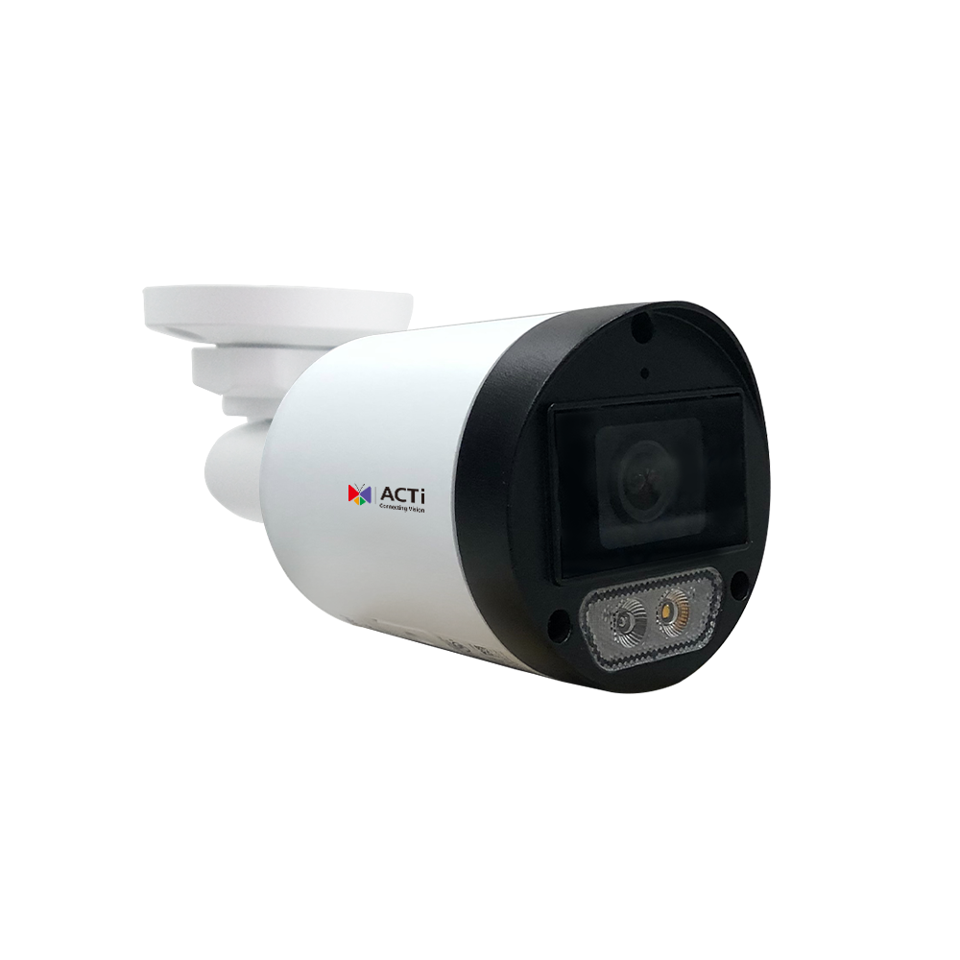
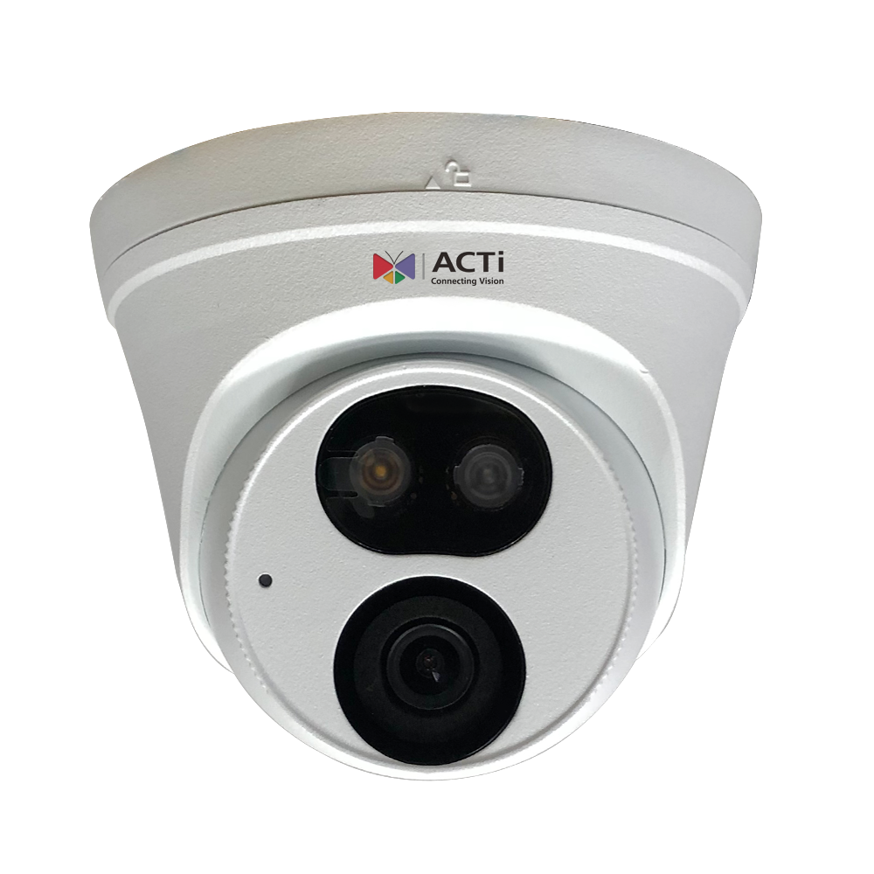
Z322/Z722: Features
Feature1: Vivid Event Clarity
  Full-color imaging enhances recognition in critical events.
Feature2: Advanced White LED Technology
  Delivers superior night vision, even for low-IR-reflective objects.
Feature3: Smart Detection Capabilities
  Basic IVA ensures accurate detection of people, vehicles, and sound.
https://www.acti.com/product/Z 322
https://www.acti.com/product/Z 722

Slide 3
Z322/Z722: Features
Feature4: Flexible Camera Options
  Available in bullet and turret models to meet diverse installation needs.
Feature 5: Unmatched Value
  NDAA-compliant with the most competitive pricing against Chinese brands.
https://www.acti.com/product/Z 322
https://www.acti.com/product/Z 722

Slide 4
Z322/Z722: Market to Application
Factory ( Factory )
Serial Number | Function | Function Description | Suitable Locations | Operating Procedures | Application Scenarios | Benefits
1 | Clear Event Imaging | Through full color imaging technology, ensure that key events can be accurately identified, enhancing security. | 1) Production Line 2) Storage Area 3) Entrance Passage | 1) Monitor Key Areas 2) Real-time Alarm Trigger 3) Security Team Response | Abnormal Monitoring during Production Process: Identify machine failures and unusual personnel actions through full color imaging. | Reduce security risks and improve production management efficiency
2 | Advanced White Light LED Technology | Provides exceptional night vision capabilities, clearly presenting even low infrared reflective objects | 1) Night Patrol Route 2) Material Storage Area 3) Perimeter of the Factory | 1) Night Monitoring Activation 2) Automatic Supplementary Lighting in Low Light Areas 3) Event Recording | Night Safety Patrol: Ensure high visibility during patrols to detect suspicious personnel or abnormal situations | Enhance nighttime security monitoring to reduce the risk of suspicious activities
3 | Intelligent Detection Capability | Support for personnel, vehicle, and sound detection to improve the accuracy of security management | 1) Main Entrance 2) Main Passage 3) Parking Area | 1) Set Monitoring Area 2) AI Detect Abnormal Behavior 3) Trigger Alarm and Record | Automatic Abnormal Alarm: The system automatically notifies management personnel when individuals or vehicles violate entry into the controlled area | Reduce false alarms, improve monitoring efficiency, and enhance incident response speed
4 | Flexible installation options | Available in bullet and dome camera types to meet different installation needs | 1) Ceiling installation area 2) Wall monitoring points 3) Production line equipment monitoring | 1) Choose the camera model based on requirements 2) Install at the optimal field of view 3) Make remote adjustments | Flexible deployment of monitoring points: Install the most suitable camera type based on the needs of different areas | Reduce installation costs and enhance monitoring flexibility

Slide 5
Z322/Z722: Market to Application
Commercial Building ( Commercial Building )
Serial Number | Function | Function Description | Suitable Locations | Operating Procedures | Application Scenarios | Benefits
1 | Clear Event Imaging | Full color imaging technology ensures the identification of suspicious personnel and events even in low light conditions | 1) Building entrances and exits 2) Elevator lobby 3) Main corridor | 1) Real-time monitoring footage 2) Automatic recording of abnormal events 3) Security personnel reviewing footage | Access control assistance: Accurately identify personnel entering and exiting during nighttime or low light conditions | Enhance building security and reduce the risk of unauthorized access
2 | Advanced White Light LED Technology | Provides clear night vision in low-light environments, ensuring immediate monitoring footage is available | 1) Underground Parking Lot 2) Parking Lot Entrance and Exit 3) Fire Lane | 1) Night mode automatically activates 2) LED Supplemental lighting activates 3) Video recording | Parking lot monitoring: Clear identification of license plates and individuals, reducing the risk of vehicle theft and vandalism | Enhance night monitoring, reduce blind spots, and improve incident response speed
3 | Intelligent Detection Capability | Equipped with personnel, vehicle, and sound detection for precise alerts | 1) Building Lobby 2) Fire Escape Door 3) Rooftop Area | 1) Set Monitoring Area 2) AI Automatic Detection of Abnormal Behavior 3) Trigger Alarm | Prevent Unauthorized Access: When unauthorized personnel enter the controlled area, the system immediately notifies management personnel. | Reduce false alarms, improve security efficiency, and strengthen security management.
4 | Flexible installation options | Bullet and dome cameras can be selected based on different monitoring needs. | 1) Wall Mount 2) Ceiling Monitoring Point 3) Indoor Stairwell | 1) Choose the camera model based on requirements 2) Install at the optimal angle 3) Make remote adjustments | Flexible deployment of monitoring points: Install the most suitable camera type based on the needs of different areas | Reduce installation costs and enhance monitoring flexibility

Slide 6
Z322/Z722: Market to Application
Logistics ( Logistics )
Serial Number | Function | Function Description | Suitable Locations | Operating Procedures | Application Scenarios | Benefits
1 | Clear Event Imaging | Providing high-definition surveillance during the loading, unloading, and transportation of goods through full-color imaging technology. | 1) Goods Loading and Unloading Area 2) Warehouse Interior 3) Logistics Corridor | 1) Monitoring the flow of goods 2) Automatically recording abnormal events 3) Security personnel reviewing images | Goods Safety Tracking: Ensuring that items are not swapped or damaged during handling and storage. | Reducing the risk of goods loss and theft, while increasing the transparency of goods circulation.
2 | Advanced White Light LED Technology | Ensure clear identification of personnel and vehicle dynamics during nighttime logistics operations | 1) Outdoor Loading Area 2) Parking Lot 3) Warehouse Interior | 1) Night mode automatically activates 2) LED Supplementary Lighting 3) Event Recording | Nighttime Loading Surveillance: Prevent loss or incorrect delivery of goods due to poor visibility at night | Enhance safety during nighttime operations and reduce surveillance blind spots
3 | Intelligent Detection Capability | Utilize AI to detect personnel, vehicles, and sounds to prevent abnormal behavior | 1) Warehouse Entrance and Exit 2) Goods Storage Area 3) Logistics Center Perimeter | 1) Set Monitoring Area 2) AI Detect Abnormal Behavior 3) Trigger Alarm | Unauthorized Entry Alarm: The system automatically alerts when unauthorized personnel or vehicles approach the protected area. | Reduce theft of goods and enhance security management efficiency.
4 | Flexible installation options | Bullet and dome cameras can be flexibly installed according to different logistics scenarios. | 1) High-altitude Surveillance in Warehouse 2) Truck Loading and Unloading Area 3) Logistics Center Main Gate | 1) Choose camera model based on requirements 2) Install at the optimal angle 3) Remote Adjustment of Surveillance Angle | Comprehensive Logistics Monitoring: Ensure that all key logistics links are within the monitoring range | Improve the efficiency of goods turnover and reduce the likelihood of accidents

Slide 7
Z322/Z722: Video

Slide 8
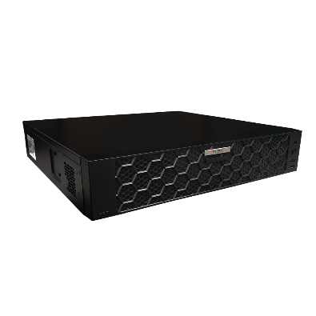
ZNR-429: Features
Feature1: 64 Channel Support
  Free bundled 64-channel license
  Live view with up to 64-channel layout, each camera supporting a maximum resolution of 32MP
  Concurrent recording for up to 64 channels
Feature2: Built-in Hardware RAID
  Built-in Hardware RAID: RAID 0, 1, 5, 6, 10
  Supports maximum storage capacity of 128TB (16TB x 8 bays)
Feature3: AI Events and Metadata Integration
  AI built-in cameras support events and metadata for people and vehicle detection, tracking, counting, classification, and recognition
  NVR built-in AI supports events and metadata for people and vehicle detection, entry/exit area monitoring, loitering, and line crossing
https://www.acti.com/product/ZNR-429

Slide 9
ZNR-429: Features
Feature4: AI Search and Playback Functionality
  Smart Search: Supports ROI-based people and vehicle detection search
  Forensic Search: Allows object-of-interest definition in playback videos for detailed searches (e.g., vehicle type, brand, attributes like color, clothing, gender, age)
  Metadata Search: Filters searches by sub-type and attributes for vehicles, faces, and people
  Object Visual Tracking:
    Verify AI search results via thumbnails
    Time-based tracking to investigate incidents and manage evidence
Feature5: Alarm and IoT Sensor Integration
  Fire and burglar alarms, plus IoT sensors, supported through NVR built-in DIO port
Feature6: Control via Two-way Audio and Keyboard Controller
  Supports keyboard controller for remote PTZ camera control
  Supports two-way audio for remote intercom via IP speaker
https://www.acti.com/product/ZNR-429

Slide 10
ZNR-429: Market to Application
Commercial Building (Commercial Building)
Serial Number | Function | Functional Operation Process | Optimal Location | Operating Procedures | Application Scenarios | Benefits
1 | 64 Channel Support | Multi-channel Monitoring, Viewing and Recording | Main Entrances and Exits, Parking Lot, Elevator | Manage Real-time Imaging to Ensure Entrance and Exit Safety | Monitor Foot Traffic and Vehicle Flow, Detect Abnormal Activities | Reduce Security Incidents and Enhance Real-time Management Efficiency
2 | Build-in Hardware RAID | High-capacity Storage and Ensure Data Integrity | Server Room | Configuration RAID for multi-layer backup | Ensure the availability of long-term recording data | Prevent data loss and improve operational stability
3 | AI Event and Meta | AI Detection of personnel/ vehicle access | Entrance and Exit, Parking Lot | Set AI Detection conditions to activate the alarm | Prevent unauthorized access | Reduce manpower monitoring costs and enhance accuracy
4 | AI Search and Playback | Quickly trace back events | Server Room | Use AI to search recording data | Confirm details of specific events | Quickly handle emergency events
5 | Alarm Sensor Integration | Integration of Fire/ Intrusion Alarms | Next to Fire Safety Facilities, Server Room | Connect Alarm Devices | Monitor Environmental Changes and Respond Quickly | Improve Efficiency in Responding to Security Incidents
6 | Two-Way Audio & Control | Remote Intercom and Control | Entrance and Exit, Monitoring Room | Communicate via IP Speaker | Provide Real-time Alerts or Inquiries | Increase Interactivity and Security Management

Slide 11
ZNR-429: Market to Application
Retail (Retail)
Serial Number | Function | Functional Operation Process | Optimal Location | Operating Procedures | Application Scenarios | Benefits
1 | 64 Channel Support | Multi-angle Monitoring of Each Counter | Cash Register, Warehouse | Real-time Imaging Viewing to Reduce Theft | Reduce Losses, Improve Service | Reduce theft and enhance operational efficiency
2 | Build-in Hardware RAID | Ensure the security of sales data | Information Center | Provide recording backup | Prevent data loss | Enhance customer and operational safety
3 | AI Event and Meta | Detect suspicious customer behavior | Main areas in the store | Set detection conditions | Early warning of abnormal behavior | Enhance customer experience and reduce losses
4 | AI Search and Playback | Quickly find images from specific time periods | Information Center | Quick search using keywords | Quickly resolve customer complaints or disputes | Enhance service efficiency
5 | Alarm Sensor Integration | Integrate business alarms | Important Warehouse, Access Control System | Immediate Alarm Trigger Response | Prevent Fire or Intrusion | Ensure Safety of Property and Personnel
6 | Two-Way Audio & Control | Communicate Instantly with Customers or Employees | Monitoring Room | Provide Remote Assistance | Increase In-Store Interaction | Enhance Customer Experience

Slide 12
ZNR-429: Market to Application
Factory (Factory)
Serial Number | Function | Functional Operation Process | Optimal Location | Operating Procedures | Application Scenarios | Benefits
1 | 64 Channel Support | Multi-Scene Monitoring of Production Processes | Production Line, Storage Area | Monitor Key Operations | Reduce Unscheduled Downtime | Improve Production Efficiency
2 | Build-in Hardware RAID | Ensure Security of Recording Data | Central Control Room | RAID Setup and Maintenance | Ensure event traceability data | Enhance security
3 | AI Event and Meta | Detect improper personnel operations | Production Line | Set operational condition monitoring | Early warning of potential hazards | Raise safety production standards
4 | AI Search and Playback | Quickly query abnormal events | Central Control Room | Locate problem areas | Trace the root cause of issues | Improve problem-solving efficiency
5 | Alarm Sensor Integration | Integrate machine abnormality alarms | Production Line | Instantly send notifications | Reduce equipment failure downtime | Increase operational time
6 | Two-Way Audio & Control | Provide immediate command or assistance to employees | Production Control Room | Assist in on-site problem handling | Enhance internal management capabilities | Reduce downtime risks

Slide 13
ZNR-429: Video

Slide 14
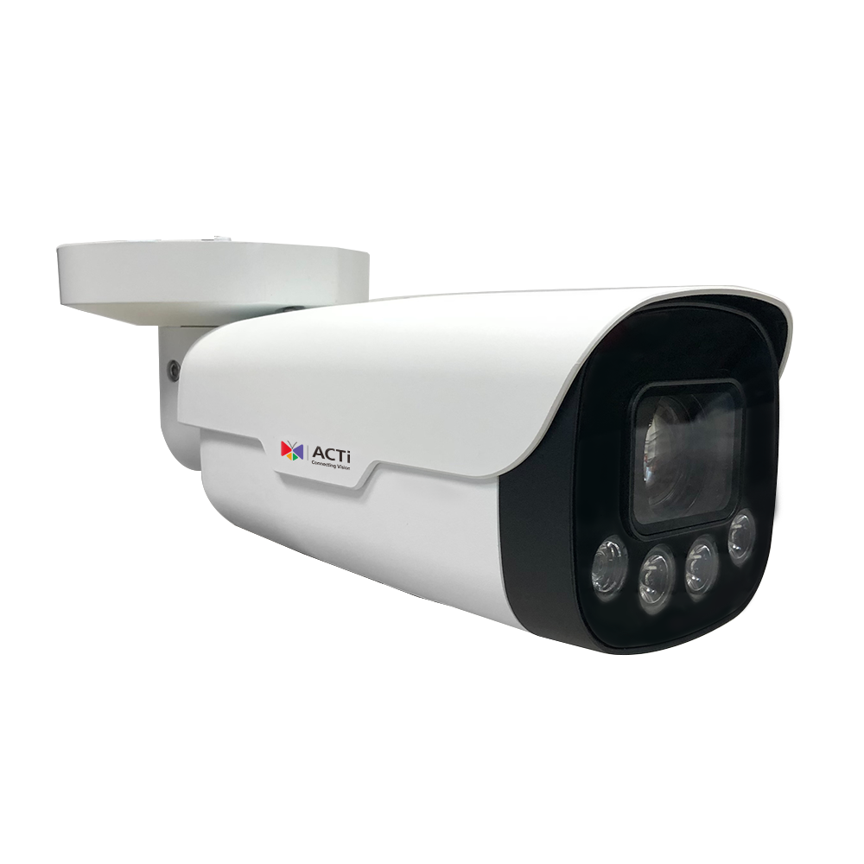
Z415/Z416: Features
Feature1: 2MP 10x and 5MP 12x Zoom Bullet Cameras
  Z415 supports 2MP at 60fps, ideal for low-speed traffic applications
  Budget-friendly alternative to zoom box and housing cameras, with an object distance of up to 100m
Feature2: 100m IR Distance and Low-light Color Mode
  Both Z415 and Z416 support 100m IR distance
  Capture color images under 0.002 lux (F1.2, AGC ON)
  Extreme WDR support up to 145dB
https://www.acti.com/product/Z415
https://www.acti.com/product/Z41 6

Slide 15
Z415/Z416: Features
Feature3: Advanced Built-in AI for Events and Metadata
  Detects people and vehicles with Object Line Crossing, Entry/Exit Area, and Intrusion Detection (Forbidden Area Detection), minimizing false alarms caused by leaves, birds, or lights, while accurately focusing on humans, motor vehicles, and non-motor vehicles
  Supports people counting and crowd density detection
  Includes sound detection
Feature4: Flexible DIO, Audio, BNC, and Built-in Heater
  Two DI ports and two DO ports
  One audio line in and one audio line out
  Supports BNC connectors for traditional or installation monitors
  Built-in heater with an operating temperature range of -40°C to +60°C
  IP67 and IK10 ratings for harsh environments
https://www.acti.com/product/Z415
https://www.acti.com/product/Z41 6

Slide 16
Z415/Z416: Market to Application
Commercial Building (Commercial Building)
Serial Number | Function | Functional Operation Process | Optimal Location | Operating Procedures | Application Scenarios | Benefits
1 | 2MP/5MP Zoom | Provides 2MP 10x or 5MP 12x optical zoom, suitable for objects up to 100m away | Production area, storage area, perimeter surveillance | Navigation > Configuration > Execution > Review Results | Factory perimeter protection, key area surveillance, suitable for low light environments | Increase surveillance coverage, reduce the number of devices, lower operational costs
2 | 100m Infrared | Supports 100m infrared night vision, color mode at 0.002lux | Factory perimeter, parking lot | Navigation > Configuration > Execution > Review Results | Provides all-weather monitoring, delivering high-quality images even in low-light or no-light environments | Enhances nighttime security, reducing crime risk
3 | Built-in AI capabilities | Detects abnormal movement of personnel and vehicles, generating event metadata | Import and export, sensitive areas | Navigation > Configuration > Execution > Review Results | Personnel counting, area intrusion detection, accurately distinguishing between personnel and vehicles | Reduces the need for manual monitoring, improving operational efficiency
4 | Robust Design | Supports IP67, IK10, suitable for harsh environments | Outdoor facilities, factory boundaries | Navigation > Configuration > Execution > Review Results | Withstand harsh environments such as rain, wind, or high temperatures to ensure long-term stable operation | Reduce maintenance costs and extend device lifespan

Slide 17
Z415/Z416: Market to Application
Traffic( Traffic )
Serial Number | Function | Function Description | Suitable Locations | Operating Procedures | Application Scenarios | Benefits
1 | 2MP/5MP Zoom | Supports 2 MP 60fps, for monitoring slow-moving vehicles | Road intersections, parking lot entrances and exits | Navigation > Configuration > Execution > Review Results | Detect vehicle direction and license plate monitoring | Increase the accuracy of traffic monitoring and reduce violations
2 | 100m Infrared | Nighttime infrared mode, suitable for road monitoring | Tunnel, parking lot, roadway | Navigation > Configuration > Execution > Review Results | Nighttime traffic event monitoring to prevent accidents | Enhance nighttime driving safety
3 | Built-in AI functionality | Vehicle entry and exit area, route detection, providing event analysis data | Highway, toll station | Navigation > Configuration > Execution > Review Results | Provide traffic flow analysis, identify vehicle types | Enhance traffic management efficiency, optimize traffic planning
4 | Robust Design | Supports BNC traditional surveillance connections, suitable for various traffic scenarios | Highway exits, bridges | Navigation > Configuration > Execution > Review Results | Can operate stably even in high vibration or harsh weather conditions | Enhances equipment reliability, reduces downtime

Slide 18
Z415/Z416: Market to Application
Utilities( Utility )
Serial Number | Function | Function Description | Suitable Locations | Operating Procedures | Application Scenarios | Benefits
1 | 2MP/5MP Zoom | Suitable for high-precision equipment monitoring, clear images over long distances | Power stations, substations, pipeline inspection areas | Navigation > Configuration > Execution > Review Results | Detailed inspection and anomaly detection of power facilities | Enhances operational stability, reduces the occurrence of accidents
2 | 100m Infrared | Low light color mode supports long-distance equipment surveillance | Petrochemical plants, gas stations | Navigation > Configuration > Execution > Review Results | Conducting safety inspections of critical facilities in no-light environments | Reduce blind spots in nighttime surveillance and improve facility management efficiency
3 | Built-in AI functionality | Detect personnel entering restricted areas and issue alarms | Surroundings of power stations, pipeline import and export | Navigation > Configuration > Execution > Review Results | Identify illegal intrusions or accidental breaches and provide event feedback | Enhance security and reduce the need for manual monitoring
4 | Robust Design | Waterproof, dustproof, and vandal-resistant design, suitable for harsh operating environments | Wind Power Generation Area, Geothermal Facilities | Navigation > Configuration > Execution > Review Results | Provides stable security assurance for long-term operation in harsh conditions | Reduces maintenance frequency, lowering long-term operational costs

Slide 19
Z415/Z416: Video

Slide 20
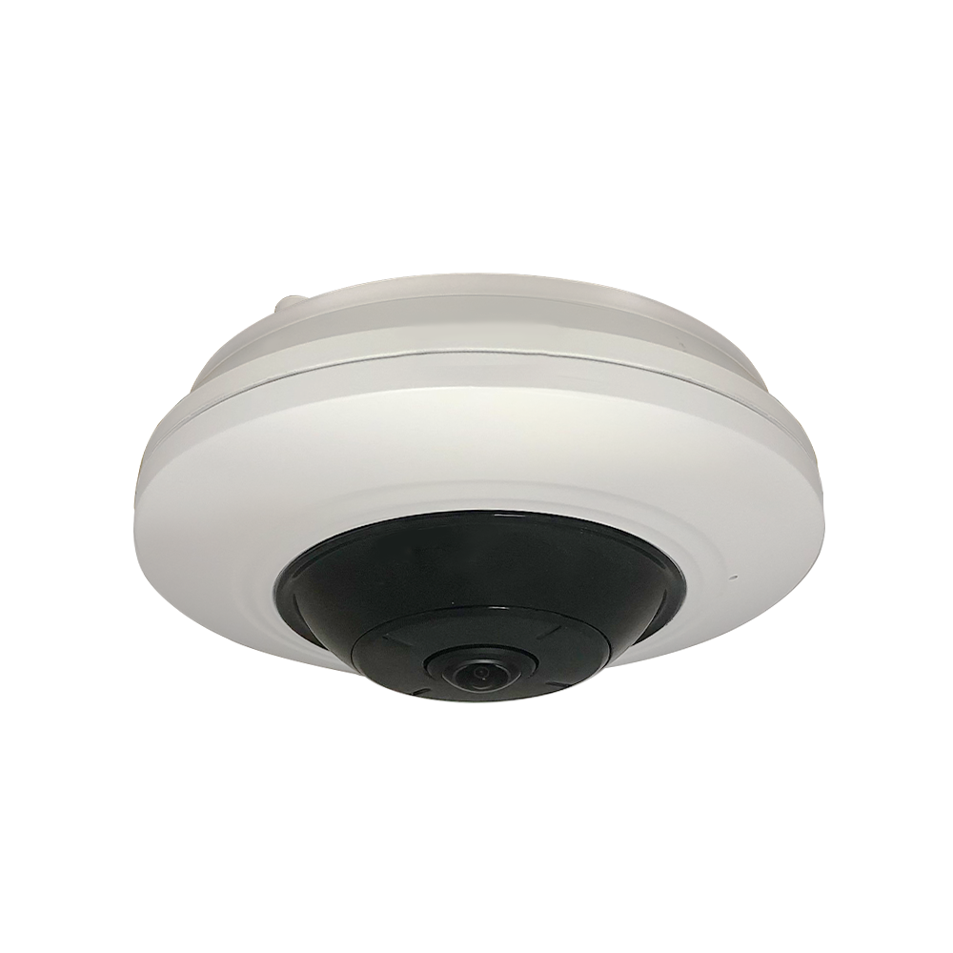
A912: Features
Feature1: 5MP Hemispheric Camera
  Supports original fisheye view
  Supports 180-degree single and dual panorama views
  Supports 4 ePTZ views
  Supports fisheye + 3 ePTZ views
Feature2: 20m IR Distance and Low-light Color Mode
  IR distance: 20m
  Supports color images under 0.017 lux (F1.2, AGC ON)
  Extreme WDR support up to 130dB
https://www.acti.com/product/A912

Slide 21
A912: Features
Feature4: Advanced Built-in AI for Events and Metadata
  People Counting:
    Supports counting, displaying, and exporting people flow data for entering, exiting, and passing by (data stored in flash).
    Supports real-time uploads and uploads by statistical cycles.
  Queue Management:
    Supports up to 4 detection regions with independent arming schedules and linkage methods.
  Supports heatmap analysis.
Feature5: Comprehensive Audio, DIO, and Control Interface
  Audio: Built-in mic, line-in, and line-out support
  DIO: Supports one DI and one DO
  Supports one RS-485
https://www.acti.com/product/A912

Slide 22
A912: Market to Application
Commercial Building (Commercial Building)
Serial Number | Function | Functional Operation Process | Optimal Location | Operating Procedures | Application Scenarios | Benefits
1 | 5MP Dome Camera | Original Fisheye View, 180° Panorama, Electronic PTZ | Building Lobby, Elevator, Lobby Passageway | Navigation → Configuration → Execution → View Results | Capturing panoramic surveillance of building entrances and passageways | Reduces blind spots, enhances overall security coverage
2 | IR Distance and Color Mode | 20m IR Distance, 0.017 lux Color Image | Parking area, Entrance, Emergency Exit | Navigation → Configuration → Execution → View Results | Monitoring in dim environments such as parking lots and emergency exits | Ensuring clear images in low light conditions, providing detailed evidence
3 | Built-in AI and Metadata | Traffic statistics, Queue Management, Heat Map | Reception area, Building Entrance, Elevator | Navigation → Configuration → Execution → View Results | Tracking pedestrian flow within the building, detecting crowded areas, and analyzing traffic flow | Improving crowd management, enhancing safety and comfort
4 | Audio and DIO Interface | Audio Recording, Digital Input/ Output | Security Control Room, Building Perimeter, Critical Areas | Navigation → Configuration → Execution → View Results | Capture on-site audio for safety analysis and respond to alarms | Quickly detect suspicious activities and provide real-time audio alerts

Slide 23
A912: Market to Application
Retail (Retail)
Serial Number | Function | Functional Operation Process | Optimal Location | Operating Procedures | Application Scenarios | Benefits
1 | 5MP Dome Camera | Original Fisheye View, 180° Panorama, Electronic PTZ | Store Entrance, Passageway, Checkout Area | Navigation → Configuration → Execution → View Results | Capture wide-angle views of store areas to detect intrusions or suspicious activities | Enhance security and coverage while reducing the number of cameras
2 | IR Distance and Color Mode | 20m IR Distance, 0.017 lux Color Image | Store Entrance, Dark Warehouse, Parking Lot | Navigation → Configuration → Execution → View Results | Surveillance in low light environments such as entrances and passageways | Enhanced visual effects under low light conditions
3 | Built-in AI and Metadata | Traffic statistics, Queue Management, Heat Map | Store entrance, checkout area, passageway display area | Navigation → Configuration → Execution → View Results | Monitoring customer flow, queue length, and hotspot areas | Optimizing store layout and staff allocation to improve customer service experience
4 | Audio and DIO Interface | Audio Recording, Digital Input/ Output | Safety station, store entrance, restricted area | Navigation → Configuration → Execution → View Results | Listening for unusual sounds and receiving signals from security sensors | Providing immediate responses to potential security threats

Slide 24
A912: Market to Application
Educational Institution (Education)
Serial Number | Function | Functional Operation Process | Optimal Location | Operating Procedures | Application Scenarios | Benefits
1 | 5MP Dome Camera | Original Fisheye View, 180° Panorama, Electronic PTZ | School entrance, classroom, corridor | Navigation → Configuration → Execution → View Results | Surveillance of school entrance and high-traffic areas such as corridors | 360-degree monitoring, reducing the number of devices, enhancing security
2 | IR Distance and Color Mode | 20m IR Distance, 0.017 lux Color Image | Parking lot, dark corridors, dormitory area | Navigation → Configuration → Execution → View Results | Surveillance of low visibility areas, such as parking lots or dormitory corridors | Providing high-quality images in low light conditions to ensure campus safety
3 | Built-in AI and Metadata | Traffic statistics, Queue Management, Heat Map | School cafeteria, classroom, auditorium | Navigation → Configuration → Execution → View Results | Monitoring student movement, detecting queue lengths, analyzing hotspots | Improving safety protocols to prevent crowding or bottleneck issues
4 | Audio and DIO Interface | Audio Recording, Digital Input/ Output | Teacher's Room, Corridor, Restricted Area | Navigation → Configuration → Execution → View Results | Capture on-site audio for safety analysis and respond to alarms | Immediately detect abnormal situations to prevent problems from occurring

Slide 25
A912: Video

Slide 26
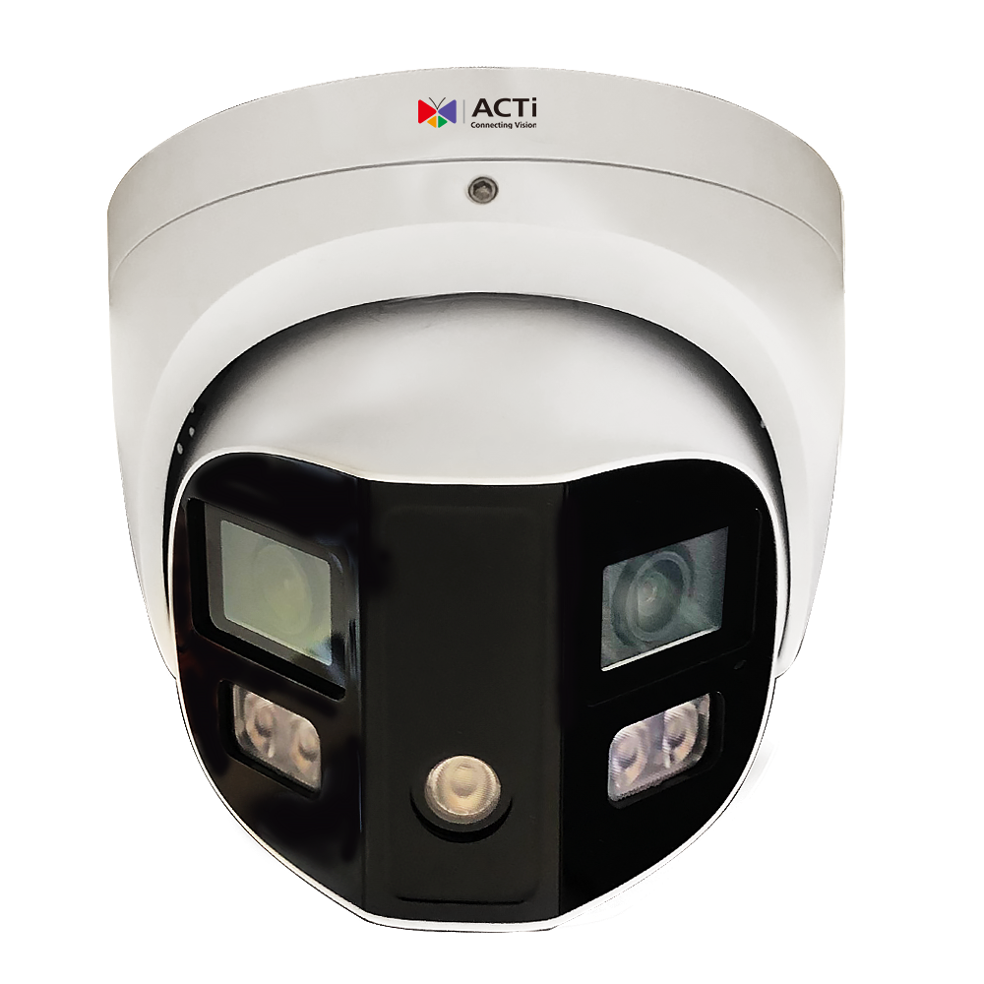
Q550: Features
Feature1: 8 Megapixel Multi-Imager
  Provides 180-degree full coverage without missing any objects
Feature2: 24-Hour Full-Color Support
  Night mode with white light LED always on for 24-hour color images, capturing detailed attributes without extra cost
  Night mode with regular IR LED; AI events can automatically turn on the white light LED to capture suspects in full-color details
  Supports extreme WDR up to 130dB for high-contrast lighting situations across a 180-degree field of view
Feature3: Advanced Built-in AI for Events and Metadata
  Detects people and vehicles with Object Line Crossing, Entry/Exit Area, and Intrusion Detection (Forbidden Area Detection), minimizing false alarms caused by leaves, birds, or lights, while accurately focusing on humans, motor vehicles, and non-motor vehicles
  Supports people counting and crowd density detection
  Includes sound detection
https://www.acti.com/product/Q550

Slide 27
Q550: Features
Feature4: Active Deterrence
  In night mode with IR LED only: All AI events, fire and burglar alarms, and IoT sensor events (via DI) can trigger the white light LED as an active alarm
  Active alarms can also utilize built-in red/blue lights
  Pre-recorded audio alerts can be played through the built-in 3W speaker
Feature5: Flexible DIO and Audio with IP67 and IK10
  Supports one DI port and one DO port
  Includes one audio line in, one audio line out, and two built-in microphones
  IP67 and IK10 ratings ensure durability in harsh environments
https://www.acti.com/product/Q550

Slide 28
Q550: Market to Application
Factory (Factory)
Serial Number | Function | Functional Operation Process | Optimal Location | Operating Procedures | Application Scenarios | Benefits
1 | 8 Million-pixel multi-lens | 180° Panoramic image covering the factory area, reducing blind spots | Production line, storage area, main entrance and exit | 1) Positioning Device 2) Configure shooting range 3) Activate photography mode 4) Monitor and store images | Monitor personnel and machinery activities during the production process to ensure equipment safety and effectiveness | Ensure all production processes are visible, reduce the risk of property loss, and improve operational efficiency
2 | 24 hours full-color mode | 24 hours full-color images, detailed recording of all object attributes | Night shift production area, key equipment operation area, access control point | 1) Select light source mode 2) Set AI event trigger conditions 3) Real-time monitoring 4) Storage record | Continuous night surveillance, capable of quickly capturing detailed abnormal behavior | No additional lighting required, nighttime images remain clear and detailed, enhancing security
3 | Comprehensive AI Intelligence and Metadata | Support personnel, vehicle detection, crossing, intrusion, etc. AI detection, significantly reducing false alarm rates | Warehouse doors, outdoor spaces, critical material areas | 1) Set up AI detection mode 2) Configure alarm trigger conditions 3) Real-time analysis of images 4) Store detection data | AI identifies personnel and vehicle behavior, promptly alarms or tracks abnormal activities | Save management resources by reducing false alarms, achieving more accurate and effective security management
4 | Proactive Deterrence | Supports red and blue warning lights and voice alarm functions, triggering white light LED at night as a proactive alarm | Factory perimeter, critical machine rooms, flammable areas | 1) Configure alarm conditions 2) Set trigger type 3) Real-time activation of alarms 4) Collect event data | Use sound and light (red and blue strobe light or white light) to deter suspicious behavior or unauthorized personnel from entering | Achieve proactive safety protection to reduce the risk of property loss
5 | Flexible DIO and audio support | Built-in 2 MICs, supporting input and output audio for bidirectional communication | Production Management Room, Security Duty Room, Inspection Points | 1) Set audio parameters 2) Configure bidirectional communication process 3) Enable voice feedback 4) Record communication content | Security management personnel can provide real-time guidance to on-site personnel or handle emergencies through voice (pre-recorded content available) | Improve the efficiency of handling security incidents and enhance communication effectiveness

Slide 29
Q550: Market to Application
Bank(Bank)
Serial Number | Function | Functional Operation Process | Optimal Location | Operating Procedures | Application Scenarios | Benefits
1 | 8 Million-pixel multi-lens | 180° Panoramic image covering the bank lobby and important transaction areas, reducing surveillance blind spots | Lobby, counter area, self-service devices (ATM) | 1) Positioning Device 2) Configure shooting range 3) Activate photography mode 4) Monitor and store images | Monitor lobby transaction activities to prevent financial crimes; monitor the ATM area to protect customers and bank assets | Ensure the security of customer transactions and reduce the risk of bank theft or fraud
2 | 24 hours full-color mode | Supports 24 hours of full-color imaging, enhancing nighttime surveillance details, ensuring safety | Vault entrances, self-service areas, nighttime operating branches | 1) Select light source mode 2) Set AI event trigger conditions 3) Real-time monitoring 4) Storage record | Quickly capture subtle anomalies during nighttime surveillance, such as suspicious behavior or violations | No additional lighting required, providing high-detail nighttime images; enhancing security for financial operations at all times
3 | Comprehensive AI Intelligence and Metadata | AI detects personnel and vehicle behavior, identifying unauthorized access or abnormal stays, reducing false alarms | Parking Lot, Lobby, VIP Customer Area | 1) Set up AI Detection Mode 2) Configure alarm trigger conditions 3) Real-time Analysis of Images 4) Store detection data | Detect abnormal behavior in the lobby, such as loitering; identify unauthorized vehicles in the parking lot | Improve alarm accuracy, reduce the impact of false alarms; effectively identify potential threats
4 | Proactive Deterrence | White light LED, red and blue warning lights, and voice alarm functions to deter suspicious behavior | Around the vault, ATM area, backstage area | 1) Configure alarm conditions 2) Set trigger type 3) Real-time activation of alarms 4) Collect event data | Real-time deterrence against suspicious personnel during non-business hours; preventing losses or delays in criminal incidents | Enhancing the ability to respond to security threats; effectively reducing property loss
5 | Flexible DIO and audio support | Two-way audio support for quick communication between customers and backend personnel | Lobby service area, ATM operation point, monitoring duty room | 1) Set audio parameters 2) Configure bidirectional communication process 3) Enable voice feedback 4) Record communication content | Can be used to remotely guide customers or operators in handling emergencies | Improving event handling efficiency and reducing the time cost of emergency communication

Slide 30
Q550: Market to Application
Retail (Retail)
Serial Number | Function | Functional Operation Process | Optimal Location | Operating Procedures | Application Scenarios | Benefits
1 | 8 Million-pixel multi-lens | 180° panoramic image coverage, reducing blind spots, achieving comprehensive monitoring | Prison Playground, Prisoner Dormitory Area, Main Passage | 1) Positioning Device 2) Configure shooting range 3) Activate photography mode 4) Monitor and store images | Covering a large surveillance area to effectively monitor abnormal behavior of prisoners | Improving surveillance accuracy and reducing the monitoring burden on personnel
2 | 24 hours full-color mode | Nighttime images can still record prisoner activities in detail, ensuring safety at all times | Dormitory Corridor, Surveillance Tower, Perimeter of the Wall | 1) Select light source mode 2) Set AI event trigger conditions 3) Real-time monitoring 4) Storage record | Preventing prisoner escapes or violations during nighttime to ensure surrounding safety | Achieve low-cost nighttime surveillance; reduce jailbreak risks
3 | Comprehensive AI Intelligence and Metadata | AI detects behaviors such as crossing lines and entering restricted areas, reducing false alarms; detects crowd density to prevent riots | Prisoner activity areas, prison gates, public facilities | 1) Set up AI Detection Mode 2) Configure alarm trigger conditions 3) Real-time Analysis of Images 4) Store detection data | Accurately identify inappropriate behavior or violent incidents by prisoners and respond with timely alarms | Reduce the impact of false alarms on management and improve prison safety management
4 | Proactive Deterrence | Use red and blue warning lights or voice playback to achieve a deterrent effect and prevent further crimes | Watchtower, prison walls, key areas | 1) Configure Alarm Conditions 2) Set trigger type 3) Real-time activation of alarms 4) Collect event data | Quickly prevent prisoner escapes or group fights, deter inappropriate behavior | Proactively intervene in dangerous events to reduce the risk of escalation of violent incidents
5 | Flexible DIO and audio support | Two-way audio function enhances management efficiency, allowing for immediate guidance or intervention | Management Room, Guard Post, Patrol Point | 1) Set Audio Parameters 2) Configure bidirectional communication process 3) Enable voice feedback 4) Record communication content | Management personnel handle emergency situations in real-time through voice, remotely directing monitoring actions | Shorten the response time for emergency events and enhance management flexibility

Slide 31
Q550: Video

Slide 32
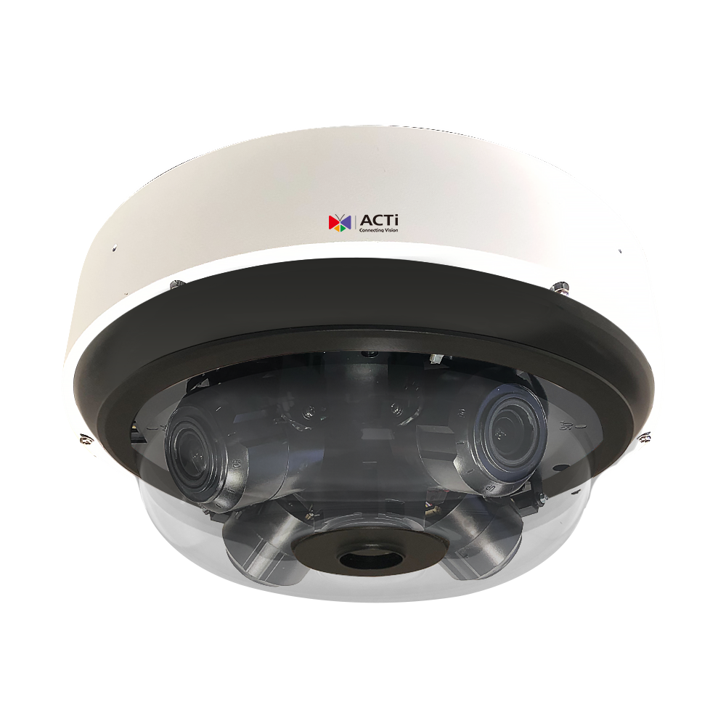
Q84: Features
Feature1: 20 Megapixel Multi-Imager (5MP x4)
  Provides 360-degree full coverage with no blind spots for global object coverage
  One IP supports 4 channels, each up to 5 megapixels (2880x1620@30fps), reducing wiring costs
  Independently adjustable for each channel:
    Pan, tilt, zoom (5x = 2.7–13.5mm), image settings, resolution, and frame rate, supporting complex scenes
Feature2: 9 IR LEDs Supporting 50m IR Distance per Lens and Low-light Color Mode
  Each lens includes 2 high-power IR LEDs, supporting IR distances up to 50m
  Additional IR LED provides downward-facing coverage for full area illumination
  Supports color images under 0.002 lux (F1.2, AGC ON)
Feature3: Advanced Built-in AI for Events and Metadata
  Detects people and vehicles with Object Line Crossing, Entry/Exit Area, and Intrusion Detection (Forbidden Area Detection), minimizing false alarms caused by leaves, birds, or lights, while accurately focusing on humans, motor vehicles, and non-motor vehicles
  Supports people counting and crowd density detection
  Includes sound detection
https://www.acti.com/product/Q 84

Slide 33
Q84: Features
Feature4: Active Deterrence
  In night mode with IR LED only: All AI events, fire and burglar alarms, and IoT sensor events (via DI) can trigger DO to activate an external strobe light
  The strobe light can use the camera’s built-in DC12V power output as its power source
Feature5: Flexible DIO and Audio with IP67 and IK10
  Supports two DI ports and two DO ports
  Includes one audio line in, one audio line out, and one built-in microphone
  IP67 and IK10 ratings ensure durability in harsh environments
https://www.acti.com/product/Q 84

Slide 34
Q84: Market to Application
Factory (Factory)
Serial Number | Function | Functional Operation Process | Optimal Location | Operating Procedures | Application Scenarios | Benefits
1 | 20MP 5MP x4 Multi-lens | Surround view 360° Panorama, no blind spots | Warehouse entrance and exit, assembly line, outdoor area | 1) Access Function Page 2) Adjust lens angle and resolution 3) Trigger event recording | Monitor vehicle and personnel activities in the warehouse or outdoor area | Reduce blind spot risks and improve safety management efficiency
2 | 9 IR LED Night Vision Function | Provide 50 meters range of clear images at night | Nighttime security areas, internal corners of the factory, outdoor parking lots | 1) Set up night vision mode 2) Detect activity in dark areas 3) Trigger Alarm | Monitor personnel or suspicious activities at night to prevent unauthorized access | Enhance nighttime safety and improve event detection accuracy
3 | AI Detection function | Automated vehicle and personnel detection | Main vehicle entry and exit points, large machinery operation areas, material storage areas | 1) Set up AI alarm parameters 2) Continuous monitoring of events 3) Generate data analysis | Statistics and records of vehicles and personnel at import and export | Reduce the burden of manual monitoring and accurately identify threats
4 | Proactive deterrence function | Use infrared lights to trigger warnings | Around employee dormitories, sensitive storage areas, and main factory areas | 1) Trigger infrared light warnings in night vision mode 2) External light source linkage | Deter potential intruders at night using infrared lights | Prevent intrusion and enhance deterrent effect
5 | Audio and Flexible DIO | Two-way audio and device integration | Management room, indoor control center, perimeter security posts | 1) Connect audio input/ output 2) Integrate with external systems 3) Deliver commands | Interact with security systems for real-time communication | Enhance communication efficiency and integrate control

Slide 35
Q84: Market to Application
Educational Institution (Education)
Serial Number | Function | Functional Operation Process | Optimal Location | Operating Procedures | Application Scenarios | Benefits
1 | 20MP 5MP x4 Multi-lens | Cover campus activity areas | Campus entrance, sports field, surrounding library | 1) Set up multi-angle coverage 2) Define image quality requirements 3) Continuous monitoring | Internal activities on campus, crowd gathering points | Enhance campus safety and prevent potential risks
2 | 9 IR LED Night Vision Function | Ensure student safety at night | Campus parking lot, around dormitories, entrance of teaching buildings | 1) Activate night vision mode 2) Record nighttime activities 3) Trigger automatic alarm | Monitor entry and exit situations and suspicious actions at night | Protect student safety and reduce nighttime incidents
3 | AI Detection function | Automatically record personnel entry and exit | Main entrances and exits of the campus, cafeteria, administrative building | 1) Set entry and exit identification parameters 2) Conduct event analysis 3) Generate personnel reports | Record the activities of students and visitors | Improve campus management efficiency and reduce disturbances
4 | Proactive deterrence function | Deter illegal intruders | Perimeter of the wall, remote monitoring points, basement entrance | 1) Combine AI to trigger deterrence 2) Set up automatic expulsion alarms | Detect and warn illegal intruders | Enhance campus security to prevent asset loss
5 | Audio and Flexible DIO | Remote commands and collaboration | Campus police command center, important equipment rooms on campus | 1) Set up voice alarms 2) Integrate device commands | Collaborate with campus police to respond to emergency events through voice | Enhance immediate response capability

Slide 36
Q84: Market to Application
Logistics ( Logistics )
Serial Number | Function | Functional Operation Process | Optimal Location | Operating Procedures | Application Scenarios | Benefits
1 | 20MP 5MP x4 Multi-lens | Comprehensive monitoring of the logistics process | Storage area, loading docks, monitoring center | 1) Define shooting area 2) Set video output parameters | Monitoring the loading and packaging operations of goods | Preventing loss and damage of goods
2 | 9 IR LED Night Vision Function | Ensuring safety of logistics at night | Indoor storage, parking area, around the dock | 1) Set IR coverage area 2) Nighttime video recording | Nighttime handling of goods and logistics monitoring | Reducing nighttime theft incidents and improving operational accuracy
3 | AI Detection function | Detecting vehicle and goods status | Main vehicle import and export, storage points | 1) Set AI analysis scene 2) Real-time Trigger Alerts | Monitor vehicle and goods flow status | Improve transportation efficiency, reduce errors and delays
4 | Proactive deterrence function | Nighttime infrared light deterrence | Large storage areas, surrounding fences | 1) Activate deterrent light source function 2) Set trigger conditions | Warn against illegal entry into the goods area | Reduce property loss and illegal intrusions
5 | Audio and Flexible DIO | Emergency event communication | Control center, vehicle entrance | 1) Conduct remote two-way dialogue 2) Convey management commands | Real-time communication between the dispatch center and operators | Enhanced communication capabilities, optimized operational processes

Slide 37
Q84: Video

Slide 38
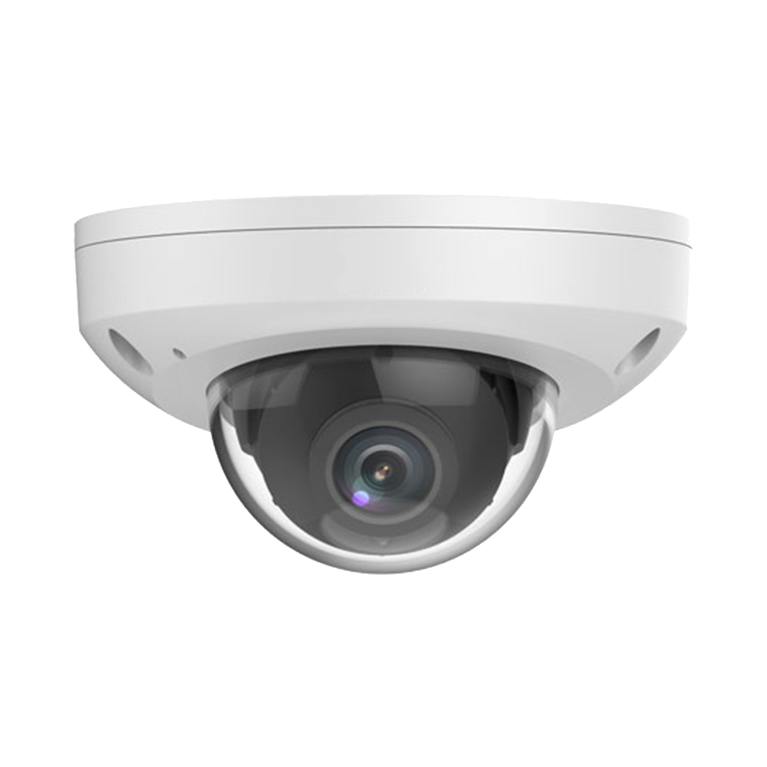
Z721: Features
Feature1: 4MP Fixed Lens with M12 Connector
  Side dome design with 3-axis adjustment support
  M12 D-coding 10/100M Ethernet connection
Feature2: 30m IR Distance and Low-light Color Mode
  IR distance: 30m
  Supports color images under 0.002 lux (F1.2, AGC ON)
  Extreme WDR support up to 135dB
https://www.acti.com/product/Z721

Slide 39
Z721: Features
Feature3: Advanced Built-in AI for Events and Metadata
  Detects people and vehicles with Object Line Crossing, Entry/Exit Area, and Intrusion Detection (Forbidden Area Detection), minimizing false alarms caused by leaves, birds, or lights, while accurately focusing on humans, motor vehicles, and non-motor vehicles
  Supports people counting and crowd density detection
  Supports sound detection
Feature4: Built-in MIC with IP67 and IK10 Support
  IP67 and IK10 ratings ensure durability in harsh environments
https://www.acti.com/product/Z721

Slide 40
Z721: Market to Application
Train(Train)
Serial Number | Function | Functional Operation Process | Optimal Location | Operating Procedures | Application Scenarios | Benefits
1 | 4MP Fixed Lens | Side dome design, supports three-axis angle adjustment, M12 D- coding Ethernet connection | Train front and rear carriages, cargo carriage, driver's cabin | 1) Navigate to the camera installation interface 2) Set image mode 3) Open surveillance footage | Monitor the interior and surrounding environment of the train, detect unauthorized personnel or abnormal behavior | Provides high stability in surveillance, reducing the risk of theft or damage, and enhancing driving safety.
2 | Low light support | Presents color images under extremely low light conditions, supporting extreme wide dynamic range (135 dB) | Nighttime train stations, tunnels, dimly lit carriages | 1) Navigate to light source mode settings 2) Enable wide dynamic range mode | External environment monitoring during nighttime train operations, capturing clear images inside tunnels | Enhances nighttime surveillance capabilities, providing reliable footage even in low light environments, while reducing security vulnerabilities.
3 | AI Event Detection | Equipped with object recognition for people, vehicles, and items, providing accurate event alerts ( such as intrusion, area entry/exit detection ) | Platforms, train entry and exit points, key passageways | 1) Enable AI Detection Function 2) Set Alarm Conditions 3) Receive Real-time Notifications | Automatically identify unauthorized personnel entering platform areas or safety behaviors during train arrivals and departures | Reduce false alarm rates, improve detection efficiency, achieve immediate response, and enhance protection for personnel and property
4 | Environmental Durability | IP67, IK10 Design, suitable for harsh weather or external impacts | Train exterior, undercarriage, exposed locations | 1) Install in the target environment 2) Test pressure resistance and waterproof functionality 3) Activate real-time monitoring | The train exterior can operate normally in rainy or snowy weather, preventing camera damage | Extend device lifespan, reduce maintenance costs, and ensure stable monitoring in all weather conditions

Slide 41
Z721: Market to Application
Bus (Bus)
Serial Number | Function | Functional Operation Process | Optimal Location | Operating Procedures | Application Scenarios | Benefits
1 | 4MP Fixed Lens | Side dome design, supports three-axis angle adjustment, M12 D- coding Ethernet connection | Interior passageway, driver's seat, exterior door | 1) Install in high-traffic areas 2) Set shooting angle and range 3) Activate surveillance footage | Monitor passenger boarding and alighting, detect luggage left behind or abnormal behavior | Reduce property loss, enhance passenger safety, optimize driver's awareness of interior dynamics
2 | AI Event Detection | Accurately detect abnormal behavior of personnel or objects, provide real-time alerts | Car doors, passenger concentration areas | 1) Enable AI Detection Function 2) Set Alarm Conditions 3) Real-time Notifications to Drivers | Detect unauthorized personnel or congestion at the vehicle door to prevent potential risks | Reduce congestion, enhance passenger experience, and achieve efficient response and handling
3 | Environmental Durability | Supports IP67 Waterproof and Dustproof, IK10 Impact-resistant Design | External camera installation points, areas prone to severe weather | 1) Install at external vulnerable points 2) Test durability and image clarity | Ensure key footage is fully captured during rainy bus operations to avoid damage due to weather | Extend equipment lifespan, reduce maintenance and replacement frequency

Slide 42
Z721: Market to Application
Truck(Truck)
Serial Number | Function | Functional Operation Process | Optimal Location | Operating Procedures | Application Scenarios | Benefits
1 | Low light support | Color image enhances night surveillance capabilities, providing low light mode | Container area, cockpit, rear of the vehicle | 1) Set lighting condition detection 2) Adjust IR mode 3) Activate surveillance | Nighttime docking area surveillance to prevent theft or damage to goods | Enhance nighttime operational safety, strengthen goods protection, and reduce potential losses
2 | AI Analysis | Personnel and vehicle detection, providing intelligent event analysis | Both sides of the vehicle, inside and outside the container | 1) Activate AI Detection and Alarm 2) Set Condition Filters 3) Achieve Proactive Response | Detect illegal intrusion into containers, abnormal behavior on the sides of vehicles, or unauthorized entry and exit behind vehicles | Reduce human intervention costs, strengthen automated surveillance and event management

Slide 43
Z721: Video

Slide 44
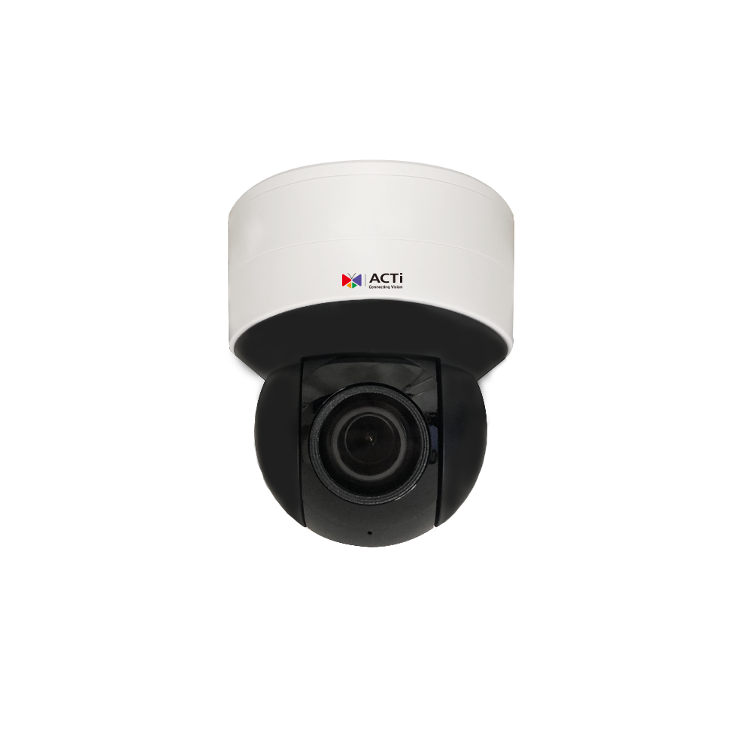
Z972: Features
Feature1: 5MP 5X Mini PTZ
  5MP resolution with 5x optical zoom provides detailed PTZ control for indoor applications
  Cost-effective solution for indoor locations, minimizing the number of cameras needed
Feature2: Low-Light and High-Contrast Performance
  IR LED range up to 50m
  WDR: 130dB
  Supports color images under 0.003 lux (F1.2, AGC ON)
https://www.acti.com/product/Z972

Slide 45
Z972: Features
Feature3: Advanced Built-in AI with Events and Metadata
  Detects people and vehicles with object line crossing, area entry/exit, and intrusion detection (forbidden area), reducing false alarms caused by leaves, birds, and lights while accurately identifying humans and vehicles
  Supports sound detection
Feature4: Wi-Fi Support
  Wi-Fi connectivity eliminates extra cabling, saving time and effort during installation
Feature5: Flexible DIO, Audio In/Out, Built-in MIC, and Speaker
  Supports one DI port and one DO port
  Includes one audio line in, one audio line out, one built-in MIC, and one built-in speaker for clear audio reception and two-way communication
https://www.acti.com/product/Z972

Slide 46
Z972: Market to Application
Commercial Building( Commercial Building )
Serial Number | Function | Functional Operation Process | Optimal Location | Operating Procedures | Application Scenarios | Benefits
1 | 5MP 5X Mini PTZ | 5MP resolution and 5 times optical zoom, suitable for indoor scenes, providing high-definition detailed images | Lobby, corridor, inside the elevator | 1) Navigate to the surveillance area 2) Set preset points 3) Trigger surveillance 4) View images | Monitor visitor and personnel behavior in the lobby, observe details in the corridor, and conduct real-time surveillance in the elevator | Reduce risks and enhance site safety
2 | Low light and strong light contrast performance | Supports IR LED 50 meters, 130 dB WDR, displays color images in low light | Underground parking lot, storage area | 1) Navigate to low light area 2) Set lighting conditions 3) Trigger capture 4) View images | Monitor vehicle entry and exit in the parking lot, and check goods and personnel dynamics in real-time within the storage area | Enhance image recognition in nighttime and high-contrast scenes
3 | AI Events and Metadata | Supports various AI detection (intrusion zones, line crossing, area entry and exit, etc.) to reduce false alarms and improve detection accuracy | Entrance, Conference Room Door | 1) Set Detection Parameters 2) Trigger Detection 3) Alarm Notification 4) View Metadata | Monitoring personnel behavior at entrances and exits, surveillance of unauthorized access at conference room doors | Enhance security efficiency and reduce manpower requirements
4 | Wifi Support | Supports Wifi installation, no additional wiring required, saving construction time and costs | Small offices, temporary event venues | 1) Connect Device Wifi 2) Proceed with Setup 3) Surveillance Activation 4) View images | Simplified installation process for small offices, rapid deployment of surveillance for temporary event venues | Shorten installation time and reduce installation costs
5 | Flexible I/O and audio functions | Provides multiple I/O interfaces and built-in microphone and speaker, supporting two-way voice communication | Reception area and security duty room | 1) Receive audio 2) Two-way communication 3) Execute voice reminders 4) Surveillance area audio | Reception and visitor voice interaction, remote voice intervention by security duty room for suspicious situations | Enhance communication efficiency and improve response capability for emergency events

Slide 47
Z972: Market to Application
Retail ( Retail )
Serial Number | Function | Functional Operation Process | Optimal Location | Operating Procedures | Application Scenarios | Benefits
1 | 5MP 5X Mini PTZ | Provide high-definition images for retail stores, supporting detailed observation | Cash register, shelves, warehouse | Same Commercial Building | Monitor cash register transactions, shelf product loss, and warehouse entry and exit situations | Reduce product loss risk and increase operational transparency
2 | Low light and strong light contrast performance | Ensure clear images of in-store and external advertising screens | In-store, warehouse, entrance and exit | Same Commercial Building | Provide monitoring of products under low light conditions and enhance display effects | Enhance customer experience and improve store image
3 | AI Events and Metadata | Support for area intrusion, item loss, and other AI detection | Cash register, entrance, robbery prevention area | Same Commercial Building | Reduce theft incidents and respond quickly to suspicious situations | Lower economic losses and enhance feelings of safety
4 | Wifi Support | Provide flexible deployment possibilities | In-store, temporary display booths | Same Commercial Building | Temporary display area deployment, saving time and costs | High flexibility, improving operational efficiency
5 | Flexible I/O and audio functions | In-store communication and customer announcements | Cash register, office, display area | Same Commercial Building | Enhance in-store communication convenience and address customer inquiries | Improve customer satisfaction and operational efficiency

Slide 48
Z972: Market to Application
Hotel( Hotel )
Serial Number | Function | Functional Operation Process | Optimal Location | Operating Procedures | Application Scenarios | Benefits
1 | 5MP 5X Mini PTZ | Suitable for public areas, providing high-quality surveillance | Lobby, Elevator, Corridor | Same Commercial Building | Monitor personnel in the lobby, internal monitoring in the elevator, and activity monitoring in the corridor | Reduce risks and enhance residents' sense of safety
2 | Low light and strong light contrast performance | Ensure clear imaging in corridors and outside guest rooms during nighttime or uneven lighting | Corridor, Outside Guest Rooms, Lobby | Same Commercial Building | Evening Activity Monitoring | Enhancing Residents' Trust and Sense of Security
3 | AI Events and Metadata | Support for Area Monitoring and Automatic Alarms | Staff-Only Access, Public Areas | Same Commercial Building | Prevent Unauthorized Access to Ensure Residents' Safety | Improve Operational Efficiency and Reduce the Need for Manual Patrols
4 | Wifi Support | Provide Flexible Wireless Deployment | In-Room, Outdoor Activity Areas | Same Commercial Building | Quick Deployment in Special Event Areas, Supporting Flexible Management | Save Wiring Costs and Time
5 | Flexible I/O and audio functions | Provide Voice Communication Functionality in Emergencies | In-Room, Emergency Exits | Same Commercial Building | Instant Communication with Guests and Staff in Emergencies | Enhance Emergency Management Capabilities

Slide 49
Z972: Video

Slide 50
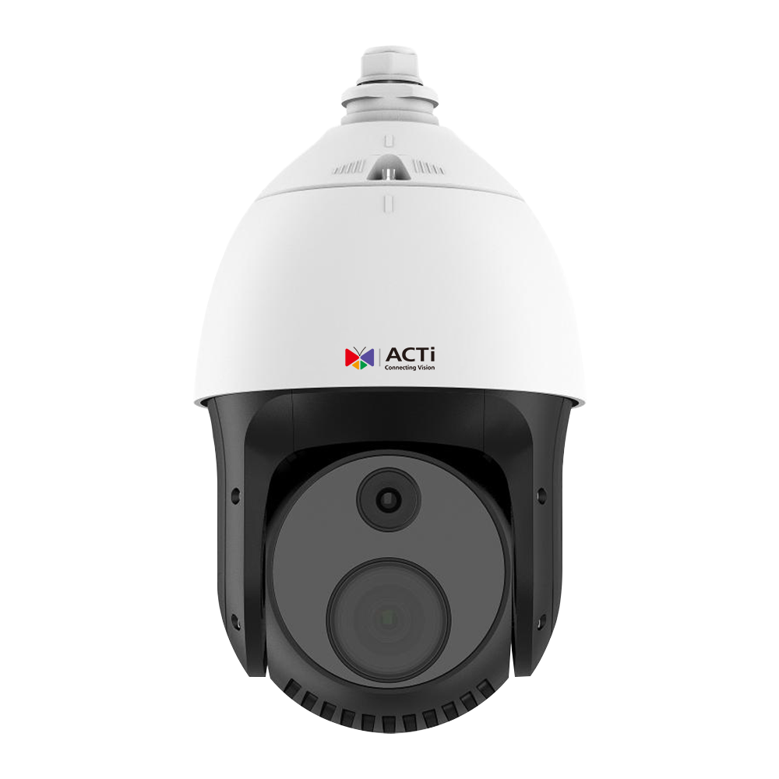
Z953: Features
Feature1: 8MP 40x PTZ Camera (Speed Dome)
  4K resolution with 40x optical zoom delivers exceptional video clarity
  Pan speed up to 300 degrees per second with 1024 preset points
Feature2: 250m IR Distance and Low-light Color Mode
  1/1.8-inch sensor ensures excellent low-light performance with an IR distance of 250m
  Supports color images under 0.003 lux (F1.2, AGC ON)
  Extreme WDR support up to 140dB
https://www.acti.com/product/A972

Slide 51
Z953: Features
Feature3: Advanced Built-in AI for Events and Metadata
  Detects people and vehicles with Object Line Crossing, Entry/Exit Area, and Intrusion Detection (Forbidden Area Detection), minimizing false alarms caused by leaves, birds, or lights, while accurately focusing on humans, motor vehicles, and non-motor vehicles
  Supports people counting and crowd density detection
  Includes sound detection
Feature4: Flexible DIO, Audio In/Out with IP66 and IK10 Support
  Seven DI ports and two DO ports supported
  Includes one audio line in and one audio line out
  IP66 and IK10 ratings ensure durability in harsh environments
https://www.acti.com/product/A972

Slide 52
Z953: Market to Application
City (City)
Serial Number | Function | Functional Operation Process | Optimal Location | Operating Procedures | Application Scenarios | Benefits
1 | 8MP 40x PTZ Camera | Provides 4 K resolution and 40 times optical zoom, allowing for precise detail capture | City center square, subway station, commercial area | Navigate to the camera control interface > Set focal length and shooting area > Trigger tracking function > View clear images | Monitor crowd gatherings and large events, accurately locate suspects or abnormal behavior | Reduce crime risk, enhance public safety, and accurately track targets
2 | Supports 250 meters of infrared distance and ultra-low light imaging | Provides clear color images in dark environments, with a dynamic range of 140 DB | Alleyways, remote areas, parking lots | Activate low light mode > Automatically switch to infrared mode > Ensure image details are clear | Night surveillance in remote or low-light locations to prevent illegal activities | Enhance nighttime visibility, reducing theft or destructive behavior
3 | AI-driven event detection and metadata analysis | Detect personnel and vehicles crossing specific areas, accurately identify crowd density, and reduce false alarms | Traffic arteries, public facilities, schools | Set event trigger conditions > Enable detection function > Generate alarm notification > Analyze relevant data | Achieve crowd control, traffic monitoring, and timely response to security incidents | Improve efficiency and accurately identify real threats
4 | Flexible I/O with durable design | Supports multiple inputs and outputs, adapts to harsh environments, impact-resistant and waterproof | Construction site, important facility entrance | Install the camera > Connect to other devices (such as alarm systems) > Test overall operational stability | Provide round-the-clock high-reliability surveillance for important facilities | Reduce equipment damage repair costs and ensure long-term stable operation of safety equipment

Slide 53
Z953: Market to Application
Airport (Airport)
Serial Number | Function | Functional Operation Process | Optimal Location | Operating Procedures | Application Scenarios | Benefits
1 | 8MP 40x PTZ Camera | Provides 4 K resolution and 40 times optical zoom, allowing for precise detail capture | Waiting room, runway area, security checkpoint | Navigate to the camera interface > Lock onto target > Automatically track airplane or suspicious luggage | Monitoring personnel flow to quickly handle emergencies or baggage theft | Ensure safe airport operations and enhance passenger experience
2 | Supports 250 meters of infrared distance and ultra-low light imaging | Maintain clear images in low light environments | Airport perimeter, tarmac | Activate infrared night vision mode > Automatically identify moving targets > Send notifications | Nighttime perimeter protection to timely detect suspicious activities | Reduce the risk of illegal intrusion and enhance perimeter protection levels
3 | AI-driven event detection and metadata analysis | Accurately identify personnel density and vehicle activity around airplanes | Waiting Area, Tarmac, Cargo Area | Set AI Conditions > Enable Density Analysis > Generate Real-time Alerts | Manage crowd density in the waiting room and monitor operations on the tarmac | Optimize airport operational efficiency and reduce management costs
4 | Flexible I/O with durable design | Adapt to various adverse conditions and support external alarm connections | Cargo Area, Underground Parking Lot | Connect Devices > Test Functions > Integrate into Existing Management System | Monitor the cargo area and vehicle entry and exit conditions | Enhance system compatibility and simplify integration processes

Slide 54
Z953: Market to Application
Traffic Market (Traffic)
Serial Number | Function | Functional Operation Process | Optimal Location | Operating Procedures | Application Scenarios | Benefits
1 | 8MP 40x PTZ Camera | Provides 4 K resolution and 40 times optical zoom, allowing for precise detail capture | Intersections, highways, bridges | Lock section > Set automatic patrol > View images | Detect traffic accidents and monitor congestion | Improve traffic flow management efficiency and respond to incidents in a timely manner
2 | Supports 250 meters of infrared distance and ultra-low light imaging | Maintain clear surveillance under nighttime conditions | Tunnels, remote highway sections | Activate night mode > Automatically track abnormal vehicles > Generate real-time imaging reports | Ensure nighttime traffic safety and reduce the risk of accidents | Enhance nighttime road safety and reduce accident rates
3 | AI-driven event detection and metadata analysis | Accurately analyze traffic flow to reduce false alarms | Highway entrances and exits, toll stations | Enable traffic flow analysis > Classify and statistics on vehicle behavior > Generate reports | Analyze peak traffic volume to optimize traffic light operation | Reduce traffic congestion and improve transportation efficiency
4 | Flexible I/O with durable design | Support harsh environments and diverse connectivity options | Parking lots, truck fueling stations | Installation and adjustment settings > Test stability > Integrate alarm functions | Automated management and safety protection of the parking lot | Ensure safe operations and enhance user confidence

Slide 55
Z953: Video

Slide 56
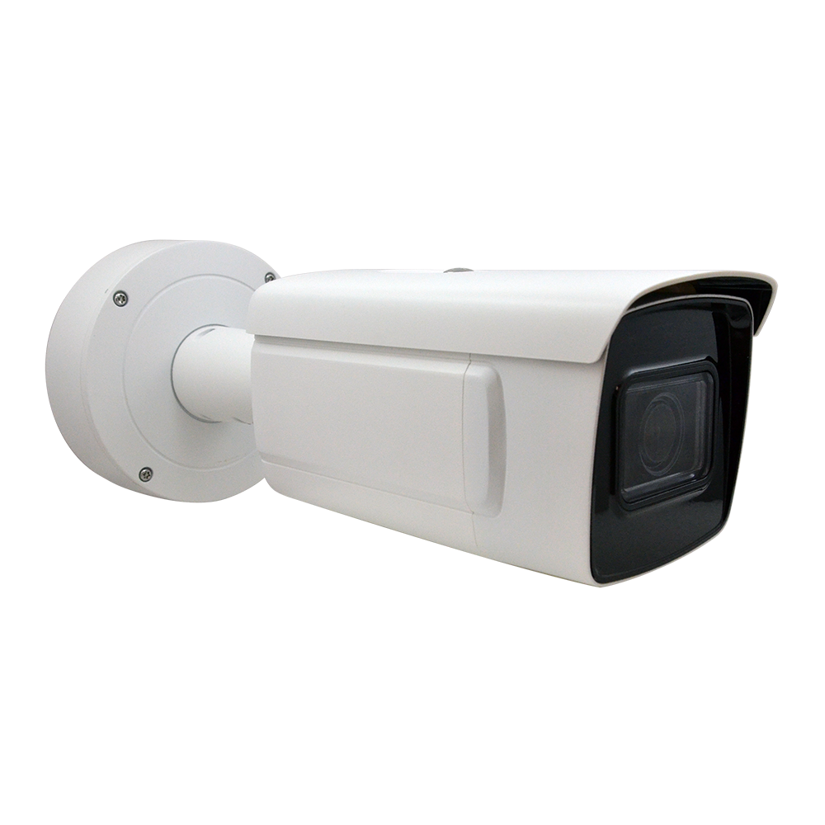
A427: Features
Feature1: 4MP 4.3x with Superior Low-light and WDR Performance
  1/1.8-inch sensor
  Color: 0.0005 lux @ (F1.2, AGC ON); B/W: 0.0001 lux @ (F1.2, AGC ON); 0 lux with IR
  IR distance: 50m; WDR: 140dB
  Supports 5 concurrent streams to meet diverse application and specification needs
Feature2: Physical Security AI Support
  Detects people and vehicles for line crossing, intrusion, region entry, and region exit
  People density detection
  People attribute metadata (e.g., clothing color)
  Face attribute metadata (e.g., gender, age)
  Facial recognition
https://www.acti.com/product/A427

Slide 57
A427: Features
Feature3: Employee Application AI Support
  Hard hat (helmet) detection for construction employees
  On/off duty detection for security guards
Feature4: Operation Management and Business Intelligence AI Support
  People counting
  Queue management
  Heatmap analysis
https://www.acti.com/product/A427

Slide 58
A427: Market to Application
Factory (Factory)
Serial Number | Function | Functional Operation Process | Optimal Location | Operating Procedures | Application Scenarios | Benefits
1 | 4MP 4.3 Variable zoom+ Low light environment performance | WDR Settings, IR Operation, Low light imaging switch | Main entrances and exits, workshops, warehouses | 1) Access Function Page 2) Set optimal lighting conditions 3) Real-time image viewing | Monitor personnel entering and exiting the factory, machinery operation status, providing clear images around the clock | Reduce blind spots, lower theft risks, and improve the efficiency of nighttime production line surveillance
2 | AI Supported Object Detection and Tracking | Wiring configuration, Area Access Analysis | Around the perimeter wall, parking lot, entrance and exit | 1) Set up the security line and area 2) Define trigger conditions 3) Review results after receiving the alarm | Automatically trigger an alarm and record an image when a vehicle or personnel enters a restricted area without authorization. | Enhance factory safety protection, reduce intrusion events, and improve response speed to emergency situations
3 | AI support for employee applications | Safety helmet detection and attendance check | Factory production line, attendance clock-in points | 1) Set up safety helmet detection 2) Set up personnel clock-in recognition 3) Surveillance and report generation | Ensure workers comply with safety regulations (wearing safety helmets) and automatically record attendance | Enhance safety compliance, reduce accidents caused by violations, and simplify the attendance process
4 | Operational Management and Business Intelligence | Traffic Statistics, Queue Management, Hotspot Analysis | Staff Canteen, Entrance Lobby, Conference Area | 1) Set Statistical Conditions 2) Set Hot Zone Monitoring 3) Generate Analysis Reports Regularly | Analyze employee activity hotspots and queue situations within the factory to optimize facility layout and resource allocation | Improve factory operational efficiency, optimize internal resource allocation, and reduce human resource management costs

Slide 59
A427: Market to Application
Logistics (Logistics)
Serial Number | Function | Functional Operation Process | Optimal Location | Operating Procedures | Application Scenarios | Benefits
1 | 4MP 4.3 Variable zoom+ Low light environment performance | WDR Settings, IR Operation, Low light imaging switch | Goods Loading and Unloading Area, Warehouse Entrance, Nighttime Transport Passage | 1) Access Function Page 2) Set Lighting Conditions 3) View Images in Real Time | Ensure there is no blind spot monitoring during the loading and transportation of goods, providing high-quality images as evidence of incidents. | Reduce risks during nighttime operations, minimize loss or theft of goods, and enhance overall operational transparency.
2 | AI Supported Object Detection and Tracking | Wiring configuration, Area Access Analysis | Around the warehouse, parking lot, entrance and exit | 1) Set Security Line 2) Define Trigger Conditions 3) Monitor Abnormal Situations and Generate Reports | Automatically alarm and record footage when unauthorized personnel or vehicles enter the restricted area | Enhance the security of the logistics park to prevent unauthorized intrusions and improve security management efficiency
3 | AI support for employee applications | Safety regulation detection and attendance tracking | Loading and unloading areas, warehouse operation points | 1) Enable safety regulation detection function 2) Set up attendance monitoring 3) Generate compliance reports regularly | Monitor whether safety measures for employees in high-risk areas are in place and record attendance | Reduce the risk of safety incidents, simplify the attendance process, and provide a complete record that is safe and compliant.
4 | Operational Management and Business Intelligence | Traffic Statistics, Queue Management, Hotspot Analysis | Main passage of the warehouse, goods sorting area, waiting area | 1) Set data collection conditions 2) Run hotspot analysis function 3) View reports | Optimize the flow of goods and personnel within the logistics area, reduce congestion, and improve transportation efficiency. | Optimize logistics process configuration, enhance space utilization efficiency, and reduce operating costs.

Slide 60
Z953: Market to Application
Educational Institution (Education)
Serial Number | Function | Functional Operation Process | Optimal Location | Operating Procedures | Application Scenarios | Benefits
1 | 4MP 4.3 Variable zoom+ Low light environment performance | WDR Settings, IR Operation, Low light imaging switch | Main entrance of the school, playground, parking lot | 1) Access Function Page 2) Adjust Light Source and Imaging Conditions 3) Real-time Monitoring Image | Provides clear monitoring at night and in low light conditions to ensure the safety of students and facilities | Enhances nighttime security, reduces incidents of destructive behavior or unauthorized access, and provides video evidence
2 | AI Supported Object Detection and Tracking | Wiring configuration, Area Access Analysis | School walls, parking lots, entrances of important buildings | 1) Set virtual alarm lines 2) Establish access conditions 3) Receive and review alarms | Detect unauthorized personnel or vehicles entering important areas of the campus and promptly address abnormal situations. | Strengthen security around the campus to reduce the risk of external intrusions and improve security efficiency.
3 | AI support for employee applications | Safety regulation detection and attendance management. | School office, dormitory entrances and exits. | 1) Set up attendance monitoring function 2) Enable safety regulation detection 3) View reports | Manage the attendance of faculty and staff while monitoring whether dormitory access complies with regulations. | Improve internal management efficiency, reduce human recording errors, enhance compliance and campus discipline
4 | Operational Management and Business Intelligence | Traffic Statistics, Queue Management, Hotspot Analysis | Cafeteria, Library, Registration Office | 1) Enable statistics and heat zone analysis 2) Define report output format 3) View data reports | Analyze the activity hotspots and queuing situations of students and staff on campus to optimize space planning | Increase resource allocation efficiency, reduce congestion, and enhance the overall utilization efficiency of campus facilities

Slide 61
A427: Video

Slide 62
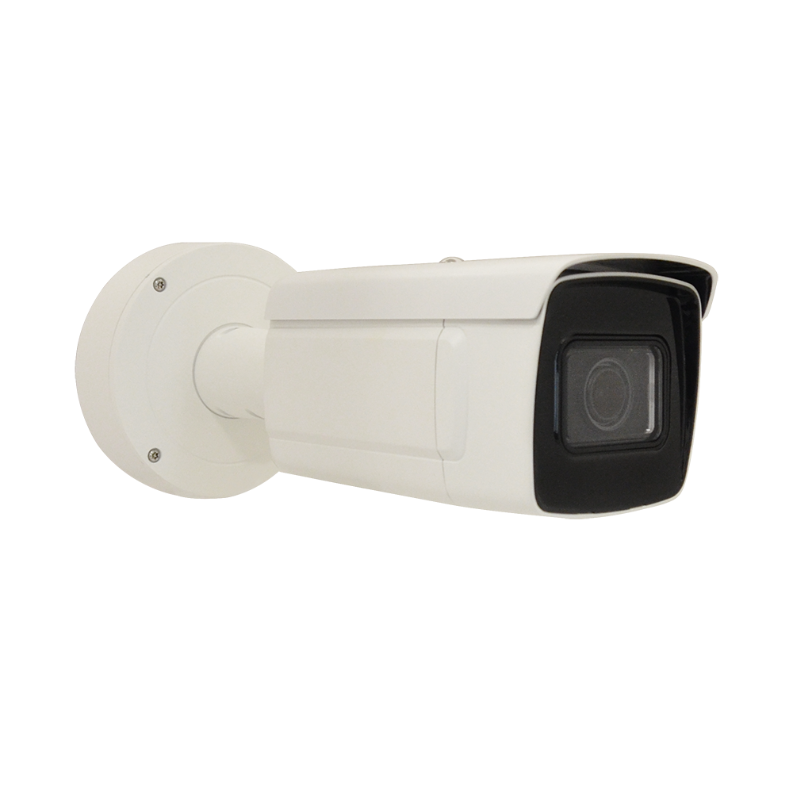
VMGB-410: Features
Feature1: 4MP 4.3x with Superior Low-light and WDR Performance
  1/1.8-inch sensor
  Color: 0.0005 lux @ (F1.2, AGC ON); B/W: 0.0001 lux @ (F1.2, AGC ON); 0 lux with IR
  IR distance: 50m; WDR: 140dB
  Supports 5 concurrent streams to meet diverse application and specification needs
Feature2: Physical Security AI Support
  Detects people and vehicles for line crossing, intrusion, region entry, and region exit
  Supports vehicle counting
  Detects vehicle attributes, including type, color, brand, and driving direction
  Supports license plate recognition (LPR)
  Front installation for checkpoint scenarios: up to 120 km/h; side installation: up to 80 km/h
  Supports monitoring up to 2 lanes
https://www.acti.com/product/VMGB-410

Slide 63
VMGB-410: Features
Feature3: Parking Lot-Related AI
  License Plate and Vehicle Mode:
    Captures simultaneous images of vehicles and license plates for entry/exit license plate recognition
  Distant View Mode:
    Monitors the status of up to 40 parking spaces, ideal for large parking lot surveillance
    Detects parking duration, helping manage vehicle stay times
    Provides vacant parking space alerts to indicate available spaces
  Close View Mode:
    Monitors up to 4 parking spaces for close-range, detailed surveillance
    Includes license plate recognition (LPR) to record parking details for each vehicle
    Detects parking timeouts and triggers alarms for overdue stays
    Provides vacant parking space alerts to improve space utilization
https://www.acti.com/product/VMGB-410

Slide 64
VMGB-410: Market to Application
Traffic (Traffic)
Serial Number | Function | Functional Operation Process | Optimal Location | Operating Procedures | Application Scenarios | Benefits
1 | 4MP 4.3 Variable zoom+ Ultra low light source and WDR | - Ensure clear images in low light environments; supports various zoom operations | Traffic arteries, expressway entrances and exits, intersections | 1) Enter interface 2) Configure low light condition image settings 3.) Trigger surveillance 4) Display high contrast images | Monitor traffic volume and vehicle import and export, especially during nighttime or in rapidly changing light traffic scenarios | - Reduce surveillance blind spots caused by insufficient light or overexposure - Enhance the effectiveness of event retrieval
2 | Object AI Recognition (Vehicle/ Personnel) | - Automatic detection of vehicle violations (e.g., wrong way, lane crossing); statistics on personnel and vehicle data | Traffic monitoring posts, bridge detection points, highway diversion areas | 1) Enter AI Detection page 2) Set vehicle/ personnel recognition parameters 3) Start detection 4) View statistical report | Detect vehicle wrong-way driving, traffic violations, and abnormal crowd gatherings, providing real-time alerts | - Enhance transportation efficiency - Reduce violation risks and fines
3 | License Plate Recognition and Vehicle Attribute Detection | - Quickly identify license plates, supporting vehicle brand, model, color, driving direction, and other information | Toll Stations, Parking Lot Entrances, Checkpoints | 1) Set LPR mode 2) Configure target vehicle attributes 3) Trigger detection 4) Automatic archiving and alerts | Automatically record vehicle entry and exit data, suitable for real-time management of unauthorized vehicles or violations | - Quickly process traffic flow, reducing manual intervention - Improve traffic flow rate

Slide 65
VMGB-410: Market to Application
Parking Lot (Parking Lot)
Serial Number | Function | Functional Operation Process | Optimal Location | Operating Procedures | Application Scenarios | Benefits
1 | 4MP 4.3 Variable zoom+ Ultra low light source and WDR | - Provide clear parking images in low light environments | Indoor Parking Lot, Underground Parking Lot, Outdoor Parking Lot | 1) Set night surveillance parameters 2) Activate low light mode 3) Provide real-time imaging and recording | Detect vehicle parking dynamics, especially in situations with insufficient light or frequent entries and exits at night | - Reduce blind spots and security risks in parking lots - Enhance vehicle security management
2 | License Plate and Vehicle Mode Recognition (Entrance and Exit Monitoring Mode) | - Simultaneously capture vehicle and license plate images for quick identification of entering and exiting vehicles | Parking lot entrances and toll areas | 1) Activate LPR mode 2) Configure vehicle entry and exit records 3) Automatically compile entrance and exit data 4) Set timeout alerts | Automatically monitor vehicle entry and exit, generating cost reminders based on parking duration, suitable for large parking lots | - Reduce manual intervention and speed up vehicle management - Provide real-time alerts to prevent overtime parking
3 | Parking Space Status Monitoring (Multi-Mode Support) | - Supports monitoring of up to 40 parking spaces, providing vacant space alerts | Large parking lots, garage management areas | 1) Set parking space monitoring mode 2) Configure vacant space reminders 3) Automatically generate parking lot maps 4) Detect parking space overtime | Provides dynamic monitoring of parking spaces, generating real-time parking space distribution maps to assist in space allocation and management | - Improves parking efficiency, reduces customer churn risk - Ensures compliance of vehicle parking behavior

Slide 66
VMGB-410: Market to Application
Factory (Factory)
Serial Number | Function | Functional Operation Process | Optimal Location | Operating Procedures | Application Scenarios | Benefits
1 | 4MP 4.3 Variable zoom+ Ultra low light source and WDR | - Provides clear images in low light and high contrast environments | Warehouse entrance and exit, goods inspection station, nighttime factory surroundings | 1) Set image enhancement mode 2) Adjust nighttime contrast parameters 3) Activate surveillance mode | Provides monitoring of abnormal behavior around the factory, suitable for scenarios with high nighttime safety requirements | - Reduces property loss - Improves work efficiency and security
2 | AI Behavior analysis and object detection | - Support monitoring of vehicle and personnel access, identifying abnormal behavior | Factory entrance, goods loading and unloading area, patrol routes | 1) Activate AI Recognition Mode 2) Set Behavior Rules 3) Automatically Detect Abnormal Behavior 4) Send Alarm | Automatically monitor interactions between vehicles and employees, especially safety risks during the goods loading and unloading process | - Reduce the occurrence of safety incidents - Improve factory operation processes
3 | Vehicle Attributes and Dynamic Monitoring | - Supports vehicle attribute recording, combining driving direction and operational status | Roads within the factory, loading docks, and heavy machinery operation areas | 1) Set vehicle attribute monitoring mode 2) Configure dynamic monitoring range 3) Activate tracking and recording 4) Automatically generate reports | Monitor internal vehicle scheduling within the factory, suitable for scenarios with frequent logistics or requiring detailed management | - Improve vehicle dispatch efficiency - Ensure the safety of heavy machinery operations

Slide 67
VMGB-410: Video

Slide 68
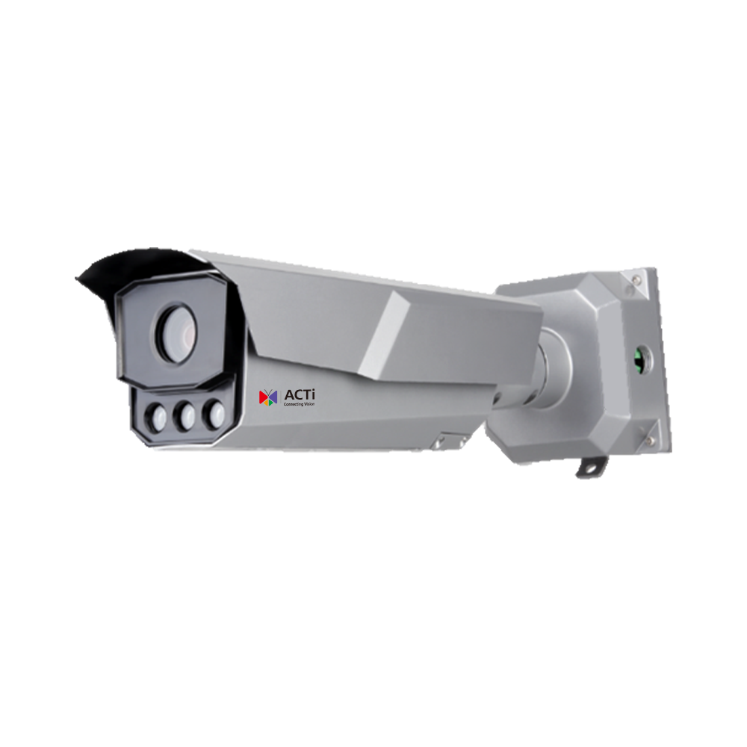
A431 / A431-P1 / A431-P2: Features
Feature1: 4MP 4.3x with Superior Low-light and WDR Performance
  1/1.8-inch sensor
  Color: 0.0005 lux @ (F1.2, AGC ON); B/W: 0.0001 lux @ (F1.2, AGC ON); 0 lux with IR
  IR distance: 50m; WDR: 150dB
  Supports 3 concurrent streams to meet diverse application and specification requirements
Feature2: Traffic-Related AI Support
  Traffic Flow Detection: Measures average speed, traffic flow, queue length, and traffic status
  Incident Detection: Identifies congestion, stopped vehicles, lane changes, wrong-way driving, speeding, and low-speed driving
  Detects vehicle attributes, including type, color, brand, and driving direction
  Supports license plate recognition (LPR)
  Front installation for checkpoint scenarios: up to 120 km/h; side installation: up to 120 km/h
  Covers up to 3 lanes
https://www.acti.com/product/A431
https://www.acti.com/product/A431-P1
https://www.acti.com/product/A431-P2

Slide 69
A431 / A431-P1 / A431-P2: Market to Application
Factory (Factory)
Serial Number | Function | Functional Operation Process | Optimal Location | Operating Procedures | Application Scenarios | Benefits
1 | 4MP 4.3x, Best performance in low light and WDR | Supports three real-time streams, providing different application scenarios and specification requirements | 1) Factory main entrance 2) Warehouse entrance and exit 3) Internal manufacturing area | 1) Equipment installed at key entrances and production areas of the factory 2) Real-time surveillance image transmission to the management center 3) WDR technology improves image quality in low light scenes 4) Conduct multi-stream data recording and analysis | 1) Monitor the dynamics of incoming and outgoing vehicles and personnel 2) Record and analyze safety incidents in the production area | Provide high-quality images, reduce visual blind spots, support multi-scene monitoring within the factory, and enhance production safety and management efficiency.
2 | Traffic-related AI support | Support vehicle attribute detection (such as model, color, brand, etc.) and license plate recognition, further enhancing factory logistics management capabilities. | 1) Goods Loading and Unloading Area 2) Parking Lot Management Area 3) Roads Surrounding the Factory | 1) AI Identification of Vehicle Attributes and License Plates 2) Verification of the Legitimacy of Entering and Exiting Vehicles 3) Real-time Data Synchronization to the Logistics Management System to Enhance Operational Efficiency | 1) Control of Truck Loading and Unloading Processes 2) Verification of Employee and Visitor Vehicle Entry and Exit 3) Detection of Unauthorized Vehicles Entering the Factory Area | Reduce the risk of unauthorized vehicle entry, enhance logistics and security management efficiency in the factory, support decision-making data analysis, and lower operational risks.

Slide 70
A431 / A431-P1 / A431-P2: Market to Application
Traffic (Traffic)
Serial Number | Function | Functional Operation Process | Optimal Location | Operating Procedures | Application Scenarios | Benefits
1 | 4MP 4)3x, Best performance in low light and WDR | Supports three real-time streams, providing different application scenarios and specification requirements | 1) Highway entrance/ exit 2) Main roads in urban areas 3) Parking lot entrance and exit | 1) Front-end equipment installed at target monitoring points 2) Real-time recording of images, transmitted to the back-end server 3) Using WDR to improve monitoring in high-contrast scenes 4) Real-time access to streams for analysis and storage | 1) Traffic flow recording at highway entrances and exits 2) Effective monitoring of high-contrast lighting scenes | Enhance the quality of surveillance images, reduce the impact of lighting, support multi-application streaming, and meet multifunctional requirements.
2 | Traffic-related AI support | Provide vehicle traffic detection, event detection (such as violations, vehicle parking, etc.), and vehicle attribute identification and license plate recognition functions. | 1) Highway service area 2) Traffic signal intersection 3) Toll station | 1) Front-end AI recognition data is transmitted in real-time to the central management server. 2) AI analysis results trigger event alarms. 3) Summary data for management analysis and reporting | 1) Traffic flow analysis in parking areas 2) Real-time alerts for traffic violations 3) License plate matching and access control | Reduce manpower monitoring costs, improve event detection response efficiency, provide traffic data to support decision-making, reduce risks, and enhance operational efficiency.

Slide 71
A431 / A431-P1 / A431-P2: Market to Application
Downtown (Downtown)
Serial Number | Function | Functional Operation Process | Optimal Location | Operating Procedures | Application Scenarios | Benefits
1 | 4MP 4.3x, Best performance in low light and WDR | Supports three real-time streams, providing different application scenarios and specification requirements | 1) Downtown intersections 2) Public parking lot entrances and exits 3) Areas around train stations | 1) Front-end devices installed in high-traffic areas 2) Real-time image streaming recording, transmitted to the backend management center 3) Using WDR to enhance monitoring effects in low light and high contrast scenarios 4) Real-time images for use by security management personnel | 1) Monitoring interactions between pedestrians and vehicles 2) Clear monitoring images under high contrast lighting 3) Preservation and analysis of traffic accident footage | Enhancing the stability and clarity of urban surveillance images to meet multi-scenario streaming needs, contributing to improved public safety management efficiency.
2 | Traffic-related AI support | Providing traffic event detection (such as congestion, wrong-way driving, etc.) along with vehicle attribute identification and license plate recognition functions. | 1) Intersection of Sidewalk and Road 2) Public Activity Areas 3) Municipal Building Entrances | 1) AI Recognition Data is Transmitted to Backend Server in Real-Time 2) Alarm Notification Triggered to Notify Administrator upon Event Detection 3) Data Aggregation for Traffic Behavior Analysis and Decision Support | 1) Warning for Wrong-Way Driving Behavior 2) Detection of Traffic Conditions in Urban Activities 3) Records and Tracking of Municipal Vehicle Entries and Exits | Reduce the incidence of safety accidents in urban areas, enhance traffic management efficiency, provide accurate data support for municipal management, and effectively lower operational risks.

Slide 72
A431 / A431-P1 / A431-P2: Video

Slide 73
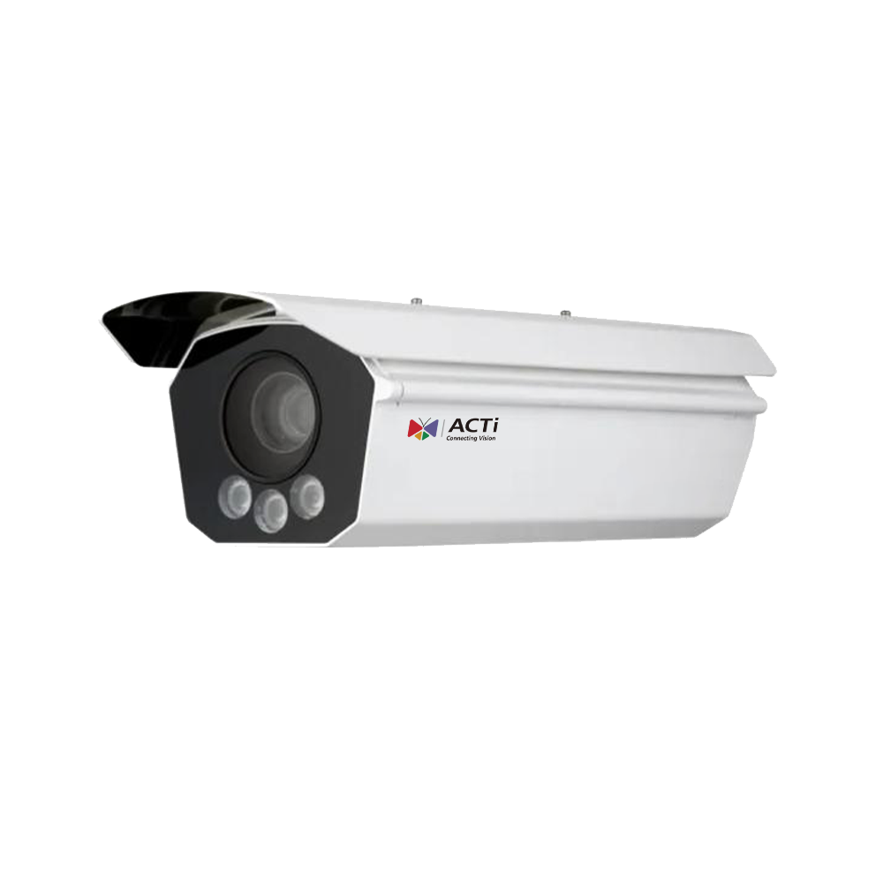
A432: Features
Feature1: 9MP 3.6x with Superior Low-light Performance
  1-inch sensor
  Color: 0.001 lux @ (F1.4, AGC ON); B/W: 0.0005 lux @ (F1.4, AGC ON)
  IR distance: 30m
  Supports 3 concurrent streams to meet diverse application and specification requirements
Feature2: Traffic-Related AI Support
  ALPR (Automatic License Plate Recognition), vehicle detection, color detection, type detection, and incorrect direction detection
  Front installation for checkpoint scenarios: up to 320 km/h; side installation: up to 320 km/h
https://www.acti.com/product/A432

Slide 74
A432: Market to Application
Traffic (Traffic)
Serial Number | Function | Functional Operation Process | Optimal Location | Operating Procedures | Application Scenarios | Benefits
1 | 9MP 3.6x provides optimal low light performance | 1) Enter the camera settings page 2) Adjust image resolution and light sensor settings 3) Real-time preview 4) Save settings | - Highway toll station - Parking lot exit - Surveillance hub section | 1) System startup 2) Real-time image capture and data transmission 3) Image returned to backend management system 4) Provide safety and traffic monitoring reports | - Highway surveillance of nighttime traffic flow and suspicious vehicles - Parking lot vehicle entry and exit records - Monitoring traffic conditions around key junctions 24/7 | - Improve nighttime surveillance efficiency and reduce missed detection events - Provide high-definition images for post-event analysis in busy areas - Enhance traffic management efficiency and accuracy
2 | Traffic-related AI Support | 1) Enter AI Settings page 2) Select ALPR ( License Plate Recognition), vehicle type, vehicle color, or direction detection function 3) Enable Function 4) View Results | - Main Road Checkpoint - Toll Booth Lane - Speed Monitoring Area | 1) System Automatically Identifies Vehicle Features 2) Image is Transmitted in Real-Time to ALPR Backend System 3) Match Database to Check for Violations or Illegal Vehicles 4) Notify Administrator for Further Processing | - Detection of Illegal Vehicle Entry and Exit - Quick Capture of License Plate and Vehicle Information for Law Enforcement - Ensure Area Safety and Reduce Vehicle Violations | - Improve the speed of vehicle data collection and detection of violations - Reduce manual operations and optimize operational efficiency - Enhance traffic and safety management capabilities in the area

Slide 75
A432: Market to Application
Downtown (Downtown)
Serial Number | Function | Functional Operation Process | Optimal Location | Operating Procedures | Application Scenarios | Benefits
1 | 9MP 3.6x provides optimal low light performance | 1) Enter the camera settings page 2) Adjust image resolution and light sensor settings 3) Real-time preview 4) Save settings | - City center intersections - Important public facilities (such as government agencies) - Crowded shopping areas | 1) System startup 2) Capture real-time images and environmental data 3) Transmit data to the management platform 4) Provide safety and surveillance reports | - Monitor vehicle and pedestrian activities in the city center at night - Surveillance of public facility entrances and exits - Assist in safety management of large event areas | - Reduce the risk of nighttime security incidents - Provide efficient and high-definition security images for downtown and public facilities - Enhance on-site security monitoring capabilities for large events
2 | Traffic-related AI Support | 1) Enter AI Settings page 2) Select ALPR ( License Plate Recognition), vehicle type, vehicle color, or direction detection function 3) Enable Function 4) View Results | - Public parking lot entrance - Monitoring areas of busy streets - Sections with traffic lights | 1) Automatically identify vehicle characteristics and driving direction 2) Transmit images to the AI backend system for analysis 3) System matches suspicious vehicle database 4) The administrator receives a notification for processing | - Detection of illegal parking in public parking lots - Tracking specific vehicles' routes in and out of the city - Analyzing traffic flow and congestion in the city center | - Improving the management efficiency of vehicle flow and violation behavior - Reducing the pressure of manual monitoring and optimizing law enforcement accuracy - Enhancing overall traffic and safety conditions in the city center

Slide 76
A432: Market to Application
Seaport (Seaport)
Serial Number | Function | Functional Operation Process | Optimal Location | Operating Procedures | Application Scenarios | Benefits
1 | 9MP 3.6x provides optimal low light performance | 1) Enter the camera settings page 2) Adjust image resolution and light sensor settings 3) Real-time preview 4) Save settings | - Main import and export of the port - Container freight area - Customs inspection point | 1) System Startup 2) Capture HD images and transmit to management platform 3) System stores and analyzes data 4) Provide security reports to managers | - Night surveillance of vehicle and personnel activities in the port - Security management of container areas - Import and export monitoring at customs checkpoints | - Provide round-the-clock HD surveillance to reduce missed incidents - Enhance security and operational efficiency in container areas - Strengthen the enforcement capabilities and accuracy of port customs
2 | Traffic-related AI Support | 1) Enter AI Settings page 2) Enable vehicle detection and ALPR functionality 3) View license plate and vehicle data in real-time 4) Match database and alert for violating vehicles | - Vehicle registration area at the port entrance - Waiting area for cargo transport vehicles - Logistics center within the port | 1) Automatically identify vehicle information (license plate, color, type) 2) Transmit data to the management system in real-time 3) Conduct backend analysis to identify suspicious vehicles 4) Provide reports or alerts to the administrator | - Manage the legality of vehicle entry and exit at the port - Prevent unauthorized vehicles from entering the port - Improve the efficiency of cargo flow within the port | - Reduce management loopholes for vehicle entry and exit, ensuring port security - Simplify the vehicle monitoring process within the port, enhancing operational efficiency - Assist in the rapid detection of suspicious vehicles and illegal activities

Slide 77
A432: Video

Slide 78
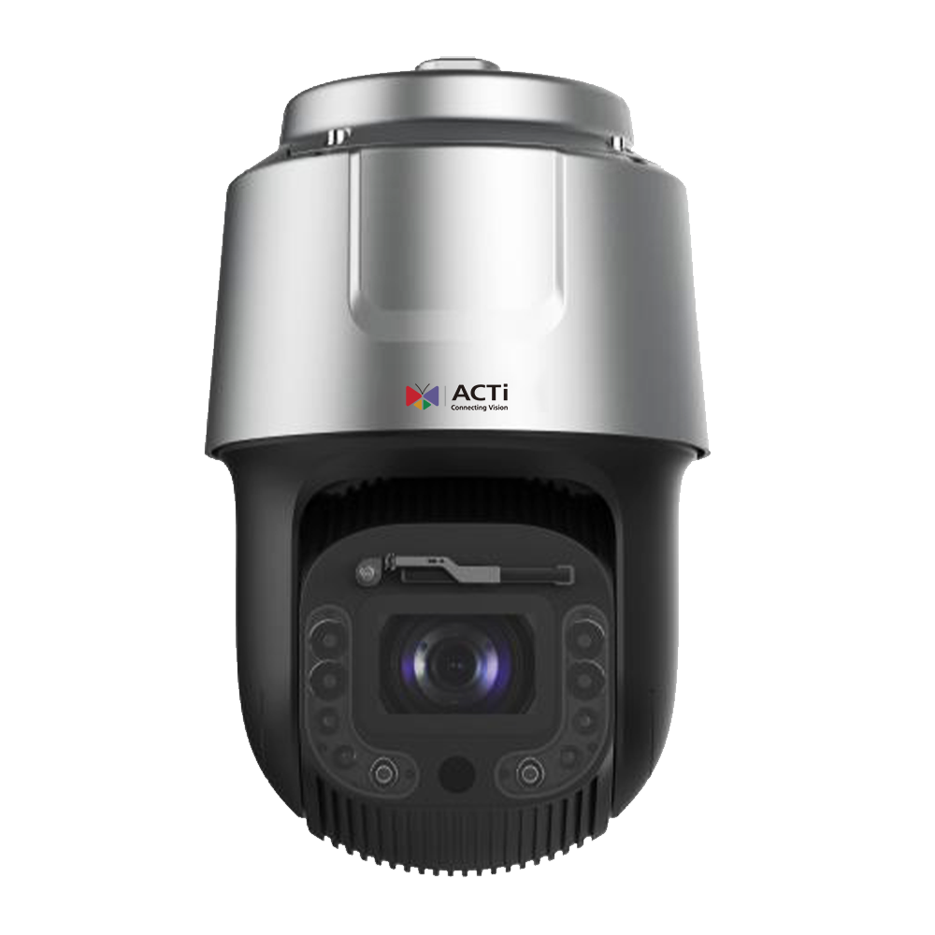
A961: Features
Feature1: 2MP 60x with Superior Low-light and WDR Performance
  1/1.2-inch sensor
  Color: 0.002 lux @ F1.6 (AGC on); B/W: 0 lux (Laser on)
  IR distance: 500m (Laser); WDR: 140dB
  Supports 3 concurrent streams to meet diverse application and specification requirements
Feature2: Deep Learning AI Support
  ALPR (Automatic License Plate Recognition)
  Vehicle detection, face detection, face tracking, object area entry detection, object line crossing detection, and object area exit detection
  Front installation for checkpoint scenarios: up to 120 km/h; side installation: up to 120 km/h
https://www.acti.com/product/A961

Slide 79
A961: Market to Application
Traffic (Traffic)
Serial Number | Function | Functional Operation Process | Optimal Location | Operating Procedures | Application Scenarios | Benefits
1 | 2MP 60x high magnification + extxcellent low light WDR performance | 1) Navigate to the image settings page 2) Adjust the zoom, enable WDR function 3) View the image in real-time | 1) Highway toll station 2) Highway entrance ramp 3) Major traffic hub exit | 1) The administrator confirms the monitoring needs of the traffic hub 2) Set the magnification and exposure 3) Real-time monitoring of road images | 1) Monitor the status of vehicles on the highway to ensure smooth traffic 2) Clearly identify vehicles and surrounding environments in low light conditions | Reduce risks caused by blurred vision, improve traffic monitoring efficiency, and minimize downtime losses due to accidents.
2 | Deep Learning AI Support | 1) Activate ALPR function 2) Set target area and vehicle speed parameters 3) View real-time license plate recognition results | 1) Highway buffer zone 2) Bridge entry and exit 3) High accident occurrence areas | 1) Managers analyze vehicle flow trends 2) System automatically detects and recognizes license plates 3) Record and store results | 1) Automatically record license plate information when vehicles pass by for illegal vehicle interception 2) Achieve precise traffic flow management in multi-path surveillance | Improve vehicle passage efficiency, quickly query vehicle passage records, and reduce manual operation errors

Slide 80
A961: Market to Application
Downtown (Downtown)
Serial Number | Function | Functional Operation Process | Optimal Location | Operating Procedures | Application Scenarios | Benefits
1 | 2MP 60x high magnification + extxcellent low light WDR performance | 1) Navigate to the image settings page 2) Adjust the zoom, enable WDR function 3) View the image in real-time | 1) City center traffic intersections 2) Nighttime security hotspots 3) Surveillance points around high-rise buildings | 1) Security management personnel analyze the surveillance area 2) Adjust shooting angles and zoom 3) Activate nighttime surveillance | 1) Provide high-resolution images for crowd management in urban areas 2) Assist in security patrols under low light conditions at night | Enhance urban security, reduce crime rates, and strengthen citizens' sense of safety
2 | Deep Learning AI Support | 1) Enable facial detection function 2) Set area alarm trigger conditions 3) Track facial targets and generate reports | 1) Urban parks 2) Large shopping mall entrances 3) Parking lot import and export | 1) System identifies specific personnel entering the area 2) Generate alarms and record facial data 3) Provide real-time notifications | 1) Monitor abnormal behavior of personnel in public spaces 2) Automatically identify faces entering specific areas and conduct analysis | Quickly respond to potential threats, reduce personnel management pressure, and address emergencies in a timely manner

Slide 81
A961: Market to Application
Factory (Factory)
Serial Number | Function | Functional Operation Process | Optimal Location | Operating Procedures | Application Scenarios | Benefits
1 | 2MP 60x high magnification + extxcellent low light WDR performance | 1) Navigate to the image settings page 2) Adjust the zoom, enable WDR function 3) View the image in real-time | 1) Raw material warehouse entrance 2) Key areas of manufacturing equipment 3) Surveillance points with insufficient ambient light | 1) Confirm surveillance locations 2) Set up cameras to cover key areas 3) Monitor the production process | 1) Clearly record the flow of materials in and out of the factory 2) Provide high-quality surveillance images in low light environments | Prevent material loss, monitor abnormal production processes, and enhance internal operational efficiency
2 | Deep Learning AI Support | 1) Enable area intrusion detection function 2) Set target range and alarm method 3) Automatically record intrusion events | 1) Around the warehouse 2) Entrance of the production workshop 3) Near high-value equipment | 1) The system automatically identifies objects entering the designated area 2) Trigger alarm and notify management personnel 3) Store event data | 1) Automatically detect illegal intrusion and generate timely reports to notify relevant personnel 2) Support real-time risk management | Reduce risks caused by personnel management oversights, ensure property safety, and improve alert efficiency.

Slide 82
A961: Video

Slide 83
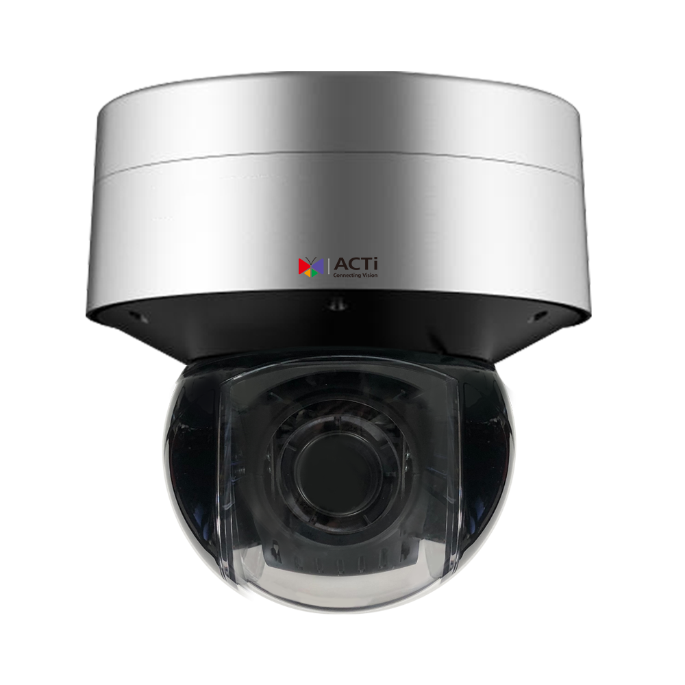
A962: Features
Feature1: 8MP 36x with Superior Low-light and WDR Performance
  1/1.8-inch sensor
  Color: 0.0005 lux @ F1.2 (AGC on); B/W: 0 lux (IR LED on)
  IR working distance: 300m; WDR: 140dB
  Supports 3 concurrent streams to meet diverse application and specification requirements
  120fps at 1080P
Feature2: Deep Learning AI Support
  ALPR (Automatic License Plate Recognition)
  Vehicle detection, face detection, face tracking, object area entry detection, object line crossing detection, and object area exit detection
  Front installation for checkpoint scenarios: up to 180 km/h; side installation: up to 180 km/h
https://www.acti.com/product/A962

Slide 84
A962: Market to Application
Traffic (Traffic)
Serial Number | Function | Functional Operation Process | Optimal Location | Operating Procedures | Application Scenarios | Benefits
1 | 8MP 36x Best low light WDR Performance | Provides high-quality images that can operate normally in extremely low light environments; multiple streams meet various application needs. | 1) Highway entrance 2) Toll station 3) Vehicle parking lot | 1) Managers can remotely view real-time images of highway sections through VMS. 2) Configure multiple streams to meet monitoring and recording needs. 3) Enable IR function in nighttime or low light conditions. | Administrator and Vehicle: Used for monitoring vehicle entry and exit, analyzing traffic flow, or tracking fleeing vehicles. Administrator and Infrastructure: Monitor the status of highway toll stations, providing clear quality event records. | Reduce the risk of accidents and traffic congestion, enhance nighttime surveillance efficiency and quality, and assist traffic managers in responding quickly to events.
2 | Deep Learning AI Support | ALPR ( Automatic License Plate Recognition), vehicle detection, object entry and exit area, and line crossing detection functions, automatically analyze data and trigger alarms. | 1) Toll Station 2) Highway Checkpoint 3) Parking Lot | 1) Use AI for vehicle detection and automatic license plate recognition. 2) Automatically capture license plates and vehicle features at speeds of up to 180 km/h in high-speed scenarios. 3) Automatically trigger alarms for illegal activities, such as illegal parking or vehicles entering restricted areas. | Administrator and Vehicle: Identify illegal vehicles or unpaid vehicles, triggering automatic alarms. Managers and Visitors: Improve parking lot entry and exit efficiency without manual intervention, enhancing overall traffic flow. | Reduce manual intervention to enhance management efficiency, quickly capture violations to minimize losses, and can be applied to law enforcement and evidence collection, meeting traffic management needs.

Slide 85
A962: Market to Application
Downtown (Downtown)
Serial Number | Function | Functional Operation Process | Optimal Location | Operating Procedures | Application Scenarios | Benefits
1 | 8MP 36x Best low light WDR Performance | Provides high-quality images that can operate normally in extremely low light environments; multiple streams meet various application needs. | 1) Parks and Public Spaces 2) Traffic Intersections 3) Periphery of Government Buildings | 1) Install cameras in public areas to provide real-time images for city managers to view remotely. 2) Utilize multi-streaming to simultaneously monitor multiple scenes and record the occurrence of events. 3) Automatically activate low light or IR mode at night to ensure availability at all times. | Managers and Visitors: Monitor visitor activities in public spaces to ensure citizen safety. Managers and Infrastructure: Monitor traffic conditions at intersections to assist in traffic control or detect infrastructure damage. | Reduce crime risk and enhance public safety; Optimize the monitoring capabilities of urban managers, ensuring clear images can still be captured in low light environments.
2 | Deep Learning AI Support | Vehicle detection, facial recognition and tracking, crowd density detection, automatic data analysis generation, and triggering alarms. | 1) Crowded urban square 2) Government facility entrance 3) Around hospitals or schools | 1) Utilize AI features for real-time facial or vehicle detection to determine if there are any suspicious individuals present. 2) Detect crowd density and timely trigger alarms for overcrowding. 3) Automatically record suspicious activities and events, generating reports for subsequent analysis. | Managers and visitors: Detect abnormal situations in public activities, such as emergencies or violent incidents, to enhance law enforcement efficiency. Managers and Employees: Track suspicious activities within government facilities to ensure employee safety. | Achieve efficient urban management and prevent incidents from occurring; Enhance public safety and internal management efficiency within the city, ensuring vigilance in sensitive areas.

Slide 86
A962: Market to Application
Seaport (Seaport)
Serial Number | Function | Functional Operation Process | Optimal Location | Operating Procedures | Application Scenarios | Benefits
1 | 8MP 36x Best low light WDR Performance | Provides high-quality images that can operate normally in extremely low light environments; multiple streams meet various application needs. | 1) Port Dock 2) Vessel Berthing Area 3) Goods Loading and Unloading Area | 1) Deploy cameras at the dock for round-the-clock monitoring of goods loading and unloading as well as vessel berthing conditions. 2) Multi-stream mode records multi-angle images for incident review or investigation. 3) Automatically switch to low light mode at night or activate IR function to obtain clear images. | Managers and Infrastructure: Monitor the goods area to ensure the safety of goods; prevent theft or loss. Managers and Anonymous Personnel: Identify unauthorized access to sensitive areas and trigger alarms to prevent incidents. | Reduce goods loss, ensure the safety of sensitive areas, and enhance nighttime operational efficiency at the port; support multi-angle image capture to improve the accuracy and efficiency of event review.
2 | Deep Learning AI Support | Vehicle detection, object crossing detection, automatic identification of entry and exit areas, assisting in managing activities in large port areas. | 1) Port Area Entrance Checkpoint 2) Customs Inspection Area 3) Parking Area | 1) Use AI technology to detect vehicles entering and exiting the port area, and automatically record license plates and vehicle characteristics. 2) Configure intrusion detection functions to prevent vehicles or personnel from mistakenly entering critical areas. 3) Automatically generate event reports for further review by management. | Management and Vehicles: Efficiently track vehicles and goods transportation entering and exiting the port area, reducing management loopholes. Managers and anonymous personnel: Trigger alarms for unauthorized activities in sensitive port areas to ensure operational safety. | Enhance overall security and operational efficiency in the port area, reduce the probability of illegal entries and incidents, and support managers in data-driven decision-making and law enforcement operations.

Slide 87
A962: Video

Slide 88

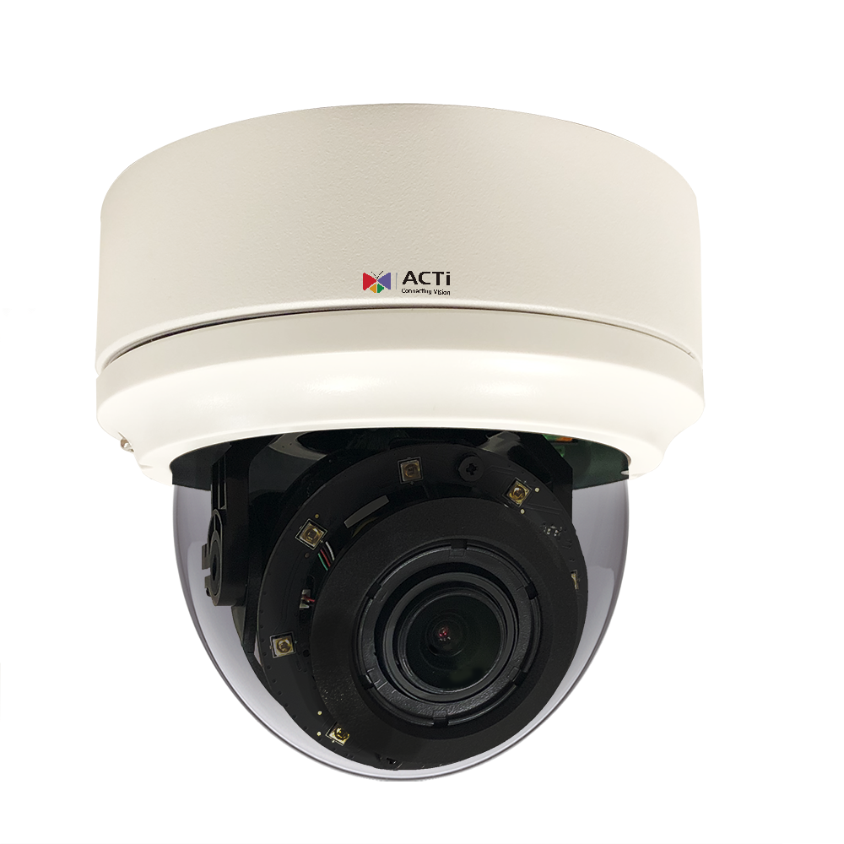
A426 / A826: Features
Feature1: 5MP 4.4x with Superior Low-light and WDR Performance
  Color: 0.01 lux; B/W: 0 lux (IR LED on)
  IR distance: 60m; WDR: 135dB
  Supports 4 concurrent streams to meet diverse application and specification needs
Feature2: Deep Learning AI for People and Face-Related Security
  People-based detection for:
    Area entry/exit, intrusion (forbidden area), loitering, and line crossing
  People area counting and line counting
  Face detection
  Facial recognition
https://www.acti.com/product/A426
https://www.acti.com/product/A826

Slide 89
A426 / A826: Features
Feature3: Deep Learning AI for Vehicle and ALPR Security
  Vehicle-based detection for:
    Area entry/exit, intrusion (forbidden area), loitering, and line crossing
  Vehicle counting and stopped vehicle detection
  Automatic License Plate Recognition (ALPR)
https://www.acti.com/product/A426
https://www.acti.com/product/A826

Slide 90
A426 / A826: Market to Application
Factory ( Factory)
Serial Number | Function | Functional Operation Process | Optimal Location | Operating Procedures | Application Scenarios | Benefits
1 | 5MP high definition 4.4 variable zoom, with optimal low light and wide dynamic range performance - Color: 0.01 lux, B/W: 0 lux (IR LED on ) - Infrared distance: 60 m, WDR: 135db - Simultaneously supports 4 streams | 1) Navigation: Enter the camera management interface 2) Configuration: Adjust zoom magnification and infrared intensity 3) Execution: Click to enable the function 4) View Results: Real-time image presents high detail and nighttime clarity | 1) Main entrance and exit of the warehouse 2) Manufacturing area 3) Perimeter wall surveillance | 1) Setup: Install in the designated area, configure zoom and WDR functions 2) Surveillance: Capture high-resolution images in real-time, adapting to light changes 3) Analysis: Provide complete detailed images for review or evidence | Scenario: Warehouse import and export monitoring of vehicles, details of goods loading and unloading operations, and support for clear visibility in low light conditions at night. | 1) Reduce accident risks and ensure the safety of important assets 2) Improve nighttime monitoring efficiency and reduce omissions 3) Provide high-resolution images as evidence.
2 | Based on deep learning for humans AI support functions - Including personnel detection, area intrusion, loitering behavior, and line crossing detection - Support for personnel counting and facial recognition functions. | 1) Navigation: Enter AI Analysis Function Interface 2) Configuration: Set Detection Rules (e.g., Intrusion Areas, Dwell Time, etc.) 3) Execution: Activate AI Analysis 4) View Results: Generate Event Alerts or Records | 1) Factory Entrance 2) Sensitive Areas (e.g., Production Equipment, Raw Material Storage) 3) Warehouse Perimeter | 1) Set Up: Define AI Analysis Rules and Key Areas 2) Surveillance: Real-time Analysis of Personnel Behavior and Send Alerts 3) Storage: Store Event Images for Future Reference | Scenario: Automatically detect unauthorized access to sensitive areas and notify security management personnel; identify personnel identity and exclude unauthorized individuals from entering. | 1) Reduce the risk of unauthorized behavior 2) Improve security management efficiency 3) Reduce manual monitoring burden through automated alerts.
3 | Vehicle-based deep learning AI support features - inclusive of vehicle detection, license plate recognition ( ALPR), area intrusion and vehicle stay detection. | 1) Navigation: Enter ALPR function interface 2) Configuration: Set vehicle detection parameters and license plate comparison list 3) Execution: Enable detection function 4) View Results: Generate real-time license plate recognition results or alerts | 1) Vehicle Entrance and Exit 2) Parking Lot 3) Roads around the Manufacturing Area | 1) Setup: Define vehicle detection areas and parameters 2) Surveillance: Automatically identify vehicles and compare with the license plate list 3) Storage: Store license plate data and images for future inquiries | Scenario: Automatically record vehicles and license plates entering and exiting the factory area, detect the duration of vehicles in the parking area, and send abnormal alerts. | 1) Reduce the risk of unauthorized vehicles entering 2) Improve parking management efficiency 3) Support quick retrieval of specific vehicle data

Slide 91
A426 / A826: Market to Application
Educational Institution ( Education )
Serial Number | Function | Functional Operation Process | Optimal Location | Operating Procedures | Application Scenarios | Benefits
1 | 5MP high definition 4.4 variable zoom, with optimal low light and wide dynamic range performance - Color: 0.01 lux, B/W: 0 lux (IR LED on ) - Infrared distance: 60 m, WDR: 135db - Simultaneously supports 4 streams | 1) Navigation: Enter the camera management interface 2) Configuration: Adjust zoom magnification and infrared intensity 3) Execution: Click to enable the function 4) View Results: Real-time image presents high detail and nighttime clarity | 1) Main entrances and exits of the campus 2) Dormitory corridors 3) Student gathering places | 1) Setup: Install in the designated area, configure zoom and WDR functions 2) Surveillance: Capture high-resolution images in real-time, adapting to light changes 3) Analysis: Provide complete detailed images for review or evidence | Scenario: Monitor students and visitors entering and exiting the school gate, improve visibility in dormitory corridors at night, and provide panoramic and detailed surveillance of event venues. | 1) Enhance campus security and reduce unauthorized personnel access 2) Improve nighttime surveillance effectiveness to ensure student safety 3) Reduce security incidents caused by insufficient visibility
2 | Based on deep learning for humans AI support functions - Including personnel detection, area intrusion, loitering behavior, and line crossing detection - Support for personnel counting and facial recognition functions. | 1) Navigation: Enter AI Analysis Function Interface 2) Configuration: Set Detection Rules (e.g., Intrusion Areas, Dwell Time, etc.) 3) Execution: Activate AI Analysis 4) View Results: Generate Event Alerts or Records | 1) Campus boundary wall 2) Dormitory entrance 3) Inside and outside the classroom | 1) Set Up: Define AI Analysis Rules and Key Areas 2) Surveillance: Real-time Analysis of Personnel Behavior and Send Alerts 3) Storage: Store Event Images for Future Reference | Scenario: Automatically detect unauthorized personnel climbing over the wall; identify the identity of individuals entering and exiting the dormitory to prevent unauthorized access; monitor abnormal behavior of individuals lingering outside the classroom | 1) Reduce potential risks around the campus 2) Enhance dormitory safety and visitor management 3) Provide alerts for abnormal behavior to improve campus management efficiency
3 | Vehicle-based deep learning AI support features - inclusive of vehicle detection, license plate recognition ( ALPR), area intrusion and vehicle stay detection. | 1) Navigation: Enter ALPR function interface 2) Configuration: Set vehicle detection parameters and license plate comparison list 3) Execution: Enable detection function 4) View Results: Generate real-time license plate recognition results or alerts | 1) Campus parking lot 2) Main entrance and exit 3) Staff-only parking area | 1) Setup: Define vehicle detection areas and parameters 2) Monitoring: Automatically identify vehicles and compare with the license plate list 3) Storage: Store license plate data and images for future inquiries | Scenario: Automatically record vehicles entering and exiting the campus, detect whether staff parking spaces are occupied, and generate abnormal alerts. | 1) Improve campus vehicle management efficiency 2) Reduce the risk of unauthorized vehicles entering 3) Support quick queries for specific vehicle data

Slide 92
A426 / A826: Market to Application
Commercial Building ( Commercial Building )
Serial Number | Function | Functional Operation Process | Optimal Location | Operating Procedures | Application Scenarios | Benefits
1 | 5MP high definition 4.4 variable zoom, with optimal low light and wide dynamic range performance - Color: 0.01 lux, B/W: 0 lux (IR LED on ) - Infrared distance: 60 m, WDR: 135db - Simultaneously supports 4 streams | 1) Navigation: Enter the camera management interface 2) Configuration: Adjust zoom magnification and infrared intensity 3) Execution: Click to enable the function 4) View Results: Real-time image presents high detail and nighttime clarity | 1) Main entrance of the building 2) Driveway entrance and exit 3) Lobby | 1) Setup: Install in the designated area, configure zoom and WDR functions 2) Surveillance: Capture high-resolution images in real-time, adapting to light changes 3) Analysis: Provide complete detailed images for review or evidence | Scenario: Monitor visitors at the main entrance of the building, monitor vehicles entering and exiting at the driveway entrance and exit, and improve management efficiency in the lobby. | 1) Improve building management efficiency and safety 2) Reduce the risk of security incidents 3) Support better visitor and vehicle monitoring
2 | Based on deep learning for humans AI support functions - Including personnel detection, area intrusion, loitering behavior, and line crossing detection - Support for personnel counting and facial recognition functions. | 1) Navigation: Enter AI Analysis Function Interface 2) Configuration: Set Detection Rules (e.g., Intrusion Areas, Dwell Time, etc.) 3) Execution: Activate AI Analysis 4) View Results: Generate Event Alerts or Records | 1) Building back door 2) Parking lot elevator entrance and exit 3) Surveillance room vicinity | 1) Set Up: Define AI Analysis Rules and Key Areas 2) Surveillance: Real-time Analysis of Personnel Behavior and Send Alerts 3) Storage: Store Event Images for Future Reference | Scenario: Automatically detect unauthorized personnel entering the back door; monitor whether there are lingering behaviors at the parking lot elevator entrance and exit; enhance surveillance capabilities around the security room | 1) Reduce the risk of unauthorized access 2) Strengthen parking lot management and entrance and exit monitoring 3) Reduce the pressure on security personnel and improve efficiency
3 | Vehicle-based deep learning AI support features - inclusive of vehicle detection, license plate recognition ( ALPR), area intrusion and vehicle stay detection. | 1) Navigation: Enter ALPR function interface 2) Configuration: Set vehicle detection parameters and license plate comparison list 3) Execution: Enable detection function 4) View Results: Generate real-time license plate recognition results or alerts | 1) Parking Fee Station 2) Lane Entrance and Exit 3) Management Room Surveillance Interface | 1) Setup: Define vehicle detection areas and parameters 2) Surveillance: Automatically identify vehicles and compare with the license plate list 3) Storage: Store license plate data and images for future inquiries | Scenario: Automatically record vehicles entering and exiting the parking lot; reduce errors at the fee station, support automatic license plate matching; assist in lane surveillance. | 1) Improve parking management efficiency 2) Reduce disputes over fee issues 3) Provide accurate vehicle records

Slide 93
A426 / A826: Video

Slide 94
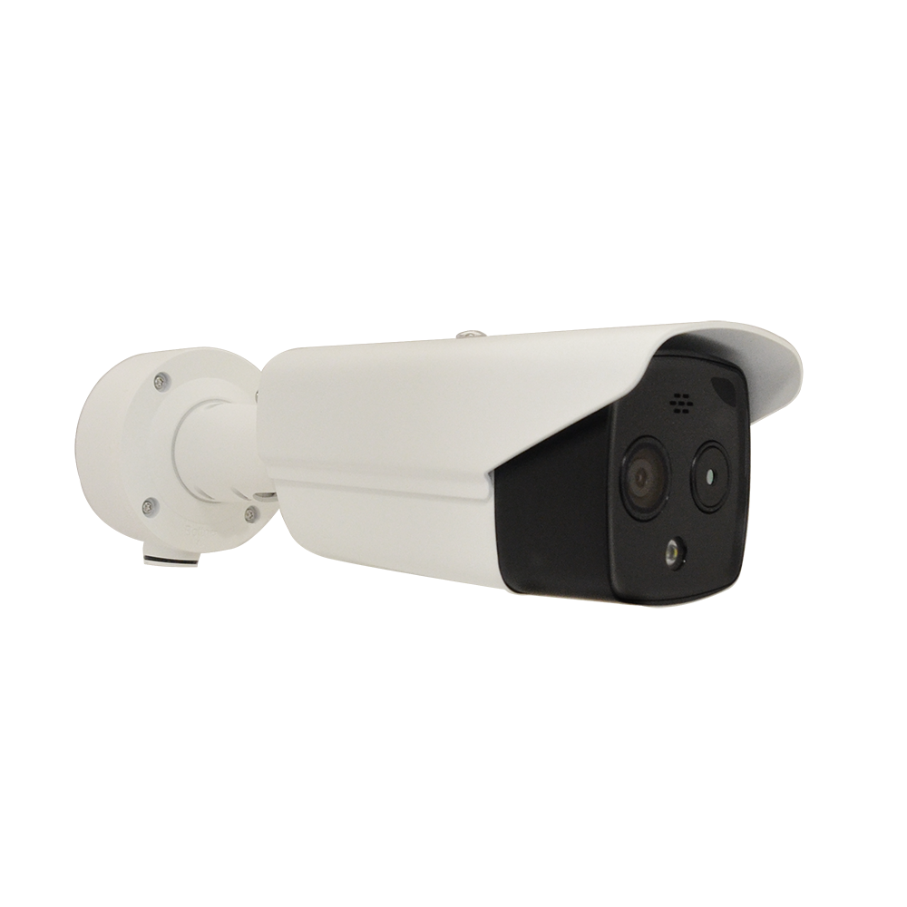
VMGB-359 / VMGB359-P1: Features
Feature1: Thermal Image Features
  Effective pixels: 160(H) × 120(V)
  NETD (Noise Equivalent Temperature Difference) < 40mK, detecting temperature differences as small as 0.04°C
  Lens options:
    VMGB-359: f6.2
    VMGB-359-P1: f3.1
  Temperature range: -20°C to 150°C (-4°F to 302°F)
  Temperature accuracy: ±8°C (14.4°F)
  Object detection distance: < 200m
Feature2: Deep Learning AI for Thermal and Optical Imaging
  Temperature exception detection (up to 10 points, 10 areas, and 1 line), intelligent event detection
  Fire detection
  Smoke detection
  People-based detection:
    Line crossing, area entry, area exit, and intrusion detection
  Vehicle-based detection:
    Line crossing, area entry, area exit, and intrusion detection (forbidden area)
https://www.acti.com/product/VMGB-359
https://www.acti.com/product/VMGB-359-P1

Slide 95
VMGB-359 / VMGB359-P1: Features
Feature3: Full-Color and Active Deterrence
  Supports white light LED with a 40m range, enabling full-color imaging
  White light LED can be activated in event mode as an active deterrence
Feature4: Optical Image Features
  Resolution: 4MP at 30fps
  Lens options:
    VMGB-359: 8mm
    VMGB-359-P1: 4mm (based on installation needs)
  Minimum illumination:
    Color: 0.017 lux @ F2.25 (AGC on)
    B/W: 0.003 lux @ F2.25 (AGC on)
  IR distance: 40m for both models
https://www.acti.com/product/VMGB-359
https://www.acti.com/product/VMGB-359-P1

Slide 96
VMGB-359 / VMGB359-P1: Market to Application
Parking Lot ( Parking Lot)
Serial Number | Function | Functional Operation Process | Optimal Location | Operating Procedures | Application Scenarios | Benefits
1 | Thermal Imaging Function | 160x120 thermal imaging resolution, capable of detecting a temperature difference of 0.04° C, supports a temperature range of -20° C ~ 150°C, temperature accuracy ±8° C | Parking lot exit, electric vehicle charging station, parking area | 1) Select function page 2) Set monitoring area and parameters 3) Activate monitoring mode 4) View real-time or stored images | Monitor electric vehicle overheating and potential fire risks in the parking lot | Reduce fire risks, protect property safety, and improve parking lot management efficiency
2 | Deep Learning AI Fire Detection | Fire abnormal temperature detection (supports up to 10 points/10 areas/1 line), smoke detection | Parking Lot Comprehensive Monitoring Points | 1) Enter the Fire Detection Page 2) Configure Area and Parameters 3) Activate 4) Real-time Detection and Alarm | Fire detection in unattended areas of the parking lot to identify fire sources early | Reduce losses in the parking lot caused by fires and respond promptly to ensure personnel safety
3 | Full Color and Active Deterrence | 40 meters White Light LED, can activate the light source for deterrence or provide color images when an event is triggered | Main entrance and corners of the parking lot | 1) Set LED Trigger Conditions 2) The system automatically detects and triggers the light source 3) Real-time recording of color images | Increase light sources in the parking lot at night to deter illegal activities, such as trespassing or destructive behavior | Enhance nighttime safety in the parking lot and reduce the likelihood of theft or destructive incidents
4 | Optical imaging function | 4MP Resolution, 30 fps, supports 8 mm (VMGB-359) and 4 mm (VMGB-359-P1) lenses, 40 meters infrared distance | Parking Lot Entrance, License Plate Recognition Area | 1) Configure Camera Angle and Field of View 2) Set Infrared Mode 3) Image Recording and Archiving | License Plate Recognition and Parking Space Monitoring | Improve parking lot operational efficiency, supporting accurate license plate recording and statistics

Slide 97
VMGB-359 / VMGB359-P1: Market to Application
Factory ( Factory )
Serial Number | Function | Functional Operation Process | Optimal Location | Operating Procedures | Application Scenarios | Benefits
1 | Thermal Imaging Function | 160x120 thermal imaging resolution, capable of detecting a temperature difference of 0.04° C, supports a temperature range of -20° C ~ 150°C, temperature accuracy ±8° C | Next to important equipment, raw material warehouse | 1) Select function page 2) Set monitoring area and parameters 3) Activate monitoring mode 4) View real-time or stored images | Monitor abnormal temperatures of factory equipment, such as motor overheating or warehouse fires | Reduce equipment downtime risk, minimize losses, and ensure stable production line

Slide 98
VMGB-359 / VMGB359-P1: Video

Slide 99
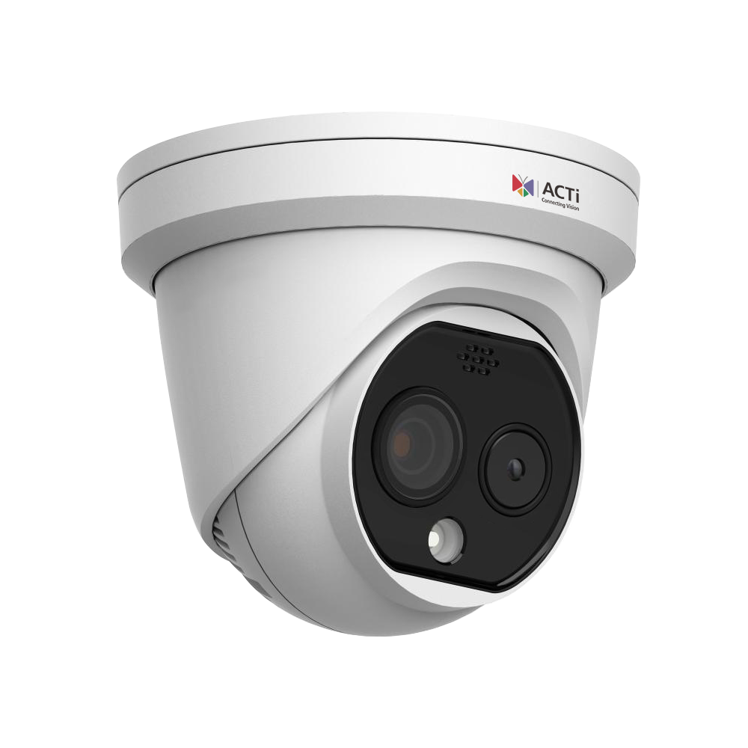
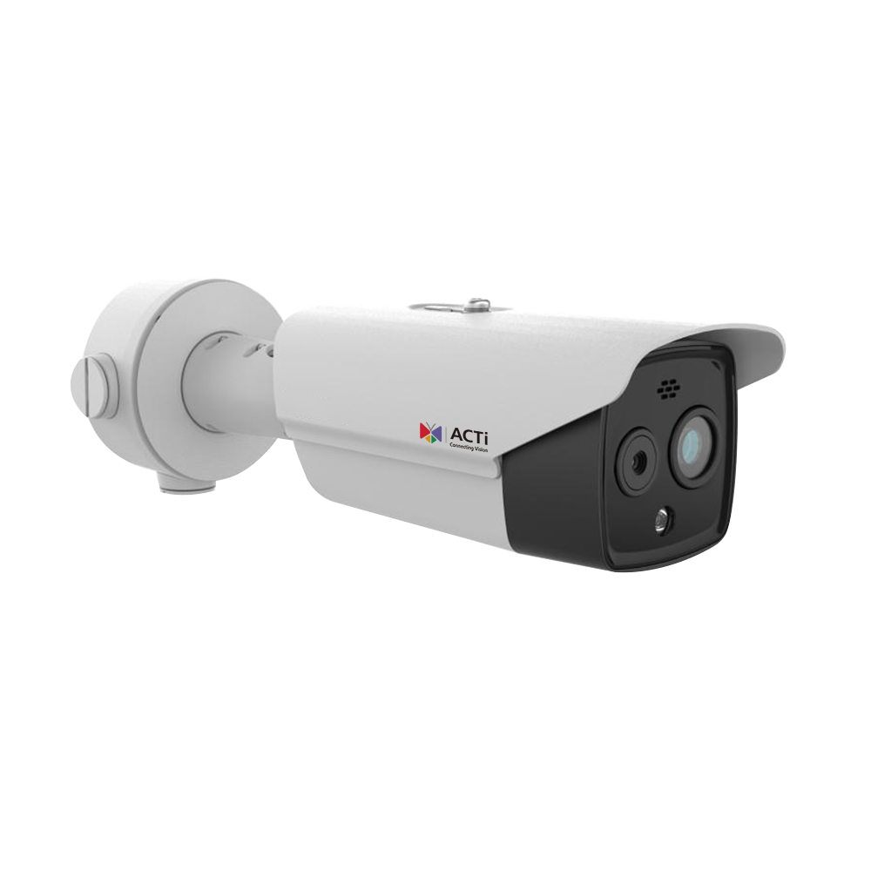
A570 / A570-Px / A371 / A371-Px: Features
Feature1: Thermal Image Features
  Effective pixels: 256(H) × 192(V)
  NETD (Noise Equivalent Temperature Difference) < 40mK, detecting temperature differences as small as 0.04°C
  Lens options for flexible installation distances:
    A570: f2.1
    A570-P1: f3.6
    A570-P2: f6.9
    A371: f3.6
    A371-P1: f6.9
    A371-P2: f9.7
  Temperature range: -20°C to 150°C (-4°F to 302°F)
  Temperature accuracy: ±8°C (14.4°F)
  Object detection distance: < 200m
Feature2: Deep Learning AI for Thermal and Optical Imaging
  Temperature exception detection (up to 10 points, 10 areas, and 1 line), intelligent event detection
  Fire detection
  Smoke detection
  People-based detection:
    Line crossing, area entry, area exit, and intrusion detection
  Vehicle-based detection:
    Line crossing, area entry, area exit, and intrusion detection (forbidden area)
https://www.acti.com/product/A570
https://www.acti.com/product/A570-P1
https://www.acti.com/product/A570-P2
https://www.acti.com/product/A371
https://www.acti.com/product/A371-P1
https://www.acti.com/product/A371-P2

Slide 100
A570 / A570-Px / A371 / A371-Px: Features
Feature3: Full-Color and Active Deterrence
  Supports white light LED with a 30m range for full-color imaging
  White light LED can be activated in event mode as an active deterrence
Feature4: Optical Image Features
  Resolution: 4MP at 30fps
  Lens options: 2.2mm, 4.3mm, 6.4mm, and 8mm for flexible installation distances
  Minimum illumination:
    Color: 0.0089 lux @ F1.6 (AGC on)
    B/W: 0 lux (IR LED on)
  IR distance:
    A570 and A570-Px: 15m
    A371 and A371-Px: 30m
https://www.acti.com/product/A570
https://www.acti.com/product/A570-P1
https://www.acti.com/product/A570-P2
https://www.acti.com/product/A371
https://www.acti.com/product/A371-P1
https://www.acti.com/product/A371-P2

Slide 101
A570 / A570-Px / A371 / A371-Px: Market to Application
Parking Lot (Parking Lot)
Serial Number | Function | Functional Operation Process | Optimal Location | Operating Procedures | Application Scenarios | Benefits
1 | Thermal Imaging Function | Provides 256( H) x 192(V) high-efficiency pixels, NETD < 40mk, high-temperature detection range-20° C ~ 150°C, supports precise camera installation | 1) Electric Vehicle Parking Area (Battery Monitoring) 2) Main Vehicle Passage 3) Parking Lot Entrance and Exit | 1) Monitor abnormal temperatures in the electric vehicle area 2) Automatically trigger alarms and recording 3) Data presented in VMS | 1) Detect overheating of electric vehicles 2) Prevent property loss caused by battery fires 3) Multi-point precise monitoring of abnormal temperatures | 1) Reduce fire risk 2) Decrease manpower patrol requirements 3) Enhance parking lot safety
2 | Deep Learning AI Functionality | Supports temperature anomaly detection, fire detection, smoke detection, and vehicle/person entry and exit detection (such as trespassing and area intrusion) | 1) Vehicle parking area 2) Personnel entry and exit 3) Electric vehicle charging station | 1) Define detection rules 2) AI automatically triggers alarms 3) Present event recordings and results | 1) Detect fire sources and smoke in the parking lot 2) Track abnormal behavior of vehicles and people (e.g., unauthorized entry) | 1) Quick response to emergencies 2) Reduce management difficulty 3) Optimize security efficiency
3 | Full Color and Active Deterrence | Supports 30 meters of white light LED, providing full-color images; activates white light as a proactive deterrent during event triggers | 1) Dim areas within the parking lot 2) Vehicle exhaust outlets 3) Parking lot boundary areas | 1) Enable event detection 2) Automatic light trigger 3) Parking lot manager receives real-time imaging | 1) Provide clear color images in low light environments 2) Deter unauthorized access to the parking lot | 1) Reduce the risk of intruders entering 2) Enhance the quality of parking lot image evidence
4 | Optical imaging function | Provides 4 MP resolution, supports various focal length lenses ( 2.2 mm, 4.3mm, etc.), and still delivers high-quality images in low light conditions | 1) Electric Vehicle Charging Station Monitoring Area 2) High-Value Vehicle Zone 3) Entrance and Exit Monitoring Points | 1) Installed in key monitoring areas 2) Integrated with VMS system for image access 3) Achieve round-the-clock image surveillance | 1) Monitor the parking situation of electric vehicles or high-value vehicles 2) Track clear images of vehicles at the entrance and exit | 1) Increase property security 2) Provide high-quality image archiving 3) Reduce disputes caused by image blurriness

Slide 102
A570 / A570-Px / A371 / A371-Px: Market to Application
Factory ( Factory )
Serial Number | Function | Functional Operation Process | Optimal Location | Operating Procedures | Application Scenarios | Benefits
1 | Thermal Imaging Function | Provides 256( H) x 192(V) high-efficiency pixels, NETD < 40mk, supports high-temperature detection range-20° C ~ 150°C, supports multiple lens options | 1) High-temperature equipment in the manufacturing area 2) Industrial electrical area 3) Hazardous materials storage area | 1) Set high-temperature alert value 2) Automatically trigger temperature anomaly alarm 3) Display data in the management system | 1) Detect equipment overheating (e.g., mechanical friction, overload) 2) Monitor temperature anomalies in the storage area | 1) Reduce fire risk 2) Prevent equipment damage 3) Lower manpower inspection requirements
2 | Deep Learning AI Functionality | Support for fire detection, smoke detection, personnel entry and exit, and intrusion detection | 1) Production line entrance 2) Hazardous operation areas 3) Warehouse storage areas | 1) Set AI detection rules 2) Automatically record events 3) Provide real-time alerts to administrators | 1) Monitor smoke and fire sources in factory areas 2) Detect unauthorized access to sensitive areas | 1) Enhance the safety of production areas 2) Shorten event response time 3) Prevent personal and equipment losses
3 | Full Color and Active Deterrence | Supports 30 meters of white light LED, offer high-brightness full-color images, activates white light for proactive deterrence when an event is triggered | 1) Entrance and exit around the factory 2) Warehouse entrance 3) Nighttime production operation area | 1) Enable abnormal event detection 2) Automatic light source activation 3) Real-time notification to the administrator | 1) Provide high-quality full-color images at night 2) Effectively prevent illegal intrusion activities | 1) Enhance factory area safety protection 2) Provide full-color evidence images at night
4 | Optical imaging function | Provides 4 MP resolution, supports multiple focal length lens options ( 2.2 mm, 4.3mm, etc.), delivering clear images in low light environments | 1) Key monitoring points for important production equipment 2) Warehouse passage 3) Main gate and entrance area | 1) Identify key monitoring points 2) Coordinate with image management platform for data access 3) Achieve 24/7 image recording | 1) Monitor key production processes 2) Record images of incoming and outgoing vehicles | 1) Enhance production and warehouse management capabilities 2) Improve image traceability

Slide 103
A570 / A570-Px / A371 / A371-Px: Market to Application
Data Center Market ( Data Center)
Serial Number | Function | Functional Operation Process | Optimal Location | Operating Procedures | Application Scenarios | Benefits
1 | Thermal Imaging Function | Provides 256( H) x 192(V) high-efficiency pixels, NETD < 40mk, supports high-temperature detection range-20° C ~ 150°C | 1) Cooling equipment in the machine room 2) Power distribution area 3) UPS and backup battery area | 1) Detect equipment operating temperature 2) Automatically record and trigger alarms 3) Present data in the management system | 1) Monitor cooling system performance 2) Detect overheating conditions (such as battery or wiring) | 1) Prevent equipment failure 2) Ensure operational stability 3) Reduce downtime risk
2 | Deep Learning AI Functionality | Supports fire detection, smoke detection, and personnel behavior detection (such as illegal intrusion) | 1) Main entrance of the machine room 2) Server area 3) Power distribution and management room | 1) Set up AI event rules 2) Automatic recording and notification 3) Display abnormal data and images | 1) Prevent fire hazards in the server room 2) Detect unauthorized actions | 1) Enhance data center security level 2) Reduce data loss risk
3 | Full Color and Active Deterrence | Supports 30 meters of white light LED, providing clear full-color images, automatically activating proactive deterrence during events | 1) Perimeter of the server room 2) Key areas inside the server room 3) Emergency exits | 1) Enable anomaly detection 2) Automatic light source activation 3) Provide real-time images to the administrator | 1) Enhanced image presentation in low light conditions 2) Effectively prevent illegal activities | 1) Improve peripheral protection effectiveness 2) Optimize image evidence quality
4 | Optical imaging function | Provides 4 MP resolution, supports multiple focal length lens options, and delivers clear images even in low light environments | 1) Server cabinet surveillance 2) Data center passageway 3) Entrance corridor | 1) Identify core surveillance points 2) Coordinate with image management platform for data access 3) Achieve round-the-clock monitoring | 1) Monitoring server security 2) Providing complete records of personnel access | 1) Enhancing operational security of data centers 2) Reducing risks to equipment and data

Slide 104
A570 / A570-Px / A371 / A371-Px: Video

Slide 105
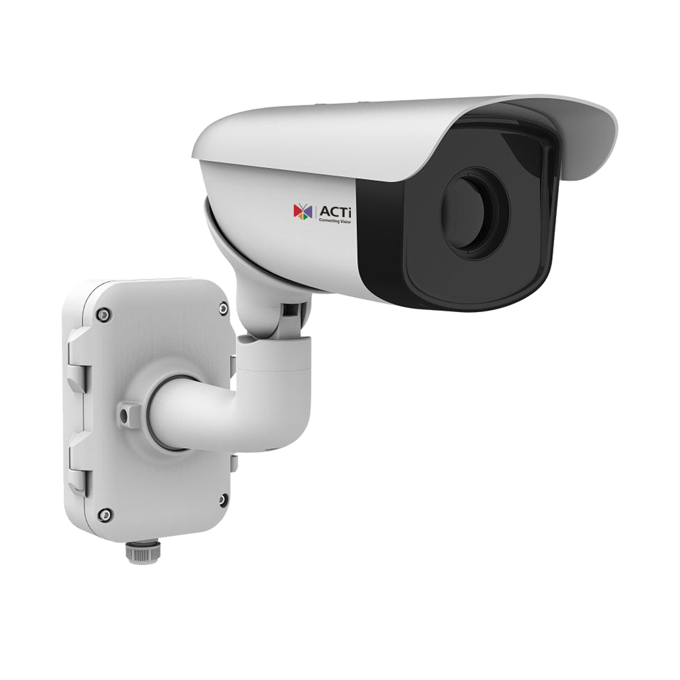
A370 / A370-P1 / A370-P2: Features
Feature1: Thermal Image Features
  Effective pixels: 640(H) × 512(V)
  NETD (Noise Equivalent Temperature Difference) < 35mK, detecting temperature differences as small as 0.035°C
  Lens options: f50, f75, f100mm
  Temperature range: -20°C to 150°C (-4°F to 302°F)
  Temperature accuracy: ±8°C or ±8%
  Object detection distance: 200m to 2100m
Feature2: Deep Learning AI for Thermal and Optical Imaging
  Temperature Exception Detection: Supports 3 temperature measurement rule types with up to 21 rules (10 points, 10 areas, and 1 line)
  Fire Detection: Dynamic fire detection, identifying up to 10 fire points
  Object-Based Detection:
    Line crossing, area entry, area exit, and intrusion detection (forbidden area)
    Tampering detection
https://www.acti.com/product/A370
https://www.acti.com/product/A370-P1
https://www.acti.com/product/A370-P2

Slide 106
A370 / A370-P1 / A370-P2: Market to Application
Public Utility
Serial Number | Function | Functional Operation Process | Optimal Location | Operating Procedures | Application Scenarios | Benefits
1 | Thermal imaging characteristics Pixels: 640(H) x 512(V) NETD:<35mk Lens options: f50, f75, f100m Temperature range:-20° C ~ 150°C Temperature accuracy: ±8° C, ±8% Object distance: 200~2100 m | Real-time monitoring of temperature anomalies and fire source locations through thermal sensing technology | 1) Power Substation 2) Natural Gas Facility 3) Water Treatment Plant | 1) Log in to the management interface 2) Set thermal imaging monitoring area and sensitivity 3) Activate temperature monitoring 4) Monitor screen and record abnormal data | Detect overheating, leakage, or fire hazards in electrical equipment within the facility, and issue real-time alerts | - Reduce fire risk and protect assets - Improve incident response efficiency - Reduce personnel inspection costs
2 | Deep learning AI support 1) Temperature anomaly detection 2) Dynamic fire source detection 3) Object crossing, intrusion, and area entry/exit detection | Provides real-time fire detection and intrusion alarms | 1) Power distribution control room 2) Chemical storage area 3) Around the oil pipeline | 1) Set up AI model rules (e.g., number of fire points, intrusion range) 2) Activate AI detection function 3) Automatically record and notify the administrator | Through AI technology, achieve real-time monitoring to prevent unauthorized personnel from approaching high-risk areas and early fire source detection. | - Improve facility security - Reduce personnel injuries and property loss - Automate monitoring processes to enhance efficiency.

Slide 107
A370 / A370-P1 / A370-P2: Market to Application
Factory ( Factory)
Serial Number | Function | Functional Operation Process | Optimal Location | Operating Procedures | Application Scenarios | Benefits
1 | Thermal imaging characteristics Pixels: 640(H) x 512(V) NETD:<35mk Lens options: f50, f75, f100m Temperature range:-20° C ~ 150°C Temperature accuracy: ±8° C, ±8% Object distance: 200~2100 m | Temperature monitoring to ensure equipment operates normally. | 1) Production workshop 2) Warehouse storage area 3) Hazardous chemical storage area. | 1) Set the temperature limit for production equipment 2) Activate monitoring and set alarm conditions 3) Real-time monitoring and report generation. | Detects overheating conditions of high-temperature equipment (such as machine bearings, heaters) to reduce downtime and fire risks | - Reduce equipment damage and production interruptions - Enhance safety operation standards - Improve risk management
2 | Deep learning AI support 1) Temperature anomaly detection 2) Dynamic fire source detection 3) Object crossing, intrusion, and area entry/exit detection | AI supports detection of unauthorized intrusion behavior | 1) Equipment maintenance area 2) Raw material storage area 3) Personnel restricted area | 1) Set AI detection range 2) Enable alarm and recording functions 3) Push alarms to on-duty personnel devices | Prevent unauthorized personnel from entering sensitive areas, enhancing internal management and asset security | - Prevent security incidents - Improve management efficiency - Comply with regulatory requirements

Slide 108
A370 / A370-P1 / A370-P2: Market to Application
Airport (Airport)
Serial Number | Function | Functional Operation Process | Optimal Location | Operating Procedures | Application Scenarios | Benefits
1 | Thermal imaging characteristics Pixels: 640(H) x 512(V) NETD:<35mk Lens options: f50, f75, f100m Temperature range:-20° C ~ 150°C Temperature accuracy: ±8° C, ±8% Object distance: 200~2100 m | Detect abnormal temperatures in airport infrastructure | 1) Runway perimeter 2) Fuel station 3) Terminal | 1) Set temperature monitoring range for runway and infrastructure 2) Activate alarm mode 3) Automatically record and upload to the security management system | Detect high temperatures in the runway and fuel area to prevent fires or equipment failures | - Ensure flight safety - Reduce emergency response time - Enhance passenger confidence
2 | Deep learning AI support 1) Temperature anomaly detection 2) Dynamic fire source detection 3) Object crossing, intrusion, and area entry/exit detection | Intelligent surveillance of high-sensitivity areas to prevent unauthorized access and dangerous behavior | 1) Tarmac 2) Hangar interior 3) Baggage handling area | 1) Set sensitive areas and intrusion rules 2) Activate real-time alert function 3) Provide reports for subsequent analysis | Prevent unauthorized access to sensitive areas, optimize airport operations and security management | - Enhance airport security standards - Reduce operational risks - Strengthen asset and personnel protection

Slide 109
A370 / A370-P1 / A370-P2: Video

Slide 110
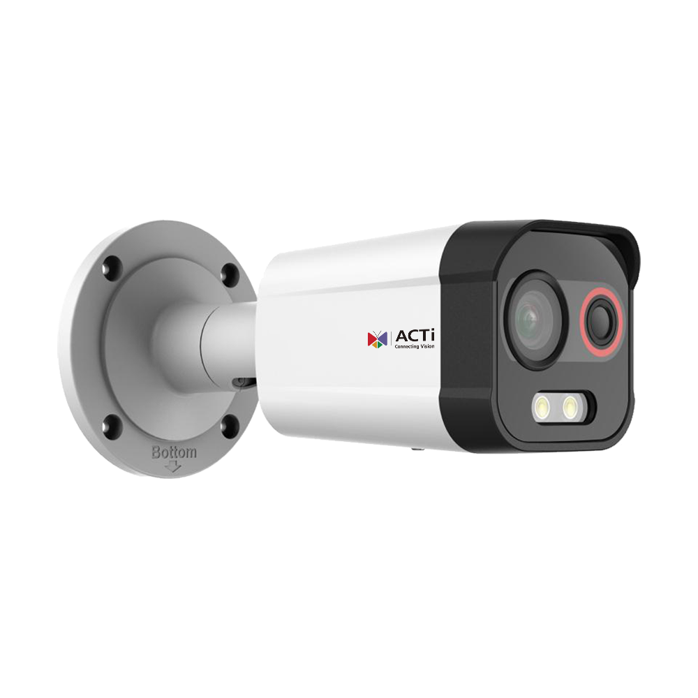
A372 / A372-P1: Features
Feature1: Thermal Image Features
  Effective pixels: 96(H) × 72(V)
  NETD (Noise Equivalent Temperature Difference) < 55mK, detecting temperature differences as small as 0.055°C
  Lens options: f2.1, f2.6
  Temperature range: -40°C to 65°C (-40°F to 149°F)
Feature2: Deep Learning AI for Thermal and Optical Imaging
  Supports object-based detection:
    Line crossing, area entry, area exit, and intrusion detection (forbidden area)
https://www.acti.com/product/A372
https://www.acti.com/product/A372-P1

Slide 111
A372 / A372-P1: Features
Feature3: Full-Color and Active Deterrence
  Supports white light LED with a 30m range for full-color imaging
  Supports pre-recorded audio alarms
Feature4: Optical Image Features
  Resolution: 4MP at 30fps
  Supports 4mm and 6mm lenses
  Minimum illumination:
    Color: 0.0005 lux @ F1.0 (AGC on)
    B/W: 0 lux (light on)
https://www.acti.com/product/A372
https://www.acti.com/product/A372-P1

Slide 112
A372 / A372-P1: Market to Application
Parking Lot ( Parking Lot)
Serial Number | Function | Function Description | Applicable Location | Operating Procedures | Application Scenarios | Benefits
1 | Thermal Imaging Function | 160x120 thermal imaging resolution, capable of detecting a temperature difference of 0.04° C, supports a temperature range of -20° C ~ 150°C, temperature accuracy ±8° C | Parking lot exit, electric vehicle charging station, parking area | 1) Select function page 2) Set monitoring area and parameters 3) Activate monitoring mode 4) View real-time or stored images | Monitor electric vehicle overheating and potential fire risks in the parking lot | Reduce fire risks, protect property safety, and improve parking lot management efficiency
2 | Deep Learning AI Fire Detection | Fire abnormal temperature detection (supports up to 10 points/10 areas/1 line), smoke detection | Parking Lot Comprehensive Monitoring Points | 1) Enter the Fire Detection Page 2) Configure Area and Parameters 3) Activate 4) Real-time Detection and Alarm | Fire detection in unattended areas of the parking lot to identify fire sources early | Reduce losses in the parking lot caused by fires and respond promptly to ensure personnel safety
3 | Full Color and Active Deterrence | 40 meters White Light LED, can activate the light source for deterrence or provide color images when an event is triggered | Main entrance and corners of the parking lot | 1) Set LED trigger conditions 2) The system automatically detects and triggers the light source 3) Real-time recording of color images | Increase light sources in the parking lot at night to deter illegal activities, such as trespassing or destructive behavior | Enhance nighttime safety in the parking lot and reduce the likelihood of theft or destructive incidents
4 | Optical imaging function | 4MP Resolution, 30 fps, supports 8 mm (VMGB-359) and 4 mm (VMGB-359-P1) lenses, 40 meters infrared distance | Parking Lot Entrance, License Plate Recognition Area | 1) Configure Camera Angle and Field of View 2) Set Infrared Mode 3) Image Recording and Archiving | License Plate Recognition and Parking Space Monitoring | Improve parking lot operational efficiency, supporting accurate license plate recording and statistics

Slide 113
A372 / A372-P1: Market to Application
Factory ( Factory )
Serial Number | Function | Function Description | Applicable Location | Operating Procedures | Application Scenarios | Benefits
1 | Thermal Imaging Function | 160x120 thermal imaging resolution, capable of detecting a temperature difference of 0.04° C, supports a temperature range of -20° C ~ 150°C, temperature accuracy ±8° C | Next to important equipment, raw material warehouse | 1) Select function page 2) Set monitoring area and parameters 3) Activate monitoring mode 4) View real-time or stored images | Monitor abnormal temperatures of factory equipment, such as motor overheating or warehouse fires | Reduce equipment downtime risk, minimize losses, and ensure stable production line

Slide 114
A372 / A372-P1: Video

Slide 115
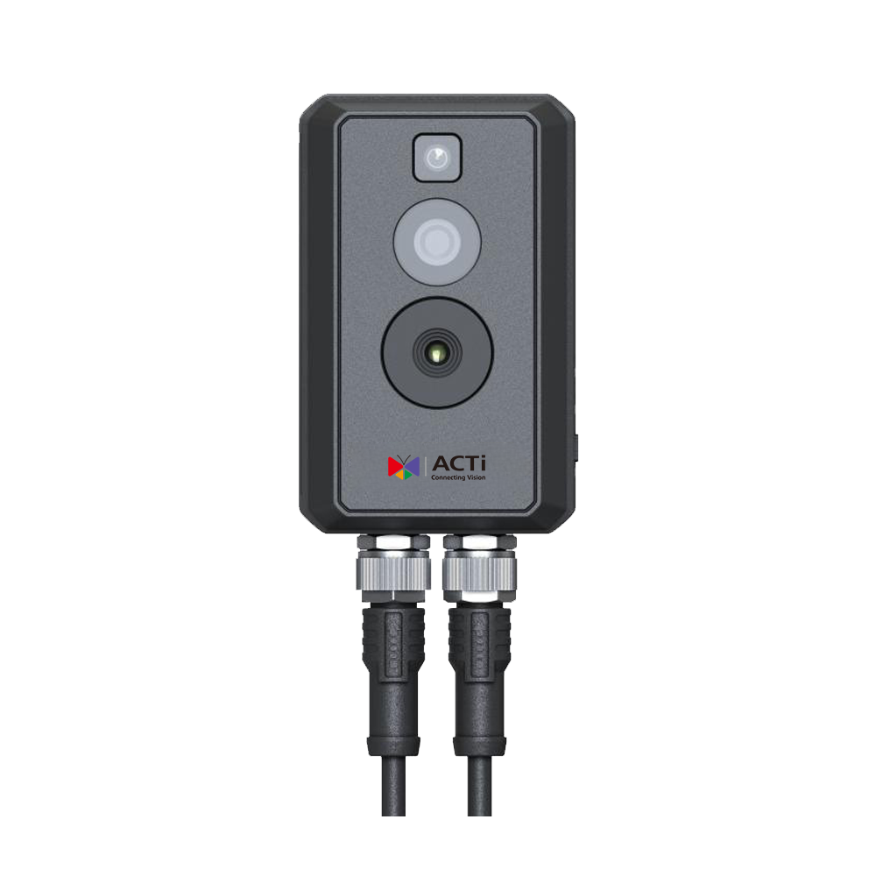
Q170: Features
Feature1: Thermal Image Features
  Effective pixels: 256(H) × 192(V)
  NETD (Noise Equivalent Temperature Difference) < 40mK, detecting temperature differences as small as 0.04°C
  Lens: f2.1
  Temperature range:
    -20°C to 150°C (-4°F to 302°F)
    0°C to 550°C (32°F to 1022°F)
  Temperature accuracy: Max (±2°C, ±2%)
Feature2: Temperature Rules
  Displays max. and min. temperatures in live view
  Supports 3 temperature measurement rule types with up to 21 rules (10 points, 10 regions, and 1 line)
https://www.acti.com/product/Q170

Slide 116
Q170: Features
Feature3: Optical Image Features
  Resolution: 4MP at 30fps
  Supports f2.2 lens
  Minimum illumination:
    Color: 0.06 lux @ F2.2 (AGC on)
    B/W: 0 lux (light on)
https://www.acti.com/product/Q170

Slide 117
Q170: Market to Application
Factory ( Factory )
Serial Number | Function | Function Description | Applicable Location | Operating Procedures | Application Scenarios | Benefits
1 | Thermal Imaging Function | - Temperature difference detection capability ( NETD) less than 40 mk - Effective pixels: 256( H) X 192(V) - Detectable temperature range:-20° C to 550° C - Temperature accuracy: maximum value (±2 ° C, ±2%) | - Inside the electrical box - Distribution cabinet - Near high-temperature machinery | 1) Log into the system and navigate to the thermal imaging screen 2) Set the temperature range and accuracy 3) Enable temperature difference monitoring function 4) View temperature alarms in real-time | - High-temperature anomaly detection inside the electrical box to prevent short circuits - Overheating detection inside the distribution cabinet to enhance safety - Monitoring of high-temperature equipment operation to ensure stability | - Reduce fire risk, enhance safety - Minimize downtime, improve operational efficiency - Lower manual inspection costs, enhance automation management capabilities
2 | Temperature Rules | - Instantly display maximum/ minimum temperature- Support 21 measurement rules (10 points, 10 areas, 1 line) | - Inside the electrical box - Indoor substation - Around cooling equipment | 1) Set measurement rules (such as point or area measurement) 2) Define temperature alert values 3) View real-time data after starting measurement 4) Receive alarm notifications | - Abnormal temperature detection in substations to prevent equipment damage - Cooling equipment temperature monitoring to ensure operational efficiency - Precise temperature monitoring in various areas of the electrical box | - Extend device lifespan and reduce maintenance costs - Enhance real-time response capabilities to prevent major incidents - Precise monitoring to reduce energy consumption
3 | Optical imaging function | - Provides 4 MP high-definition images, 30 fps - Supports low light conditions: color 0.06 lux, black and white 0 lux - lens f2.2, details are clearer | - Surveillance around the electrical box - Internal corridor of the factory - External perimeter wall | 1) Activate optical imaging function 2) Set imaging surveillance area 3) Enable low light compensation mode (if necessary) 4) View recordings and real-time imaging | - Monitoring personnel activities inside and outside the factory corridor - Surveillance of key areas under no light conditions at night - Intrusion alert for unidentified personnel around the electrical box | - Enhance all-weather surveillance capability - Reduce the risk of illegal intrusion - Achieve high-definition image evidence preservation, improving incident handling efficiency

Slide 118
Q170: Video

Slide 119
A972: Features
Feature1: Thermal Image Features
  Effective pixels: 256(H) × 192(V)
  NETD (Noise Equivalent Temperature Difference) < 35mK, detecting temperature differences as small as 0.035°C
  Thermal view angle: 18.1°(H) × 13.6°(V)
  Temperature range: -20°C to 150°C (-4°F to 302°F)
  Temperature accuracy: ±8°C (14.4°F)
Feature2: Thermal-Based Events
  Fire detection event
  Detection range:
    Object 2×2m: 833m
    Object 1×1m: 417m
https://www.acti.com/product/A972

Slide 120
A972: Features
Feature3: Optical Image Features
  Resolution: 4MP at 30fps
  32x optical zoom, f4.8–153mm
  Minimum illumination:
    Color: 0.05 lux @ F1.2 (AGC on)
    B/W: 0 lux (IR LED on)
  WDR: 120dB
  Operating temperature: -40°C to 70°C (-40°F to 158°F)
https://www.acti.com/product/A972

Slide 121
A972: Market to Application
Utility ( Utility)
Serial Number | Function | Function Description | Applicable Location | Operating Procedures | Application Scenarios | Benefits
1 | Thermal Imaging Features • Effective Pixels: 256( H) × 192(V) • NETD < 35mk ( Detectable Temperature Difference 0.035° C) • Thermal Field of View: 18.1°( H) × 13.6°(V) • Temperature Range: -20° C ~ 150°C • Temperature Error: ±8° C | Temperature Monitoring and Anomaly Alarm • Monitor critical equipment for thermal anomalies • Automatic alarm notifications | 1) Substation 2) Natural Gas Pipeline Area 3) Power Plant Generator Room | 1) Set monitoring area through A972 2) Set temperature anomaly trigger alarm threshold 3) Automatically detect and send alarm | • Overheating monitoring of substation equipment • Detection of natural gas pipeline leaks or abnormal hotspots | • Reduce accident risk: Early detection of overheating or abnormal heat sources to minimize fire and equipment damage risk • Enhance operational efficiency: Automated monitoring reduces manual inspection costs
2 | Support for thermal imaging events • Fire detection events • Object detection distance: (2×2 m object ) 833 m, (1×1m object ) 417 m | Fire and abnormal hotspot detection • AI automatically identifies flames or abnormal high temperatures • Notifies the administrator via VMS | 1) Oil depot and storage facilities 2) High voltage power line tower areas 3) Industrial boiler rooms | 1) Set up flame and high temperature detection 2) Detect abnormalities and trigger alarms in real-time 3) Automatically send alarms to the management center | • Abnormal heat monitoring in oil depots • Fire source detection in high voltage wire areas | • Reduce disaster occurrence: Automatic alarms can quickly respond to initial fires, preventing further damage • Reduce manpower burden: AI automatic monitoring reduces the workload of surveillance personnel
3 | Optical image characteristics • Resolution: 4 MP @ 30fps • 32x optical zoom ( f4.8-153mm) • Minimum illumination: Color 0.05 lux, Black and white 0 lux ( Infrared on ) • WDR 120 dB | Remote monitoring and detail inspection • 32 x Optical zoom supports remote observation • High-performance monitoring in low-light environments | 1) Gas processing station 2) Aerial pipeline inspection area 3) Large power substation | 1) Set patrol points 2) View details through optical zoom 3. Record abnormal footage and report | • Long-distance pipeline safety monitoring • Nighttime inspection image enhancement | • Clear Monitoring Details: 32 x Zoom provides detailed images for identifying anomalies • All-Weather Surveillance: Low-light performance ensures effective night monitoring

Slide 122
A972: Market to Application
Factory ( Factory)
Serial Number | Function | Function Description | Applicable Location | Operating Procedures | Application Scenarios | Benefits
1 | Thermal Imaging Features • Effective Pixels: 256( H) × 192(V) • NETD < 35mk ( Detectable Temperature Difference 0.035° C) • Thermal Field of View: 18.1°( H) × 13.6°(V) • Temperature Range: -20° C ~ 150°C • Temperature Error: ±8° C | Equipment Temperature Monitoring and Alarm • Monitor abnormal temperatures of industrial equipment • Trigger alarm when temperature threshold is reached | 1) Factory production line machinery 2) Electrical control room 3) High-temperature smelting furnace | 1) Set monitoring equipment temperature range 2) Automatically detect abnormal temperatures 3) Trigger alarm and log data | • Monitor the operating temperature of production machinery • Prevent equipment overheating to avoid downtime | • Reduce the risk of equipment damage: Early detection of overheating issues to minimize mechanical failures and downtime • Improve production efficiency: Automated monitoring reduces the burden of manual inspections
2 | Support for thermal imaging events • Fire detection events • Object detection distance: (2×2 m object ) 833 m, (1×1m object ) 417 m | Fire detection and alarm • AI automatically identifies fire sources and sends alerts • Interconnects with the fire protection system via VMS | 1) Hazardous materials storage area in chemical factory 2) Raw materials storage warehouse 3) Production workshop | 1) Set fire detection area 2) Detect fire source and trigger alarm 3) Notify security and fire department | • Early detection of warehouse fires • Reduce the risk of flammable chemicals igniting | • Shorten response time: AI automatically detects and quickly notifies the fire department, reducing fire loss • Reduce manpower monitoring costs: Smart surveillance replaces manual patrolling
3 | Optical image characteristics • Resolution: 4 MP @ 30fps • 32x optical zoom ( f4.8-153mm) • Minimum illumination: Color 0.05 lux, Black and white 0 lux ( Infrared on ) • WDR 120 dB | Remote monitoring and detailed observation • Monitor factory areas from a distance • Clear images maintained in low light environments | 1) Factory perimeter wall and entrance 2) Important equipment control room 3) Warehouse goods storage area | 1) Set patrol surveillance points 2) Use zoom function to check for abnormalities 3) Record abnormalities and notify management | • Monitor factory security status • Prevent internal theft in the factory | • Enhance security management: 32 x Optical zoom allows for detailed observation of abnormal situations, facilitating decision-making for management personnel • Night surveillance enhancement: High sensitivity ensures effective monitoring in low light environments

Slide 123
A972: Market to Application
Airport (Airport)
Serial Number | Function | Function Description | Applicable Location | Operating Procedures | Application Scenarios | Benefits
1 | Thermal Imaging Features • Effective Pixels: 256( H) × 192(V) • NETD < 35mk ( Detectable Temperature Difference 0.035° C) • Thermal Field of View: 18.1°( H) × 13.6°(V) • Temperature Range: -20° C ~ 150°C • Temperature Error: ±8° C | Airport Security Surveillance and Abnormal Temperature Detection • Monitor airport perimeter security • Detect abnormal temperature areas | 1) Tarmac and Aircraft Maintenance Area 2) Airport Fuel Storage and Fuel Pipeline 3) Runway and Taxiway | 1) Set monitoring area 2) Detect abnormal heat sources or overheating equipment 3) Trigger alarm and notify administrator | • Detect abnormal overheating of aircraft engines • Temperature monitoring of fuel storage area | • Preventing aviation safety incidents: Timely detection of overheating or abnormalities in machinery to reduce fire risk • Reducing equipment maintenance costs: Early detection of anomalies can prevent significant equipment damage
2 | Support for thermal imaging events • Fire detection events • Object detection distance: (2×2 m object ) 833 m, (1×1m object ) 417 m | Fire source detection and automatic alarm • AI automatically identifies flames • Quickly initiates fire response measures | 1) Inside the terminal and baggage area 2) Parking lot and pick-up area 3) Cargo storage area | 1) Set fire detection area 2) AI automatically identifies fire sources and triggers alarm 3) Immediate coordination with airport security and fire department | • Internal fire source detection in the terminal • Abnormal monitoring in baggage areas | • Shorten response time: AI immediately notifies fire department after detecting fire sources, reducing fire impact • Lower manpower monitoring costs: No need for manual 24 hour monitoring, can automatically detect anomalies
3 | Optical image characteristics • Resolution: 4 MP @ 30fps • 32x optical zoom ( f4.8-153mm) • Minimum illumination: Color 0.05 lux, Black and white 0 lux ( Infrared on ) • WDR 120 dB | High-resolution long-distance surveillance • Monitoring airport perimeters and key areas • 32 x Optical zoom supports distant detail inspection | 1) Airport perimeter walls and intrusion monitoring 2) Runway and taxiway surveillance 3) Tarmac and maintenance area | 1) Set up patrol surveillance points 2) View suspicious targets through zoom 3) Record images and notify security personnel | • Long-distance surveillance of airport perimeters • Monitoring suspicious personnel and drone intrusions | • Enhancing airport security levels: 32 x Zoom ensures detailed monitoring from a distance, reducing potential threats • All-weather monitoring: Provides clear images even in low-light environments

Slide 124
A972: Video

