Slide 1
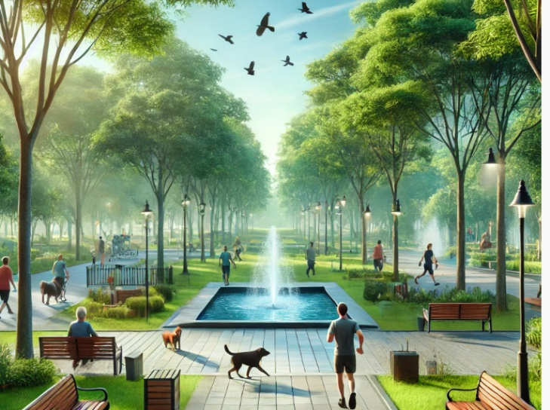
ACTi
Park & Square Surveillance Solutions

Slide 2
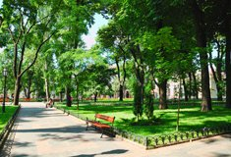
Park & Square: Overview
To provide a safe environment for the citizens, ACTi provides its cameras, analytics and VMS as a full solution for the public safety purposes. Gangster gathering, criminal activities, homeless issues and much more can all be detected using deep learning AI for prompt handling.
The security or business management related challenges and solution requirements vary for each park and squares type. Since these public areas are open to everyone, gangster gathering, criminal activities and homeless issues are the challenges here.
To provide a safe environment for residents, ACTi incorporates its cameras, video management system, analytics, public intercom and much more for a complete and reliable solution for the public safety management.

Slide 3
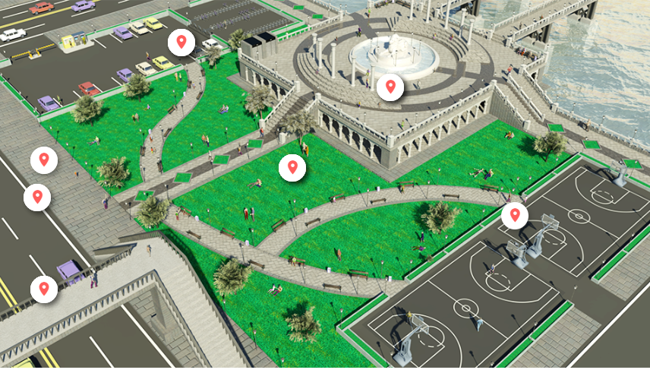
Park & Square: Map
Outdoor Parking Area
Public Square
Sidewalk
Field
Road
Sports Court
Pedestrian Overpass

Slide 4
Park & Square: Applications vs Locations
 | Parking Lot | Sidewalk | Road | Public Square | Pedestrian Overpass | Sports Court | Field
Restricted Area Driving Detection |  | Y |  | Y |  | Y | Y
Suspicious Loitering Detection | Y | Y | Y | Y | Y | Y | Y
Trespassing Detection |  |  |  |  |  | Y
Suspicious Items Detection |  | Y |  | Y | Y | Y | Y
Blacklisted Persons Identification | Y | Y |  | Y | Y | Y | Y
Intercom Service | Y | Y |  | Y | Y | Y | Y
On-the-Go Surveillance | Y | Y |  | Y | Y | Y | Y
Real-time Suspect Tracking | Y | Y | Y | Y | Y | Y | Y
Safety Assurance | Y | Y |  | Y | Y | Y | Y
Video Evidence Push to NVR by Mobile Phone | Y | Y |  | Y | Y | Y | Y

Slide 5
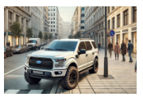
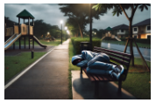

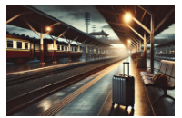
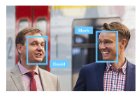
Park & Square: Applications
Restricted Area Driving Detection
Detects vehicles appearing in the restricted areas, such as sidewalks, parks and other non-drivable places.
Suspicious Loitering Detection
Detect suspiciously loitering people during night hours in public places.
Trespassing Detection
Detecting the person entering the area without permission.
Suspicious Items Detection
Detect the items that are left unattended to precent serious security and safety hazards.
Blacklisted Persons Identification
Identify the blacklisted persons by recognizing their faces automatically.

Slide 6
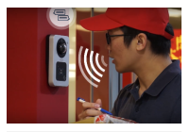
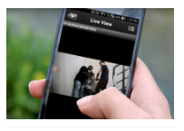
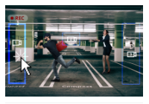
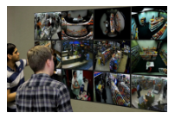

Park & Square: Applications
Intercom Service
Interact with other individuals by local voice-based communication system.
On-the-Go Surveillance
Monitor the views from the surveillance cameras using a mobile device while walking around the area, in order to respond to incidents instantly.
Real-time Suspect Tracking
Track the suspect seamlessly by switching between video channels using transparent video overlay buttons in video management system.
Safety Assurance
Ensure safety of people using video surveillance system.
Video Evidence Push to NVR by Mobile Phone
Use the built-in camera of the mobile phone to stream the video evidence of the incident to NVR.

Slide 7






Park & Square: Applications
Restricted Area Driving Detection
Detects vehicles appearing in the restricted areas, such as sidewalks, parks and other non-drivable places.
There are many locations where the motor vehicles are not permitted to drive. They may include sidewalks, public squares, parks, certain types of tunnels, bridges and other locations. The violation will be detected by the vehicle detection analytics and reported instantly.
This is based on the Vehicle Enter Area Detection analytics inside ACTi cameras. Read More.
Solutions
Read
Read
Read
Read
Read

Slide 8

Park & Square: Applications
Suspicious Loitering Detection
Detect suspiciously loitering people during night hours in public places.
The public areas are monitored for the safety purposes. One of the signs of potential safety risk is the detection of suspicious loitering in the public areas such as city parks, especially at night.
This is based on the People Loitering Detection analytics inside ACTi cameras. Read More.
Solutions
Read
Read
Read
Read
Read

Slide 9
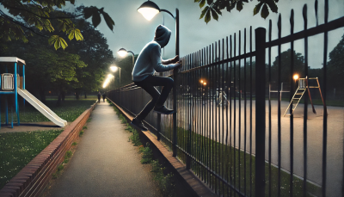
Park & Square: Applications
Trespassing Detection
Detecting the person entering the area without permission.
When a person enters someone's land or property without permission, it is considered trespassing, and it is illegal. There are places that are restricted for strangers nearly all the time, such as residential areas, schools. There are also some places that are open for anyone during daytime but are closed at night due to safety reasons. For example, certain parks and outdoor sport courts. Entering those areas at night would be considered trespassing.
This is based on the People Enter Area Detection analytics inside ACTi cameras. Read More.
Solutions
Read
Read
Read
Read
Read

Slide 10

Park & Square: Applications
Suspicious Items Detection
Detect the items that are left unattended to prevent serious security and safety hazards.
The unattended objects, such as bags, boxes, suitcases, strollers, carts, are considered risk items that should be handled quickly. Those objects can sometimes simply be of value and someone accidentally forgot them there. An early detection saves them from being stolen.
Rarely, these items could also pose threats as being malicious. They could disguise explosives or other dangerous substances.
This is based on the Unattended Object Detection analytics inside ACTi cameras. Read More.
Solutions
Read
Read
Read
Read
Read

Slide 11
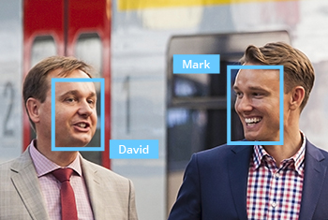
Park & Square: Applications
Blacklisted Persons Identification
Identify the blacklisted persons by recognizing their faces automatically.
There may be various types of attention lists. There may be lists maintained by the police department. There may also be lists created by the private sector for the safety purposes, such as for the shoplifting prevention.
This is based on the Face Recognition analytics inside ACTi cameras. Read More.
Solutions
Read
Read
Read
Read
Read

Slide 12

Park & Square: Applications
On-the-Go Surveillance
Monitor the views from surveillance cameras using a mobile device while walking around the premises, in order to respond to incidents instantly.
Universal mobile application designed to remotely access NVR, CMS or camera for video playback and management.
Features: Live view and playback, Search video recordings by events, PTZ Control, Google Maps, Activate Digital Output, Playback from camera's memory card
This is based on the ACTi Mobile Client, both for Android and iOS. It is free.
Solutions
Read
Read
Read
Read
Read

Slide 13

Park & Square: Applications
Real-time Suspect Tracking
Track the suspect seamlessly by switching between video channels using transparent video overlay buttons in video management system.
Track the suspect using the video management system interface by using the convenient feature of switching the views with 1 click on the video which opens up the next view of the area the suspect is moving towards to. This method works for both live view and playback. By this method it is possible to instantly find out where the suspect is going and dispatch officers to handle the situation immediately.
This is based on the NVR 3 and CMS 2 series products.
Solutions
Read
Read

Slide 14

Park & Square: Applications
Safety Assurance
Ensure safety of people using video surveillance system.
ACTi provides surveillance solution for small-scale retail, ensuring the safety with both overview and details monitoring. By installing a camera with wide viewing angle at the center or the corner of the store, the whole area can be perfectly covered. Meanwhile, the faces of people entering the premises can be captured by the covert camera discreetly installed into the height strip at the entrance.
For large scale projects, ACTi TV Wall enables multiple views to be displayed on different monitors at the same time. Get the complete overview to improve situational awareness and operational efficiency.
Solutions

Slide 15
Park & Square: Applications
Video Evidence Push to NVR by Mobile Phone
Use the built-in camera of the mobile phone to stream the video evidence of the incident to NVR.
The patrolling security guard can now use his smartphone with ACTi Mobile Client to capture live video and "push" it through wireless network to NVR 3 in real time. Moreover, the recording can be reviewed later during incident investigation using advanced features that apply to surveillance cameras including synchronized playback, bookmarks, timeline search, and more.
This is based on the ACTi Mobile Client, both for Android and iOS. It is a free app.
Solutions
Read
Read

Slide 16
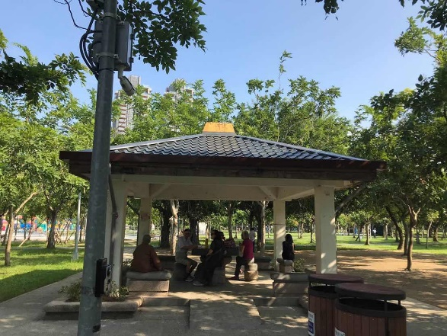
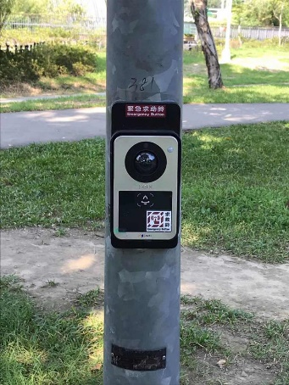
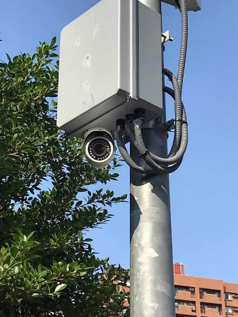
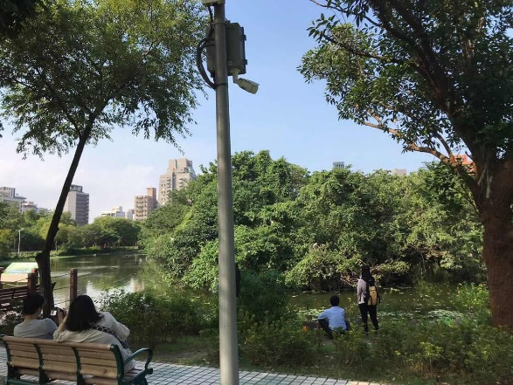
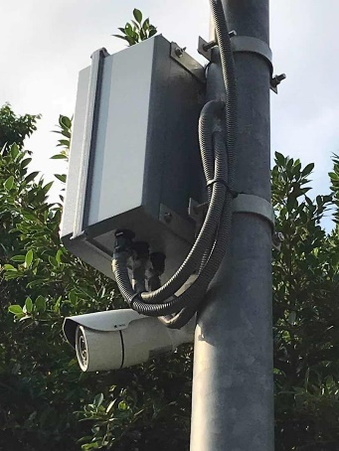
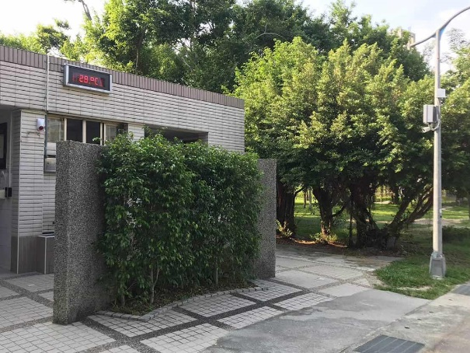
Park & Square: Project References
Taiwan
Taiwan
Taiwan
Taiwan
Taiwan
Taiwan

Slide 17





ACTi Deep Learning AI Camera Product Line
Deep learning is a method in artificial intelligence (AI) that teaches computers to process data in a way that is inspired by the human brain. Deep learning models can recognize complex patterns in pictures, text, sounds, and other data to produce accurate insights and predictions.
Model | A426 | A826 | A952 | A956 | Q83
Photo
Type | Zoom Bullet | Zoom Dome | Speed Dome | Speed Dome | Multi-Imager
Resolution | 5MP | 5MP | 8MP | 2MP | 20MP
Lens | 4.4x Zoom | 4.4x Zoom | 22x Zoom | 40x Zoom | 4 zoom lenses
Built-in Vehicle Related Analytics | Vehicle Counting, Vehicle Line Crossing Detection, Vehicle Enter Area Detection, Vehicle Incorrect Direction Detection, Vehicle Loitering Detection, Vehicle Tracking, Stopped vehicle detection, License Plate Detection, Automatic License Plate Recognition

Slide 18


A426 Traffic Installation
PMAX-0534
Pole Mount with Junction Box, supports 3.25" to 7.0" Poles
A426
5MP Zoom Bullet with D/N, Adaptive IR, Extreme WDR, SLLS, 4.4x Zoom Lens, Deep Learning AI

Slide 19


ALPR Camera (A426)
The AI camera can recognize multiple license plates across multiple lanes at the same time.
WATCH THE VIDEO
https://www.acti.com/video/v2902
ALPR Camera + NVR 3
ACTi NVR 3 supports the deep learning AI events and metadata. When the blacklisted vehicle is detected, the NVR will display instant alert.
WATCH THE VIDEO
https://www.acti.com/video/v2904

Slide 20





ACTi AI Solution Architecture
MOBILE CLIENT
E-mail
alerts
alerts
video
video
Realtime
analytics data
Realtime
analytics data, alerts
AI CAMERA
NVR SERVER
(ACTi NVR 3 Corporate)
NVR CLIENT

Slide 21
ACTi Advantages compared to Server-Based AI Providers
Hundreds of channels with deep learning analytics can be managed by a single VMS server, using just a common server hardware configuration. The Server-based AI solutions have limited number of channels and require very expensive hardware.
VMS video recording functionality is much better secured when the VMS does not have the burden of running the analytics that may consume the server resource to its limits.
Faster response to the events – AI cameras can control the other nearby PTZ cameras for instant response, to get better video coverage of the scene. The analyses that are processed on the VMS side will be too slow for proper response.
Since the AI features are inside the camera, there are no Analytics related licenses required on the server side. Therefore, the cost of VMS in some cases is up to 10 times lower than the server-side AI solutions.

Slide 22
NVR and CMS Features
ACTi NVR 3 Corporate (and CMS 2) manages the analytics events from the cameras as follows:
Set up the analytic rules and thresholds – for example, how big is the crowd, how long time is considered loitering.
Receive real-time analytic events from all the cameras and respond by the pre-defined actions, such as send e-mail, instant pop-up of the video channel on the VMS screen and more.
Automatically push video to the mobile app of the patrolling security guards.
Search by the specific filter rules, bookmarks, thumbnails.

Slide 23

Where to Buy
Via Authorized Resellers
https://www.acti.com/Corporate/WhereToBuy
From ACTi Corporation Directly
E-Mail: sales@acti.com
Tel (US): +1-866-410-2284 (Toll Free)
Tel (Non-US): +886-2-2656-2588

Slide 24
Support & Services
Technical Support
- Online Customer Helpdesk - https://www.acti.com/chd
- Phone support
US: +1-866-410-2284 (Toll Free)
Other Regions: +886-2-2656-5200
RMA Services
- Warranty
- Repair services
Training
- Self-learning

