Slide 1
Z415, Z416
New Product Introduction
Medium Range Zoom (10-12x) NDAA Bullets

Slide 2
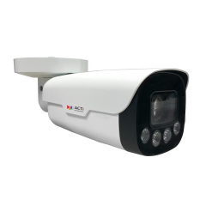
ACTi is introducing the newest products:
Z415
2MP 60fps Zoom Bullet with D/N, Adaptive IR 100 meters, Superior WDR, SLLS, 10x Zoom lens, f5-50mm/F1.6 HOV:55.87°-4.71°), DC iris, Auto Focus (for installation), H.265/H.264, 2D+3D DNR, Audio, MicroSD, PoE/DC12V, IP67, IK10 (metal casing), DI/DO, RS-485, NDAA, Analytics
Z416
5MP Zoom Bullet with D/N, Adaptive IR 100 meters, Superior WDR, SLLS, 12x Zoom lens, f5-60mm/F1.6 HOV:59.99°-5.73°), DC iris, Auto Focus (for installation), H.265/H.264, 2D+3D DNR, Audio, MicroSD, PoE/DC12V, IP67, IK10 (metal casing), DI/DO, RS-485, NDAA, Analytics

Slide 3
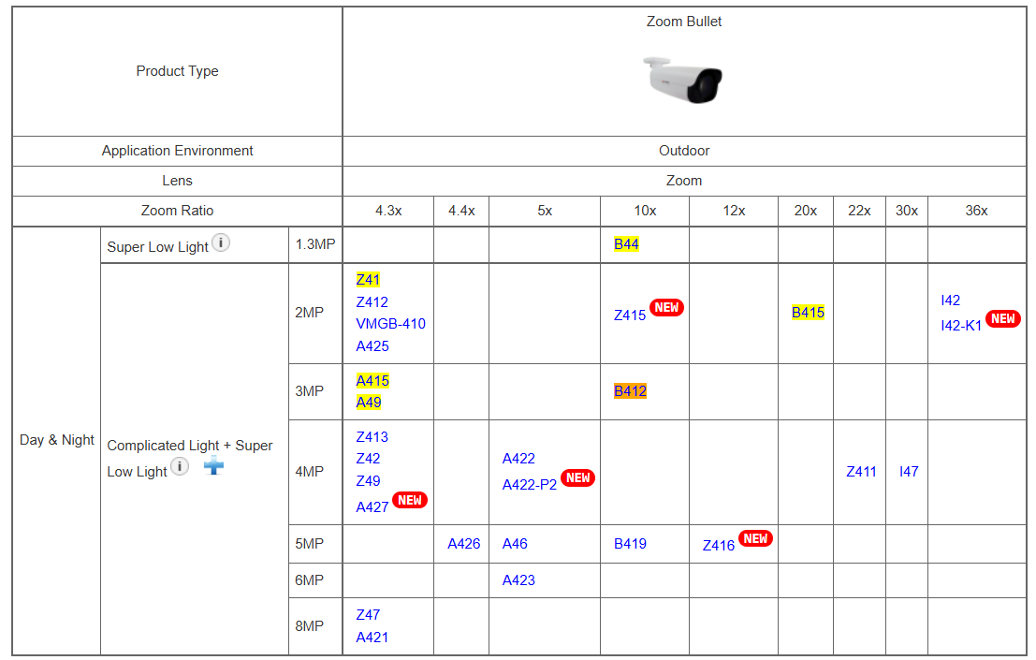
Product Matrix:
Z415 and Z416 bring the price-competitive high-quality NDAA products to the Mid Zoom cluster.
Low Zoom
Mid Zoom
High Zoom

Slide 4
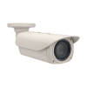
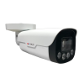
Spec Comparison:
Model | B412 | Z415 (new) | B419 | Z416 (new)
Photo
Product type | Zoom Bullet | Zoom Bullet | Zoom Bullet | Zoom Bullet
Resolution | 3MP | 2MP | 5MP | 5MP
Max fps | 30fps | 60fps | 30fps | 30fps
Lens | f4.7-47mm | f5-50mm | f4.7-47mm | f5-60mm
Zoom Ratio | 10x | 10x | 10x | 12x
WDR | Extreme 145 dB | Extreme 145 dB | Superior 120dB | Extreme 145 dB
Low Light | Superior | Superior | Superior | Superior
IR LED distance | 60m | 100m | 60m | 100m
Audio | 2-way | 2-way | 2-way | 2-way
Environment | IP66, IK10 | IP67, IK10 | IP66, IK10 | IP67, IK10
Analytics | Yes, basic | Yes, full | Yes, basic | Yes, full
NDAA | No | Yes | No | Yes

Slide 5
Analytics Comparison:
Analytics | B412, B419 | Z415, Z416
Object Based Motion Detection | Y | Y
Tampering Detection | Y | Y
Face Detection, Age Detection, Gender Detection, Face Mask Detection, People Counting, Crowd Detection, Object Line Crossing Detection, Object Enter Area Detection, Object Exit Area Detection, Smart Intrusion Detection, Missing Object Detection, Unattended Object Detection | - | Y

Slide 6
Supported VMS and Solutions
 | Standard Features | AI Events/Meta | Solutions
NVR 3 Corporate | Yes | Yes | S110, S111, S112
NVR 3 Business | Yes | Yes | S110, S111, S112
CMS 2 | Yes | Yes | S120, S121, S122
ZNR-Series NVR | Yes |  | S60
ENR-Series NVR | Yes |  | S72

Slide 7
Applications
The Mid Zoom models are great for the large perimeter surveillance, such as Utility territory, factory, large campuses, city surveillance.
The 60fps model (Z415) is also great for the traffic applications, especially, for supporting 100-meter IR LED distance.
People Counting, support people flow counting and crowd density monitoring, suitable for different statistical scenarios.

