Slide 1
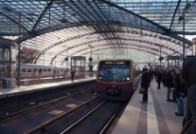
ACTi
Train Station Surveillance Solutions

Slide 2
Train Station: Overview
ACTi's end-to-end solutions can detect suspicious activities and control passenger flow to ensure the safety of passengers and traffic network. The solutions consist of in-house developed cameras, deep-learning based analytics, and the integration with various systems, such as alarm, intercom and digital signage systems.
Every day, hundreds and thousands passengers will pass through train stations; thus, the major security related challenges include pickpocketing, mugging, bullying, harassment and vandalism. The video management system together with the TV Wall gives the clearest overview of all the critical areas of the train station.
When there is a sudden congestion or the crowds are gathering for no clear reason, the AI detects the unexpectedly large crowd automatically and alerts the team. The AI can also help monitoring the restricted areas such as train tracks.
There are also potential risks with unattended objects such as suitcases. Such objects may be considered as high security threat. ACTi's unattended object detection technology notifies the security personnel automatically when it happens.

Slide 3
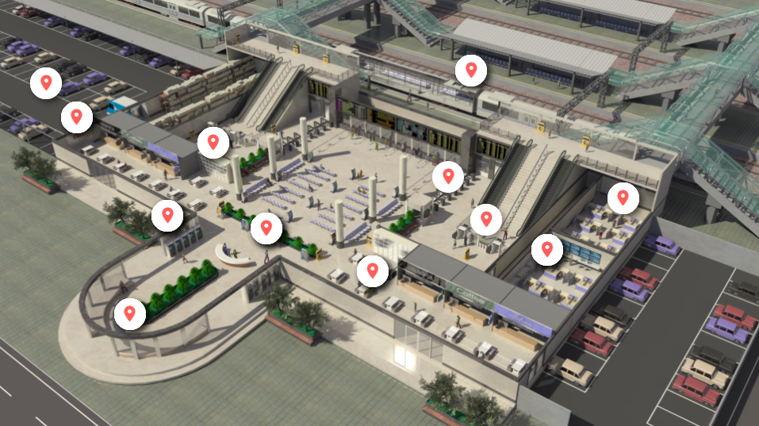
Train Station: Map
Parking
Platform
Emergency Exit
Lockers
Ticket Gate
ATM
Office
Concourse Area
Security Gate
Control Room
Dining Area
Entrance
Gate

Slide 4
Train Station: Applications vs Locations
 | Entrance | Gate | Office | Ticket/Security Gate | Control Room | Concourse | Platform | Parking
Unauthorized Access Detection |  |  | Y |  | Y
Tailgating Detection |  |  | Y |  | Y
Real-time Suspect Tracking | Y | Y | Y | Y | Y | Y | Y | Y
Vehicle Access Control |  | Y |  |  |  |  |  | Y
Person on Train Tracks Detection |  |  |  |  |  |  | Y
Human Body Temperature Detection | Y |  |  | Y |  | Y
Suspicious Items Detection | Y | Y |  | Y |  | Y | Y | Y
On-the-Go Surveillance | Y | Y | Y | Y | Y | Y | Y | Y
Safety Assurance | Y | Y | Y | Y | Y | Y | Y | Y
Trespassing Detection |  |  |  |  |  |  | Y

Slide 5





Train Station: Applications
Unauthorized Access Detection
Detect the intrusion attempts using video analytics and notify the security personnel.
Tailgating Detection
Detect tailgating at the entrance of restricted area by comparing the detected head count with number of presented access credentials.
Real-time Suspect Tracking
Track the suspect seamlessly by switching between video channels using transparent video overlay buttons in video management system.
Vehicle Access Control
The access control at the gate can be done conveniently using ALPR technology.
Person on Train Tracks Detection
Automatically alert when the person is detected on the tracks using AI technology.

Slide 6
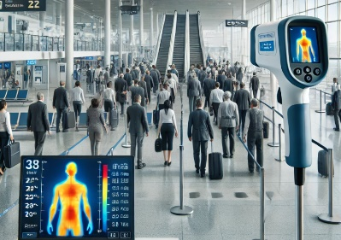





Train Station: Applications
Human Body Temperature Detection
Detect abnormal human body temperature by using a high accuracy thermal camera together with built-in face detection AI.
Suspicious Items Detection
Detect the items that are left unattended to prevent serious security and safety hazards.
On-the-Go Surveillance
Monitor the views from surveillance cameras using a mobile device while walking around the premises, to respond to incidents instantly.
Safety Assurance
Ensure safety of people using video surveillance system.
Trespassing Detection
Detecting the person entering the area without permission.

Slide 7


Train Station: Applications
Unauthorized Access Detection
Detect the intrusion attempts using video analytics and notify the security personnel.
Without surveillance videos, it is hard to be sure if the identity shown in the entry log matches the accessing person. Access control integrated with the surveillance system can remarkably prevent the crises and loss resulted from unauthorized access.
This is based on the Face Recognition analytics in ACTi’s Door Stations.
Solutions
Read

Slide 8

Train Station: Applications
Tailgating Detection
Detect tailgating at the entrance of restricted area by comparing the detected head count with number of presented access credentials.
Whenever the RFID card is swiped, the system will count the number of the actual entries. When mismatched, the system will create the alarm. This prevents both tailgating and piggybacking.
This is based on the People Counting analytics and RFID technology. Read More.
Solutions
Read

Slide 9




Train Station: Applications
Real-Time Suspect Tracking
Track the suspect seamlessly by switching between video channels using transparent video overlay buttons in video management system.
Track the suspect using the video management system interface by using the convenient feature of switching the views with 1 click on the video which opens up the next view of the area the suspect is moving towards to. This method works for both live view and playback. By this method it is possible to instantly find out where the suspect is going and dispatch officers to handle the situation immediately.
This is based on the unique Visual Tracking feature of ACTi’s NVR 3 and CMS 2.
Solutions
Read
Read
Read

Slide 10

Train Station: Applications
Vehicle Access Control
The access control at the gate can be done conveniently using ALPR technology.
Except for the highest security facilities, most locations can benefit from the automatic gate control without requiring the gate officer to be present all the time. Only the white-listed vehicles can enter the premises. Furthermore, it is possible to set up a blacklist which alerts the security officers instantly when the blacklisted vehicle appears.
This is based on the ALPR analytics inside ACTi cameras. Read More.
Solutions
Read

Slide 11

Train Station: Applications
Person on Train Tracks Detection
Automatically alert when the person is detected on the tracks using People Detection related AI technologies.
Regardless of trespassing, accidental falling on the train tracks, being pushed by criminals or suicide attempts, the lives can be saved by an instant response. The cameras with the built-in AI help monitor the train tracks areas throughout the train station. The PTZ models can even track the persons if they continue to walk on the tracks using the auto tracking feature.
List of cameras with the People Line Crossing Detection feature - Read More.
List of cameras with the People Enter Area Detection feature - Read More.
List of cameras with the People Detection feature - Read More.
Solutions
Read
Read
Read

Slide 12



Train Station: Applications
Human Body Temperature Detection
Detect abnormal human body temperature by using a high accuracy thermal camera together with built-in face detection AI.
To prevent the spread of diseases, there are smart surveillance devices that can detect high body temperature from the distance using specially designed high precision thermal imagers. These cameras will first detect human faces using its deep learning AI and then analyze each face using the thermal image and get the exact temperature reading of the face. The temperature above the threshold will trigger an event.
This is based on the Temperature Detection analytics inside ACTi thermal cameras, such as VMGB-370, VMGB-371.
Solutions
Read
Read
Read
Read
Read

Slide 13
Train Station: Applications
Suspicious Items Detection
Detect the items that are left unattended to prevent serious security and safety hazards.
The unattended objects, such as bags, boxes, suitcases, strollers, carts, are considered risk items that should be handled quickly. Those objects can sometimes be accidentally forgotten there. An early detection saves them from being stolen. Rarely, these items could also pose threats as being malicious. They could disguise explosives or other dangerous substances.
This is based on the Unattended Object Detection analytics inside ACTi cameras. Read More.
Solutions
Read
Read
Read
Read

Slide 14

Train Station: Applications
On-the-Go Surveillance
Monitor the views from surveillance cameras using a mobile device while walking around the premises, in order to respond to incidents instantly.
Universal mobile application designed to remotely access NVR, CMS or camera for video playback and management.
Features: Live view and playback, Search video recordings by events, PTZ Control, Google Maps, Activate Digital Output, Playback from camera's memory card
This is based on the ACTi Mobile Client, both for Android and iOS. It is free.
Solutions
Read
Read
Read

Slide 15

Train Station: Applications
Safety Assurance
Ensure safety of people using video surveillance system.
ACTi provides surveillance solution for ensuring the safety with both overview and details monitoring. By installing a camera with wide viewing angle at the center or the corner of the room, the whole area can be perfectly covered. Meanwhile, the faces of people entering the premises can be captured by the covert camera discreetly installed into the height strip at the entrance.
For large scale projects, ACTi TV Wall enables multiple views to be displayed on different monitors at the same time. Get the complete overview to improve situational awareness and operational efficiency.
Solutions
Read
Read
Read
Read
Read

Slide 16

Train Station: Applications
Trespassing Detection
Detecting the person entering the area without permission.
When a person enters someone's land or property without permission, it is considered trespassing, and it is illegal. There are places that are restricted for strangers nearly all the time, such as the train tracks area or maintenance area. Entering those areas at night would be considered trespassing.
This is based on the People Enter Area Detection analytics inside ACTi cameras. Read More.
Solutions
Read
Read
Read
Read
Read

Slide 17
Recommended Products vs Locations
 | Entrance | Gate | Office | Ticket/Security Gate | Control Room | Concourse | Platform | Parking
Thermal Cameras (VMGB-370, VMGB-371) |  |  |  |  |  |  | Y | Y
Intercom (Q950) | Y | Y | Y | Y | Y | Y | Y | Y
ALPR Bullet Camera (A426) |  | Y
Access Control Door Station (R1- R7- series readers/controllers) |  |  | Y |  | Y
People Counter for Tailgating prevention (Q963) |  |  | Y |  | Y
High Zoom Cameras |  |  |  |  |  | Y | Y
General Surveillance Bullets (3xx, 4xx series) | Y | Y | Y | Y | Y | Y | Y | Y
General Surveillance Domes (91x, 7xx, 8xx series) | Y | Y | Y | Y | Y | Y | Y | Y
Surveillance PTZ (95x/96x/97x Series) | Y | Y | Y | Y | Y | Y | Y | Y

Slide 18
Products vs Management Servers
 | Windows NVR (NVR 3) | Access Control Smart Server
Thermal Cameras (VMGB-370, VMGB-371) | Y | Y
Intercom (Q950) | Y | Y**
ALPR Bullet Camera (A426) | Y | Y
Access Control Door Station (R1- R7- series readers/controllers) |  | Y
People Counter for Tailgating prevention (Q963) | Y | Y
High Zoom Cameras | Y | Y*
General Surveillance Bullets (3xx, 4xx series) | Y | Y
General Surveillance Domes (91x, 7xx, 8xx series) | Y | Y
Surveillance PTZ (95x/96x/97x Series) | Y | Y*
PTZ controls available via NVR interface.
** Video stream only

Slide 19

Windows NVR (NVR 3)
NVR 3 is one of the most famous ACTi products – it is a professional and elegant network video recorder platform with wide range of features and extremely reliable performance, available in two editions (read more).
Feature | NVR 3 Business | NVR 3 Corporate
Maximum Number of Channels | 100 | 200 (Standalone NVR 256)
Free ACTi Camera Channels Included | 32 | 1
Free 3rd Party Camera Channels Included | 1 | 1
CMS Support | No | Yes
POS, Access Control, Network IO Support | No | Yes
eMap | Yes | Yes
Google Map | No | Yes
Embedded Websites within Display | No | Yes
PTZ Control | Yes | Yes
Redundancy Support (N+1, N-to-N) | Yes | Yes
Workstation, Web Client, Mobile Client | Yes | Yes
Display Layouts (maximum grid size) | 225 | 225

Slide 20


Access Control Smart Server
Access Control Smart Server (ACSS) is an easy-to-use access control software for managing employees and visitors access through the doors and gates as well as managing employee attendance. (read more)
Core Function
Access Control Management Doors, gates, locks, identification of face*, card, ALPR*, tailgating* detection
Attendance Management Work shifts, clock-in, clock-out, late, absent
Visitor management Visitor enrollment for temporary access
Construction site management Temporary sites management
Food ordering management Conveniently manage the employee services
Conference room management Book the available meeting rooms in your company
Customer arrival management Track when the customers arrive to the appointments

Slide 21





ACTi Deep Learning AI Camera Product Line
Deep learning is a method in artificial intelligence (AI) that teaches computers to process data in a way that is inspired by the human brain. Deep learning models can recognize complex patterns in pictures, text, sounds, and other data to produce accurate insights and predictions.
Model | A426 | A826 | A952 | A956 | Q83
Photo
Type | Zoom Bullet | Zoom Dome | Speed Dome | Speed Dome | Multi-Imager
Resolution | 5MP | 5MP | 8MP | 2MP | 20MP
Lens | 4.4x Zoom | 4.4x Zoom | 22x Zoom | 40x Zoom | 4 zoom lenses
Built-in Vehicle Related Analytics | Vehicle Counting, Vehicle Line Crossing Detection, Vehicle Enter Area Detection, Vehicle Incorrect Direction Detection, Vehicle Loitering Detection, Vehicle Tracking, Stopped vehicle detection, License Plate Detection, Automatic License Plate Recognition

Slide 22


A426 Train Station Installation
PMAX-0534
Pole Mount with Junction Box, supports 3.25" to 7.0" Poles
A426
5MP Zoom Bullet with D/N, Adaptive IR, Extreme WDR, SLLS, 4.4x Zoom Lens, Deep Learning AI

Slide 23


ALPR Camera (A426)
The AI camera can recognize multiple license plates across multiple lanes at the same time.
WATCH THE VIDEO
https://www.acti.com/video/v2902
ALPR Camera + NVR 3
ACTi NVR 3 supports the deep learning AI events and metadata. When the blacklisted vehicle is detected, the NVR will display instant alert.
WATCH THE VIDEO
https://www.acti.com/video/v2904

Slide 24





ACTi AI Solution Architecture
MOBILE CLIENT
E-mail
alerts
alerts
video
video
Realtime
analytics data
Realtime
analytics data, alerts
AI CAMERA
NVR SERVER
(ACTi NVR 3 Corporate)
NVR CLIENT

Slide 25
ACTi Advantages compared to Server-Based AI Providers
Hundreds of channels with deep learning analytics can be managed by a single VMS server, using just a common server hardware configuration. The Server-based AI solutions have limited number of channels and require very expensive hardware.
VMS video recording functionality is much better secured when the VMS does not have the burden of running the analytics that may consume the server resource to its limits.
Faster response to the events – AI cameras can control the other nearby PTZ cameras for instant response, to get better video coverage of the scene. The analyses that are processed on the VMS side will be too slow for proper response.
Since the AI features are inside the camera, there are no Analytics related licenses required on the server side. Therefore, the cost of VMS in some cases is up to 10 times lower than the server-side AI solutions.

Slide 26
NVR and CMS Features
ACTi NVR 3 Corporate (and CMS 2) manages the analytics events from the cameras as follows:
Set up the analytic rules and thresholds – for example, how big is the crowd, how long time is considered loitering.
Receive real-time analytic events from all the cameras and respond by the pre-defined actions, such as send e-mail, instant pop-up of the video channel on the VMS screen and more.
Automatically push video to the mobile app of the patrolling security guards.
Search by the specific filter rules, bookmarks, thumbnails.

Slide 27

Where to Buy
Via Authorized Resellers
https://www.acti.com/Corporate/WhereToBuy
From ACTi Corporation Directly
E-Mail: sales@acti.com
Tel (US): +1-866-410-2284 (Toll Free)
Tel (Non-US): +886-2-2656-2588

Slide 28
Support & Services
Technical Support
- Online Customer Helpdesk - https://www.acti.com/chd
- Phone support
US: +1-866-410-2284 (Toll Free)
Other Regions: +886-2-2656-5200
RMA Services
- Warranty
- Repair services
Training
- Self-learning

