Slide 1

ACTi
Mobile Vehicle Surveillance Solutions

Slide 2
Mobile Vehicle: Overview
ACTi video-based mobile vehicle security solution ensures passengers and drivers safety. The fully vibration proof surveillance equipment ensures clear and uninterrupted video evidence even in rough roads and sudden brakes.
Nowadays, in-vehicle surveillance has become more and more significant in order to deter pickpocketing, bullying, vandalism, clarify incidents or car collisions, and reinforce driver's accountability as well as respond to the driver's safety issues.
The mobile vehicle surveillance solution consists of wide-angle vandal proof IP cameras, covert cameras for more discreet applications, on-board standalone NVR, panic button, local display and more. All these are fully vibration proof and certified.
Furthermore, the control center of the fleet can monitor every single vehicle remotely thanks to the 4G/5G and Wi-Fi connectivity - the live video stream can immediately be accessed when suspicious events occur.

Slide 3
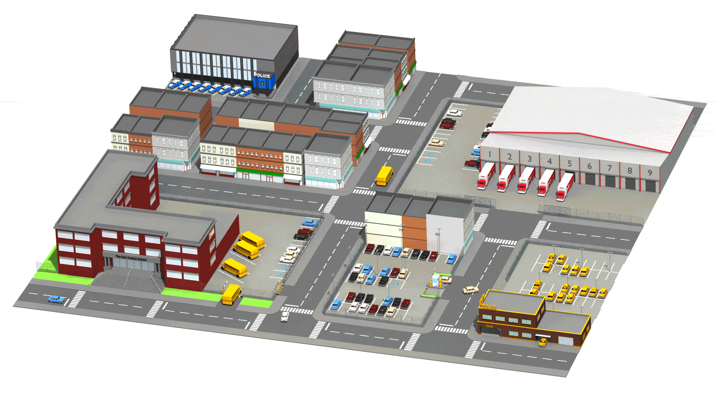
Mobile Vehicle: Map
Control Center
Fire Truck Fleet
School Bus Fleet
Taxi Fleet
Rental Car Fleet

Slide 4
Mobile Vehicle: Applications vs Locations
 | School Bus Fleet | Taxi Fleet | Fire Truck Fleet | Rental Car Fleet | Parking | Control Center
Driver’s Safety Alert | Y | Y
Vehicle Crash Detection | Y | Y | Y | Y
Vehicle Out of Area Detection | Y | Y |  | Y
Map-Based Vehicle Tracking | Y | Y | Y | Y
On-Board Fight or Vandalism Detection | Y | Y
Video Evidence Backup | Y | Y | Y | Y |  | Y
Unauthorized Access Detection |  |  |  |  |  | Y
Tailgating Detection |  |  |  |  |  | Y
Real-time Suspect Tracking |  |  |  |  |  | Y
Vehicle Access Control |  |  |  |  | Y

Slide 5



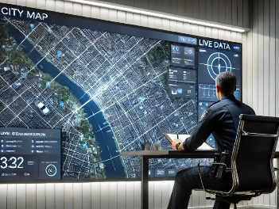

Mobile Vehicle: Applications
Driver’s Safety Alert
Instantly alert the control center when the driver presses the panic button upon being attacked or due to severe health issue.
Vehicle Crash Detection
Detect when the vehicle stops abruptly using the g-sensor module of the on-board NVR.
Vehicle Out of Area Detection
Alert when the vehicle drove outside of the pre-defined zone on the map.
Map-Based Vehicle Tracking
Check the location of the whole fleet on a map.
On-Board Fight or Vandalism Detection
Instantly review the video footage to confirm fight or vandalism when the alert is received.

Slide 6
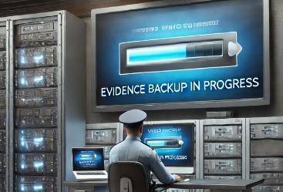




Mobile Vehicle: Applications
Video Evidence Backup
Offload the recorded videos from the on-board NVR to the Backup Server at the Control Center over Wi-Fi.
Unauthorized Access Detection
Detect the intrusion attempts using video analytics and notify the security personnel.
Tailgating Detection
Detect tailgating at the entrance of restricted area by comparing the detected head count with number of presented access credentials.
Real-time Suspect Tracking
Track the suspect seamlessly by switching between video channels using transparent video overlay buttons in video management system.
Vehicle Access Control
The access control at the gate can be done conveniently using ALPR technology.

Slide 7



Mobile Vehicle: Applications
Driver’s Safety Alert
Instantly alert the control center when the driver presses the panic button upon being attacked or due to severe health issue.
Driver’s safety is important to the drivers themselves, to the passengers and to the other vehicles nearby. When the driver is suddenly unable to drive while the vehicle is in motion, it might become a severe hazard.
There is a wide range of cameras and the NVRs supporting digital input feature, allowing the Panic Button to be connected.
Solutions
Read
Read

Slide 8

Mobile Vehicle: Applications
Vehicle Crash Detection
Detect when the vehicle stops abruptly using the g-sensor module of the on-board NVR.
When the vehicle decelerates too fast, it usually indicates a potential vehicle crash. Since the driver may not be able to respond, it is extremely important that the control center of the fleet would get the alert instantly using automatic solution.
Solutions
Read
Read

Slide 9

Mobile Vehicle: Applications
Vehicle Out of Area Detection
Alert when the vehicle drove outside of the pre-defined zone on the map.
When the vehicle appears outside of the pre-defined zone, it may indicate one of the following: vehicle being stolen, the driver not knowing the route, or the vehicle’s misuse.
This is based on the Live Map feature of ACTi’s NVR 3 and CMS 2.
Solutions
Read
Read

Slide 10


Mobile Vehicle: Applications
Map-Based Vehicle Tracking
Check the location of the whole fleet on a map.
ACTi VMS provides the map-based live view option in addition to the conventional grid-based live video views. The maps allow seeing the exact location of each vehicle of the fleet.
This is based on the Live Map feature of ACTi’s NVR 3 and CMS 2.
Solutions
Read
Read
Read

Slide 11

Mobile Vehicle: Applications
On-Board Fight or Vandalism Detection
Instantly review the video footage to confirm fight or vandalism when the alert is received.
When there is a fight on-board or someone is behaving aggressively or there is vandalism going on, the driver or the passengers can press the panic button to alert the control center. The control center staff can instantly access the on-board NVR over the 4G/5G mobile network and verify the incident even when the driver has no opportunity to communicate. The help can be sent instantly to deal with the incident.
Solutions
Read
Read

Slide 12
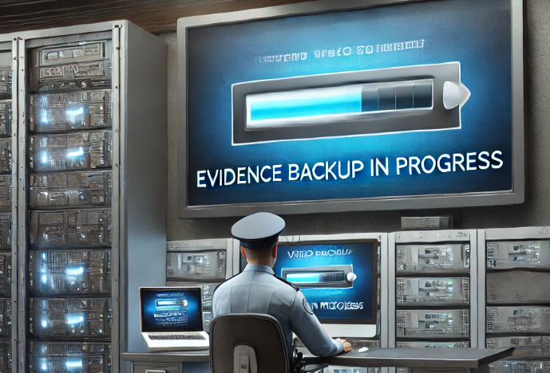
Mobile Vehicle: Applications
Video Evidence Backup
Offload the recorded videos from the on-board NVR to the Backup Server at the Control Center over Wi-Fi.
When the vehicle reaches its destination parking lot, it is usually covered with the Wi-Fi network. The on-board NVR will be able to analyze which of the files have not been backed up yet and starts the transmission of the video files to the backup server, located in that Wi-Fi network. This way, the important evidence is always protected.
This is based on the NVR 3 and Backup Server.
Solutions
Read
Read

Slide 13


Mobile Vehicle: Applications
Unauthorized Access Detection
Detect the intrusion attempts using video analytics and notify the security personnel.
Without surveillance videos, it is hard to be sure if the identity shown in the entry log matches the accessing person. Access control integrated with the surveillance system can remarkably prevent the crises and loss resulted from unauthorized access.
This is based on the Face Recognition analytics in ACTi’s Door Stations.
Solutions
Read

Slide 14

Mobile Vehicle: Applications
Tailgating Detection
Detect tailgating at the entrance of restricted area by comparing the detected head count with number of presented access credentials.
Whenever the RFID card is swiped, the system will count the number of the actual entries. When mismatched, the system will create the alarm. This prevents both tailgating and piggybacking.
This is based on the People Counting analytics and RFID technology. Read More.
Solutions
Read

Slide 15

Mobile Vehicle: Applications
Real-Time Suspect Tracking
Track the suspect seamlessly by switching between video channels using transparent video overlay buttons in video management system.
Track the suspect using the video management system interface by using the convenient feature of switching the views with 1 click on the video which opens up the next view of the area the suspect is moving towards to. This method works for both live view and playback. By this method it is possible to instantly find out where the suspect is going and dispatch officers to handle the situation immediately.
This is based on the unique Visual Tracking feature of ACTi’s NVR 3 and CMS 2.
Solutions
Read
Read
Read

Slide 16

Mobile Vehicle: Applications
Vehicle Access Control
The access control at the gate can be done conveniently using ALPR technology.
Except for the highest security facilities, most locations can benefit from the automatic gate control without requiring the gate officer to be present all the time. Only the white-listed vehicles can enter the premises. Furthermore, it is possible to set up a blacklist which alerts the security officers instantly when the blacklisted vehicle appears.
This is based on the ALPR analytics inside ACTi cameras. Read More.
Solutions
Read

Slide 17

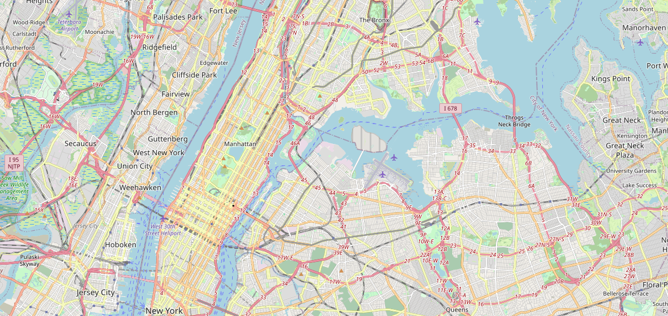

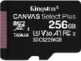
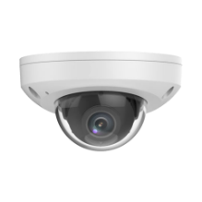
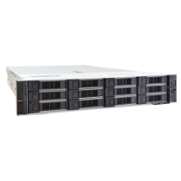
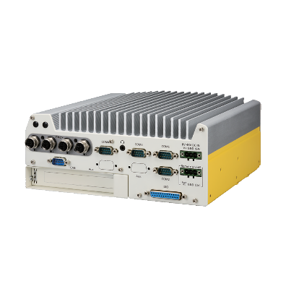
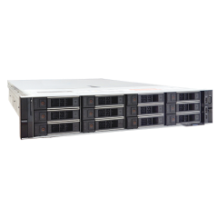

Mobile Vehicle: Solution Architecture #1
Control Station (with CMS)
Truck
Truck
CMS Workstation
Track vehicles on the Map, watch video
Truck
MicroSDHC
(Failover & Sync solution)
GPS Tracker
Mini Dome
CMS 2 Server
MicroSDHC
(Failover & Sync solution)
Wi-Fi
On-board NVR with PoE (PCI-201) + LTE / Wi-Fi / 5G
Backup Server
Connects to the on-board NVR and backs up the recorded data whenever the vehicle arrives in the Wi-Fi zone.
Mini Dome

Slide 18
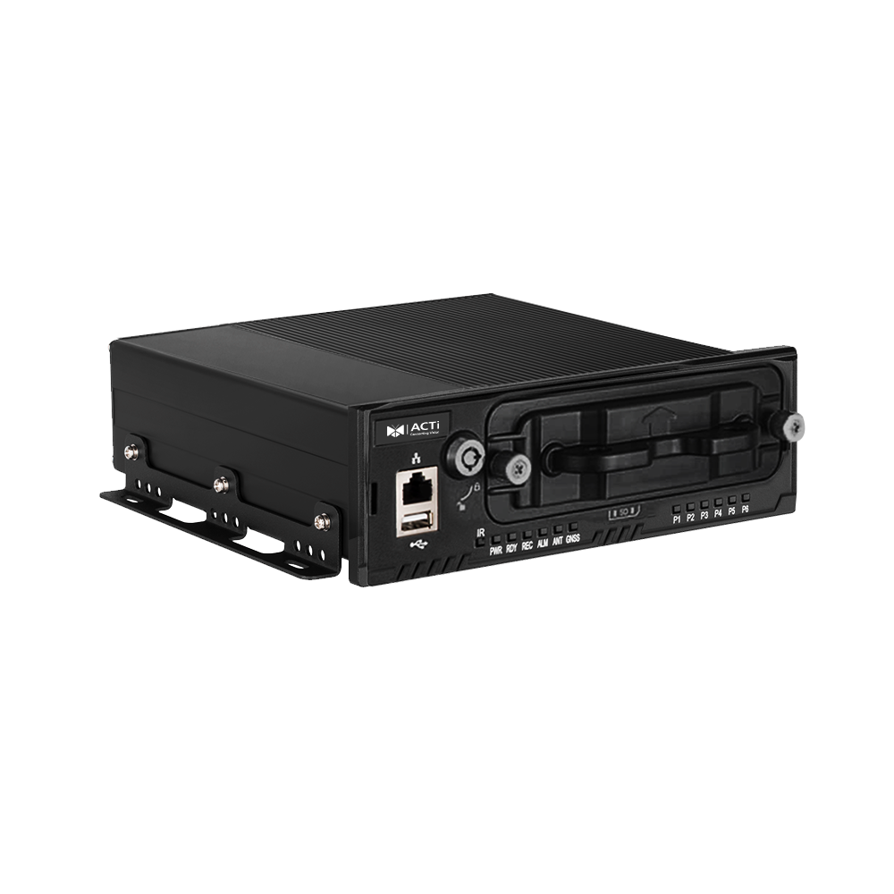
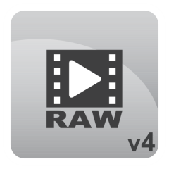
Mobile Vehicle: Solution Architecture #2
Mobile Solution without any wireless connectivity:
All the on-board channels are recorded on the removable MicroSDXC card.
Every day the storage card can be removed and carried to the facility to offload the video files. The offloaded video files can be viewed with ACTi’s Archive Player.
Office
Truck
Standard SD-card reader
& PC:
MicroSDXC
(Failover & Sync solution)
Remove the MicroSDXC card and bring it along.
Mini Dome
Standalone NVR Server
(MNR-402P/MNR-403P)
Archive Player
(view the exported files)
Download here
Mini Dome

Slide 19
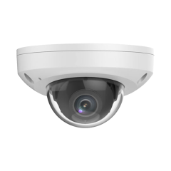
On-board Camera Specifications
Model | Z721
Photo
Product Type | Fixed Rugged Dome
Maximum Resolution | 4MP @ 30fps
HOR Viewing Angle | 101.1°
IR LED | Yes
WDR | 135 dB
Vibration Proof (Transportation grade) | Yes
Environmental Casing | IP67, IK10
Ethernet Cable Connector | M12
NDAA Compliant | Yes

Slide 20


Transportation NVR Server Comparison
Model | PCI-101 | PCI-201
Photo
Type | Server | Server
CPU | Intel® Atom® x6425E (quad-core 2.0GHz/ 3.0GHz 12W) | Intel® Core™ i3-12100E (12M Cache, up to 3.20 GHz)
RAM | 8GB, DDR4, 3200MT/s | 16GB, DDR5, 4800MT/s
Storage Bay | 1 | 2
PoE Ports | M12, 4 port(s) | M12, 4 port(s)
DI/DO | 4/4 | 4/4
Operating System | Windows 11 IoT Enterprise | Windows 11 IoT Enterprise
Power Input | DC 8-35V | DC 8-48V
Ignition Control | Yes | Yes
Vibration Proof | EN50155 | EN50155
Approvals | E-Mark | E-Mark
NVR 3 Corporate edition will be installed in those Servers upon the project.

Slide 21
Recommended Products vs Locations
 | School Bus Fleet | Taxi Fleet | Fire Truck Fleet | Rental Car Fleet | Parking | Control Center
On-Board Cameras (e.g Z721) | Y | Y | Y | Y
Intercom (Q950) |  |  |  |  | Y | Y
ALPR Bullet Camera (A426) |  |  |  |  | Y
Access Control Door Station (R1- R7- series readers/controllers) |  |  |  |  |  | Y
People Counter for Tailgating prevention (Q963) |  |  |  |  |  | Y
General Surveillance Bullets (3xx, 4xx series) |  |  |  |  |  | Y
General Surveillance Domes (91x, 7xx, 8xx series) |  |  |  |  |  | Y
Surveillance PTZ (95x/96x/97x Series) |  |  |  |  |  | Y

Slide 22
Products vs Management Servers
 | Windows NVR (NVR 3) | Access Control Smart Server
On-Board Cameras (e.g Z721) | Y | Y
Intercom (Q950) | Y | Y**
ALPR Bullet Camera (A426) | Y | Y
Access Control Door Station (R1- R7- series readers/controllers) | Y | Y
People Counter for Tailgating prevention (Q963) | Y | Y
General Surveillance Bullets (3xx, 4xx series) | Y | Y
General Surveillance Domes (91x, 7xx, 8xx series) | Y | Y
Surveillance PTZ (95x/96x/97x Series) | Y | Y*
* PTZ controls available via NVR interface.
** Video stream only

Slide 23

Windows NVR (NVR 3)
NVR 3 is one of the most famous ACTi products – it is a professional and elegant network video recorder platform with wide range of features and extremely reliable performance, available in two editions (read more).
Feature | NVR 3 Business | NVR 3 Corporate
Maximum Number of Channels | 100 | 200 (Standalone NVR 256)
Free ACTi Camera Channels Included | 32 | 1
Free 3rd Party Camera Channels Included | 1 | 1
CMS Support | No | Yes
POS, Access Control, Network IO Support | No | Yes
eMap | Yes | Yes
Google Map | No | Yes
Embedded Websites within Display | No | Yes
PTZ Control | Yes | Yes
Redundancy Support (N+1, N-to-N) | Yes | Yes
Workstation, Web Client, Mobile Client | Yes | Yes
Display Layouts (maximum grid size) | 225 | 225

Slide 24


Access Control Smart Server
Access Control Smart Server (ACSS) is an easy-to-use access control software for managing employees and visitors access through the doors and gates as well as managing employee attendance. (read more)
Core Function
Access Control Management Doors, gates, locks, identification of face*, card, ALPR*, tailgating* detection
Attendance Management Work shifts, clock-in, clock-out, late, absent
Visitor management Visitor enrollment for temporary access
Construction site management Temporary sites management
Food ordering management Conveniently manage the employee services
Conference room management Book the available meeting rooms in your company
Customer arrival management Track when the customers arrive to the appointments

Slide 25





ACTi Deep Learning AI Camera Product Line
Deep learning is a method in artificial intelligence (AI) that teaches computers to process data in a way that is inspired by the human brain. Deep learning models can recognize complex patterns in pictures, text, sounds, and other data to produce accurate insights and predictions.
Model | A426 | A826 | A952 | A956 | Q83
Photo
Type | Zoom Bullet | Zoom Dome | Speed Dome | Speed Dome | Multi-Imager
Resolution | 5MP | 5MP | 8MP | 2MP | 20MP
Lens | 4.4x Zoom | 4.4x Zoom | 22x Zoom | 40x Zoom | 4 zoom lenses
Built-in Vehicle Related Analytics | Vehicle Counting, Vehicle Line Crossing Detection, Vehicle Enter Area Detection, Vehicle Incorrect Direction Detection, Vehicle Loitering Detection, Vehicle Tracking, Stopped vehicle detection, License Plate Detection, Automatic License Plate Recognition

Slide 26


A426 Mobile Vehicle Installation
PMAX-0534
Pole Mount with Junction Box, supports 3.25" to 7.0" Poles
A426
5MP Zoom Bullet with D/N, Adaptive IR, Extreme WDR, SLLS, 4.4x Zoom Lens, Deep Learning AI

Slide 27


ALPR Camera (A426)
The AI camera can recognize multiple license plates across multiple lanes at the same time.
WATCH THE VIDEO
https://www.acti.com/video/v2902
ALPR Camera + NVR 3
ACTi NVR 3 supports the deep learning AI events and metadata. When the blacklisted vehicle is detected, the NVR will display instant alert.
WATCH THE VIDEO
https://www.acti.com/video/v2904

Slide 28





ACTi AI Solution Architecture
MOBILE CLIENT
E-mail
alerts
alerts
video
video
Realtime
analytics data
Realtime
analytics data, alerts
AI CAMERA
NVR SERVER
(ACTi NVR 3 Corporate)
NVR CLIENT

Slide 29
ACTi Advantages compared to Server-Based AI Providers
Hundreds of channels with deep learning analytics can be managed by a single VMS server, using just a common server hardware configuration. The Server-based AI solutions have limited number of channels and require very expensive hardware.
VMS video recording functionality is much better secured when the VMS does not have the burden of running the analytics that may consume the server resource to its limits.
Faster response to the events – AI cameras can control the other nearby PTZ cameras for instant response, to get better video coverage of the scene. The analyses that are processed on the VMS side will be too slow for proper response.
Since the AI features are inside the camera, there are no Analytics related licenses required on the server side. Therefore, the cost of VMS in some cases is up to 10 times lower than the server-side AI solutions.

Slide 30
NVR and CMS Features
ACTi NVR 3 Corporate (and CMS 2) manages the analytics events from the cameras as follows:
Set up the analytic rules and thresholds – for example, how big is the crowd, how long time is considered loitering.
Receive real-time analytic events from all the cameras and respond by the pre-defined actions, such as send e-mail, instant pop-up of the video channel on the VMS screen and more.
Automatically push video to the mobile app of the patrolling security guards.
Search by the specific filter rules, bookmarks, thumbnails.

Slide 31

Where to Buy
Via Authorized Resellers
https://www.acti.com/Corporate/WhereToBuy
From ACTi Corporation Directly
E-Mail: sales@acti.com
Tel (US): +1-866-410-2284 (Toll Free)
Tel (Non-US): +886-2-2656-2588

Slide 32
Support & Services
Technical Support
- Online Customer Helpdesk - https://www.acti.com/chd
- Phone support
US: +1-866-410-2284 (Toll Free)
Other Regions: +886-2-2656-5200
RMA Services
- Warranty
- Repair services
Training
- Self-learning

