Slide 1

ACTi
Data Center Surveillance Solutions

Slide 2
Data Center: Overview
ACTi's data center security solution ensures the seamless service of the data centers by preventing illegal access, tampering and other malicious activities either around or inside the premises.
The data centers must be secured against trespassing, tampering, hacking and vandalism.
ACTi's intelligent and cybersecure video management system can help prevent those risks and provide the solid evidence of any incidents that may occur.
The deep learning AI cameras analyze both video and audio. Trespassing, tailgating, piggybacking, loitering and other types of suspicious behavior can be detected by the artificial intelligence automatically without human supervision.
The surveillance system itself is also well-protected against any hacking or tampering attempts, as ACTi has designed its products with high focus on cybersecurity.
The video management solution consists of AI cameras, video management system with the TV wall, intercom, access control and various types of redundancy and backup services to ensure the seamless surveillance regardless of the tampering attempts.

Slide 3
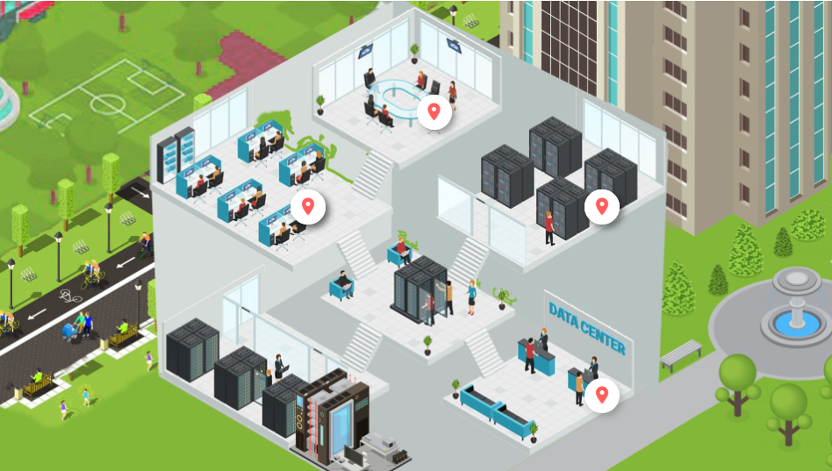
Data Center: Map
Office
Control Room
Equipment Room
Entrance
Stairway
Service Desk
Surroundings
Seating Area

Slide 4
Data Center: Applications vs Locations
 | Entrance / Gate | Service Desk | Seating Area | Equipment Room | Stairway | Control Room | Office | Surrounding
Unauthorized Access Detection | Y |  |  | Y |  | Y | Y
Tailgating Detection | Y |  |  | Y |  | Y | Y
Real-time Suspect Tracking | Y | Y | Y | Y | Y | Y | Y | Y
Digital Signage | Y | Y | Y | Y
Intercom Service | Y | Y |  | Y |  | Y | Y | Y
Blacklisted Persons Identification | Y |  |  |  |  |  |  | Y
Suspicious Items Detection | Y |  |  |  |  |  |  | Y
On-the-Go Surveillance | Y | Y | Y | Y | Y | Y | Y | Y
Safety Assurance | Y | Y | Y | Y | Y | Y | Y | Y
Vehicle Access Control | Y

Slide 5

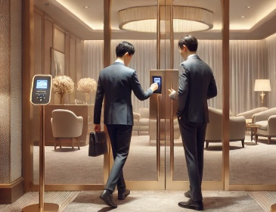


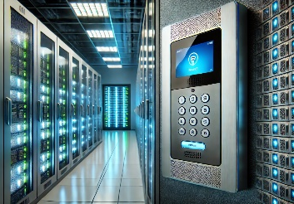
Data Center: Applications
Unauthorized Access Detection
Detect the intrusion attempts using video analytics and notify the security personnel.
Tailgating Detection
Detect tailgating at the entrance of restricted area by comparing the detected head count with number of presented access credentials.
Real-time Suspect Tracking
Track the suspect seamlessly by switching between video channels using transparent video overlay buttons in video management system.
Digital Signage
Show predefined digital content on the public monitors with customized layout, based on predefined schedule or event rules.
Intercom Service
Interact with other individuals by local voice-based communication system.

Slide 6
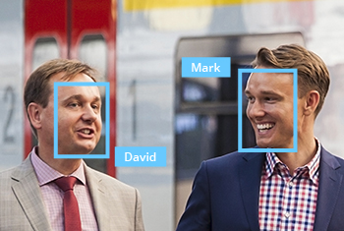




Data Center: Applications
Blacklisted Persons Identification
Identify the blacklisted persons by recognizing their faces automatically.
Suspicious Items Detection
Detect the items that are left unattended to prevent serious security and safety hazards.
On-the-Go Surveillance
Monitor the views from surveillance cameras using a mobile device while walking around the premises, to respond to incidents instantly.
Safety Assurance
Ensure safety of people using video surveillance system.
Vehicle Access Control
The access control at the gate can be done conveniently using ALPR technology.

Slide 7


Data Center: Applications
Unauthorized Access Detection
Detect the unauthorized access attempts using the access control system and the video analytics and notify the security personnel.
Without surveillance videos, it is hard to be sure if the identity shown in the entry log matches the accessing person. Access control integrated with the surveillance system can remarkably prevent the crises and loss resulted from unauthorized access.
This is based on the Face Recognition analytics in ACTi’s Door Stations.
Solutions
Read

Slide 8

Data Center: Applications
Tailgating Detection
Detect tailgating at the entrance of restricted area by comparing the detected head count with number of presented access credentials.
Whenever the RFID card is swiped, the system will count the number of the actual entries. When mismatched, the system will create the alarm. This prevents both tailgating and piggybacking.
This is based on the People Counting analytics and RFID technology. Read More.
Solutions
Read

Slide 9




Data Center: Applications
Real-Time Suspect Tracking
Track the suspect seamlessly by switching between video channels using transparent video overlay buttons in video management system.
Track the suspect using the video management system interface by using the convenient feature of switching the views with 1 click on the video which opens up the next view of the area the suspect is moving towards to. This method works for both live view and playback. By this method it is possible to instantly find out where the suspect is going and dispatch officers to handle the situation immediately.
This is based on the unique Visual Tracking feature of ACTi’s NVR 3 and CMS 2.
Solutions
Read
Read
Read

Slide 10

Data Center: Applications
Digital Signage
ACTi provides end-to-end solution for effective and real-time communication. Digital signage is able to display various contents such as pre-recorded video, live video streams, images, text and web pages with customized layout.
The digital signage can be used as:
General Advertising
Notifications, Reminders, Instructions
Surveillance Monitoring, Scam Prevention
For General Advertising, Notifications, Reminders, Instructions, the cloud-based digital signage is used. For Theft Prevention, the ECD-series decoders are used along with ACTi’s VMS solution.
Solutions
Cloud-based Digital Signage Solution
(SF21)
Read
Read
Read
Read

Slide 11

Data Center: Applications
Intercom Service
Interact with other individuals by local voice-based communication system.
There will be voice access points as intercoms in various locations across the Utility, such as gates and entrances, loading area, parking lot and others. The employees and the visitors can talk to the security staff immediately using that feature.
This is based on the NVR 3 or CMS 2 along with intercom devices such as Q950.
Solutions
Read
Read
Read

Slide 12
Data Center: Applications
Blacklisted Persons Identification
Identify the blacklisted persons by recognizing their faces automatically.
The banks may have a list of individuals who might be a potential risk for the bank. An early notification of the arrival of the blacklisted person helps the staff be prepared for that.
This is based on the Face Recognition supported surveillance cameras.
Solutions
Read
Read
Read

Slide 13

Retail: Applications
Suspicious Items Detection
Detect the items that are left unattended to prevent serious security and safety hazards.
The unattended objects, such as bags, boxes, suitcases or suspicious devices are considered risk items that should be handled quickly. Those objects can sometimes be accidentally forgotten there. Rarely, these items could also pose threats as being malicious. They could disguise explosives or other dangerous substances.
This is based on the Unattended Object Detection analytics inside ACTi cameras. Read More.
Solutions
Read
Read
Read
Read

Slide 14

Data Center: Applications
On-the-Go Surveillance
Monitor the views from surveillance cameras using a mobile device while walking around the premises, in order to respond to incidents instantly.
Universal mobile application designed to remotely access NVR, CMS or camera for video playback and management.
Features: Live view and playback, Search video recordings by events, PTZ Control, Google Maps, Activate Digital Output, Playback from camera's memory card
This is based on the ACTi Mobile Client, both for Android and iOS. It is free.
Solutions
Read
Read
Read

Slide 15


Data Center: Applications
Safety Assurance
Ensure safety of people using video surveillance system.
ACTi provides surveillance solution for ensuring the safety with both overview and details monitoring. By installing a camera with wide viewing angle at the center or the corner of the store, the whole area can be perfectly covered. Meanwhile, the faces of people entering the premises can be captured by the covert camera discreetly installed into the height strip at the entrance.
For large scale projects, ACTi TV Wall enables multiple views to be displayed on different monitors at the same time. Get the complete overview to improve situational awareness and operational efficiency.
Solutions
Read
Read
Read
Read
Read

Slide 16

Data Center: Applications
Vehicle Access Control
The access control at the gate can be done conveniently using ALPR technology.
Except for the highest security facilities, most locations can benefit from the automatic gate control without requiring the gate officer to be present all the time. Only the white-listed vehicles can enter the premises. Furthermore, it is possible to set up a blacklist which alerts the security officers instantly when the blacklisted vehicle appears.
This is based on the ALPR analytics inside ACTi cameras. Read More.
Solutions
Read

Slide 17
Recommended Products vs Locations
 | Entrance / Gate | Service Desk | Seating Area | Equipment Room | Stairway | Control Room | Office | Surrounding
Thermal Cameras (VMGB-370, VMGB-371) |  |  |  | Y |  |  |  | Y
Intercom (Q950) | Y | Y |  | Y |  | Y | Y | Y
ALPR Bullet Camera (A426) | Y
Access Control Door Station (R1- R7- series readers/controllers) | Y |  |  | Y |  | Y | Y
People Counter for Tailgating prevention (Q963) | Y |  |  | Y |  | Y | Y
General Surveillance Bullets (3xx, 4xx series) | Y | Y | Y | Y | Y | Y | Y | Y
General Surveillance Domes (91x, 7xx, 8xx series) | Y | Y | Y | Y | Y | Y | Y | Y
Surveillance PTZ (95x/96x/97x Series) | Y | Y | Y | Y | Y | Y | Y | Y

Slide 18
Products vs Management Servers
 | Windows NVR (NVR 3) | Access Control Smart Server
Thermal Cameras (VMGB-370, VMGB-371) | Y | Y
Intercom (Q950) | Y | Y
ALPR Bullet Camera (A426) | Y | Y
Access Control Door Station (R1- R7- series readers/controllers) |  | Y
People Counter for Tailgating prevention (Q963) | Y | Y
General Surveillance Bullets (3xx, 4xx series) | Y | Y
General Surveillance Domes (91x, 7xx, 8xx series) | Y | Y
Surveillance PTZ (95x/96x/97x Series) | Y | Y*
PTZ controls available via NVR interface.

Slide 19

Windows NVR (NVR 3)
NVR 3 is one of the most famous ACTi products – it is a professional and elegant network video recorder platform with wide range of features and extremely reliable performance, available in two editions (read more).
Feature | NVR 3 Business | NVR 3 Corporate
Maximum Number of Channels | 100 | 200 (Standalone NVR 256)
Free ACTi Camera Channels Included | 32 | 1
Free 3rd Party Camera Channels Included | 1 | 1
CMS Support | No | Yes
POS, Access Control, Network IO Support | No | Yes
eMap | Yes | Yes
Google Map | No | Yes
Embedded Websites within Display | No | Yes
PTZ Control | Yes | Yes
Redundancy Support (N+1, N-to-N) | Yes | Yes
Workstation, Web Client, Mobile Client | Yes | Yes
Display Layouts (maximum grid size) | 225 | 225

Slide 20
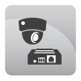
Redundancy Solutions for NVR 3 Editions
There may be situations where the NVR server may become inaccessible, and the cameras have no recorder to send the video stream to. It could happen due to the network failure, data switch failure, power outage, human error or due to any other reasons. Even though such incidents are very unlikely to happen, the mission critical solutions should have a protection against that. The seamless service can be achieved by using NVR Redundancy Service. It would ensure that whenever the original NVR is not accessible, the alternative system will immediately step in and start recording the video streams of the cameras belonging to the original NVR. ACTi offers two kinds of Redundancy Service solutions: N+1 and N-to-N
Notes:
PR: P,O,I
RG: G,U,T
ND: Y,N
ST:

Slide 21
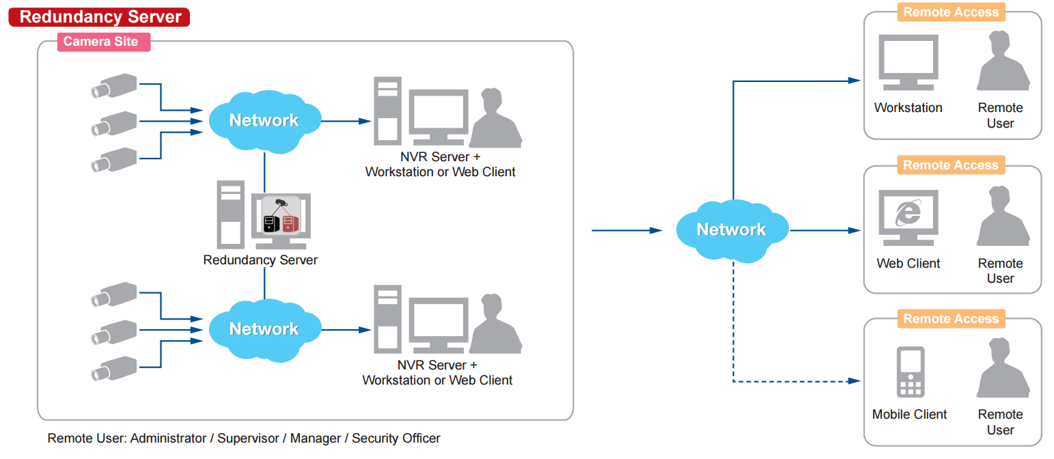
N+1 Redundancy
There will be an additional NVR 3 server installed in the network which will stay idle and watch over the other NVR servers. By activating the redundancy service licenses (LRDS3000) in that idle NVR 3 server, it will have the capability to watch over the other NVR 3 servers. One redundancy server can monitor up to 16 other NVR servers. If any of those NVR servers becomes inaccessible, then the redundancy server will notice it and will immediately take over the camera management of the original NVR.
Notes:
PR: P,O,I
RG: G,U,T
ND: Y,N
ST:

Slide 22
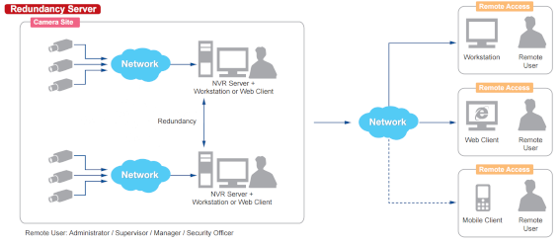
N-to-N Redundancy
There is also another way to set up the redundancy without requiring the additional server to be installed. It is called N-to-N redundancy. It means that when there is a group of NVR servers installed in the same network, they can watch over each other and take over the cameras of the inaccessible NVR server.
Although the additional idle server is not required, in order to achieve the redundancy capabilities, each of the NVRs must have unused video channels capacity. For example, a standalone NVR server INR-470 comes with the 64 free channels license included and can be extended up to 200 channels with add-on licenses (LNVR3003).
Notes:
PR: P,O,I
RG: G,U,T
ND: Y,N
ST:

Slide 23
N-to-N Redundancy
If that server has 150 cameras of its own to manage, it could potentially take the role of watching over 50 more cameras from any other NVR server, provided that the full 200 channels capacity has been enabled with the help of LNVR3003 licenses. In such case, INR-470 becomes the redundancy server for 50 selected camera channels from any other NVR 3 in the network.
Applying the same concept to all the NVR 3 servers, they all will be able to use their surplus channel quota to act as redundancy servers.
This method also provides flexibility - you can decide which camera channels you want to serve under redundancy mode. You can skip less important channels, for example. However, if the full redundancy must be achieved in the network, then on average each NVR should have twice as many video channel licenses activated than there are cameras under that NVR.
Notes:
PR: P,O,I
RG: G,U,T
ND: Y,N
ST:

Slide 24
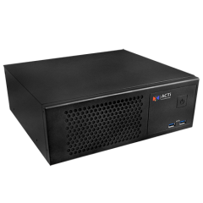
System Health Management
SHM-102
Monitors the health ACTi NVR 3 Servers, CMS Servers, TV Wall Servers and Cameras
Send email notification for issues
Reports and graphs
Map based monitoring with instant alerts
License (LMAS50000) is required per each managed server (NVR, CMS, TV Wall)
The health management plug-in will be installed in each target server.
The System Health Management server (SHM-102) will be able to monitor the servers via plug-in.
Notes:
PR: P,O,I
RG: G,U,T
ND: Y,N
ST:

Slide 25
System Health Management
Features |  | SHM-102
Managed products for health status | Cameras via ACTi NVR 3 | Y
 | NVR 3, GNR, INR | Y
 | CMS 2 | Y
 | TV Wall Server | Y
Health data | Basic product status | Y
 | Details | Y
 | server's system status | Y
Health Management | Display health status on web client | Y
 | Issue ticket auto-generation & assignment | Y
Scalability | Maximum number of managed devices | up to 200 NVR servers with related cameras with single SHM architecture
Solution installation | Solution options | Use standalone only
 | Works outside SHM | Must install plugin to all the managed Windows-based servers, including NVR 3, CMS 2, TV Wall.
Licensing | License unit | Per plugin
Notes:
PR: P,O,I
RG: G,U,T
ND: Y,N
ST:

Slide 26
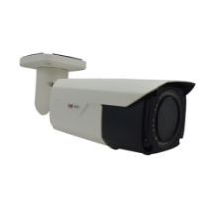

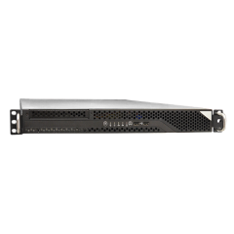


System Health Management Architecture
System Health Management Server SHM-102
NVR 3 Servers
Cameras
CMS 2 Server
TV Wall Servers
In this example, there are totally 13 managed items via 7 servers. The SHM license LMAS5000 is required for each of those 7 servers. The plug-in shall be installed in each of those 7 servers.
Notes:
PR: P,O,I
RG: G,U,T
ND: Y,N
ST:

Slide 27


Access Control Smart Server
Access Control Smart Server (ACSS) is an easy-to-use access control software for managing employees and visitors access through the doors and gates as well as managing employee attendance. (read more)
Core Function
Access Control Management Doors, gates, locks, identification of face*, card, ALPR*, tailgating* detection
Attendance Management Work shifts, clock-in, clock-out, late, absent
Visitor management Visitor enrollment for temporary access
Construction site management Temporary sites management
Food ordering management Conveniently manage the employee services
Conference room management Book the available meeting rooms in your company
Customer arrival management Track when the customers arrive to the appointments

Slide 28





ACTi Deep Learning AI Camera Product Line
Deep learning is a method in artificial intelligence (AI) that teaches computers to process data in a way that is inspired by the human brain. Deep learning models can recognize complex patterns in pictures, text, sounds, and other data to produce accurate insights and predictions.
Model | A426 | A826 | A952 | A956 | Q83
Photo
Type | Zoom Bullet | Zoom Dome | Speed Dome | Speed Dome | Multi-Imager
Resolution | 5MP | 5MP | 8MP | 2MP | 20MP
Lens | 4.4x Zoom | 4.4x Zoom | 22x Zoom | 40x Zoom | 4 zoom lenses
Built-in Vehicle Related Analytics | Vehicle Counting, Vehicle Line Crossing Detection, Vehicle Enter Area Detection, Vehicle Incorrect Direction Detection, Vehicle Loitering Detection, Vehicle Tracking, Stopped vehicle detection, License Plate Detection, Automatic License Plate Recognition

Slide 29


A426 Data Center Installation
PMAX-0534
Pole Mount with Junction Box, supports 3.25" to 7.0" Poles
A426
5MP Zoom Bullet with D/N, Adaptive IR, Extreme WDR, SLLS, 4.4x Zoom Lens, Deep Learning AI

Slide 30


ALPR Camera (A426)
The AI camera can recognize multiple license plates across multiple lanes at the same time.
WATCH THE VIDEO
https://www.acti.com/video/v2902
ALPR Camera + NVR 3
ACTi NVR 3 supports the deep learning AI events and metadata. When the blacklisted vehicle is detected, the NVR will display instant alert.
WATCH THE VIDEO
https://www.acti.com/video/v2904

Slide 31





ACTi AI Solution Architecture
MOBILE CLIENT
E-mail
alerts
alerts
video
video
Realtime
analytics data
Realtime
analytics data, alerts
AI CAMERA
NVR SERVER
(ACTi NVR 3 Corporate)
NVR CLIENT

Slide 32
ACTi Advantages compared to Server-Based AI Providers
Hundreds of channels with deep learning analytics can be managed by a single VMS server, using just a common server hardware configuration. The Server-based AI solutions have limited number of channels and require very expensive hardware.
VMS video recording functionality is much better secured when the VMS does not have the burden of running the analytics that may consume the server resource to its limits.
Faster response to the events – AI cameras can control the other nearby PTZ cameras for instant response, to get better video coverage of the scene. The analyses that are processed on the VMS side will be too slow for proper response.
Since the AI features are inside the camera, there are no Analytics related licenses required on the server side. Therefore, the cost of VMS in some cases is up to 10 times lower than the server-side AI solutions.

Slide 33
NVR and CMS Features
ACTi NVR 3 Corporate (and CMS 2) manages the analytics events from the cameras as follows:
Set up the analytic rules and thresholds – for example, how big is the crowd, how long time is considered loitering.
Receive real-time analytic events from all the cameras and respond by the pre-defined actions, such as send e-mail, instant pop-up of the video channel on the VMS screen and more.
Automatically push video to the mobile app of the patrolling security guards.
Search by the specific filter rules, bookmarks, thumbnails.

Slide 34

Where to Buy
Via Authorized Resellers
https://www.acti.com/Corporate/WhereToBuy
From ACTi Corporation Directly
E-Mail: sales@acti.com
Tel (US): +1-866-410-2284 (Toll Free)
Tel (Non-US): +886-2-2656-2588

Slide 35
Support & Services
Technical Support
- Online Customer Helpdesk - https://www.acti.com/chd
- Phone support
US: +1-866-410-2284 (Toll Free)
Other Regions: +886-2-2656-5200
RMA Services
- Warranty
- Repair services
Training
- Self-learning

