Slide 1
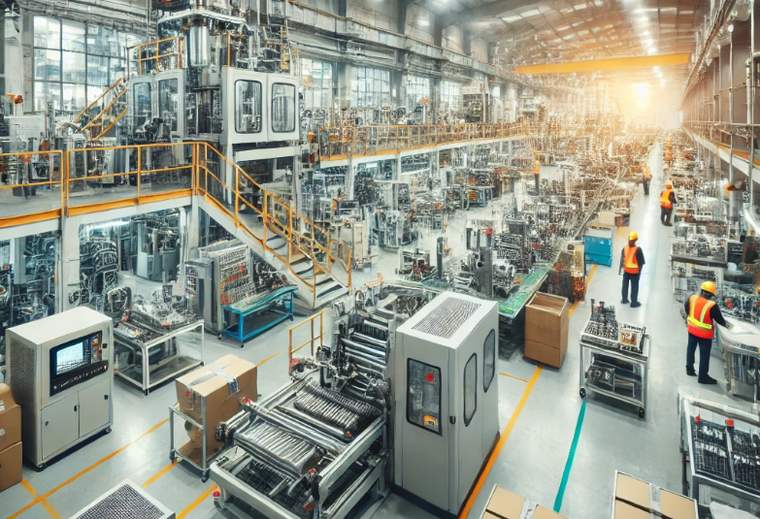
ACTi
Factory Surveillance Solutions

Slide 2

Factory: Overview
ACTi has been helping factory owners create a safe and more automated environment. Real-time updates on the safety of the employees and the overall health status of the equipment and facilities, visualized information of the operational processes, and factory incident detection can maximize the efficiency of operations and security.
The security monitoring of the factory is assured by the AI-based video surveillance system while the authorized access is managed by ACTi’s Access Control system.
The digital signage system is used both for the emergencies as well as for the regular instructions in the production areas.
The factory equipment can also be monitored in various ways – either by integrating the equipment’s health status with the video management system or by monitoring the equipment’s performance using the optical or thermal surveillance cameras.

Slide 3
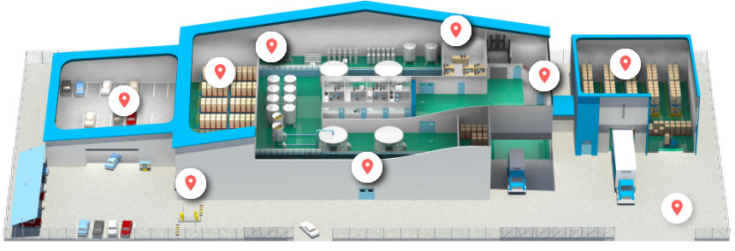
Factory: Map
Production Area
Control Room
Storage
Loading Area
Parking
Emergency
Exit
Entrance
Gate
Surrounding

Slide 4
Factory: Applications vs Locations
 | Production Area | Storage | Control Room | Loading Area | Parking | Entrance | Gate | Surrounding
Unauthorized Access Detection | Y | Y | Y | Y |  | Y | Y
Tailgating Detection | Y | Y | Y | Y |  | Y
Real-time Suspect Tracking | Y | Y | Y | Y | Y | Y | Y | Y
Vehicle Access Control |  |  |  |  | Y |  | Y
Intercom Service | Y |  |  | Y | Y | Y | Y
Large Perimeter Surveillance |  |  |  |  |  |  |  | Y
Equipment Status Monitoring | Y
On-the-Go Surveillance | Y | Y | Y | Y | Y | Y | Y | Y
Safety Assurance | Y | Y | Y | Y | Y | Y | Y | Y
Video Evidence Push to NVR by Mobile Phone | Y | Y | Y | Y | Y | Y | Y | Y

Slide 5





Factory: Applications

Slide 6
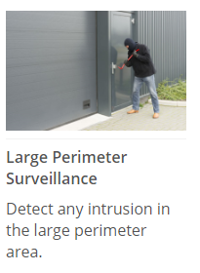
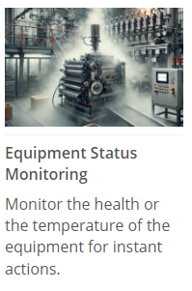



Factory: Applications

Slide 7


Factory: Applications
Unauthorized Access Detection
Detect the intrusion attempts using video analytics and notify the security personnel.
Without surveillance videos, it is hard to be sure if the identity shown in the entry log matches the accessing person. Access control integrated with the surveillance system can remarkably prevent the crises and loss resulted from unauthorized access.
This is based on the Face Recognition analytics in ACTi’s Door Stations.
Solutions
Read

Slide 8

Factory: Applications
Tailgating Detection
Detect tailgating at the entrance of restricted area by comparing the detected head count with number of presented access credentials.
Whenever the RFID card is swiped, the system will count the number of the actual entries. When mismatched, the system will create the alarm. This prevents both tailgating and piggybacking.
This is based on the People Counting analytics and RFID technology. Read More.
Solutions
Read

Slide 9




Factory: Applications
Real-Time Suspect Tracking
Track the suspect seamlessly by switching between video channels using transparent video overlay buttons in video management system.
Track the suspect using the video management system interface by using the convenient feature of switching the views with 1 click on the video which opens up the next view of the area the suspect is moving towards to. This method works for both live view and playback. By this method it is possible to instantly find out where the suspect is going and dispatch officers to handle the situation immediately.
This is based on the unique Visual Tracking feature of ACTi’s NVR 3 and CMS 2.
Solutions
Read
Read
Read

Slide 10

Factory: Applications
Vehicle Access Control
The access control at the gate can be done conveniently using ALPR technology.
Except for the highest security facilities, most locations can benefit from the automatic gate control without requiring the gate officer to be present all the time. Only the white-listed vehicles can enter the premises. Furthermore, it is possible to set up a blacklist which alerts the security officers instantly when the blacklisted vehicle appears.
This is based on the ALPR analytics inside ACTi cameras. Read More.
Solutions
Read

Slide 11

Factory: Applications
Intercom Service
Interact with other individuals by local voice-based communication system.
There will be voice access points as intercoms in various locations across the factory, such as gates and entrances, loading area, parking lot and others. The employees and the visitors can talk to the security staff immediately using that feature.
This is based on the NVR 3 or CMS 2 along with intercom devices such as Q950.
Solutions
Read
Read
Read

Slide 12
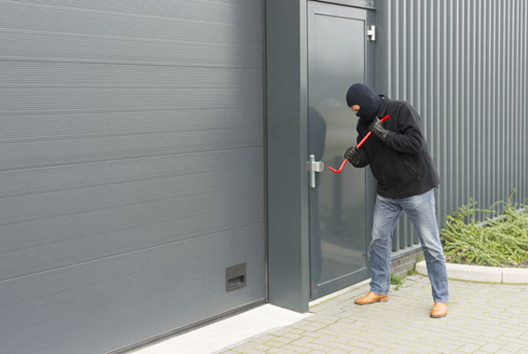


Factory: Applications
Large Perimeter Surveillance
Detect any intrusion in the large perimeter area automatically.
The solutions are suitable for large areas with restricted or limited access, where every moving object (people, vehicles) should be monitored and evidence recorded.
This is based on the People and Vehicle Enter Area Detection analytics inside ACTi cameras. Read More.
Solutions
Read
Read
Read
Read
Read

Slide 13
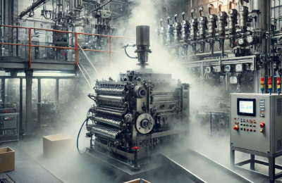
Factory: Applications
Equipment Status Monitoring
Monitor the health or the temperature of the equipment for instant actions.
There are two ways to receive the health information about the monitored equipment - either by observing its appearance using the optical or thermal cameras, or by receiving the health status data over the IP network.
This is based on the Network Modules for status data transmission or Thermal Cameras.
Solutions
Read
Read
Read
Read

Slide 14

Factory: Applications
On-the-Go Surveillance
Monitor the views from surveillance cameras using a mobile device while walking around the premises, in order to respond to incidents instantly.
Universal mobile application designed to remotely access NVR, CMS or camera for video playback and management.
Features: Live view and playback, Search video recordings by events, PTZ Control, Google Maps, Activate Digital Output, Playback from camera's memory card
This is based on the ACTi Mobile Client, both for Android and iOS. It is free.
Solutions
Read
Read
Read

Slide 15

Factory: Applications
Safety Assurance
Ensure safety of people using video surveillance system.
ACTi provides surveillance solution for ensuring the safety with both overview and details monitoring. By installing a camera with wide viewing angle at the center or the corner of the store, the whole area can be perfectly covered. Meanwhile, the faces of people entering the premises can be captured by the covert camera discreetly installed into the height strip at the entrance.
For large scale projects, ACTi TV Wall enables multiple views to be displayed on different monitors at the same time. Get the complete overview to improve situational awareness and operational efficiency.
Solutions
Read
Read
Read
Read
Read

Slide 16

Factory: Applications
Video Evidence Push to NVR by Mobile Phone
Use the built-in camera of the mobile phone to stream the video evidence of the incident to NVR.
The patrolling security guard can now use his smartphone with ACTi Mobile Client to capture live video and "push" it through wireless network to NVR 3 in real time. Moreover, the recording can be reviewed later during incident investigation using advanced features that apply to surveillance cameras including synchronized playback, bookmarks, timeline search, and more.
This is based on the ACTi Mobile Client, both for Android and iOS. It is a free app.
Solutions
Read
Read

Slide 17
Factory: Recommended Products vs Locations
 | Production Area | Storage | Control Room | Loading Area | Parking | Entrance | Gate | Surrounding
Thermal Cameras (VMGB-359, VMGB-371) | Y | Y |  |  |  |  |  | Y
Intercom (Q950) | Y |  |  | Y | Y | Y | Y
ALPR Bullet Camera (A426) |  |  |  |  | Y |  | Y
Access Control Door Station (R1- R7- series readers/controllers) | Y | Y | Y | Y |  | Y | Y
People Counter for Tailgating prevention (Q963) | Y | Y | Y | Y |  | Y | Y
General Surveillance Bullets (3xx, 4xx series) | Y | Y | Y | Y | Y | Y | Y | Y
General Surveillance Domes (91x, 7xx, 8xx series) | Y | Y | Y | Y | Y | Y | Y | Y

Slide 18





ACTi Deep Learning AI Camera Product Line
Deep learning is a method in artificial intelligence (AI) that teaches computers to process data in a way that is inspired by the human brain. Deep learning models can recognize complex patterns in pictures, text, sounds, and other data to produce accurate insights and predictions.
Model | A426 | A826 | A952 | A956 | Q83
Photo
Type | Zoom Bullet | Zoom Dome | Speed Dome | Speed Dome | Multi-Imager
Resolution | 5MP | 5MP | 8MP | 2MP | 20MP
Lens | 4.4x Zoom | 4.4x Zoom | 22x Zoom | 40x Zoom | 4 zoom lenses
Built-in Vehicle Related Analytics | Vehicle Counting, Vehicle Line Crossing Detection, Vehicle Enter Area Detection, Vehicle Incorrect Direction Detection, Vehicle Loitering Detection, Vehicle Tracking, Stopped vehicle detection, License Plate Detection, Automatic License Plate Recognition

Slide 19


A426 Factory Installation
PMAX-0534
Pole Mount with Junction Box, supports 3.25" to 7.0" Poles
A426
5MP Zoom Bullet with D/N, Adaptive IR, Extreme WDR, SLLS, 4.4x Zoom Lens, Deep Learning AI

Slide 20


ALPR Camera (A426)
The AI camera can recognize multiple license plates across multiple lanes at the same time.
WATCH THE VIDEO
https://www.acti.com/video/v2902
ALPR Camera + NVR 3
ACTi NVR 3 supports the deep learning AI events and metadata. When the blacklisted vehicle is detected, the NVR will display instant alert.
WATCH THE VIDEO
https://www.acti.com/video/v2904

Slide 21





ACTi AI Solution Architecture
MOBILE CLIENT
E-mail
alerts
alerts
video
video
Realtime
analytics data
Realtime
analytics data, alerts
AI CAMERA
NVR SERVER
(ACTi NVR 3 Corporate)
NVR CLIENT

Slide 22
ACTi Advantages compared to Server-Based AI Providers
Hundreds of channels with deep learning analytics can be managed by a single VMS server, using just a common server hardware configuration. The Server-based AI solutions have limited number of channels and require very expensive hardware.
VMS video recording functionality is much better secured when the VMS does not have the burden of running the analytics that may consume the server resource to its limits.
Faster response to the events – AI cameras can control the other nearby PTZ cameras for instant response, to get better video coverage of the scene. The analyses that are processed on the VMS side will be too slow for proper response.
Since the AI features are inside the camera, there are no Analytics related licenses required on the server side. Therefore, the cost of VMS in some cases is up to 10 times lower than the server-side AI solutions.

Slide 23
NVR and CMS Features
ACTi NVR 3 Corporate (and CMS 2) manages the analytics events from the cameras as follows:
Set up the analytic rules and thresholds – for example, how big is the crowd, how long time is considered loitering.
Receive real-time analytic events from all the cameras and respond by the pre-defined actions, such as send e-mail, instant pop-up of the video channel on the VMS screen and more.
Automatically push video to the mobile app of the patrolling security guards.
Search by the specific filter rules, bookmarks, thumbnails.

Slide 24

Where to Buy
Via Authorized Resellers
https://www.acti.com/Corporate/WhereToBuy
From ACTi Corporation Directly
E-Mail: sales@acti.com
Tel (US): +1-866-410-2284 (Toll Free)
Tel (Non-US): +886-2-2656-2588

Slide 25
Support & Services
Technical Support
- Online Customer Helpdesk - https://www.acti.com/chd
- Phone support
US: +1-866-410-2284 (Toll Free)
Other Regions: +886-2-2656-5200
RMA Services
- Warranty
- Repair services
Training
- Self-learning

