Slide 1

ACTi
City Surveillance Solutions

Slide 2
Traffic

Slide 3
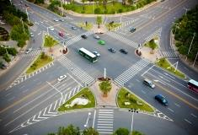
Traffic: Overview
ACTi offers end-to-end solutions to optimize city security and traffic management using high quality surveillance cameras, video analytics, and management servers. Traffic congestion, car accidents, driving in the wrong direction, blacklisted vehicles passing by and many more types of incidents can be detected using video surveillance together with AI technology.
The security or management related challenges and solution requirements vary for each traffic type. The biggest traffic-related challenges are traffic congestion, weather conditions influencing traffic safety, car accidents, and behavior related issues, such as driving in the wrong direction.
ACTi's end-to-end traffic surveillance solution consists of IP cameras, video management system, mobile surveillance, video analytics, alarm system, eMap system and much more.

Slide 4
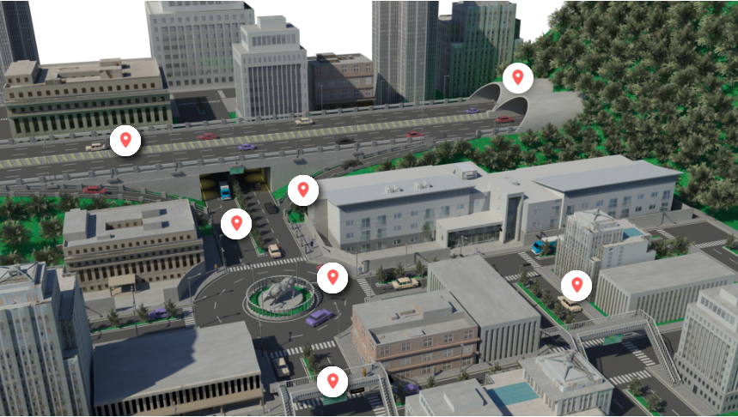
Traffic: Map
Tunnel
Highway
Lane
Road
Intersection and Roundabout
Sidewalk
Pedestrian Overpass

Slide 5
Traffic: Applications vs Locations
 | Tunnel | Highway | Road | Lane | Roundabout | Intersection | Pedestrian Overpass | Sidewalk
Vehicle Direction Violation Detection | Y | Y | Y | Y | Y | Y
Restricted Area Driving Detection |  |  |  |  |  |  |  | Y
Illegal Stopping Detection | Y |  |  |  | Y | Y
Suspicious Loitering Detection |  |  |  |  |  |  | Y | Y
Traffic Congestion Monitoring | Y | Y | Y | Y | Y | Y
Illegal Parking Detection | Y | Y | Y | Y
Stolen Vehicle Detection | Y | Y | Y | Y | Y | Y
Trucks Detection in the Fast Lane | Y | Y
Safety Assurance |  |  |  |  |  |  | Y | Y
Blacklisted Vehicles Identification | Y | Y | Y | Y | Y | Y

Slide 6
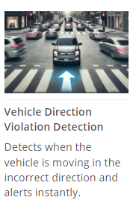
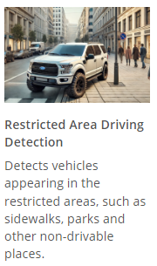
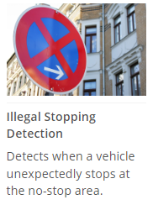
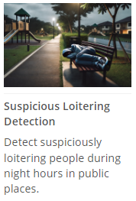
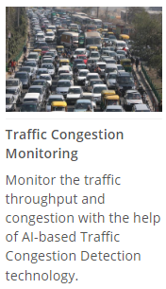
Traffic: Applications

Slide 7
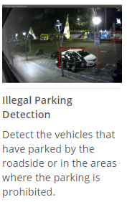
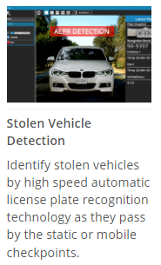
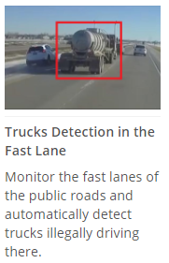

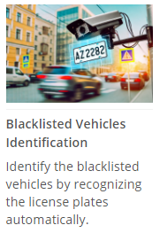
Traffic: Applications

Slide 8
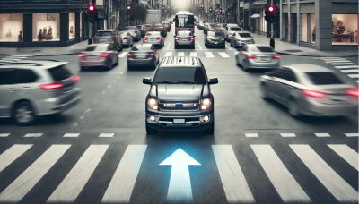





Traffic: Applications
Vehicle Direction Violation Detection
Detects when the vehicle is moving in the incorrect direction and alerts instantly.
A vehicle going in the opposite direction of the permitted traffic flow is huge safety risk, regardless of this is being intentional or by accident. An early response allows handling the incident before the accident happens.
This is based on the Vehicle Incorrect Direction Detection analytics inside ACTi cameras. Read More.
Solutions
Read
Read
Read
Read
Read

Slide 9

Traffic: Applications
Restricted Area Driving Detection
Detects vehicles appearing in the restricted areas, such as sidewalks, parks and other non-drivable places.
There are many locations where the motor vehicles are not permitted to drive. They may include sidewalks, public squares, parks, certain types of tunnels, bridges and other locations. The violation will be detected by the vehicle detection analytics and reported instantly.
This is based on the Vehicle Enter Area Detection analytics inside ACTi cameras. Read More.
Solutions
Read
Read
Read
Read
Read

Slide 10
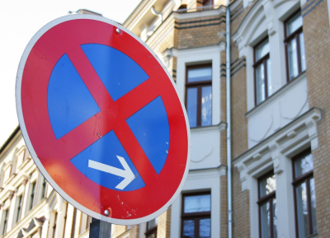
Traffic: Applications
Illegal Stopping Detection
Detects when a vehicle unexpectedly stops at the no-stop area.
Illegal stopping can immediately cause the risks of traffic accidents or traffic jams. To resolve them as quickly as possible, the automatic stopped vehicle detection analytic alerts the officers.
This is based on the Stopped Vehicle Detection analytics inside ACTi cameras. Read More.
Solutions
Read
Read
Read
Read
Read

Slide 11

Traffic: Applications
Suspicious Loitering Detection
Detect suspiciously loitering people during night hours in public places.
The public areas are monitored for the safety purposes. One of the signs of potential safety risk is the detection of suspicious loitering in the public areas such as city parks, especially at night.
This is based on the People Loitering Detection analytics inside ACTi cameras. Read More.
Solutions
Read
Read
Read
Read
Read

Slide 12
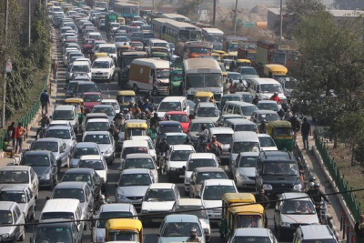
Traffic: Applications
Traffic Congestion Monitoring
Monitor the traffic throughput and congestion with the help of AI-based Traffic Congestion Detection technology.
There are two reasons to be alerted automatically about traffic congestions:
1. To collect the statistics about the traffic congestion patterns for the long-term solutions planning
2. To detect unusual traffic congestions and handle them instantly.
The unexpected traffic jams can be a result of some incident. Without immediate handling, the congestion could affect thousands of vehicles.
This is based on the Vehicle Counting analytics inside ACTi cameras. Read More.
Solutions
Read
Read
Read
Read
Read

Slide 13
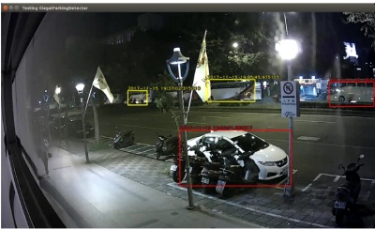
Traffic: Applications
Illegal Parking Detection
Detect the vehicles that have parked by the roadside or in the areas where the parking is prohibited.
Detect the vehicles that have parked by the roadside or in the areas where the parking is prohibited. The violations may include:
Wrong parked vehicle type, Prohibited area for parking, Prohibited time period for parking
This is based on the Vehicle Loitering Detection analytics inside ACTi cameras. Read More.
Solutions
Read
Read
Read
Read
Read

Slide 14
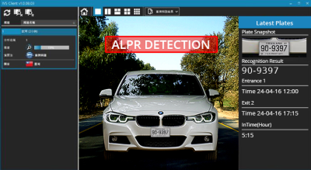
Traffic: Applications
Stolen Vehicle Detection
Identify stolen vehicles by high-speed automatic license plate recognition technology as they pass by the static or mobile checkpoints.
Identify stolen vehicles by high-speed automatic license plate recognition technology as they pass by the checkpoint. The checkpoint could be a static traffic surveillance post or a police vehicle.
This is based on the ALPR analytics inside ACTi cameras. Read More.
Solutions
Read
Read
Read
Read
Read

Slide 15
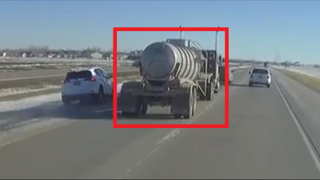
Traffic: Applications
Trucks Detection in the Fast Lane
Monitor the fast lanes of the public roads and automatically detect trucks illegally driving there.
In most countries trucks are not allowed to enter the fast lane of the freeway to provide more safety to smaller vehicles. However, when the right lanes run into congestions, some truck drivers may be tempted to temporarily switch to the fast lane to get ahead of traffic and meet the delivery deadlines. Such reckless driving is penalized with big fines whenever detected. However, there is no police around each time to see the incident.
This is based on the Vehicle Type Detection analytics inside ACTi cameras. Read More.
Solutions
Read
Read
Read
Read
Read

Slide 16

Traffic: Applications
Safety Assurance
Ensure safety of people using video surveillance system.
ACTi provides surveillance solution for ensuring the safety with both overview and details monitoring. By installing a camera with wide viewing angle at the center or the corner of the store, the whole area can be perfectly covered. Meanwhile, the faces of people entering the premises can be captured by the covert camera discreetly installed into the height strip at the entrance.
For large scale projects, ACTi TV Wall enables multiple views to be displayed on different monitors at the same time. Get the complete overview to improve situational awareness and operational efficiency.
Solutions

Slide 17
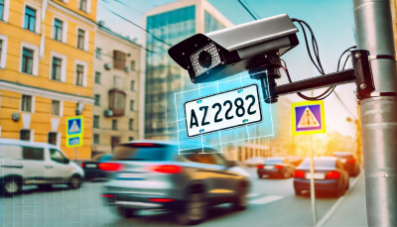
Traffic: Applications
Blacklisted Vehicles Identification
Identify the blacklisted vehicles by recognizing the license plates automatically.
There are various types of blacklists. There are blacklists of the vehicles that are not permitted to certain locations. There are also blacklists of the vehicles that are associated with the crime suspects. There may also be vehicles with the expired license plates or other reasons of being listed.
This is based on the ALPR analytics inside ACTi cameras. Read More.
Solutions
Read
Read
Read
Read
Read

Slide 18
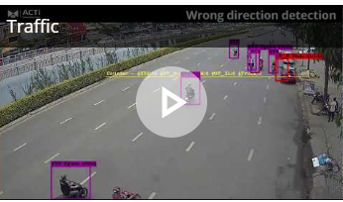
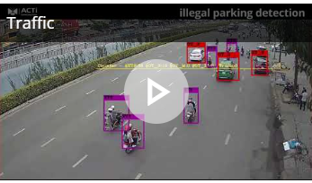
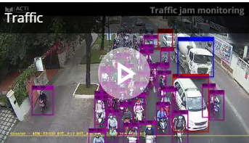
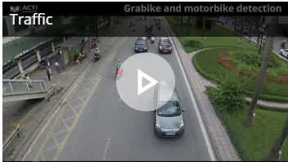
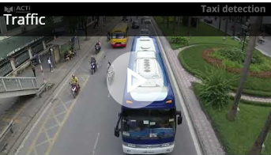
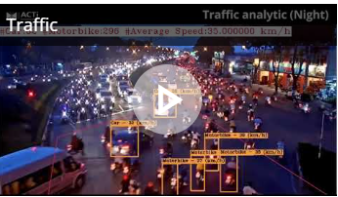
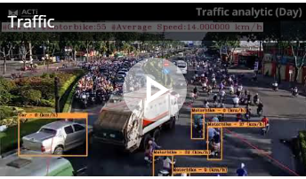
Traffic: Project References

Slide 19
Park & Square

Slide 20
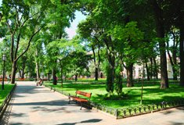
Park & Square: Overview
To provide a safe environment for the citizens, ACTi provides its cameras, analytics and VMS as a full solution for the public safety purposes. Gangster gathering, criminal activities, homeless issues and much more can all be detected using deep learning AI for prompt handling.
The security or business management related challenges and solution requirements vary for each park and squares type. Since these public areas are open to everyone, gangster gathering, criminal activities and homeless issues are the challenges here.
To provide a safe environment for residents, ACTi incorporates its cameras, video management system, analytics, public intercom and much more for a complete and reliable solution for the public safety management.

Slide 21
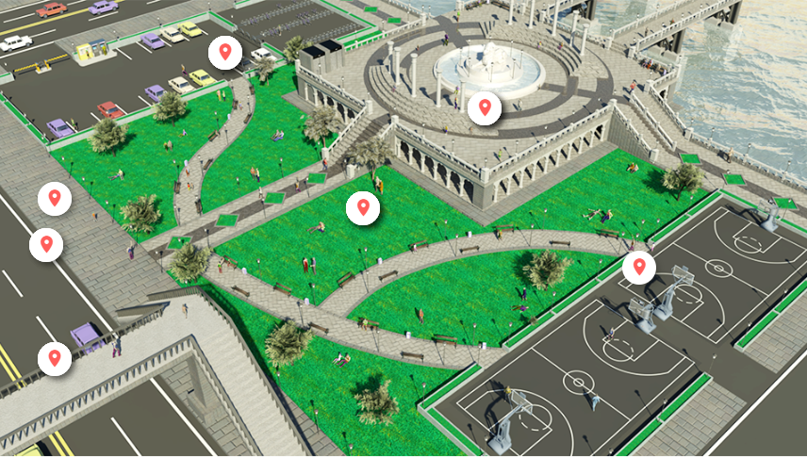
City Area: Park & Square
Outdoor Parking Area
Public Square
Sidewalk
Field
Road
Sports Court
Pedestrian Overpass

Slide 22
Park & Square: Applications vs Locations
 | Parking Lot | Sidewalk | Road | Public Square | Pedestrian Overpass | Sports Court | Field
Restricted Area Driving Detection |  | Y |  | Y |  | Y | Y
Suspicious Loitering Detection | Y | Y | Y | Y | Y | Y | Y
Trespassing Detection |  |  |  |  |  | Y
Suspicious Items Detection |  | Y |  | Y | Y | Y | Y
Blacklisted Persons Identification | Y | Y |  | Y | Y | Y | Y
Intercom Service | Y | Y |  | Y | Y | Y | Y
On-the-Go Surveillance | Y | Y |  | Y | Y | Y | Y
Real-time Suspect Tracking | Y | Y | Y | Y | Y | Y | Y
Safety Assurance | Y | Y |  | Y | Y | Y | Y
Video Evidence Push to NVR by Mobile Phone | Y | Y |  | Y | Y | Y | Y

Slide 23

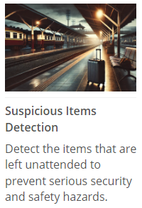
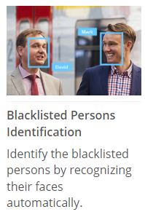
Park & Square: Applications

Slide 24
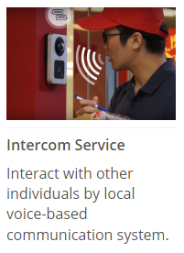
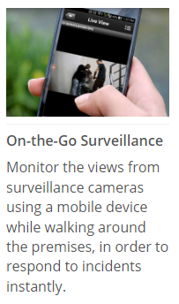
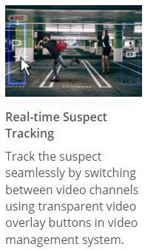
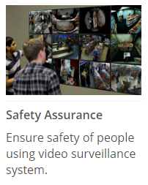

Park & Square: Applications

Slide 25
Park & Square: Applications
Restricted Area Driving Detection
Detects vehicles appearing in the restricted areas, such as sidewalks, parks and other non-drivable places.
There are many locations where the motor vehicles are not permitted to drive. They may include sidewalks, public squares, parks, certain types of tunnels, bridges and other locations. The violation will be detected by the vehicle detection analytics and reported instantly.
This is based on the Vehicle Enter Area Detection analytics inside ACTi cameras. Read More.
Solutions
Read
Read
Read
Read
Read

Slide 26
Park & Square: Applications
Suspicious Loitering Detection
Detect suspiciously loitering people during night hours in public places.
The public areas are monitored for the safety purposes. One of the signs of potential safety risk is the detection of suspicious loitering in the public areas such as city parks, especially at night.
This is based on the People Loitering Detection analytics inside ACTi cameras. Read More.
Solutions
Read
Read
Read
Read
Read

Slide 27

Park & Square: Applications
Trespassing Detection
Detecting the person entering the area without permission.
When a person enters someone's land or property without permission, it is considered trespassing, and it is illegal. There are places that are restricted for strangers nearly all the time, such as residential areas, schools. There are also some places that are open for anyone during daytime but are closed at night due to safety reasons. For example, certain parks and outdoor sport courts. Entering those areas at night would be considered trespassing.
This is based on the People Enter Area Detection analytics inside ACTi cameras. Read More.
Solutions
Read
Read
Read
Read
Read

Slide 28

Park & Square: Applications
Suspicious Items Detection
Detect the items that are left unattended to prevent serious security and safety hazards.
The unattended objects, such as bags, boxes, suitcases, strollers, carts, are considered risk items that should be handled quickly. Those objects can sometimes simply be of value and someone accidentally forgot them there. An early detection saves them from being stolen.
Rarely, these items could also pose threats as being malicious. They could disguise explosives or other dangerous substances.
This is based on the Unattended Object Detection analytics inside ACTi cameras. Read More.
Solutions
Read
Read
Read
Read
Read

Slide 29
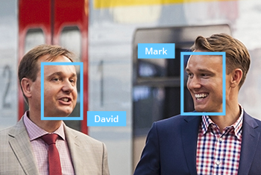
Park & Square: Applications
Blacklisted Persons Identification
Identify the blacklisted persons by recognizing their faces automatically.
There may be various types of attention lists. There may be lists maintained by the police department. There may also be lists created by the private sector for the safety purposes, such as for the shoplifting prevention.
This is based on the Face Recognition analytics inside ACTi cameras. Read More.
Solutions
Read
Read
Read
Read
Read

Slide 30
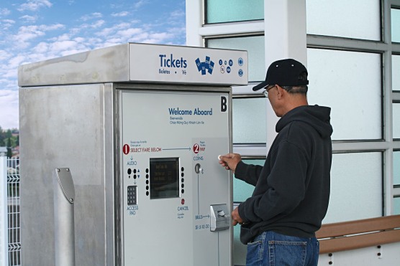
Park & Square: Applications
Intercom Service
Interact with other individuals by local voice-based communication system.
Secure building: Intercom for door opening request
Gate: Intercom for gate opening request
Train Station: Intercom for emergency situations
Kiosk: Intercom for support
Taxi stop: Intercom for car request
This is based on the Intercom Cameras, such as Q950.
Solutions
Read
Read
Read
Read
Read

Slide 31

Park & Square: Applications
On-the-Go Surveillance
Monitor the views from surveillance cameras using a mobile device while walking around the premises, in order to respond to incidents instantly.
Universal mobile application designed to remotely access NVR, CMS or camera for video playback and management.
Features: Live view and playback, Search video recordings by events, PTZ Control, Google Maps, Activate Digital Output, Playback from camera's memory card
This is based on the ACTi Mobile Client, both for Android and iOS. It is free.
Solutions
Read
Read
Read
Read
Read

Slide 32

Park & Square: Applications
Real-time Suspect Tracking
Track the suspect seamlessly by switching between video channels using transparent video overlay buttons in video management system.
Track the suspect using the video management system interface by using the convenient feature of switching the views with 1 click on the video which opens up the next view of the area the suspect is moving towards to. This method works for both live view and playback. By this method it is possible to instantly find out where the suspect is going and dispatch officers to handle the situation immediately.
This is based on the NVR 3 and CMS 2 series products.
Solutions
Read
Read

Slide 33
Park & Square: Applications
Safety Assurance
Ensure safety of people using video surveillance system.
ACTi provides surveillance solution for ensuring the safety with both overview and details monitoring. By installing a camera with wide viewing angle at the center or the corner of the store, the whole area can be perfectly covered. Meanwhile, the faces of people entering the premises can be captured by the covert camera discreetly installed into the height strip at the entrance.
For large scale projects, ACTi TV Wall enables multiple views to be displayed on different monitors at the same time. Get the complete overview to improve situational awareness and operational efficiency.
Solutions

Slide 34
Park & Square: Applications
Video Evidence Push to NVR by Mobile Phone
Use the built-in camera of the mobile phone to stream the video evidence of the incident to NVR.
The patrolling security guard can now use his smartphonewith ACTi Mobile Client to capture live video and "push" it through wireless network to NVR 3 in real time.Moreover, the recording can be reviewed later during incident investigation using advanced features that apply to surveillance cameras including synchronized playback, bookmarks, timeline search, and more.
This is based on the ACTi Mobile Client, both for Android and iOS. It is a free app.
Solutions
Read
Read

Slide 35
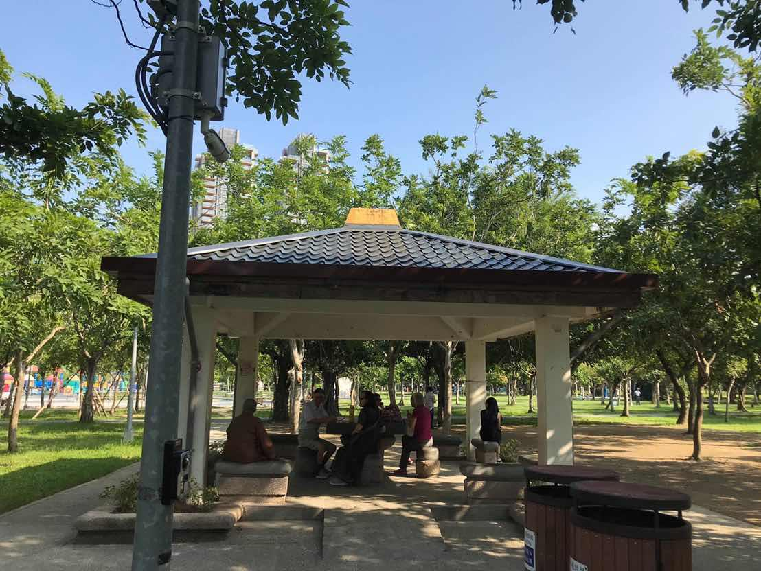
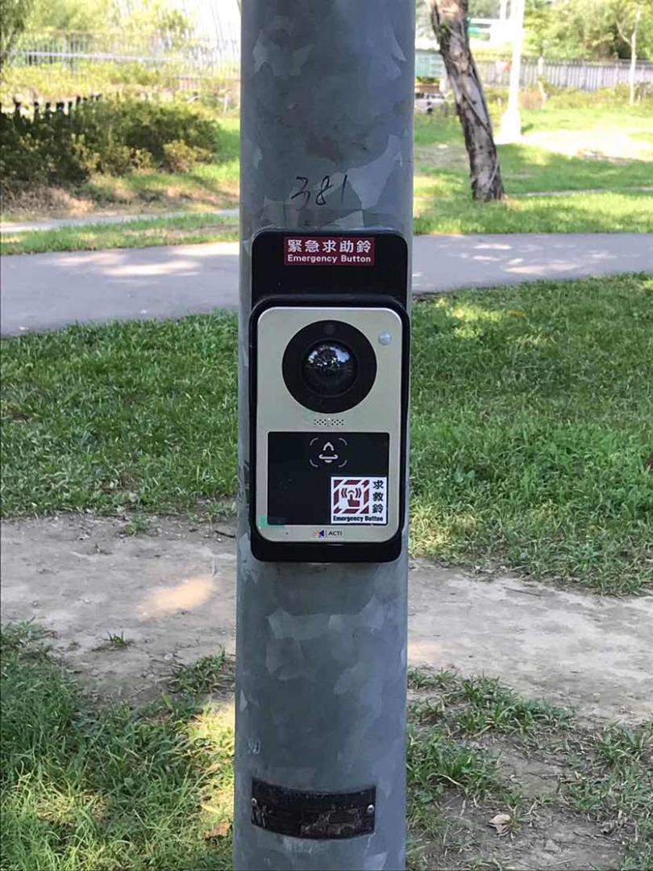
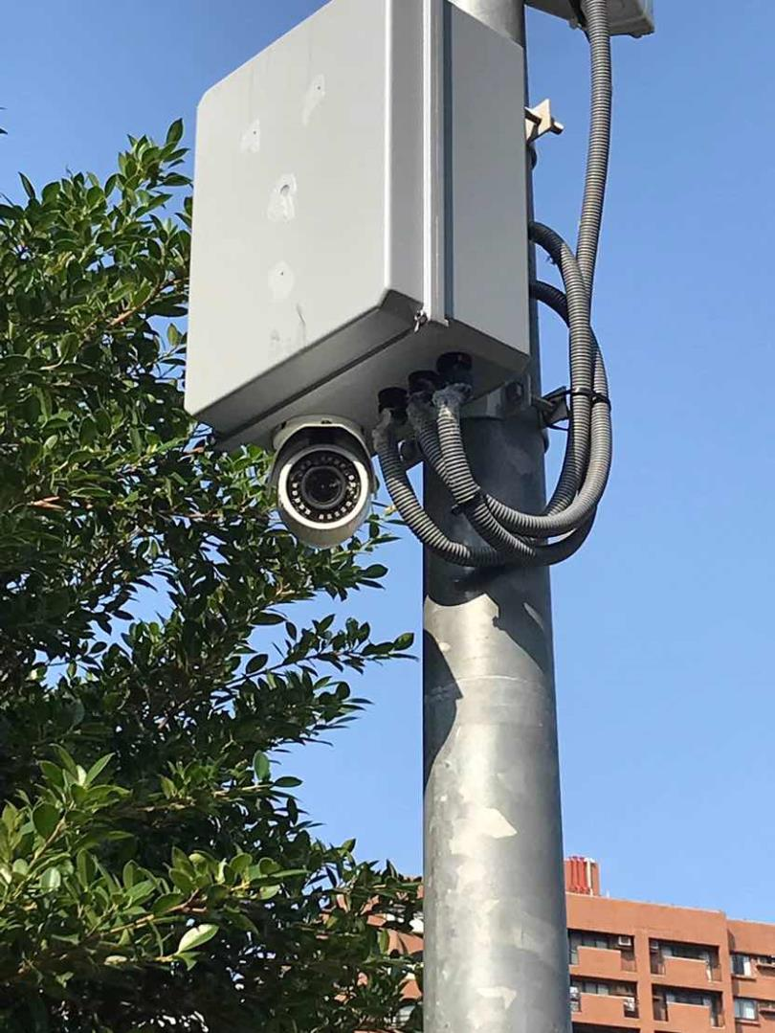
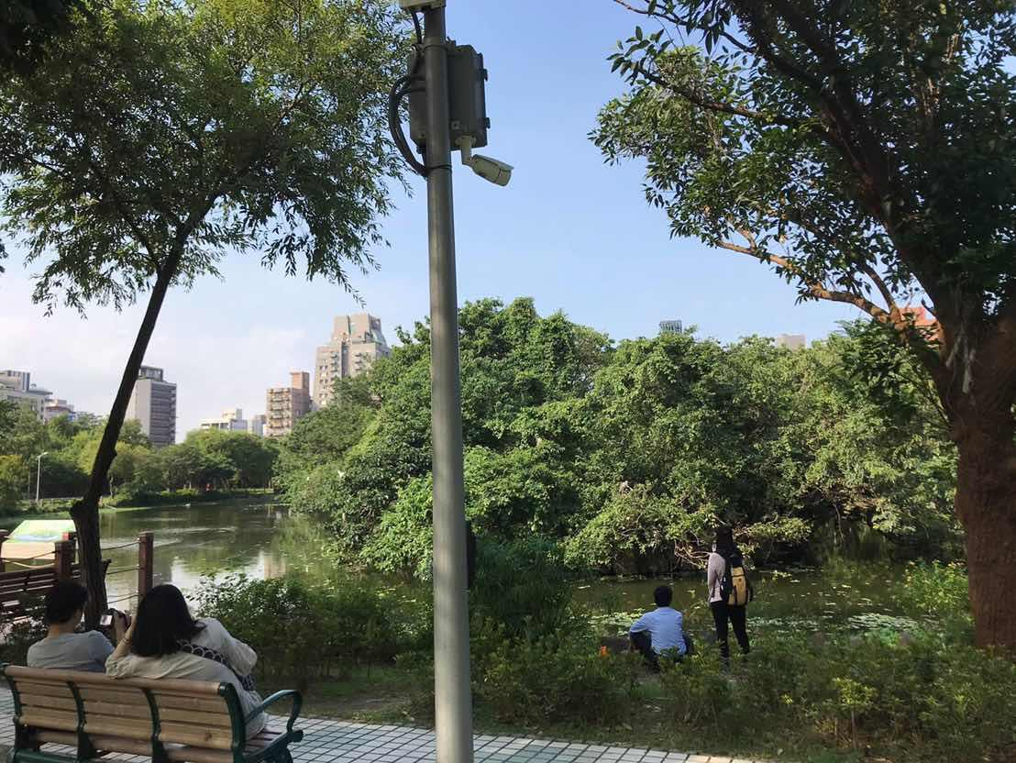
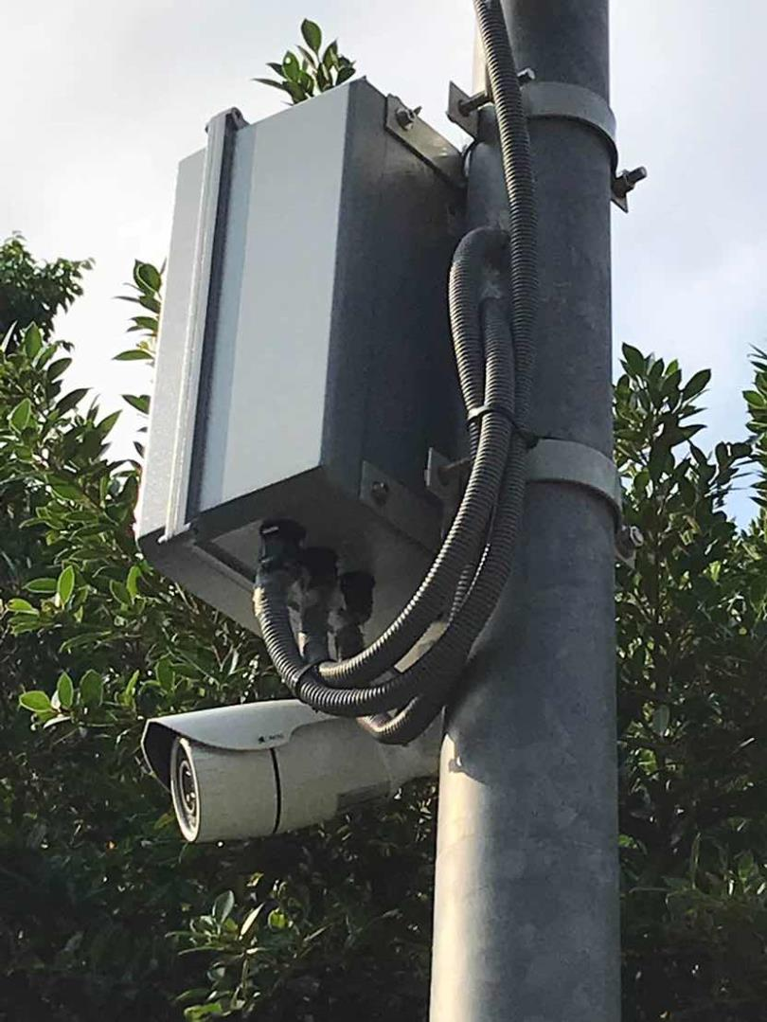
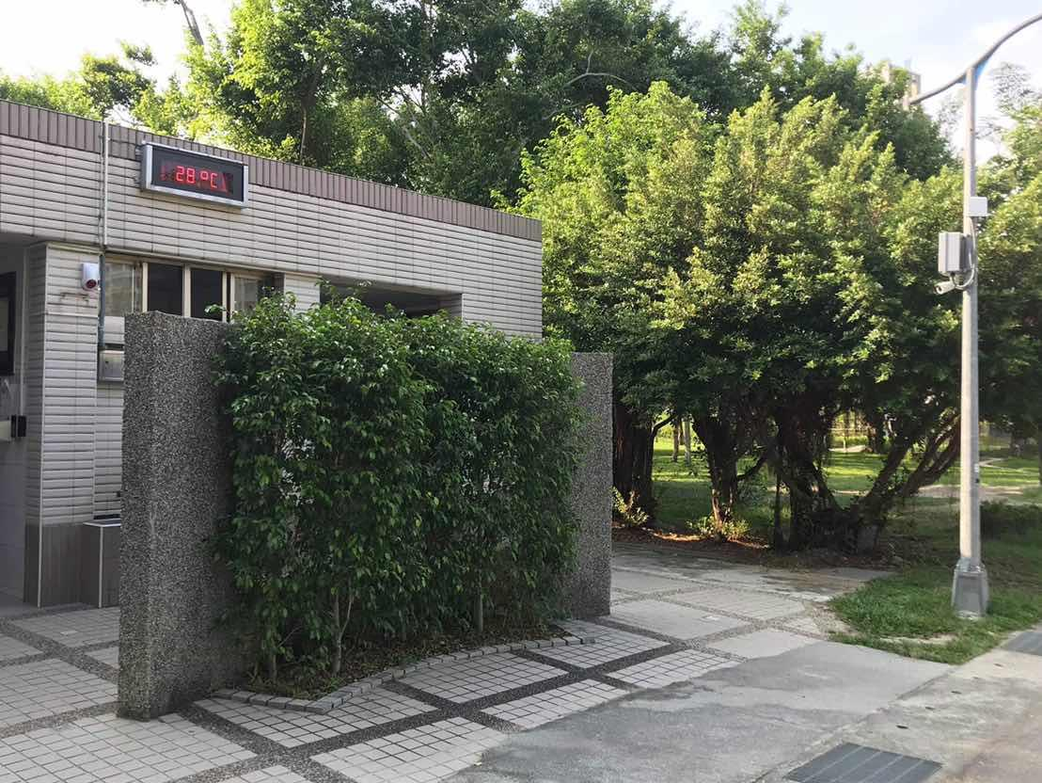
Park & Square: Project References
Taiwan
Taiwan
Taiwan
Taiwan
Taiwan
Taiwan

Slide 36





ACTi Deep Learning AI Camera Product Line
Deep learning is a method in artificial intelligence (AI) that teaches computers to process data in a way that is inspired by the human brain. Deep learning models can recognize complex patterns in pictures, text, sounds, and other data to produce accurate insights and predictions.
Model | A426 | A826 | A952 | A956 | Q83
Photo
Type | Zoom Bullet | Zoom Dome | Speed Dome | Speed Dome | Multi-Imager
Resolution | 5MP | 5MP | 8MP | 2MP | 20MP
Lens | 4.4x Zoom | 4.4x Zoom | 22x Zoom | 40x Zoom | 4 zoom lenses
Built-in Vehicle Related Analytics | Vehicle Counting, Vehicle Line Crossing Detection, Vehicle Enter Area Detection, Vehicle Incorrect Direction Detection, Vehicle Loitering Detection, Vehicle Tracking, Stopped vehicle detection, License Plate Detection, Automatic License Plate Recognition

Slide 37


A426 Traffic Installation
PMAX-0534
Pole Mount with Junction Box, supports 3.25" to 7.0" Poles
A426
5MP Zoom Bullet with D/N, Adaptive IR, Extreme WDR, SLLS, 4.4x Zoom Lens, Deep Learning AI

Slide 38


ALPR Camera (A426)
The AI camera can recognize multiple license plates across multiple lanes at the same time.
WATCH THE VIDEO
https://www.acti.com/video/v2902
ALPR Camera + NVR 3
ACTi NVR 3 supports the deep learning AI events and metadata. When the blacklisted vehicle is detected, the NVR will display instant alert.
WATCH THE VIDEO
https://www.acti.com/video/v2904

Slide 39





ACTi AI Solution Architecture
MOBILE CLIENT
E-mail
alerts
alerts
video
video
Realtime
analytics data
Realtime
analytics data, alerts
AI CAMERA
NVR SERVER
(ACTi NVR 3 Corporate)
NVR CLIENT

Slide 40
ACTi Advantages compared to Server-Based AI Providers
Hundreds of channels with deep learning analytics can be managed by a single VMS server, using just a common server hardware configuration. The Server-based AI solutions have limited number of channels and require very expensive hardware.
VMS video recording functionality is much better secured when the VMS does not have the burden of running the analytics that may consume the server resource to its limits.
Faster response to the events – AI cameras can control the other nearby PTZ cameras for instant response, to get better video coverage of the scene. The analyses that are processed on the VMS side will be too slow for proper response.
Since the AI features are inside the camera, there are no Analytics related licenses required on the server side. Therefore, the cost of VMS in some cases is up to 10 times lower than the server-side AI solutions.

Slide 41
NVR and CMS Features
ACTi NVR 3 Corporate (and CMS 2) manages the analytics events from the cameras as follows:
Set up the analytic rules and thresholds – for example, how big is the crowd, how long time is considered loitering.
Receive real-time analytic events from all the cameras and respond by the pre-defined actions, such as send e-mail, instant pop-up of the video channel on the VMS screen and more.
Automatically push video to the mobile app of the patrolling security guards.
Search by the specific filter rules, bookmarks, thumbnails.

Slide 42

Where to Buy
Via Authorized Resellers
https://www.acti.com/Corporate/WhereToBuy
From ACTi Corporation Directly
E-Mail: sales@acti.com
Tel (US): +1-866-410-2284 (Toll Free)
Tel (Non-US): +886-2-2656-2588

Slide 43
Support & Services
Technical Support
- Online Customer Helpdesk - https://www.acti.com/chd
- Phone support
US: +1-866-410-2284 (Toll Free)
Other Regions: +886-2-2656-5200
RMA Services
- Warranty
- Repair services
Training
- Self-learning

